Slide 1

TCP Prep Class Mechanical Technologist Grade 3
September 22, 2021, 11:00 am – 1:00 pm

Slide 2


CWEA, its Board members and
volunteers are not responsible for the
actions of speakers or the content of their
sessions. No endorsement is implied or
given of any persons or their philosophies,
ideas or statements; nor of any products
or processes; nor of any organizations
or companies who volunteer to serve as
speakers in educational programs.
For reporters: all speakers today are off the record.

Slide 3


Robert Delgado, CMRP, CRL
Manager of Operations and Maintenance
Inland Empire Utilities Agency

Slide 4
Mechanical Technologist Grade 3
CWEA - SARBS Training
September 22, 2021
Robert Delgado
Manager of operations and maintenance

Slide 5

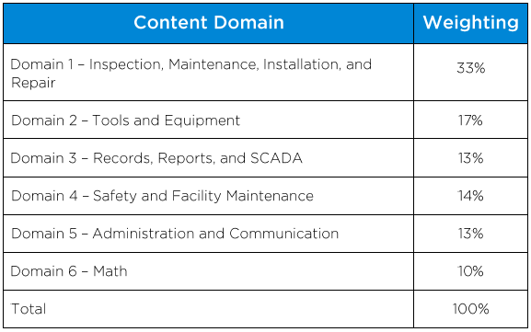
Mechanical Tech. 3 exam Blueprint

Slide 6

Mechanical Technologist candidate handbook

Slide 7

Domain 1 – inspection, maintenance, installation, and repair

Slide 8
Domain 1: inspection, maintenance, installation, and repair
Sub-domain 1.1 & 1.2
Sub-Domain 1.1:
Inspection of Systems and Equipment
Supervise and participate in the inspection of water/wastewater machinery and equipment.
Independently troubleshoot and diagnose complex mechanical and electrical malfunctions and determine effective course of action for correcting them.
Advanced knowledge of standard practices and procedures for precision alignment of rotating equipment, vari-speed drives, gear-reduction drives, shafts, and belts.
Advance knowledge of standard practices and procedures for emergency diesel generator operation, maintenance, and repair.
Advanced knowledge of standard practices and procedures for natural gas engines.
Advanced knowledge of standard practices and procedures for co-generation systems.
Oversee acceptance testing of any new equipment or stations, and after any major overhaul of equipment, systems, and facilities, and assist in inspection of newly constructed water/wastewater facilities.
Knowledge of condition monitoring and predictive maintenance.

Slide 9
Domain 1: inspection, maintenance, installation, and repair
Sub-Domain 1.2:
Installation, Maintenance, and Repair of Tools, Equipment, Systems and Facilities
Supervise and participate in troubleshooting and repairing defects within mechanical equipment necessary to the operation of water/wastewater facilities.
Knowledge of standard practices, procedures, tools, and materials used in the installation, maintenance, and repair of heavy plant equipment, pump, motors, controllers, variable speed and chain drives, and lift/pump stations,
Supervise and participate in the installation of pumps, carriable speed drives and motors, controllers, and timing devices.
Supervise maintenance and repair of equipment used for disinfection of water/wastewater treatment facilities using various disinfection process.
Supervise and participate in the replacing of packing/mechanical seals in pumps and valves and bearings in motors, pumps, and other equipment.
Investigate interruptions of service, identify defects, and resolve complex mechanical repair problems.
Recommend improvements to the design and maintenance of water/storm/sewer stations and equipment used to operate water/wastewater facilities.

Slide 10
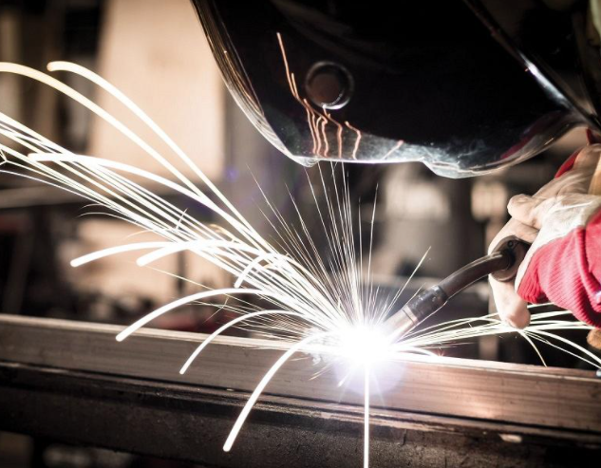
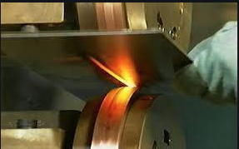
Domain 1: inspection, maintenance, installation, and repair
Two Categories of Welding Processes
Fusion Welding:
Base metal is melted.
Filler metal may be added.
Heat is supplied by various means:
  Oxyacetylene gas
  Electric Arc
  Plasma Arc
  Laser
Solid States Welding:
A welding process in which two work pieces are joined under a pressure providing an intimate contact between them and at a temperature essentially below the melting point of the parent material.
Heat and/or pressure are used to achieve coalescence, but no melting of base metals occurs.
No filler metal is added.
- Examples: forge welding, diffusion welding, friction welding.

Slide 11
Domain 1: inspection, maintenance, installation, and repair
Cold welding (a.k.a. contact welding): A solid-state welding process in which joining takes place without fusion/heating at the interface of the two parts to be welded.
Pressure welding: A solid-state welding process in which the parts are not melted, although heat is usually required. Recrystallization across the interface occurs. Also referred to as resistance welding and spot welding.
Friction welding (FRW): A solid-state welding process that generates heat through mechanical friction between workpieces in relative motion to one another, with the addition of a lateral force called "upset" to plastically displace and fuse the materials. Because no melting occurs, friction welding is not a fusion welding process in the traditional sense, but more of a forge welding technique
Explosion welding (EXW): A solid state welding process where welding is accomplished by accelerating one of the components at extremely high velocity through the use of chemical explosives. This process is most commonly utilized to clad carbon steel plate with a thin layer of corrosion resistant material (e.g., stainless steel, nickel alloy, titanium, or zirconium)

Slide 12
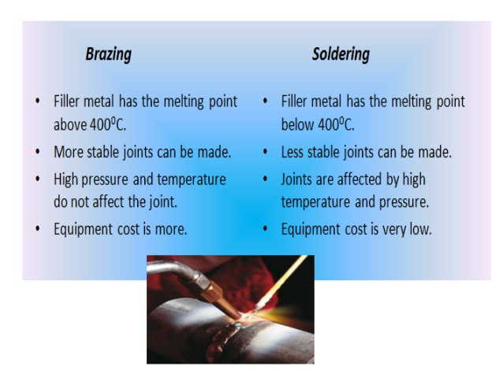
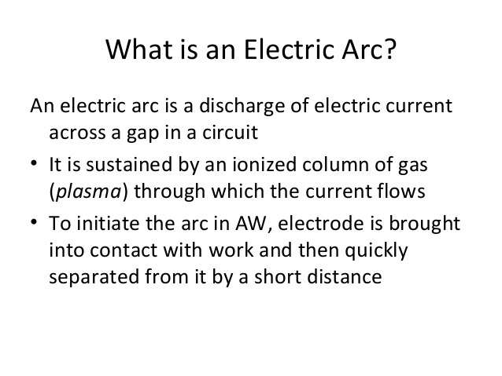
Domain 1: inspection, maintenance, installation, and repair

Slide 13
Domain 1: inspection, maintenance, installation, and repair
Troubleshooting and Repairing Engines
To be an effective troubleshooter of any type of machinery or engines you must be able to see, smell, feel and hear. These sense assist in determining what system is having a problem and what needs to be done to return the equipment to normal operation.
Engine Horsepower is based on the well-known fact that one mechanical horsepower is equivalent to 33,000 foot-pounds of work in one minute or 500 foot-pounds of work in one second.
The most common failure of gear fuel pumps are seals leaking from worn shafts and or bushings.

Slide 14
Domain 1: inspection, maintenance, installation, and repair
INSPECTING, TESTING, AND REPAIRING VALVES AND VALVE ASSEMBLIES: Regardless of differences existing in engine construction, there are certain troubles common to all assemblies.
Sticking Valves:
Sticking valves will produce unusual noise at the cam followers, pushrods, and rocker arms and may cause the engine to misfire. Sticking is usually caused by resinous deposits left by improper lube oil or fuel.
To free sticking valves without having to disassemble the engine, use one of several approved commercial solvents.
If the engine is disassembled, use either a commercial solvent or a mixture of half lube oil and half kerosene to remove the resins. Do NOT use the kerosene mixture on an assembled engine, since a small amount of this mixture settling in a cylinder could cause a serious explosion

Slide 15
Domain 1: inspection, maintenance, installation, and repair
Bent Valves:
Bent or slightly warped valves tend to hang open. A valve that hangs open not only prevents the cylinder from firing, but also is likely to be struck by the piston and bent so that it cannot seat properly. Symptoms of warped or slightly bent valves will usually show up as damage to the surface of the valve head.
To lessen the possibility that cylinder head valves will be bent or damaged during overhaul, NEVER place a cylinder head directly on a steel deck or grating; use a protective material such as wood or cardboard. Also, NEVER pry a valve open with a screwdriver or similar tool.
Weak Springs:
Valves may close slowly, or fail to close completely, because of weak springs. At high speeds, valves may “float,” thus reducing engine efficiency.
Valve springs wear quickly when exposed to excessive temperatures and to corrosion from moisture combining with sulfur present in the fuel.
Burned Valves:
Burned valves are indicated by irregular exhaust gas temperatures and sometimes by excessive noise. In
general, the principal causes of burned valves are carbon deposits, insufficient tappet clearance, defective valve seats, and valve heads that have been excessively reground

Slide 16
Domain 1: inspection, maintenance, installation, and repair
Piston Rings:
Over a period of time all piston rings wear. Some stick and may even break.
While you may be able to free stuck rings and make them serviceable, you must replace excessively worn or broken rings with new ones.
Insufficient Compression:
Proper compression pressures are essential if an engine is to operate satisfactorily.
Insufficient compression may cause an engine to fail to start. If you
suspect low pressure as the reason, check the compression with the appropriate instrument. If the test indicates pressures below standard, disassembly is required for complete inspection and correction.

Slide 17
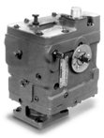
Domain 1: inspection, maintenance, installation, and repair
Inoperative Engine Governor:
There are many troubles that may cause a governor to become inoperative. The most frequent trouble associated with starting an engine is generally caused by bound control linkage or, if the governor is hydraulic, by low oil level.
Whether the governor is mechanical or hydraulic, binding of linkage is generally due to distorted, misaligned, defective, or dirty parts.
If you suspect binding, move the linkage and governor parts by hand and check their movement. Eliminate any undue stiffness or sluggishness in the movement of the linkage.

Slide 18
Domain 1: inspection, maintenance, installation, and repair
Engine Stalls Frequently or Stops Suddenly:
Look for troubles such as:
  Air in the fuel system
  Clogged fuel filters
  Unsatisfactory operation of fuel injection equipment
  Incorrect governor setting
  Misfiring
  Low cooling water temperature
  Improper application of load
  Improper timing
  Obstruction in the combustion space or in the exhaust system
  Insufficient intake air
  Defective auxiliary drive mechanisms.

Slide 19
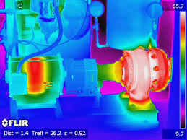
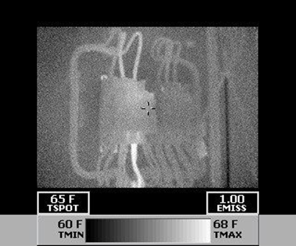
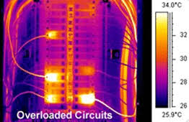
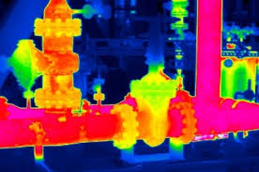
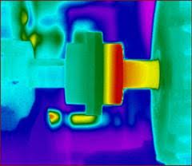
Domain 1: inspection, maintenance, installation, and repair
Pump Repair and Maintenance

Slide 20
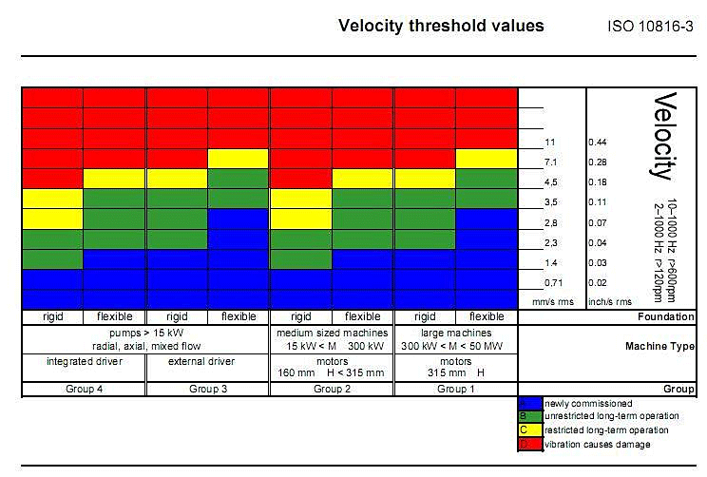
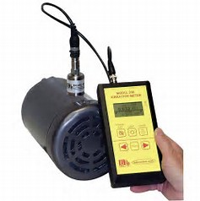
Domain 1: inspection, maintenance, installation, and repair
Vibration Measurement is a simple but effective method of looking at the condition or “health” of rotating machinery.
Vibration meters help mechanics spot deteriorating machine conditions before they become critical. By identifying and quantifying a vibration problem, you can take corrective actions before the problem becomes significant.
A simple vibration meter usually measures vibrations velocity in units of inch (often shown as in./sec or ips.) and can measure the bearing condition to determine flaws inside an anti-friction bearing.
Checking the vibration velocity at key points on a machine is a very good indicator of machinery severity.

Slide 21
Domain 1: inspection, maintenance, installation, and repair
Pump Troubleshooting:
Centrifugal Pump loss of suction:
Air leak in suction line (Repair & replace)
Suction lift too high (Lower suction lift, install foot valve and prime)
Insufficient inlet pressure or suction head (Increase inlet pressure by adding more water to tank or increasing back pressure)
Clogged foot valve check valve or strainer (Unclog)
Defective foot valve or check valve (Replace)
Defective priming hose bibb on suction pipe (Replace)
Defective well (Repair or replace)
Pump vibrates and/or makes excessive noise:
Mounting plate or foundation not rigid enough (Reinforce)
Foreign material in pump (Dismantle pump and clean)
Impeller damaged (Replace impeller)
Worn motor bearings (Replace bearings)
Suction lift too high ( Lower suction lift, install foot valve and prime)

Slide 22
Domain 1: inspection, maintenance, installation, and repair
Pump will not prime:
No priming water in casing (Fill pump casing)
Mechanical seal leaking (Replace mechanical seal)
Leak in suction line (Repair or replace)
Discharge line is closed and priming air has nowhere to go (Open)
Suction line or valve is closed (Open)
Pump is down (Replace worn parts)
Foot valve or check valve is leaking ( Replace valve)
Suction screen clogged (Clean or replace)

Slide 23
Domain 1: inspection, maintenance, installation, and repair
Cavitation:
The condition of cavitation is essentially an indication of an abnormality in the pump suction system, whereas the condition of low flow indicates an abnormality in the entire pumping system or process. The two conditions are also inter-linked such that a low flow situation can also induce cavitation.
When cavitating, the pump not only fails to serve its basic purpose of pumping the liquid but also may experience internal damage, leakage from the seal and casing, bearing failure, etc.
Cavitation is a common occurrence but is the least understood of all pumping problems.

Slide 24
KSA 306 – Pump Repair and Maintenance
Bearings:
Ball bearing are categorized into three area:
Radial ball bearing
Angular contact ball bearing
Thrust ball bearing.
Radial ball bearing primarily designed to support radial loads. This type of construction permits the bearing also to support relatively high thrust load in either direction. In fact, the thrust load capacity is about 70% of radial load capacity.
Angular-contact ball bearing is the one directional thrust type, which has a single row of balls and is so designed that the centerline of contact between the balls and raceway is at an angle to a plane perpendicular to the axis of rotation. This angle called contact angle.
Thrust ball bearing are designed to carry pure thrust load and if any radial load is present, separate radial bearing must be used.

Slide 25
Domain 1: inspection, maintenance, installation, and repair
Bearings (Cont.)
Roller bearing serve the same purpose as ball bearing, but they can support much higher loads than comparably sized ball bearing because they have line contact instead of point contact.
Most type of radial roller bearing cannot resist thrust load of any significant magnitude and with exception of the cylinder type.
Cylinder roller bearing comes in a variety of forms. They are available in a wide range of bore sizes and function with rollers having length to diameter ratios from 1:1 to 3:1. The outside diameter of the roller is often crowned to increase the load carrying capacity by eliminating any edge loading.

Slide 26
Domain 1: inspection, maintenance, installation, and repair
Bearings (Cont.)
Needle roller bearing are like cylinder roller bearing in that they can withstand high radial loads but are different in that their roller (called needles) have a much greater length to diameter ratio.
Tapered roller bearing is design specifically to withstand high radial load, high thrust load and combined high radial and thrust loads at moderate to high speeds. Tapered roller bearing are ideally suited to withstand repeated shock load that can be expected from service application.
Spherical roller bearing is available in single row, double row or single row thrust types.
  The important characteristic common to all spherical roller bearing is their self aligning property.

Slide 27
Domain 1: inspection, maintenance, installation, and repair
What is brinelling to the races of a bearing?
It is caused by wearing away of material due to external vibratory motion during storage or transport and corrosion due to lack of preservative compounds on bearing surfaces
Installing Bearings:
The first and most important rule when mounting and dismounting bearings is that: The mounting pressure will never be applied in such a way that's it is transmitted through the rolling elements of the bearing
Squeaking noise = Inadequate lubrication or insufficient load
Smooth, clear tone = Marks in stationary raceway cause by brinelling
Intermittent noise = Usually unique to ball bearings and indicates a damaged ball
Crunching noise = Presence of dirt
Displaced grease may be dark in color which could indicate = The onset of oxidation or presence of dirt

Slide 28
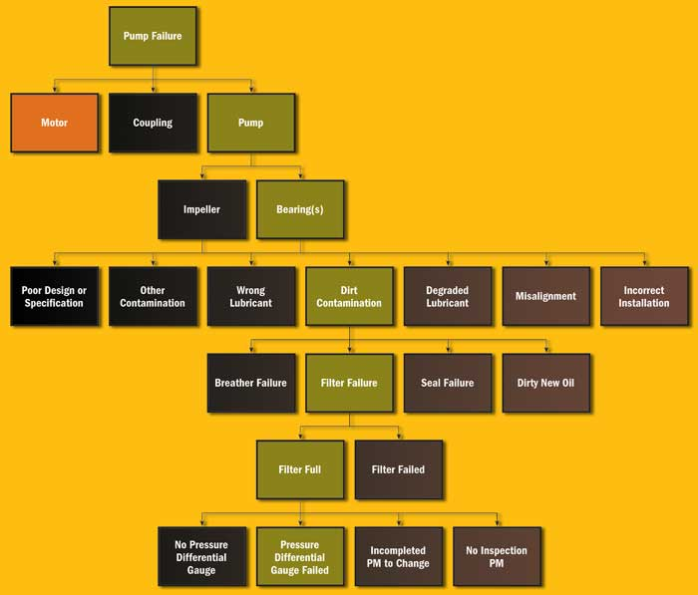
Domain 1: inspection, maintenance, installation, and repair
Root Cause Analysis (RCA):
Is a systematic process for identifying “root causes” of problems or events and an approach for responding to them.
RCA is based on the basic idea that effective management requires more than merely “putting out fires” for problems that develop but finding a way to prevent them.

Slide 29
Domain 1: inspection, maintenance, installation, and repair
The most common causes of hydraulic system failures are:
Clogged and dirty oil filters
An inadequate supply of oil in the reservoir
Leaking seals
Loose inlet lines, which cause pump cavitation and eventual pump damage
Incorrect type of oil
Excessive oil temperature
Excessive oil pressure
Most of these problems can be overcome through a planned preventive maintenance program.

Slide 30
Domain 1: inspection, maintenance, installation, and repair
The three maintenance procedures that have the greatest effect on system life, performance and efficiency are:
Maintaining an adequate quantity of clean and proper hydraulic fluid with the correct viscosity
Periodic cleaning and changing of all filters and strainers
Keeping air out of the system by ensuring tight connections
A vast majority of the problems encountered in hydraulic systems have been traced to the hydraulic fluid, which makes frequent sampling and testing of the fluid, a vital necessity.
Oxidation and corrosion are phenomena which seriously hamper the functioning of the hydraulic fluid. Although rust and corrosion are two distinct phenomena, they both contribute a great deal to contamination and wear.
Rust, which is a chemical reaction between iron and oxygen, occurs on account of the presence of moisture-carrying oxygen.
Corrosion on the other hand is a chemical reaction between a metal and acid.
Corrosion and rust tend to eat away the hydraulic component material, causing malfunctioning and excessive leakage

Slide 31
KSA 306 – Pump Repair and Maintenance
Affinity Laws as it relates to impeller diameter change states that if speed should remain a constant:
The flow (GPM) varies proportionally with the change in impeller diameter. This means that 10 percent impeller reduction is 10 percent flow reduction.
The pump head (pressure) varies with the square of the change in the impeller diameter. If you reduce the impeller diameter by 20 percent (80 percent original diameter), the pump head is reduced to about 65 percent (.802 = .64) the original head generated.
The power requirement (BHp or Kw) varies by the cube of the diameter change. A 20 percent reduction in the impeller diameter (80 percent original diameter) would reduce the power consumption to about half (.803 = .512). This is significant.
Algebraically, we would write the equations as:
New Flow = Old Flow x (new imp. diam. / old imp. diam.)
New Head = Old Head x (new imp. diam. / old imp. diam.)
New Power = Old Power x (new imp. diam. / old imp. diam.)

Slide 32
Domain 1: inspection, maintenance, installation, and repair
Pipeline and Valves
Piping Layouts:
Start with a basic sketch of your project, including general dimensions. For projects using flanged or precut threaded pipe, layout planning is much more critical.
Take some time to research various fittings.
Consider using sweeps or a pair of spaced 45s instead of close elbows to cut down on total dynamic head.
Include clean-outs and flushing points in your layout.
For threaded assemblies allow for twisting the pipes and fittings together — you will probably need to include a union or flanged joint to complete the assembly.

Slide 33
Domain 1: inspection, maintenance, installation, and repair
Pipe support or pipe hanger:
Element that transfer the load from a pipe to the supporting structures. The load includes the weight of the pipe, the content that the pipe carries, all the pipe fittings attached to pipe, and the pipe covering such as insulation.
The four main functions of a pipe support provides are: Anchoring, Guiding, Shock Absorption and Support
Primary Load - these are typically steady or sustained types of loads such as internal fluid pressure, external pressure, gravitational forces acting on the pipe such as weight of pipe and fluid, forces due to relief or blow down, pressure waves generated due to water/steam hammer effects.
Secondary Load - Just as the primary loads have their origin in some force, secondary loads are caused by displacement of some kind. For example, the pipe connected to a storage tank may be under load if the tank nozzle to which it is connected moves down due to tank settlement. Similarly, pipe connected to a vessel is pulled upwards because the vessel nozzle moves up due to vessel expansion. Also, a pipe may vibrate due to vibrations in the rotating equipment it is attached to.

Slide 34
Domain 1: inspection, maintenance, installation, and repair
Rigid Support:
Rigid supports are used to restrict pipe in certain direction(s) without any flexibility (in that direction). Main function of a rigid support can be Anchor, Rest, Guide or both Rest & Guide.
Spring Support:
Spring supports (or Flexible supports) use helical coil compression springs ( to accommodate loads and associated pipe movements due to thermal expansions). Types of spring supports include: Variable Spring Hanger or Variable Effort Support and Constant Spring Hanger or Constant Effort Support.
Shock Absorber:
It is designed to absorb and transfer sudden increases in load from the pipe into the building structure and to deaden any opposing oscillation between the pipe and the structure. Types of restraints are: Hydraulic Snubber, Mechanical Snubber, shock absorber, insulated pipe support (also called pre-insulated pipe support) and engineered spring support upholds a specific load.

Slide 35
Domain 1: inspection, maintenance, installation, and repair
Compressors
An air compressor should be selected to run 1/3 to 1/2 of the time, based on average air consumption of a system.
Average air consumption is expressed in standard cubic feet per minute – SCFM.
Compressors are rated in SCFM at a given tank pressure, usually 80-110 psig.
Sizing a compressor is matching the compressor capacity to a system’s requirement. The consumption of each air-using device in a system is taken into consideration.
Relays, thermostats, switches, transmitters, and all devices that use air must be considered, and the compressor should be sized so that when operating, 1/3 to 1/2 of the time it will deliver enough air to satisfy the average air requirement of a system.

Slide 36

Domain 2 – tools and equipment

Slide 37
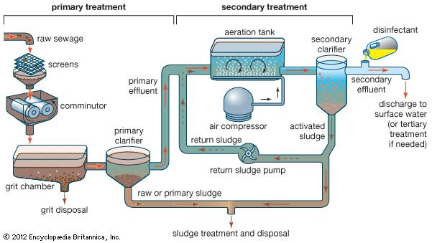
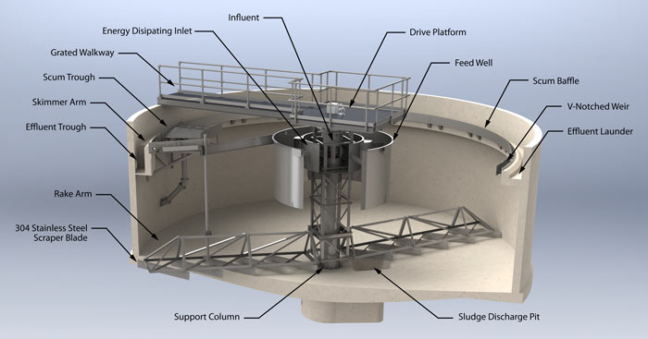

Domain 2: Tools & equipment

Slide 38
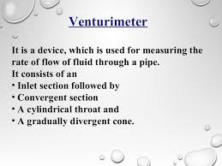
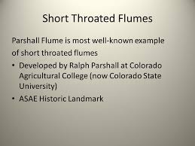
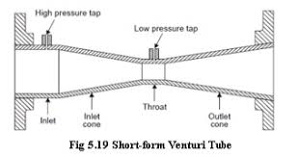
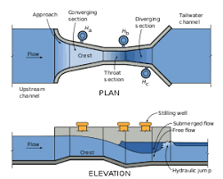
Domain 2: Tools & equipment
Process Equipment
Measures flows in open channels

Slide 39
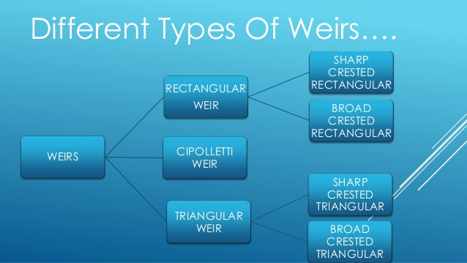
Domain 2: Tools & equipment
Weir (WEER)
A wall or plate placed in an open channel and used to measure the flow of water. The depth of the flow over the weir can be used to calculate the flow rate, or a chart or conversion table may be used to convert depth to flow.
A wall or obstruction used to control flow (from settling tanks and clarifiers) to ensure a uniform flow rate and avoid short-circuiting.
A standard Cipoletti weir is trapezoidal in shape. The crest and sides of the weir plate are placed far enough from the bottom and sides of the approach channel to produce full contraction. The sides incline outwardly at a slope of 1 horizontal to 4 vertical.

Slide 40
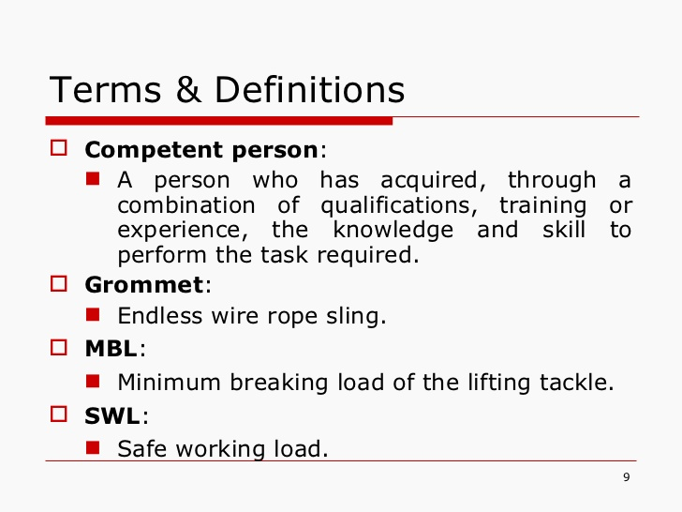
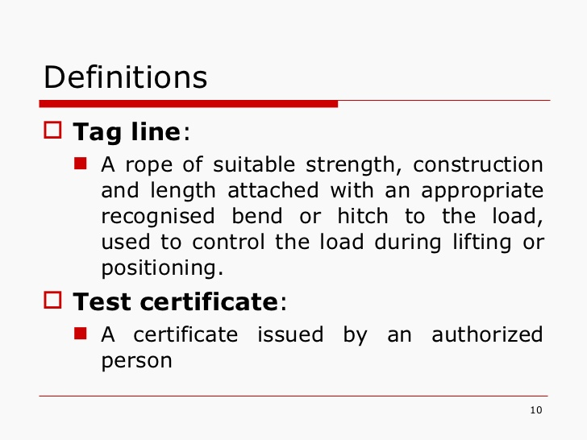
Domain 2: Tools & equipment
Crane / Forklift Operation

Slide 41
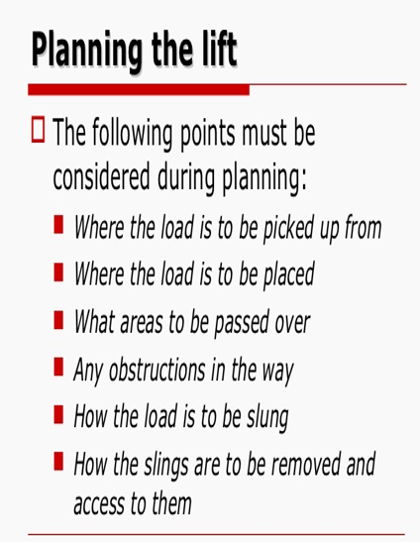
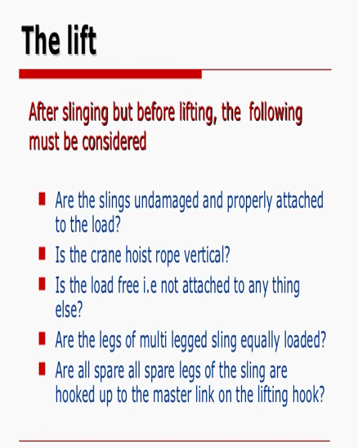
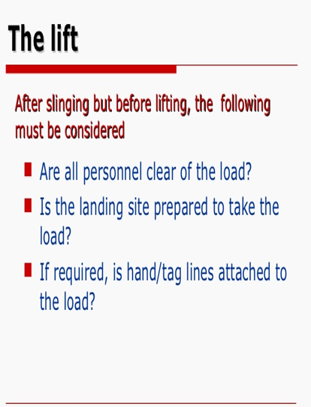
Domain 2: Tools & equipment

Slide 42
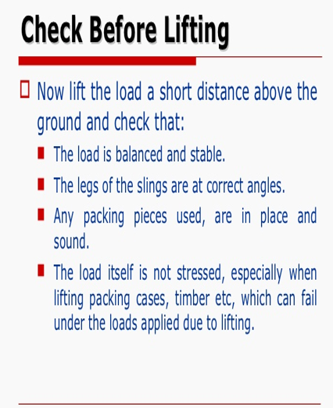
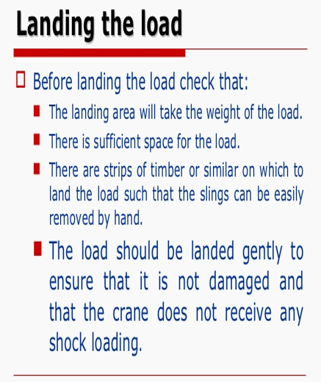
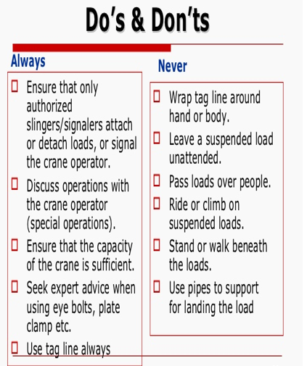
Domain 2: Tools & equipment

Slide 43
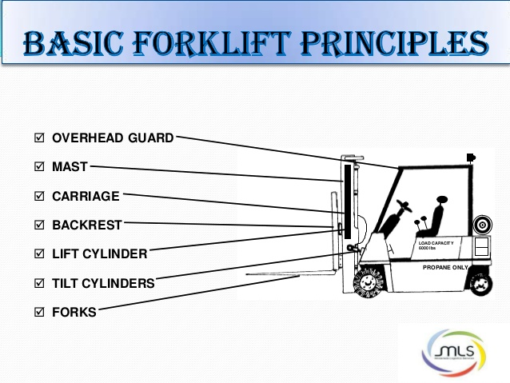
Domain 2: Tools & equipment
Safety Practices for the Operator
Only trained authorized personnel are permitted to operate a forklift.
The operator should not drive the truck up to a person standing in front of a bench or other object.
The operator should not carry loads heavier than those for which the truck is rated.
The operator should avoid making fast starts, sudden stops and quick turns.
The operator should report all accidents involving personnel, building structures and other equipment immediately.
Operation on main roads outside the facility should be permitted only with proper authorization from local transport authority.

Slide 44
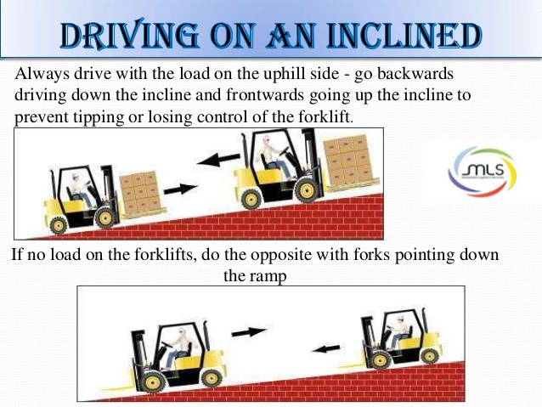
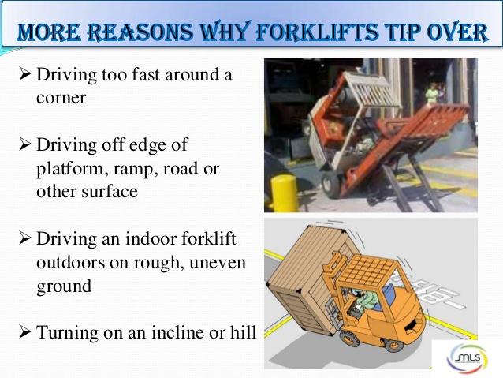
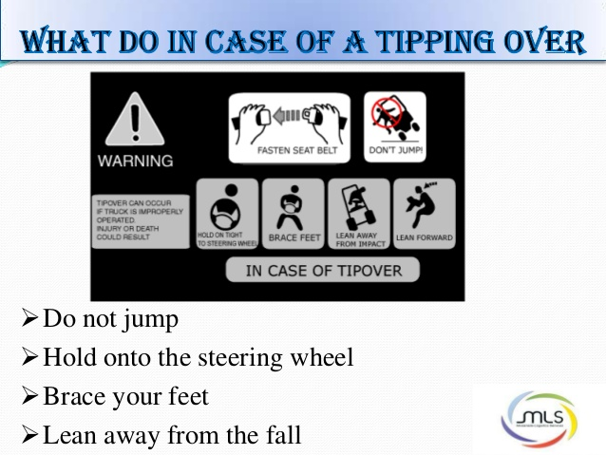
Domain 2: Tools & equipment

Slide 45

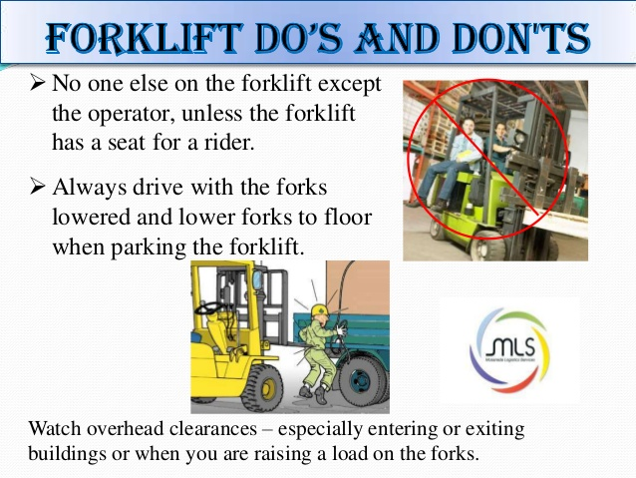
Domain 2: Tools & equipment

Slide 46
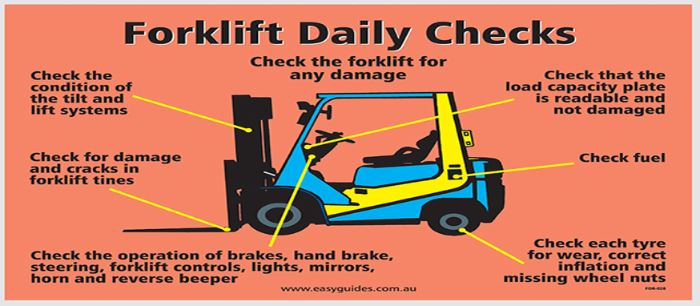
Domain 2: Tools & equipment

Slide 47
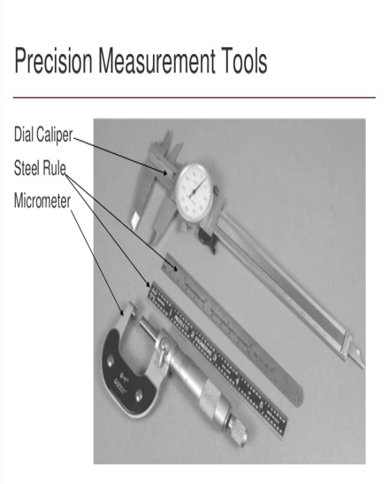
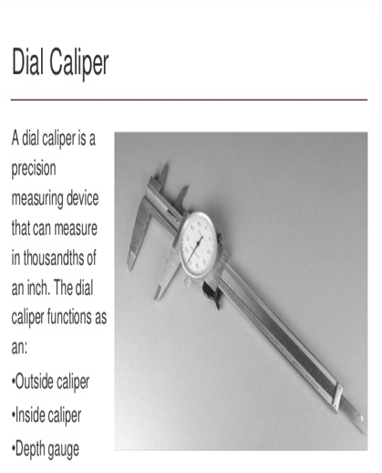
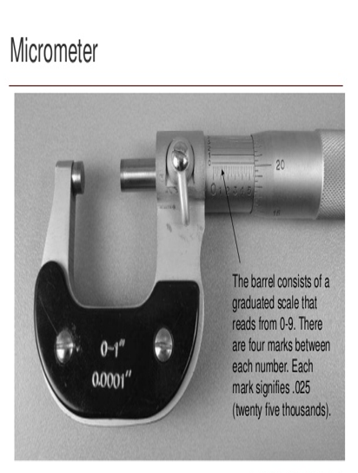
Domain 2: Tools & equipment
Tool Usage

Slide 48
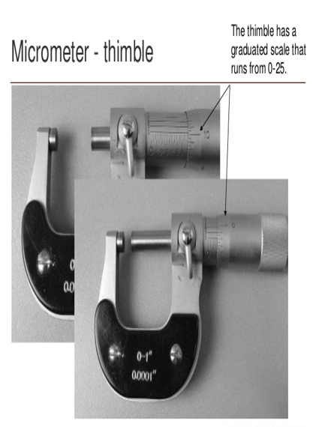
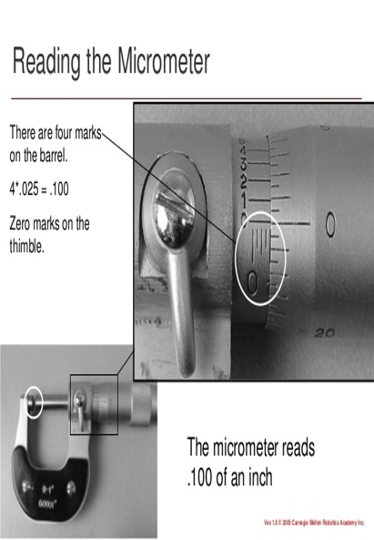
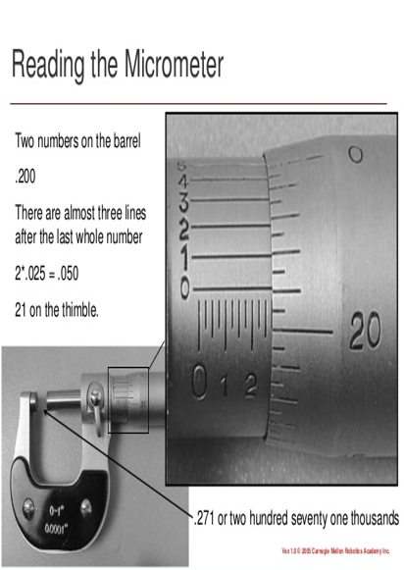
Domain 2: Tools & equipment

Slide 49
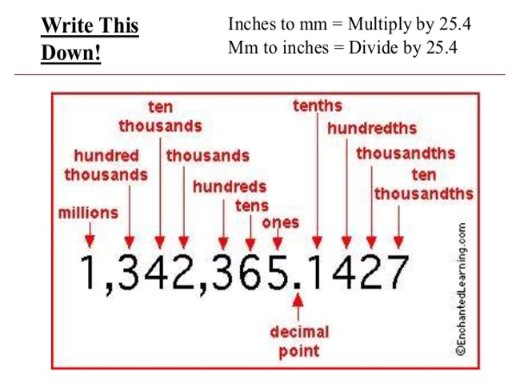
Domain 2: Tools & equipment

Slide 50
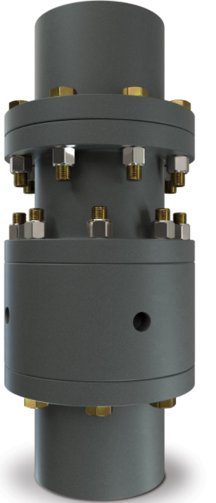
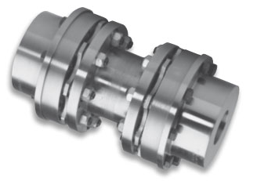
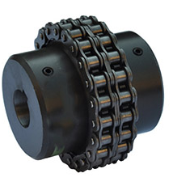
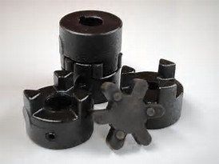
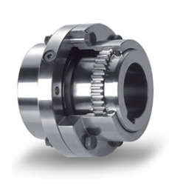
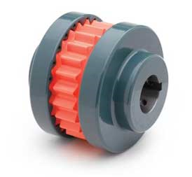
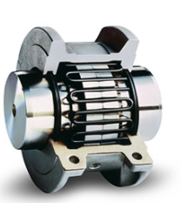
Domain 2: Tools & equipment
Power Transmission
Rigid Coupling
Flexible (Disc) Coupling
Roller-Chain Coupling
Spider coupling
Grid-align Coupling
Grid Coupling
Gear Coupling

Slide 51
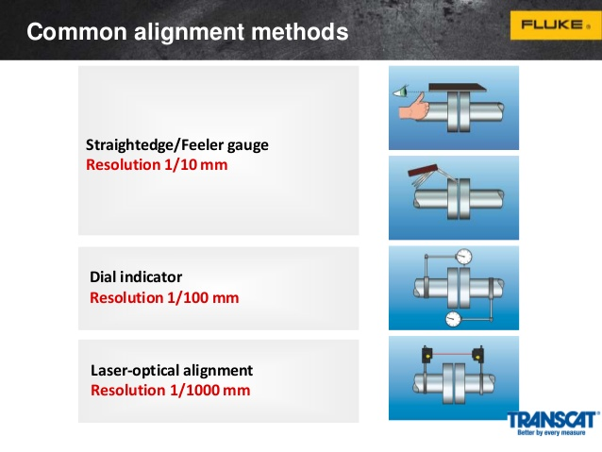
Domain 2: Tools & equipment

Slide 52


Domain 2: Tools & equipment

Slide 53
Domain 2: Tools & equipment
Gear types may be grouped into five main categories:
Spur
Helical
Bevel
Hypoid, and
Worm
Belt drives are simple, inexpensive, and do not require axially aligned shafts. Flat belts, Rope drives, Round belts, V belts, Multi-groove belts, Ribbed belt and Film belts.
All v-belts have a 40° angle between the faces, except the V series (aka "Harvester" or "Wedge" belts), which have a 30° angle between the faces. The inside edge of the belt is wider than the base of the V in a v-belt pulley - the belt touches the pulley only on the sides.
Accessory drive belts are of two types, V-belts (conventional, cogged and multi-ribbed) and serpentine (multi-ribbed) belts. A V-belt rides in V-shaped pulleys to rotate various accessories, such as the power steering pump, air conditioner compressor, alternator/generator, water pump, and air pump.

Slide 54

Domain 3 – Records, Reports, and Scada

Slide 55
Domain 3: records, reports, & scada
Maintenance Management
The installation of a Maintenance Management system of either a manual or computerized system. Whatever mode(s) your facility chooses, the overall outcome is to have a Preventative, Predictive and Corrective Maintenance Program that will assist in making valued decisions.
Preventative Maintenance is time based. Certain tasks such as lubrication, inspection or adjustments are made at a required time or frequency on a piece of machinery.
Predictive Maintenance makes use of physical measurements on a machine, such as vibration levels, bearing conditions, noise emission reading, oil sample results or temperature and compares these readings to the norm. It also trends readings to determine impending failure in a machine or components.

Slide 56
Domain 3: records, reports, & scada
Logical steps on establishing a successful Maintenance Management Program:
Get a process drawing, building equipment location drawing or other “map” of the plant or process that list all the equipment and shows the location.
Make a list of equipment that will need to be implemented into the program. It is beneficial to group the equipment by name, number, location and type.
If equipment has never been numbered, it might be a smart idea to “adopt” an intelligent numbering system that helps in sorting or locating the equipment.
  PU-2004. A Pump located on the second and the fourth one in the process train.
  100-EX-405. A heat Exchanger in building 100 on the fourth floor and the fifth item in the process train.
  100-AC-405. An AC motor used to drive the gear pump on the heat exchanger shown in the previous entry

Slide 57
Domain 3: records, reports, & scada
Logical steps on establishing a successful Maintenance Management Program (Cont.):
Locate all maintenance manuals for the equipment: Make sure to ask for “cut sheets” or “exploded diagrams” to make spare-part identification easier when working on the equipment.
Schedule a meeting with the O&M personnel: Review the manufacturers’ information with others and see if the recommended PM strategies makes sense. Some manufacturers will use an overkill approach and suggest much more PM than is necessary.
Begin setting up the maintenance activities: Pay attention to common types of equipment (gear boxes, motors) and common activities (greasing, oil changes, chain inspections).
Setup work orders with routes: Scheduling things to be accomplished so that staff use their time properly. Incorporate the entire Maintenance Management system into the daily planning and scheduling of personnel.
Conduct audits every three to six months to determine the efficiency of the program and modify the program to change tasks, change frequencies, add or remove equipment, change routes or change personnel based on results of the audits.

Slide 58
Domain 3: records, reports, & scada
The goal of managing maintenance is to minimize investments in labor, materials, money and equipment. In other words, we want to manage our human and material resources as effective as possible, while delivering a high level of service to our customers.
The benefits of an effective operation and maintenance program are as follows:
Ensuring the availability of facilities and equipment as intended.
Maintaining the reliability of the equipment and facilities as designed.
Obtaining full use of the system throughout its design life.
Collecting accurate information and data on which to base the operation and maintenance of the system and justify requests for the financial resources necessary to support it.

Slide 59
Domain 3: records, reports, & scada
Contingencies and Emergency Plans
Emergency Planning Process:
The chief motivation behind emergency planning is to reduce the likelihood of lives being lost. A second motivation is to reduce damage to the infrastructures.
An emergency plan in its broad sense is to inform, instruct and direct participants in the measures needed to manage the direct and flow-on effects of emergency events that may lead to disasters. A plan is also a means of coordinating and advoiding the duplications of effort and resources. By its very nature, an emergency plan must be devised, implemented and tested.
Planning needs to be undertaken for each of the four emergency management cycles:
  Reduction
  Readiness
  Response
  Recovery
  Inefficiencies' in planning lead to loss or damage that could have been adverted. Thus, it is a moral responsibility for those involved with public or employee safety to ensure that emergency planning is carried, effectively and appropriately.

Slide 60
Domain 3: records, reports, & scada
Under 40 CFR Part 122.26, stormwater from certain industrial activities is required to be under a National Pollution Discharge Elimination System (NPDES) permit.
All NPDES permits that include stormwater are required to have a stormwater pollution prevention plan (SWPPP).
The key elements of an SWPPP are:
  A detailed site map showing drainage areas and hazardous material storage areas
  A materials inventory
  Identification of past spills and leaks
  The location of non-storm discharges
  Details of existing monitoring data
  An evaluation of the site for potential spills and leaks
  Best management practice procedures
  Conducting an annual site compliance evaluation
  Inspection procedures
  Recordkeeping and internal reporting, and
  Employee training

Slide 61
Domain 3: records, reports, & scada
Risk Management Plan (RMP): 40 CFR Parts 68.150 to 68.195 under the chemical accident prevention program, require the development of a risk management plan (RMP).
The regulations require that the RMP be submitted to the U.S. EPA, certified by the owner/operator and updated at a minimum of every 5 years.
Water and Wastewater facilities that handle or store above a threshold quantity from a specific list of chemicals may be subject to RMP requirements.
The key elements of an RMP are:
  An executive summary
  A registration form
  An offsite consequence analysis
  5-year accident history
  Prevention program depending on the type of process being used
  An emergency response program, and
  A certification statement from the owner or operator.

Slide 62
Domain 3: records, reports, & scada
The most important principle of good disaster preparedness planning is that it must include training as a key component.
The goal of training in emergency management is to bring order to chaos during a disaster.
Training must focus on a specific system the organization is using to manage a disaster
For most organizations, the incident command system (ICS) is used to manage disasters.

Slide 63
Domain 3: records, reports, & scada
Drawings
Drawings made up of lines to describe shape and contour must also have dimensions and notes to supply sizes and locations.
Three systems of writing dimension values are in general use.
The first is the “common fraction” system, with all dimension values written as units and common fractions.
The second system uses decimals to express fractions when distances require precision greater than plus or minus 1/64 of an inch.
The third system , the complete decimal system, uses decimal fractions for all dimensional values.
The foot (‘) and inch (“) marks may be used to identify the units.
Feet and inch dimensions should only be used for distances exceeding 72 inches.

Slide 64

Domain 4 – safety and facility maintenance

Slide 65
Domain 4: safety & facility maintenance
Electrical Principles
Because of the ever-present dangers of electrical energy, a basic requirement when working with electricity is that there is no guesswork or risk taking.
All mechanics, whether they do the actual electrical work or not, should have such an understanding if they must do troubleshooting. The potential danger , ever present with electrical energy, cannot be overemphasized.
Three-phase current has three separate surges of current flowing together. In any given instant, however, their values differ, as the peaks and valleys of the pulsations are spaced equally apart. If each cycle were considered to be a full 360* rotation, each of the phases would be 120* apart.
Overload Protection can be classified by the following protective devices, fuse, a circuit breaker, or any other overload protection device (thermal trips, moisture protection, etc.).
The size of electrical wiring is specified by gauge number according to the American Wire Gauge (AWG) system.
Cord-carrying capacity for No. 18 wire is 7A(840W), No. 16 wire is 10A(1200 W), No.14 wire is 15A(1800W) and No. 12 wire is 20A(2400W).
Note: Use only extension cords that are listed by Underwriters’ Laboratories.

Slide 66
Domain 4: safety & facility maintenance
What an IIPP Is and How It Works
The Injury and Illness Prevention Program (IIPP) is a basic written workplace safety program. Title 8 of the California Code of Regulations (T8CCR) section 3203, requires every employer to develop and implement an effective IIPP.
An effective IIPP improves the safety and health in your workplace and reduces costs by good management and employee involvement.
The 8 required Injury and Illness Prevention Program elements are:
  Responsibility
  Compliance
  Communication
  Hazard Assessment
  Accident/Exposure Investigation
  Hazard Correction
  Training and Instruction
  Recordkeeping
To be effective your IIPP must:
Fully involve all employees, supervisors, and management
Identify the specific workplace hazards employees are exposed to
Correct identified hazards in an appropriate and timely manner
Provide effective training

Slide 67

Domain 5 – Administration and communication

Slide 68
Domain 5: administration & communication
Training and Mentoring
Training has become an ongoing process in the workplace. The manager “must” provide new employee training as well as ongoing training for all employees. Safety training is particularly important for all staff members.
Certification of mechanics assures the municipality, utility, JPA, etc. that the facility is going to be maintained by qualified mechanics who posses a certain level of competence.
One area of training that is frequently overlooked is training for supervisors. Managing people requires a different set of skills than performing the day-to-day work maintaining a wastewater treatment facility.
Supervisors need to know how to communicate effectively and how to motivate others, as well as how to delegate responsibility and hold people accountable for their performance.

Slide 69
Domain 5: administration & communication
Train and Mentor Staff (Cont.)
For a successful safety program, the following must take place:
  Safety education of all employees
  Reinforced education in safety
  Safety education in the use of tools and equipment
The three most important controlling factors in safety are education, education, and more education.
Supervisors bear the greatest responsibility for safety and are held (generally) accountable for planning, implementing, and controlling the safety program.

Slide 70
Domain 5: administration & communication
Working Relationships & Communication
"A team is a small number of people with complementary skills who are committed to a common purpose, performance goals, and approach for which they hold themselves mutually accountable.“
Three important competencies for the effective team builder and leader:
Promoting understanding of why a group of people need to be a team. The team needs to understand its shared goals and what each team member brings to the team that is relevant and crucial to its overall successes.
Ensuring the team has adequate knowledge to accomplish its task. This includes information relevant to the team's goals and individual job competencies.
Facilitating effective interaction in such as way as to ensure good problem solving, decision making and coordination of effort.

Slide 71
Domain 5: administration & communication
Characteristics of Highly Effective Teams
An effective team understands the big picture.
  In an effective team, each team member understands the context of the team's work to the greatest degree possible. That includes understanding the relevance of his or her job and how it impacts the effectiveness of others and the overall team effort. Too often, people are asked to work on part of a task without being told how their role contributes to the desired end result, much less how their efforts are impacting the ability of others to do their work. Understanding the big picture promotes collaboration, increases commitment and improves quality.
An effective team has common goals.
  Effective teams have agreed-upon goals that are simple, measurable and clearly relevant to the team's task. Each goal includes key measurable metrics (that are available to everyone on the team), which can be used to determine the team effectiveness and improvement. Understanding and working toward these common goals as a unit is crucial to the team's effectiveness.

Slide 72
Domain 5: administration & communication
An effective team works collaboratively, as a unit.
  In an effective team you'll notice a desire for collaboration and a keen awareness of interdependency. Collaboration and a solid sense of interdependency in a team will defuse blaming behavior and stimulate opportunities for learning and improvement. Without this sense of interdependency in responsibility and reward, blaming behaviors can occur which will quickly erode team effectiveness.
The Roles of the Effective Team Leader
In order to encourage this level of collaboration and interdependency, the team leader must provide the necessary support and structure for the team, starting with putting together the right people. Team members should be selected, and their tasks assigned with their natural skills in mind.
The team must also have the resources and training required to develop the skills needed to do their jobs. This includes cross-training. Cross-training gives team members a greater awareness of how their jobs are interdependent, increasing the team's flexibility and improving response time.

Slide 73
Domain 5: administration & communication
The quality of the team's response is highly dependent on the timeliness of the feedback received from the team's leader, other team members and customers. Receiving timely feedback is crucial to the effectiveness of the team.
The effective team leader ensures that feedback reaches the entire team on its goals and metrics, as well as feedback to each individual team member. This feedback must be received in time to make adjustments and corrections. Often, feedback is received too late to have any practical value in the moment, and consequently, it feels like criticism.
Criticism, while it might be useful for future planning, it does not promote immediate corrections in performance. Feedback is a form of constructive communication, another necessary tool in the effective team leader's tool chest. No matter how traditional or innovative the workplace, consistent and constructive communication throughout the team is essential.
The act of constructive communication can do more than anything else to improve quality and productivity. Timely and appropriately delivered feedback can make the difference between a team that hides mistakes and a team that sees mistakes as opportunities.

Slide 74
Domain 5: administration & communication
Remember:
A "willingness" to participate collaboratively as a team member does not guarantee the desired outcome. People thrown into a collaborative situation, especially those without experience operating in this mode, need assistance to guarantee success. Managers who are skeptical of team participation to begin with often throw their people into an unplanned, unstructured decision-making process, responding with "I told you so" as they watch their team flounder.
By contrast, managers who focus on promoting good understanding, ensuring adequate knowledge and facilitating effective interaction, will watch the transformation of their job from one that required constant supervision, fire-fighting, and oversight, to one that allows the leader to focus on serving the needs of the team and each individual team member.

Slide 75

Domain 6 – math

Slide 76
Domain 6: math
You change the impeller in pump that was pumping 500 gpm from a 5 inches to 6 inches. With no other changes to the volute or rotational speed, what would you expect the pump output to approach.
Affinity Laws
Algebraically, we would write the equations as:
New Flow = Old Flow x (new imp. diam. / old imp. diam.)
5”
6”
New Flow = 500 gpm x (6inches / 5 inches)
New Flow = 500 gpm x (1.2)
New Flow = 600 gpm

Slide 77

Domain 6: math
What is the pressure at the bottom of a rectangular tank 100 feet x 20 feet x 10 feet deep, in psi
Formula – 1 psi at 2.31 feet
Psi at 1 foot = 1 / 2.31
Psi at 1 foot = 0.4329
20 ft.
100 ft.
10 ft.
psi
psi = 0.433 x 10
psi = 4.33
0.433
10

Slide 78

Domain 6: math
A 480-volt system has a resistance of 20 ohms. What is the power consumed, in watts?
Formula: P = E² / R
P = 480 X 480 / 20
P = 230,400 / 20
P = 11,520 watts

Slide 79
Domain 6: math
The training room at your plant needs new carpet. If the room is rectangular in shape and measures 30 feet by 54 feet, how much carpet is needed in square yards?
Formula:
Area rectangle = (length x width)
AR = (30 X 54)
AR = 1620 sq. ft.
Square yards = 3 ft. x 3 ft.
Square Yards = 9
AR (Sq. Yards) = 1620 / 9
AR (Sq. Yards) = 180
54 ft.
30 ft.

Slide 80

Domain 6: math
How many gallons in the clarifier that measures 65 diameter, 14 feet deep, with a 4-foot cone.
Formula:
Volume Cylinder = (.785)(diameter²)(Height)
VC = .785 x (65 x 65) x (14)
VC = .785 X (4225) X (14)
VC = 3,317 x 14
VC = 46,433 ft³
Volume of Cone = (1/3)(.785)(D²)(H)
VOC = (1/3)(.785)(65 x 65)(4)
VOC = (1/3)(.785)(4225)(4)
VOC = (1/3)(3,317)(4)
VOC = (1/3)(13268)
VOC = 4,378 ft³
46,433 + 4378 = 50811 ft³
1 cubic foot = 7.48 gallons
Gallons = 50811 x 7.48
Gallons = 380,066
65 ft.
14 ft.
4 ft.

Slide 81
Questions?
Thank You, Best wishes on your upcoming Test!
Robert Delgado
rdelgado@ieua.org

Slide 82
Thank You!

