Slide 1
CWEA/CASA Presents: National Webinar on Wastewater Based Epidemiology

Slide 2
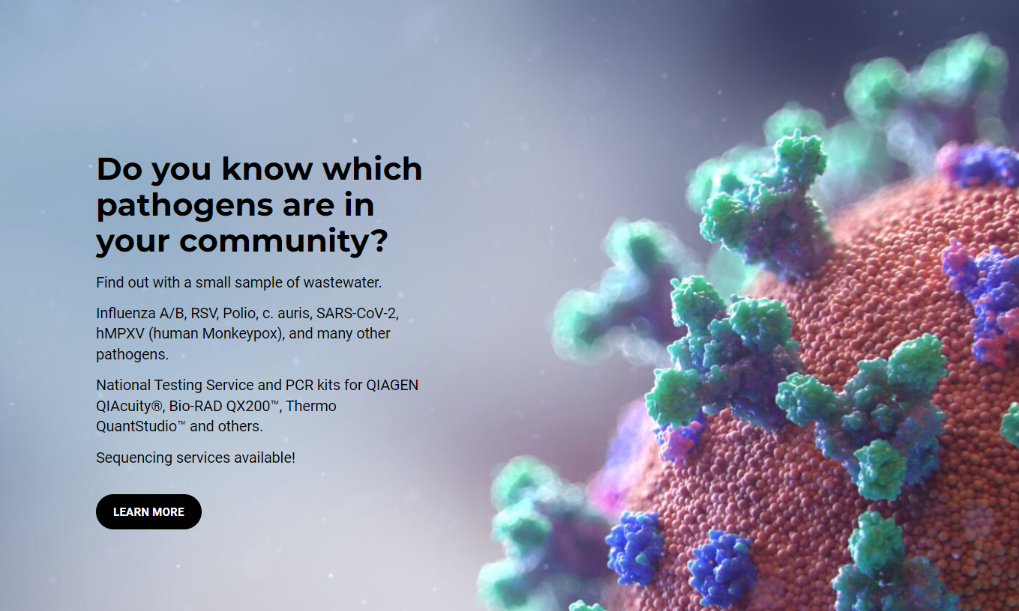
Notes:
Thank you to our sponsor today GT Molecular.
GT Molecular provides a full suite of testing solutions for SARS-Co-V-2; variants of flu A & B, RSV, MPXV, Polio and other pathogens. A company optimized to serve the wastewater industry.
Visit gtmolecular.com and we’ll add their link to the chat.

Slide 3
Greg Kester
MODERATOR DIRECTOR OF RENEWABLE RESOURCE PROGRAMS CASA
Notes:
Please DON’T put speakers agency logo on the slide. It will not look good.

Slide 4
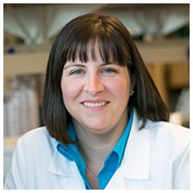
Amy E. Kirby, PhD MPH
National Wastewater Surveillance System Lead
Waterborne Disease Prevention Branch Centers for Disease Control and Prevention

Slide 5
CDC’s Vision for the Future of the National Wastewater Surveillance System
Amy E. Kirby, PhD, MPH
National Wastewater Surveillance System Program Lead
Waterborne Disease Prevention Branch
Division of Foodborne, Waterborne and Environmental Diseases
CWEA Webinar
January 11, 2023

Slide 6
Wastewater Surveillance for Rapid Response
Nimble structure to rapidly adapt to changing public health needs
 | Emergency Response Local or regional activations in the wake of natural disasters to detect outbreaks |  | Emerging Infections Short-term activations to assess the prevalence and distribution of emerging threats
 | Pandemic Preparedness Rapid activation and increased sampling frequency to detect pandemic spread into communities to target mitigation efforts |  | Bioterrorism Rapid local or regional activation with increased sampling frequency to detect and track bioterrorism threats

Slide 7
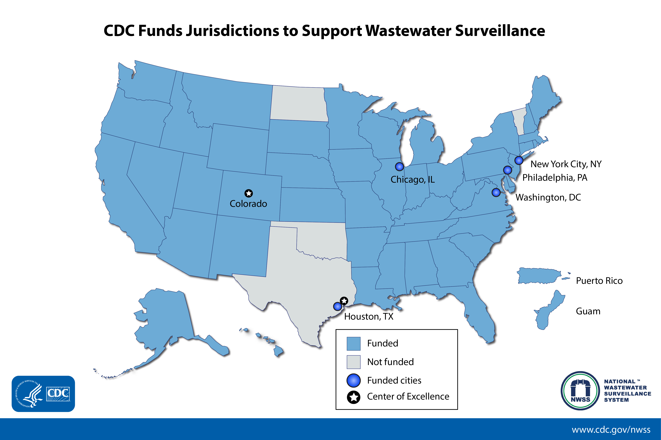
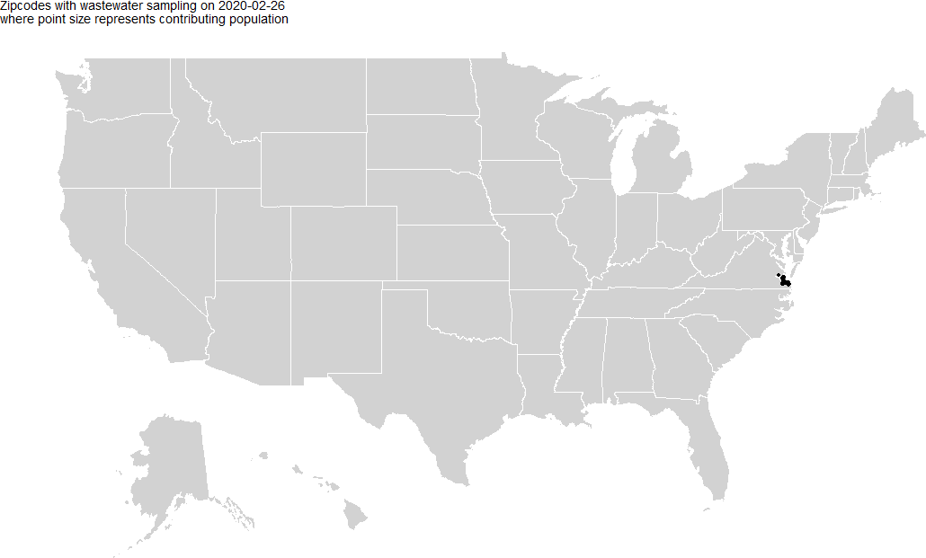
NWSS Implementation
46 states, 5 major cities and 2 territories using CDC funds for wastewater surveillance
2 Centers of Excellence
>113,000 unique wastewater samples
>1400 sites in 50 states, 2 territories and 7 Tribal communities
Representing >134M people
Notes:
Major points-
ELC funding to STLT
Data sources – STLT systems, national contract, private systems (Biobot, WastewaterSCAN)

Slide 8
Community support and capacity building
Health Departments
Host: CDC
200+ Participants
43 jurisdictions
Peer-to-peer sharing
Data coordination, submission, and interpretation
Public Health action
Laboratories
Host: APHL
100+ Participants
39 states 19 local
2 academic 5 other
Best practices and lab startup guides
Corporate pricing agreements
Workflow pilot projects
Utilities
Host: WEF
230 members
42 jurisdictions
Information, discussion board, and podcast at nwbe.org
Free autosampler program
Annual Wastewater Disease Surveillance Summit

Slide 9
DCIPHER dashboard | One-stop shop for implementers
Metric | What does this show us?
Percentiles | Relative levels of virus present in a community over time
Percent Change | Magnitude and direction of virus levels in a community
Detection Proportion | How frequently is the virus detected in a community
Variant Specific Metrics | If a known variant is present, and at what proportion
Also includes-
Resource library
Contact list
Automated QC reports
Automated utility reports
Support forum

Slide 10
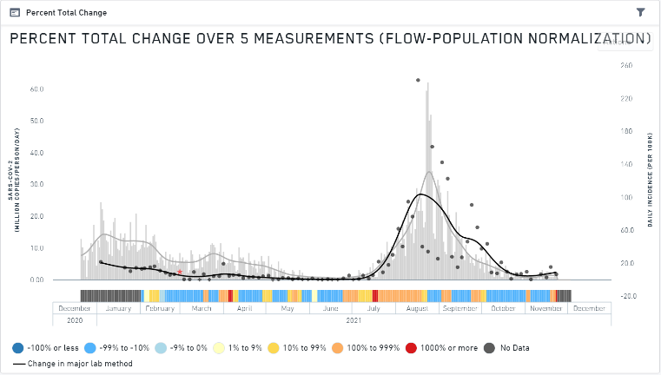
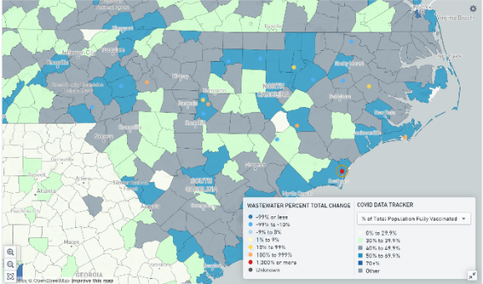
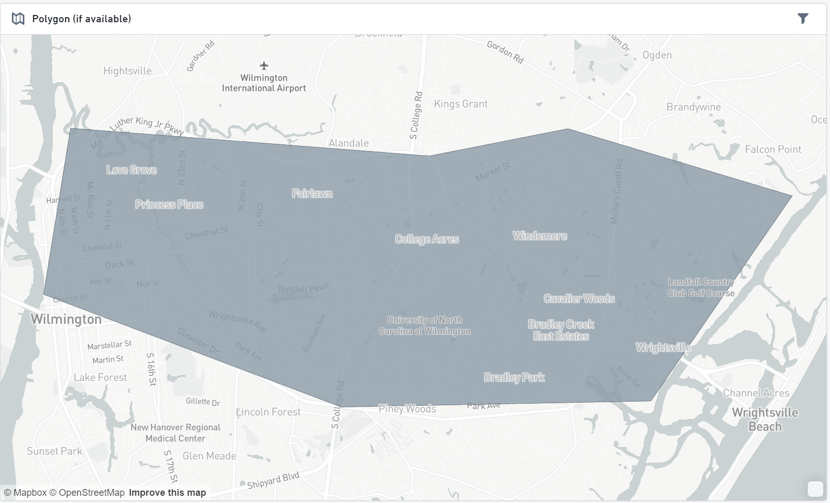
Elements of the NWSS DCIPHER Dashboard
DCIPHER Dashboard Percent Change Map of US
Wastewater Concentrations and Sewershed COVID-19 Cases for NC wastewater sampling location
Wastewater Percent Change Overlaying COVID Data Tracker Spatial Layers for NC
Sewershed Service Area Shapefile

Slide 11
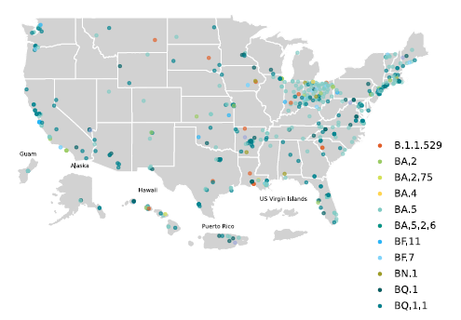
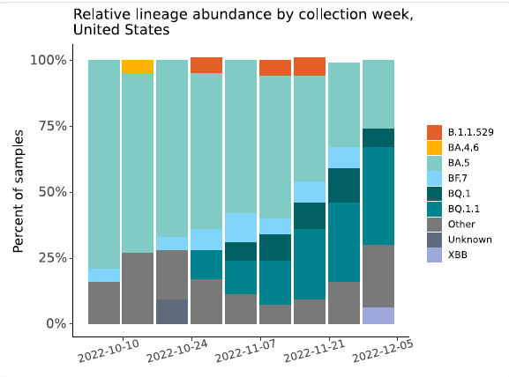
NWSS Sequence Data Visualization Dashboard
DCIPHER Dashboard Dominant Variant of Concern Map of US
Variant Distribution in Wastewater

Slide 12
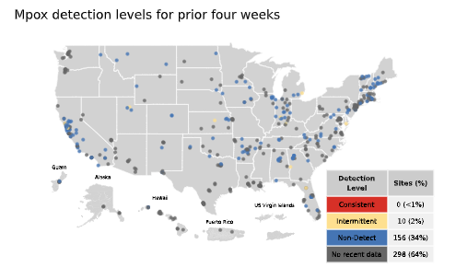
Mpox Data Dashboard
Frequency of detection in past 4 weeks
Non-detect (all samples negative)
Inconsistent detection (<80% of samples positive)
Consistent detection (≥80% of samples positive)
DCIPHER dashboard anticipated next week
Public dashboard anticipated by the end of January

Slide 13
Beyond COVID

Slide 14
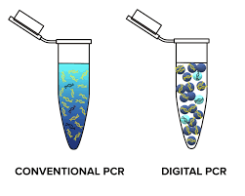
Transition to a single test type
The NWSS testing panel must be
Quantitative
Highly parallel or multiplexed
Readily adapted
Robust to inhibitors present in wastewater
Low limits of detection
Digital PCR satisfies all of these requirements and is already in use by many NWSS laboratories
Developing assays that are compatible with both BioRad and Qiagen dPCR systems
Image: jetmolecular.com

Slide 15
Wastewater surveillance can inform diverse surveillance strategies
Core
Regular surveillance for endemic or common diseases, such as flu or antibiotic resistance
Provides regular, consistent updates at minimal cost
Emergency
Rapid response for outbreaks, emergencies, natural disasters
Sporadic but expected diseases, such as shigellosis or polio
Provides acute, timely updates on a flexible platform
Pandemic preparedness
Horizon scanning for potential epidemic or pandemic threats
Evaluation of potential rare, unexpected diseases such as typhoid, Ebola, or monkeypox

Slide 16
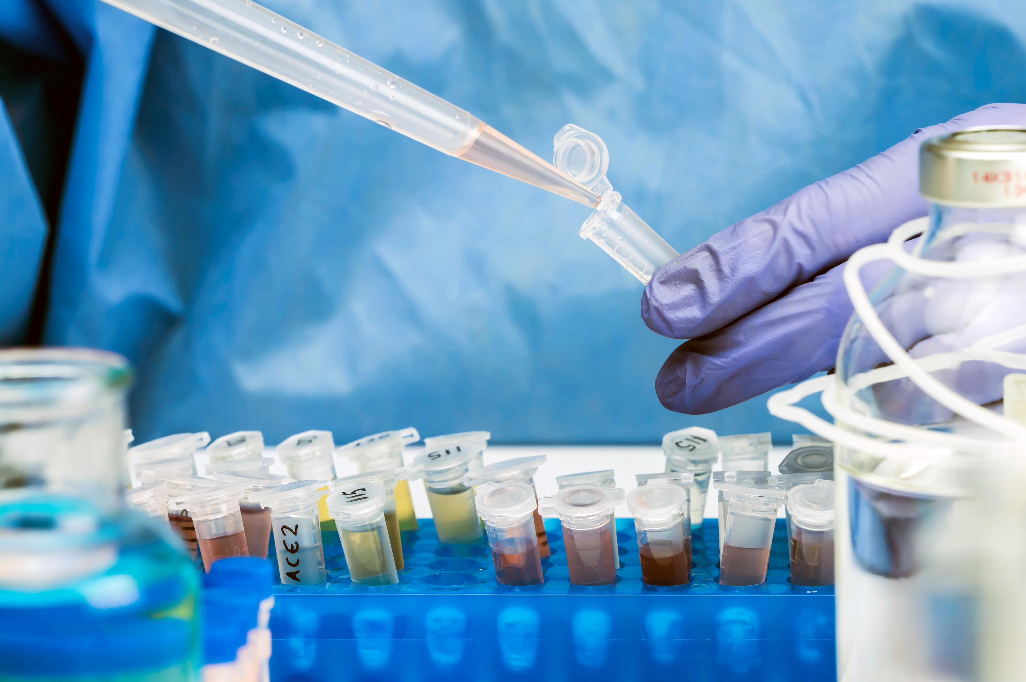
NWSS Panel for Core Targets
Components
Fecal normalization control
Pepper Mild Mottle Virus
Crassphage
Process control (e.g., BCoV)
Antibiotic resistance genes
Carbapenemases
ESBLs
Colistin resistance
Pathogen targets
SARS-CoV-2
Influenza A and B
Respiratory Syncytial Virus
Adenovirus 40/41
Norovirus
Candida auris
Timeline
Piloted in NWSS Centers of Excellence in early 2023
Anticipated system-wide rollout August 2023
Data integrated into DCIPHER for real-time access
Develop NWSS dashboard for public data sharing
Reviewed annually by CDC NWSS Advisory Committee

Slide 17
NWSS Data Sources and Dissemination
 | SARS-CoV-2 | Variants | Mpox | Influenza | RSV | AR | C. auris
Data Submitters
Public Health Labs | ✓ | ✓ |  | Fall 2023 | Fall 2023 | Fall 2023 | Fall 2023
Biobot contract | ✓ | ✓ | ✓
Wastewater SCAN | ✓ |  | ✓ | Pending | Pending
Data Dissemination
DCIPHER | ✓ | ✓ | January | Fall 2023 | Fall 2023 | Fall 2023 | Fall 2023
COVID Data Tracker | ✓ | ✓
Mpox Response webpage |  |  | January
NWSS dashboard |  |  |  | Fall 2023 | Fall 2023 | Fall 2023 | Fall 2023

Slide 18
Ethics must be incorporated into growing wastewater surveillance systems
Wastewater provides rich samples, both in microbes and genetic material
Wastewater surveillance is a relatively new public health tool, and as such, has limited ethical guidance
Raises issues of
Consent
Privacy
Equity
Stigma

Slide 19
Challenges for NWSS development and sustainability
Extending coverage, 20% unsewered
Impact of vaccination and variants
Improved metrics including estimating disease prevalence
Improved data submission, dissemination, messaging
Optimal geographic and temporal sampling frame for multiple targets
Ethical transparency, especially around sample archiving
Improved methods, streamlined workflow

Slide 20
Please reach out to us at NWSS@cdc.gov for more information!
www.cdc.gov/NWSS

Slide 21
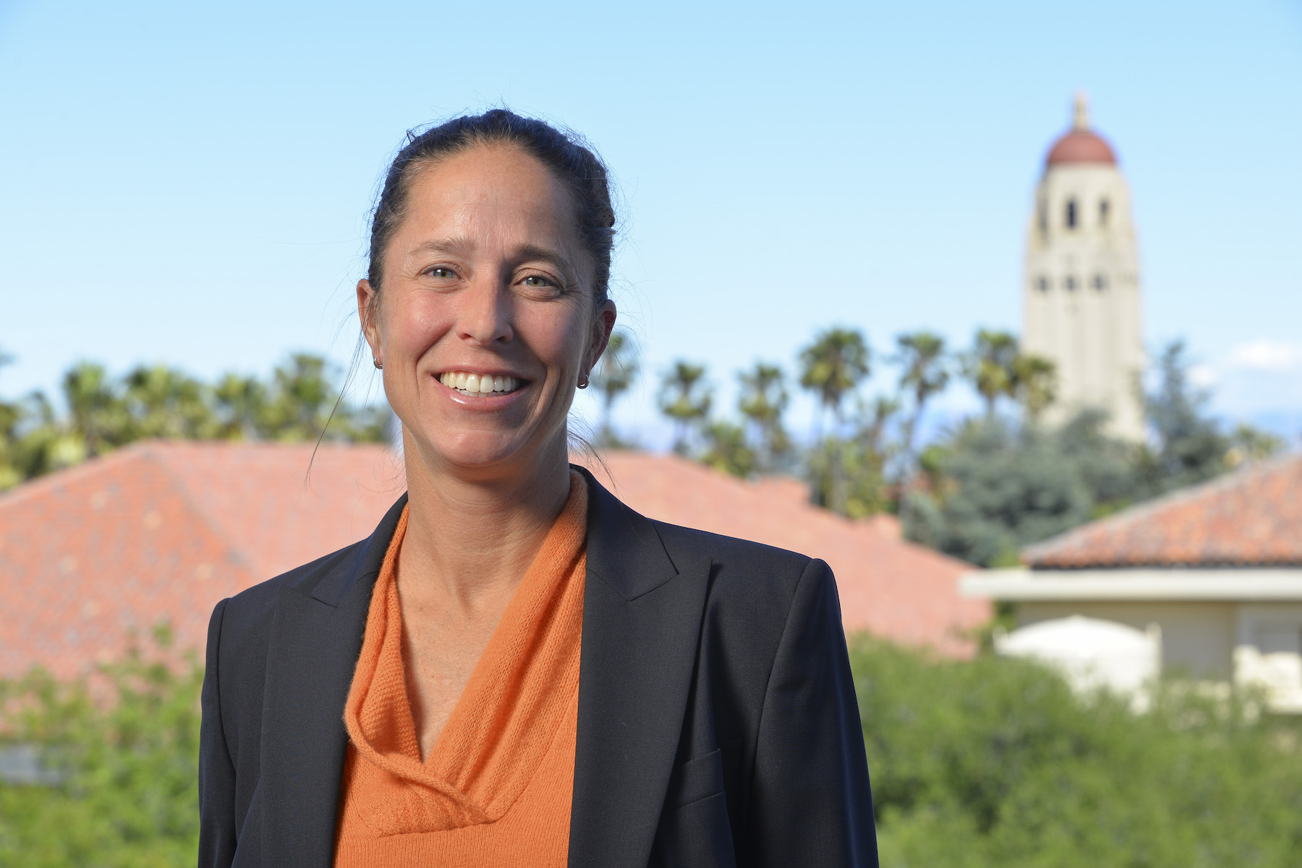
Alexandria Boehm
Environmental Engineering
Stanford University

Slide 22
WastewaterSCAN: A national collaboration to use wastewater solids to understand infectious disease occurrence for COVID-19 and beyond
January 11, 2023
Alexandria Boehm, Stanford University, CA, USA

Slide 23
Who we are
WastewaterSCAN is a national effort based at Stanford University to build a national network using consistent methods for monitoring diseases using wastewater solids collected from municipal wastewater systems to inform public health responses locally and nationally. This project grew out of SCAN.
Scientific Leads Stanford University (Alexandria Boehm, PhD, and colleagues) Emory University (Marlene Wolfe, PhD, and colleagues) | National Scaling Partners Verily for recruiting, logistics, laboratory analysis, and data collection National League of Cities for capacity building | Local Partners Municipal public works/wastewater officials State and local public health officials

Slide 24
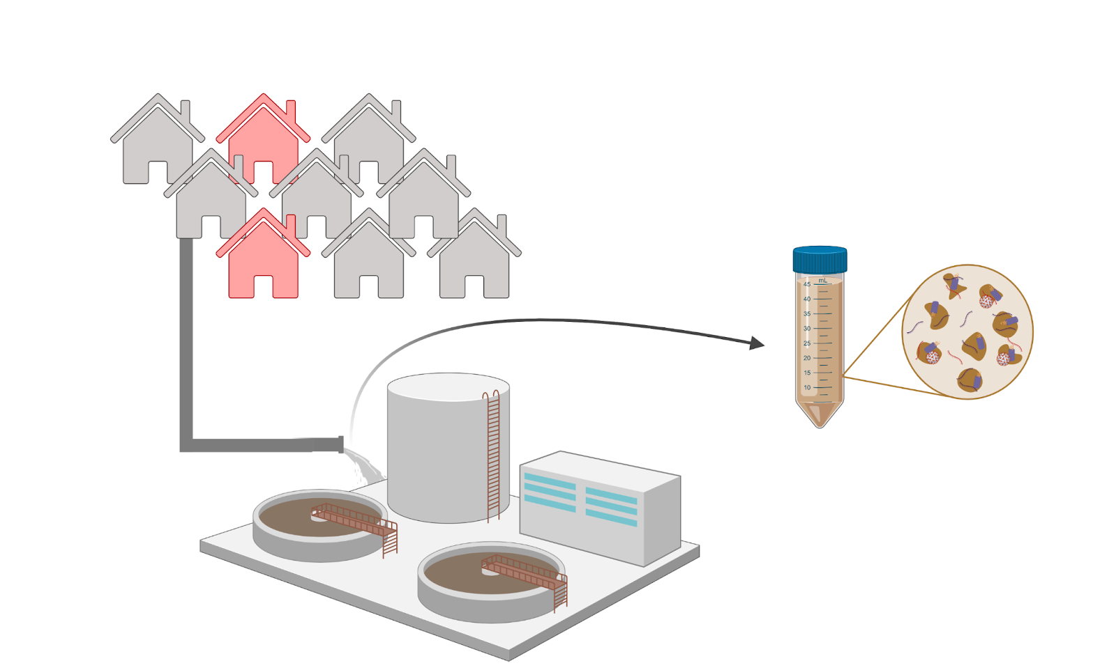
Outline
Project overview
WastewaterSCAN participants
Project duration / sampling frequency
Methods / targets measured / supporting science
Recent trends
SARS-CoV-2
Influenza A
RSV
Mpox
Norovirus GII, Influenza B, and Human metapneumovirus
Data availability and website

Slide 25
Project Overview

Slide 26
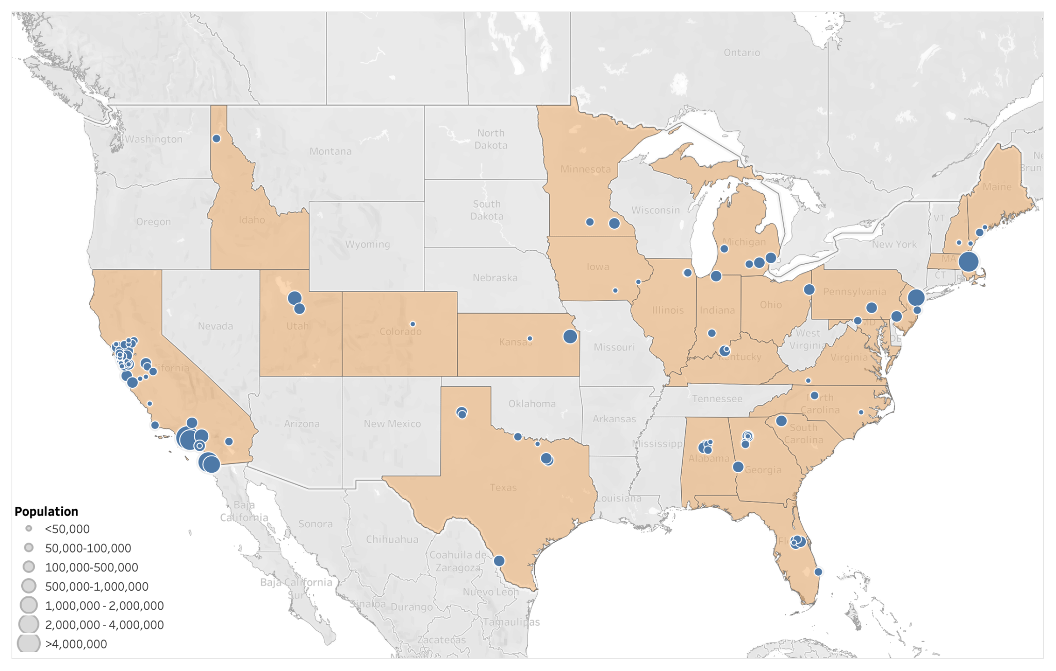
WastewaterSCAN participants / duration / sampling frequency
Participants:
114 plants sampling
133 plants onboarded
9.91% US population represented (32,661,859 people)
25 states represented
Goal: enroll 300 plants with at least one in each state
Duration: through Jan 2024 but aim to continue beyond with additional support
Sampling frequency: 3 times per week

Slide 27
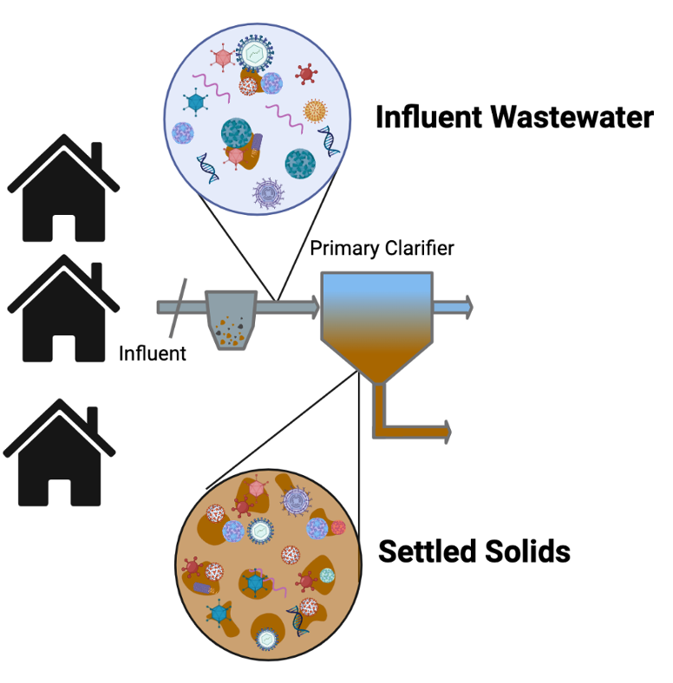
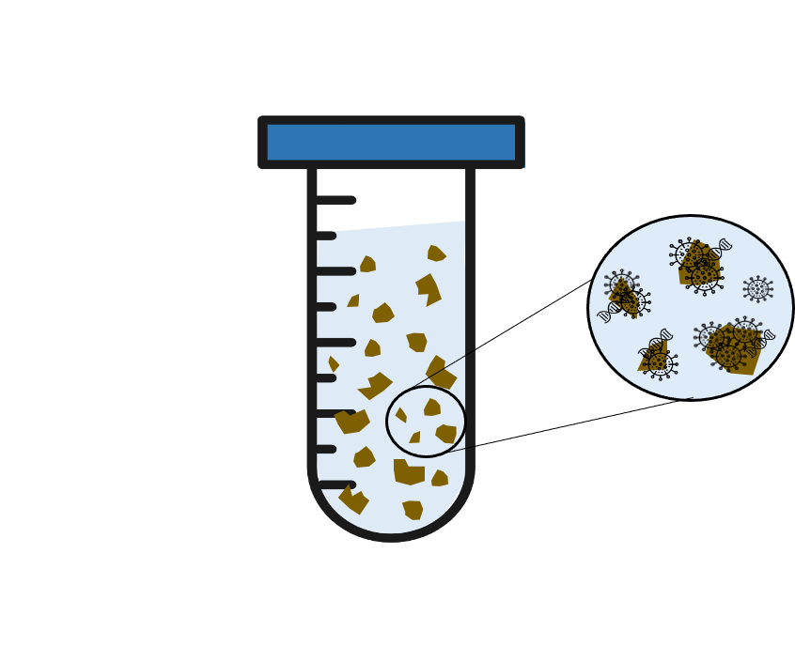
Viral genomic targets are enriched in solid phase
Viral targets are enriched 1000X in solid phase over liquid phase on an equivalent mass basis
Influenza RSV
Rhinovirus PMMoV
Norovirus MPox
SARS-CoV-2 … and more

Slide 28
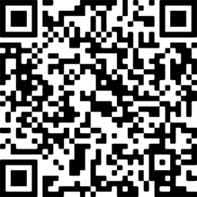
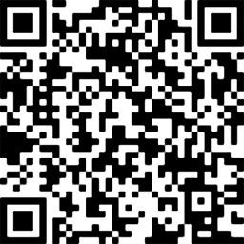
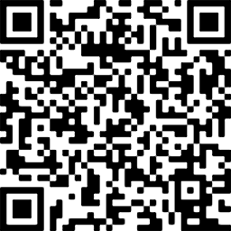
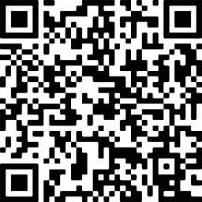
Analytical methods (all publicly available on protocols.io)
Attention Check Code 1:
6127
Pre-analytical
Dewatering/ Resuspending Solids
Nucleic Acid Extraction
Chemagic 360
Inhibitor removal
Droplet digital PCR
Multiplexing targets
and controls

Slide 29
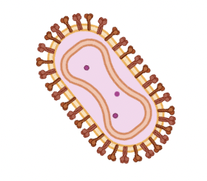
Targets
SARS-CoV-2:
N gene and S gene (pan-SARS-CoV-2 targets)
HV69-70 mutation (BA.4 and BA.5 including B.Q.*)
Influenza (IAV): M1 gene
Influenza (IBV): M gene
Human Metapneumovirus: L gene
Respiratory Syncytial Virus (RSV): N gene (detects RSV A and RSV B)
Mpox Virus: G2R_WA marker in the mpox virus genome
Norovirus: ORF1-2 junction (detects HuNoV GII)
Controls
PMMoV (pepper mild mottle virus) - endogenous control
BCoV (bovine coronavirus) - exogenous control
This platform is flexible and we can pivot to new targets
All methods are in public domain (protocols.io)

Slide 30
Research underpinning target choices
Assay design and testing
in silico and in vitro
Application to wastewater samples in a research capacity
Choose samples retrospectively and measure target (in collaboration with plant and public health)
Identify and obtain customary clinical data stream
Assess agreement between wastewater & clinical data
Write and publish preprint and submit for peer review at a journal
Collaborate with public health colleagues to discuss use cases
Prospective roll out new target to SCAN plants (Greater San Francisco Bay Area, CA)
Add data visualization to websites
Provide data interpretation to stakeholders
Prospective roll out to WastewaterSCAN plants
Add data visualization to websites
Provide data interpretation to stakeholders

Slide 31
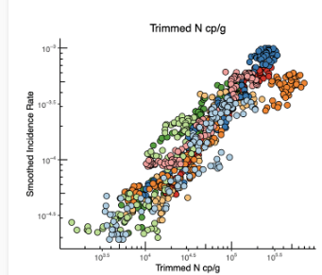
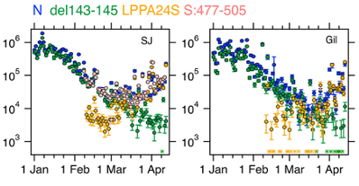
SARS-CoV-2 and variants
N = all SARS-CoV-2
del143-145 = BA.1
LPPA24S = BA.2 + BA.4 + BA.5
S:477-505 = BA.1 + BA.2 + BA.4 + BA.5
Published in mSystems
Published in ES&T Letters

Slide 32
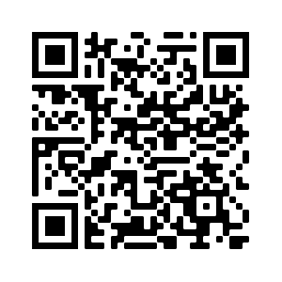
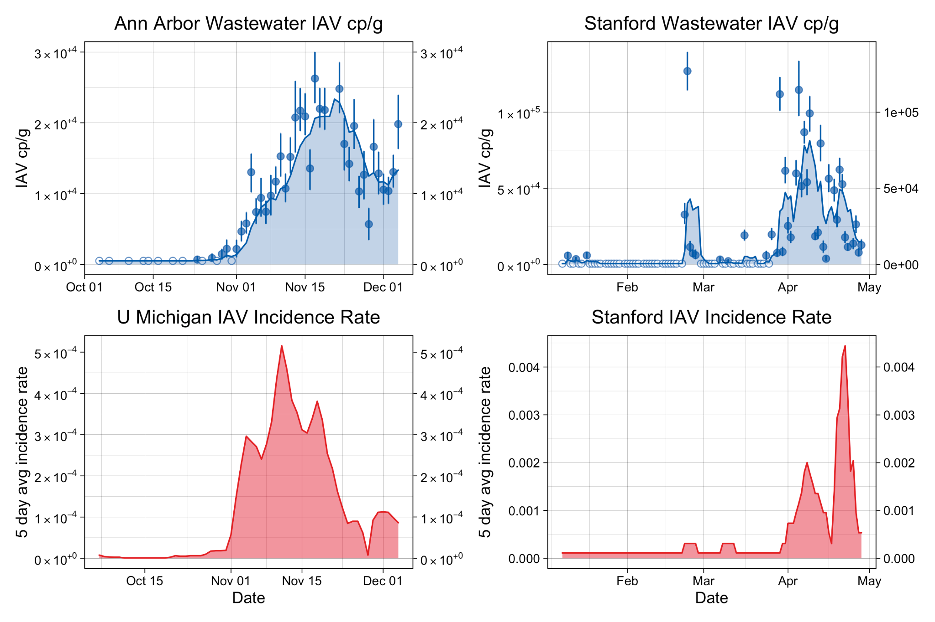
Influenza A RNA
Published in ES&T Letters
High quality clinical data:
CDC investigation (UM)
Screening testing of athletes (Stanford)
IAV RNA associated with incidence rates (Kendall’s tau):
0.58 at UM and
0.67 at Stanford University
Sequencing of RNA from wastewater indicates the same circulating strain at UM

Slide 33
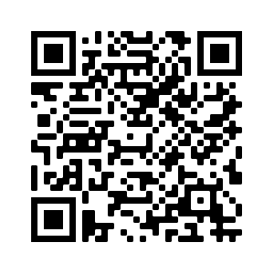
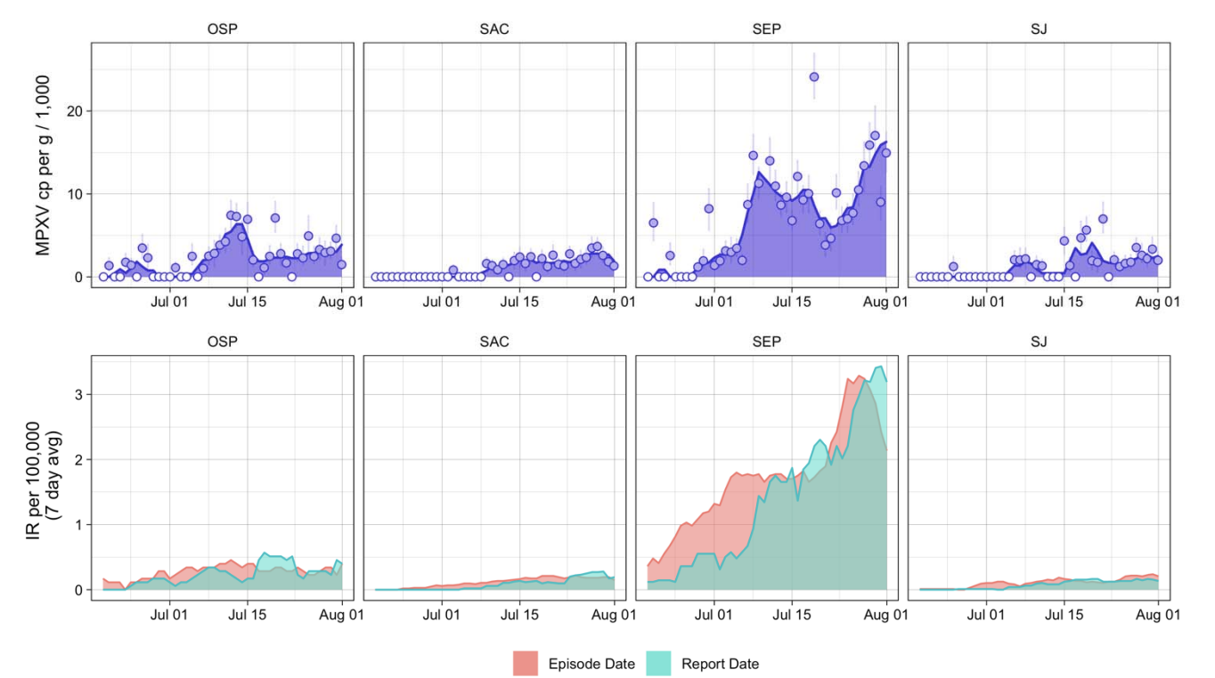
MPXV DNA
Accepted and preprint is available
Partnered with CA Department of Public Health for an analysis of MPX cases and wastewater results
Strong association between MPXV DNA concentration in wastewater and cases
MPXV DNA detected at 5 of 9 sites prior to or within a day of the first case identified in source sewershed

Slide 34
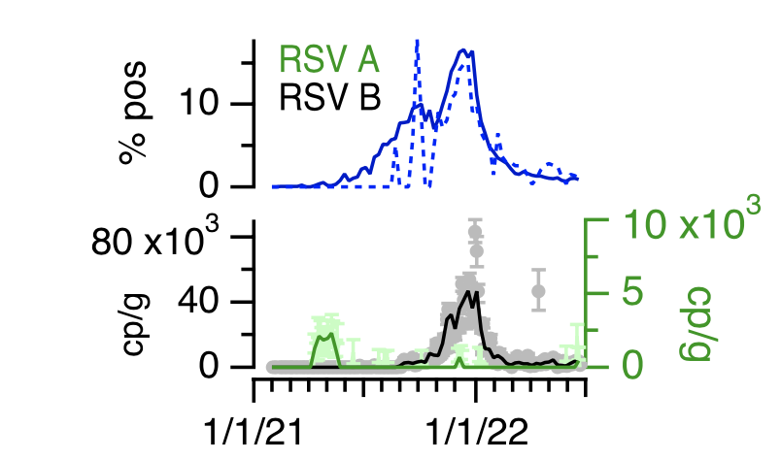
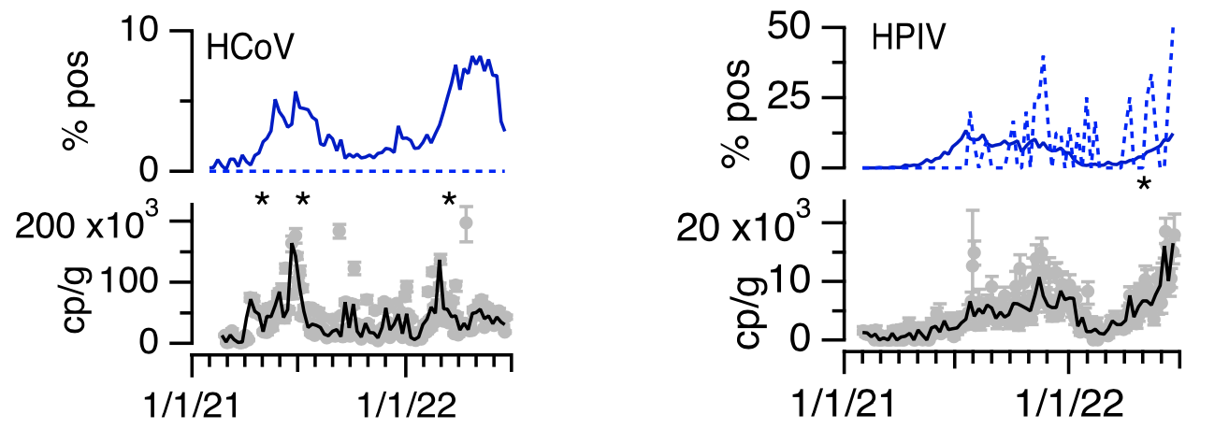
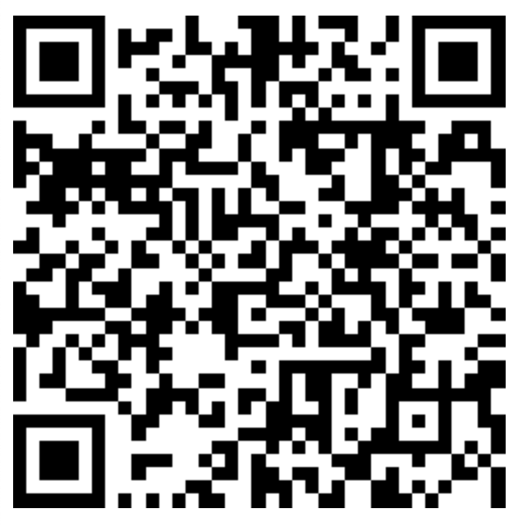
RSV, seasonal human coronaviruses, and human parainfluenza
17 months of data from one WWTP (2/2021 - 7/ 2022)
State and county-level positivity rate data
https://www.medrxiv.org/content/10.1101/2022.09.22.22280218v1
Accepted at Lancet Microbe

Slide 35
Recent trends at WastewaterSCAN sites

Slide 36
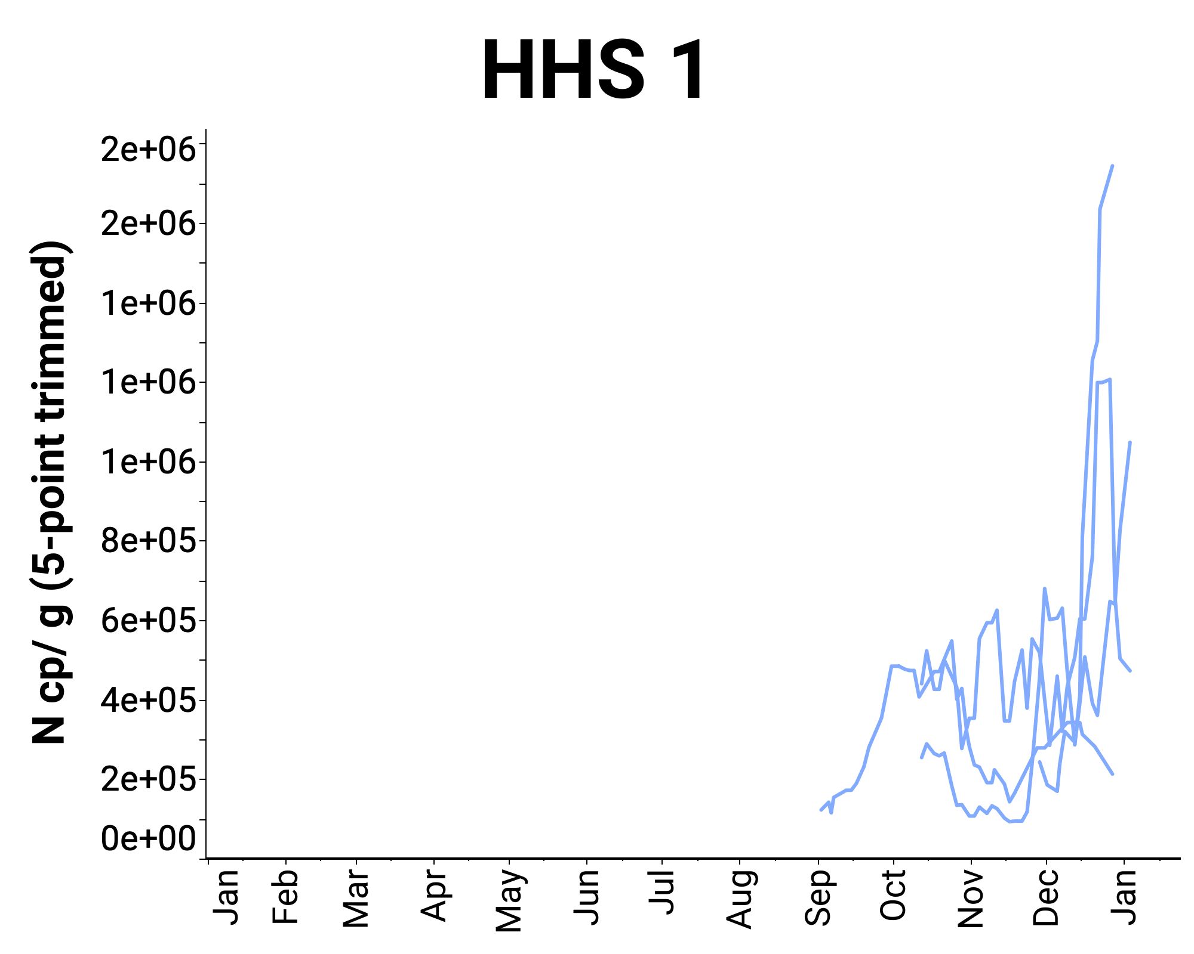
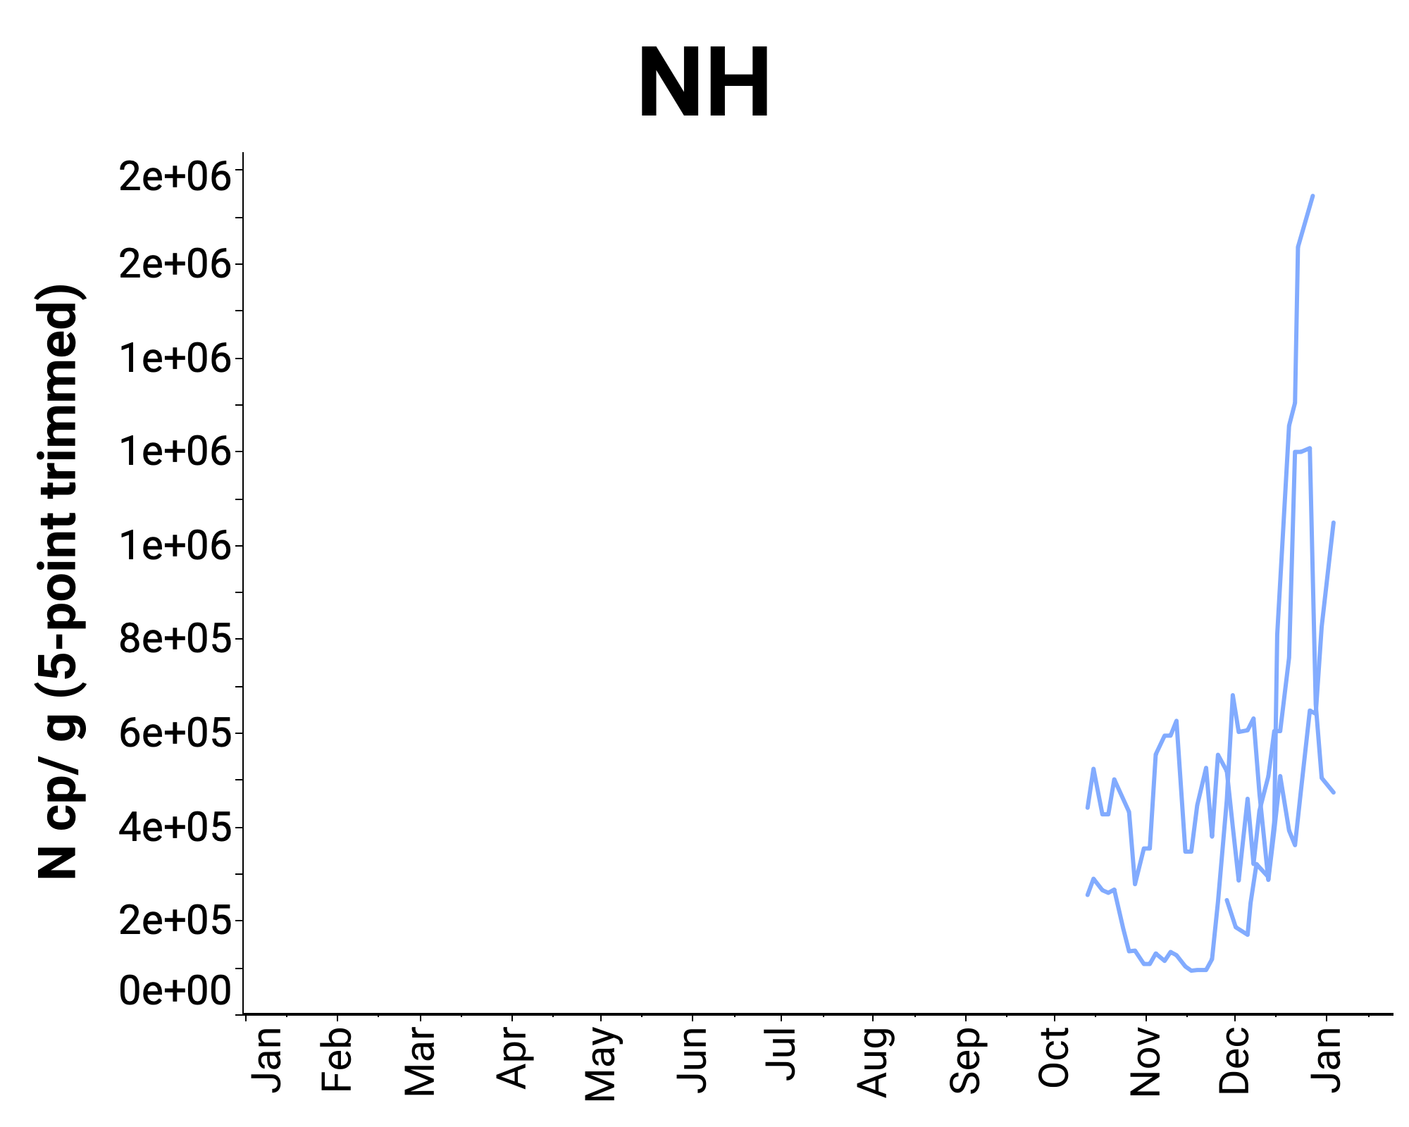
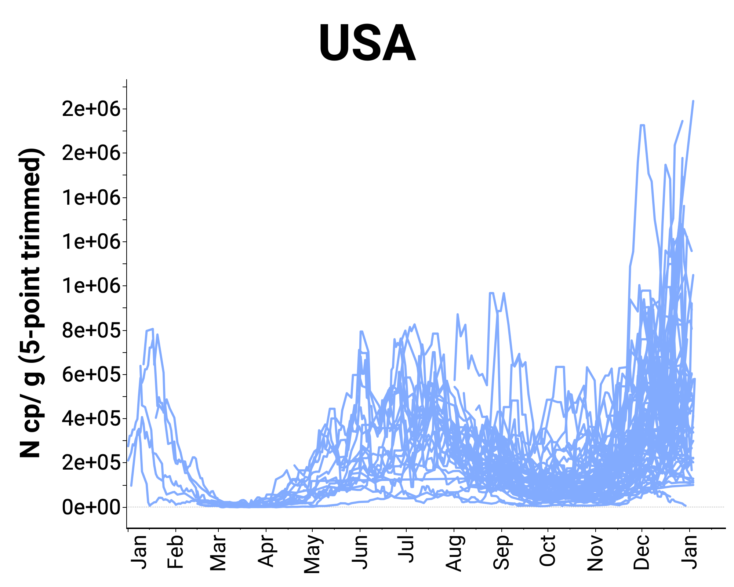
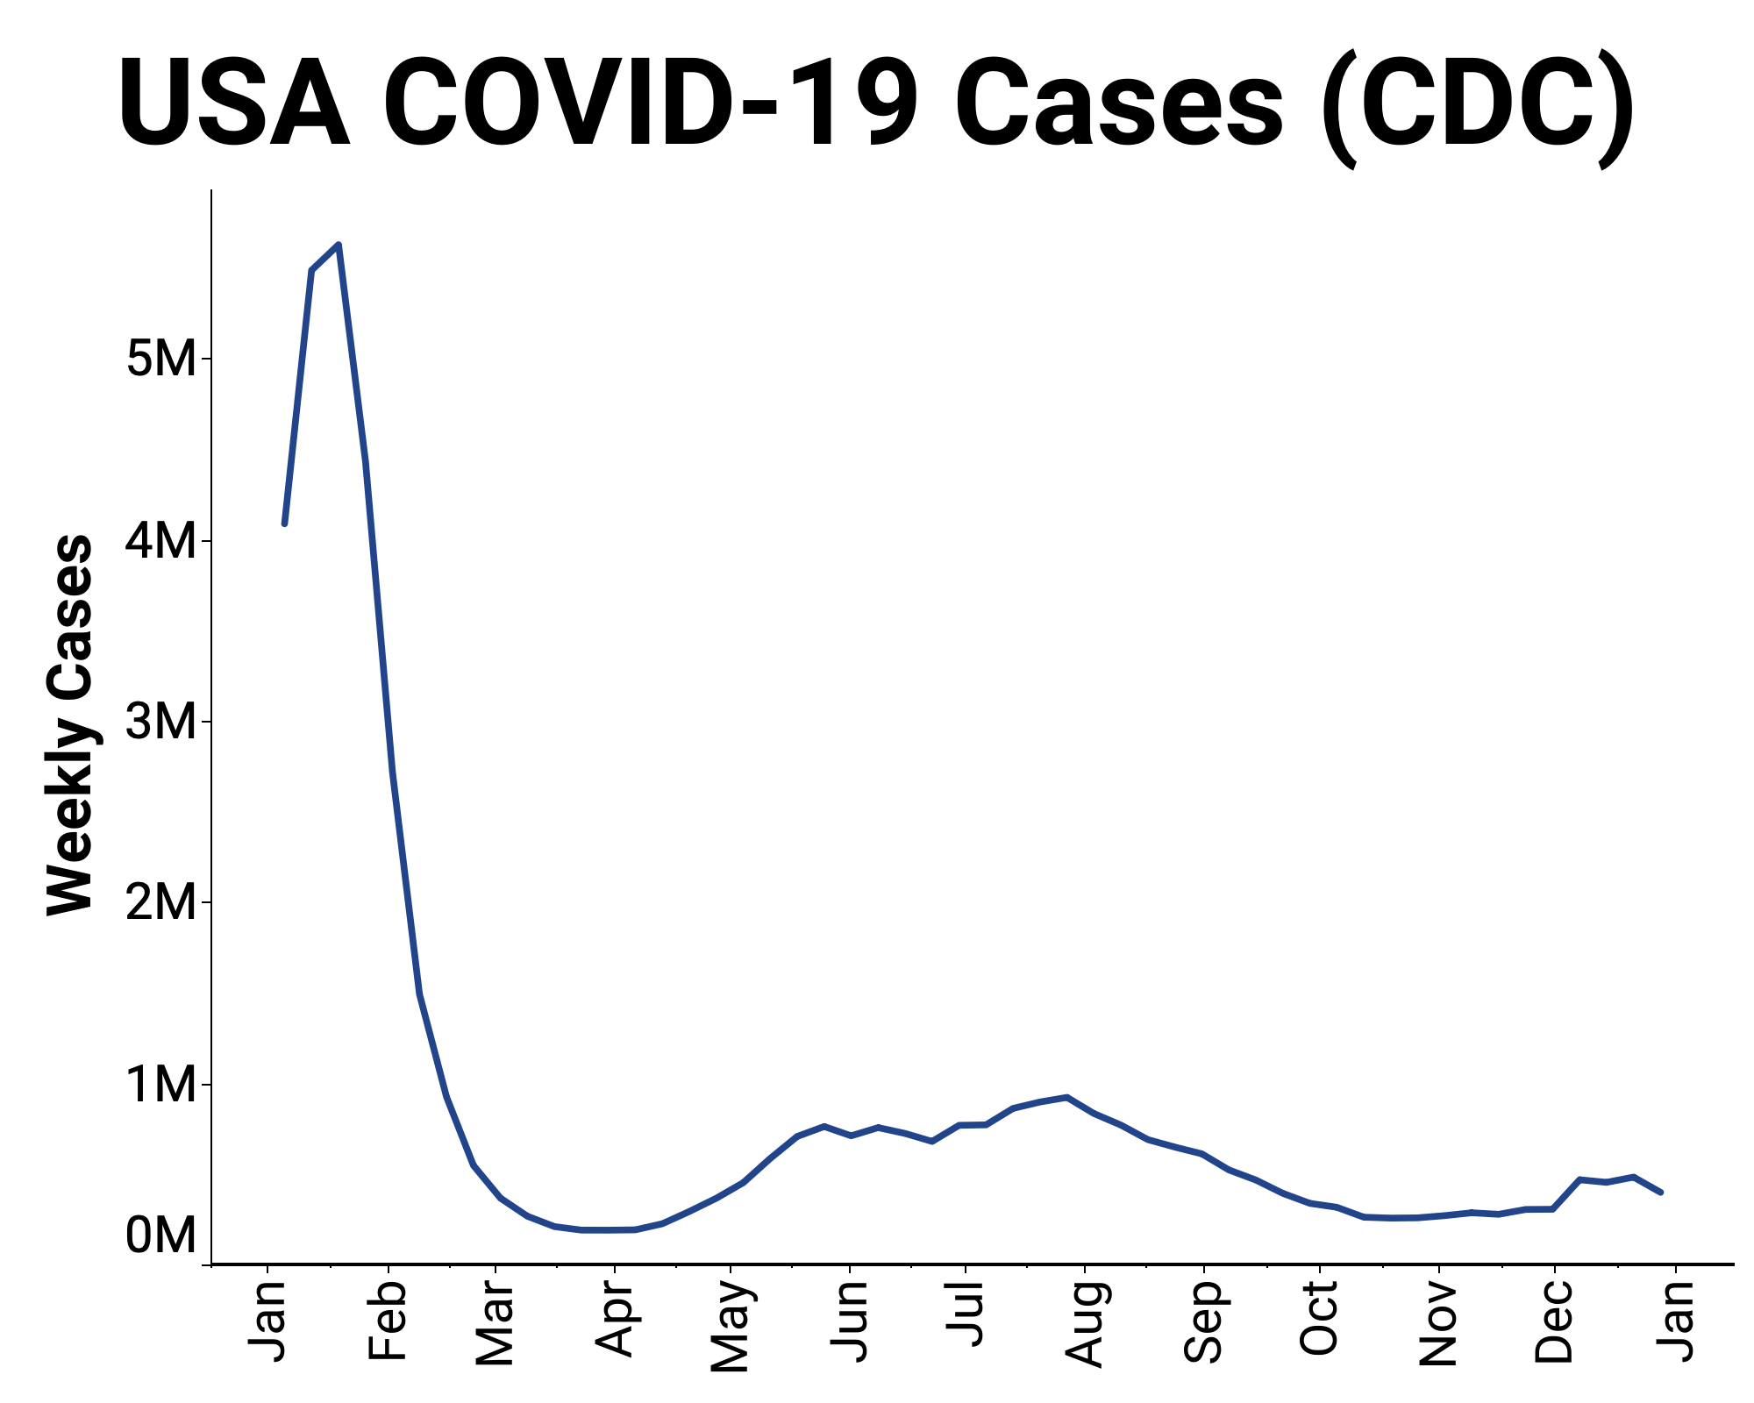
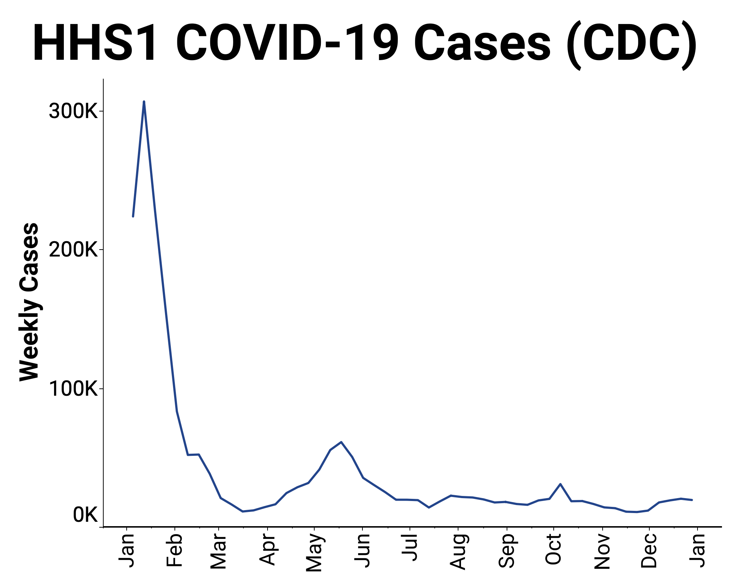
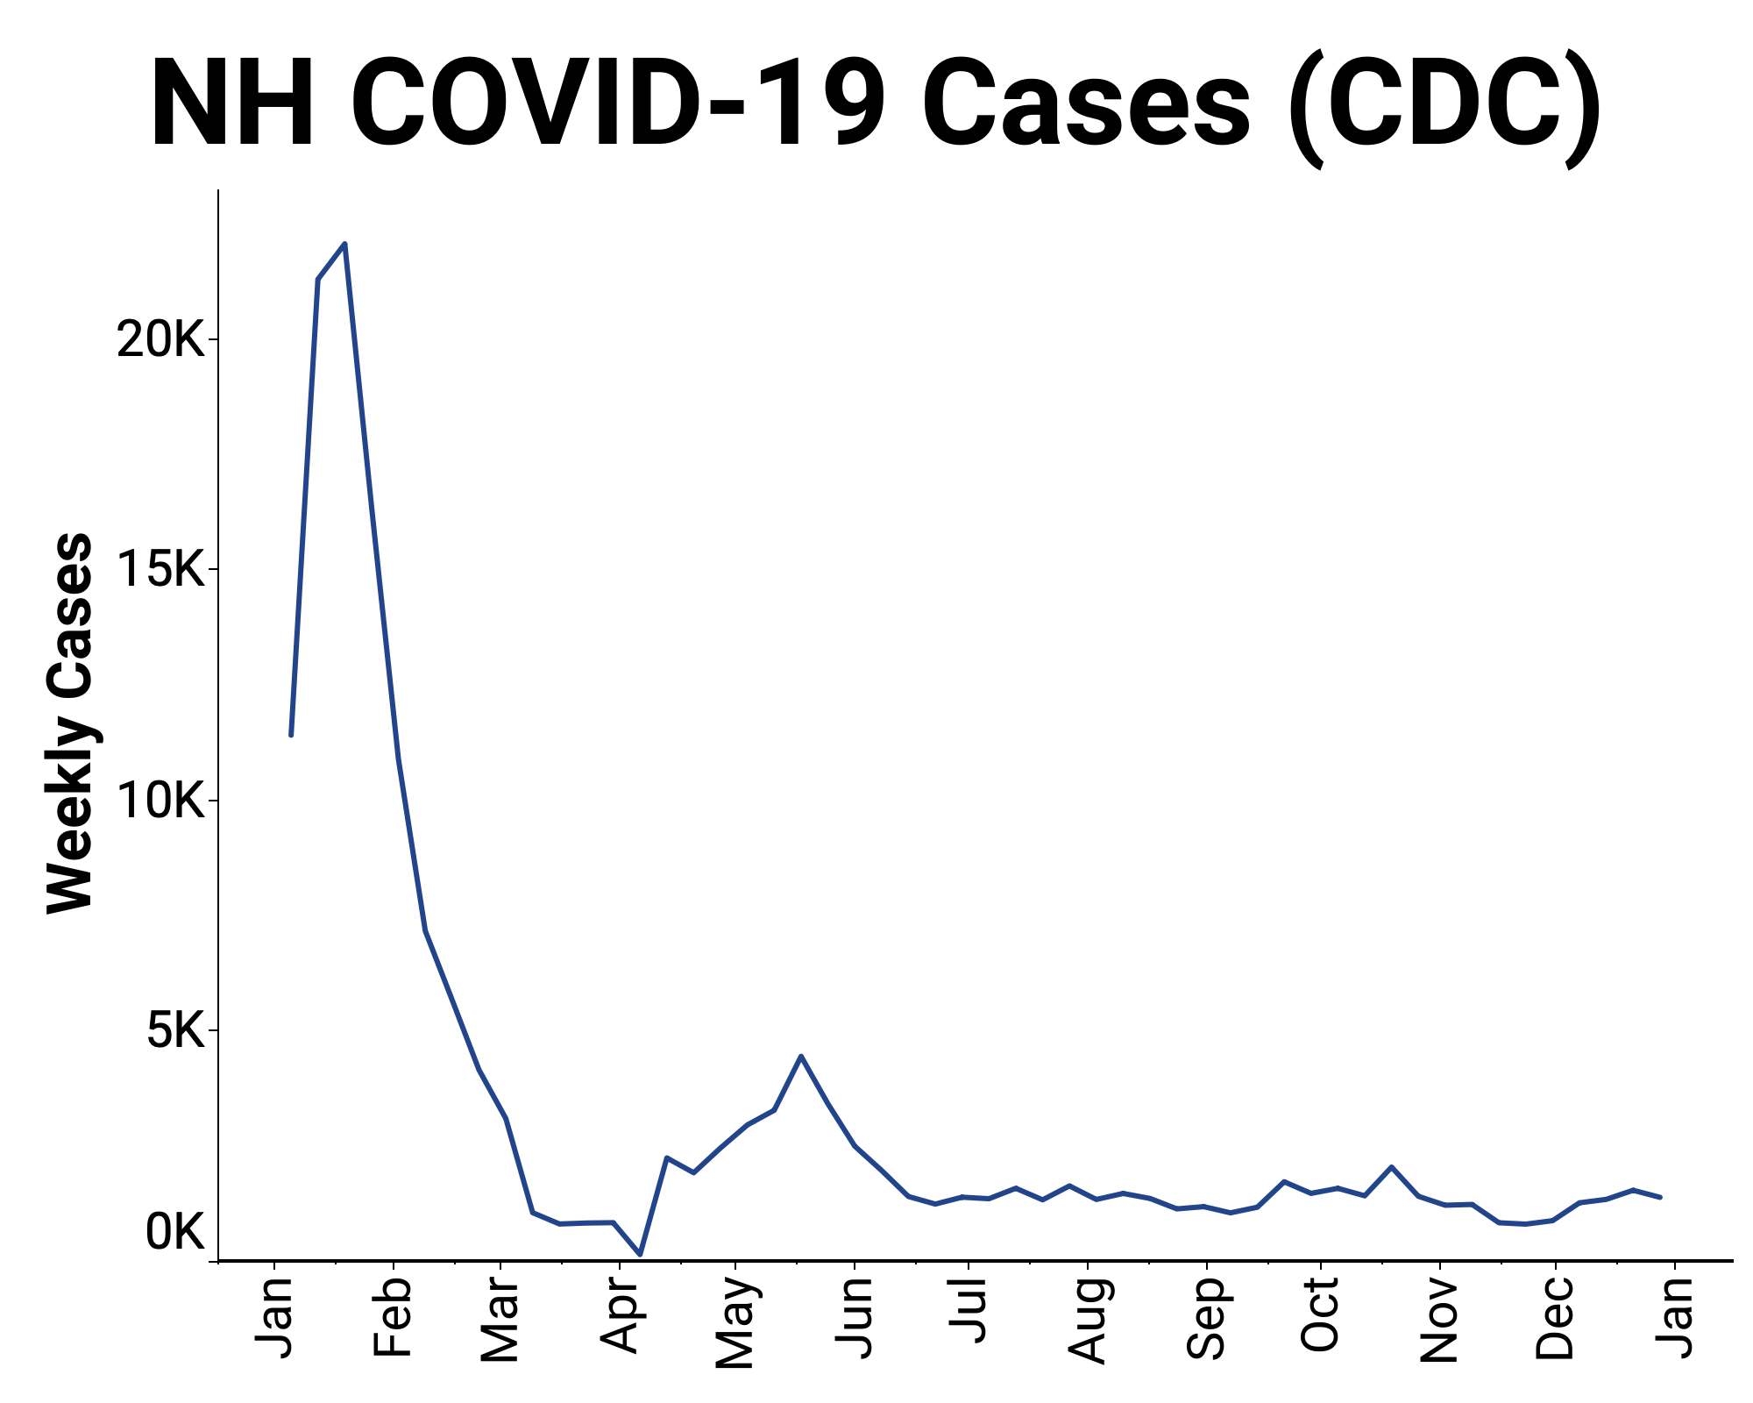
TARGET: SARS-CoV-2
WW & COVID-19
Surveillance
21-d trends are
⬇ 13/114
⬆ 29/114
Remainder No trend
Clinical data through Dec 28, 2022

Slide 37
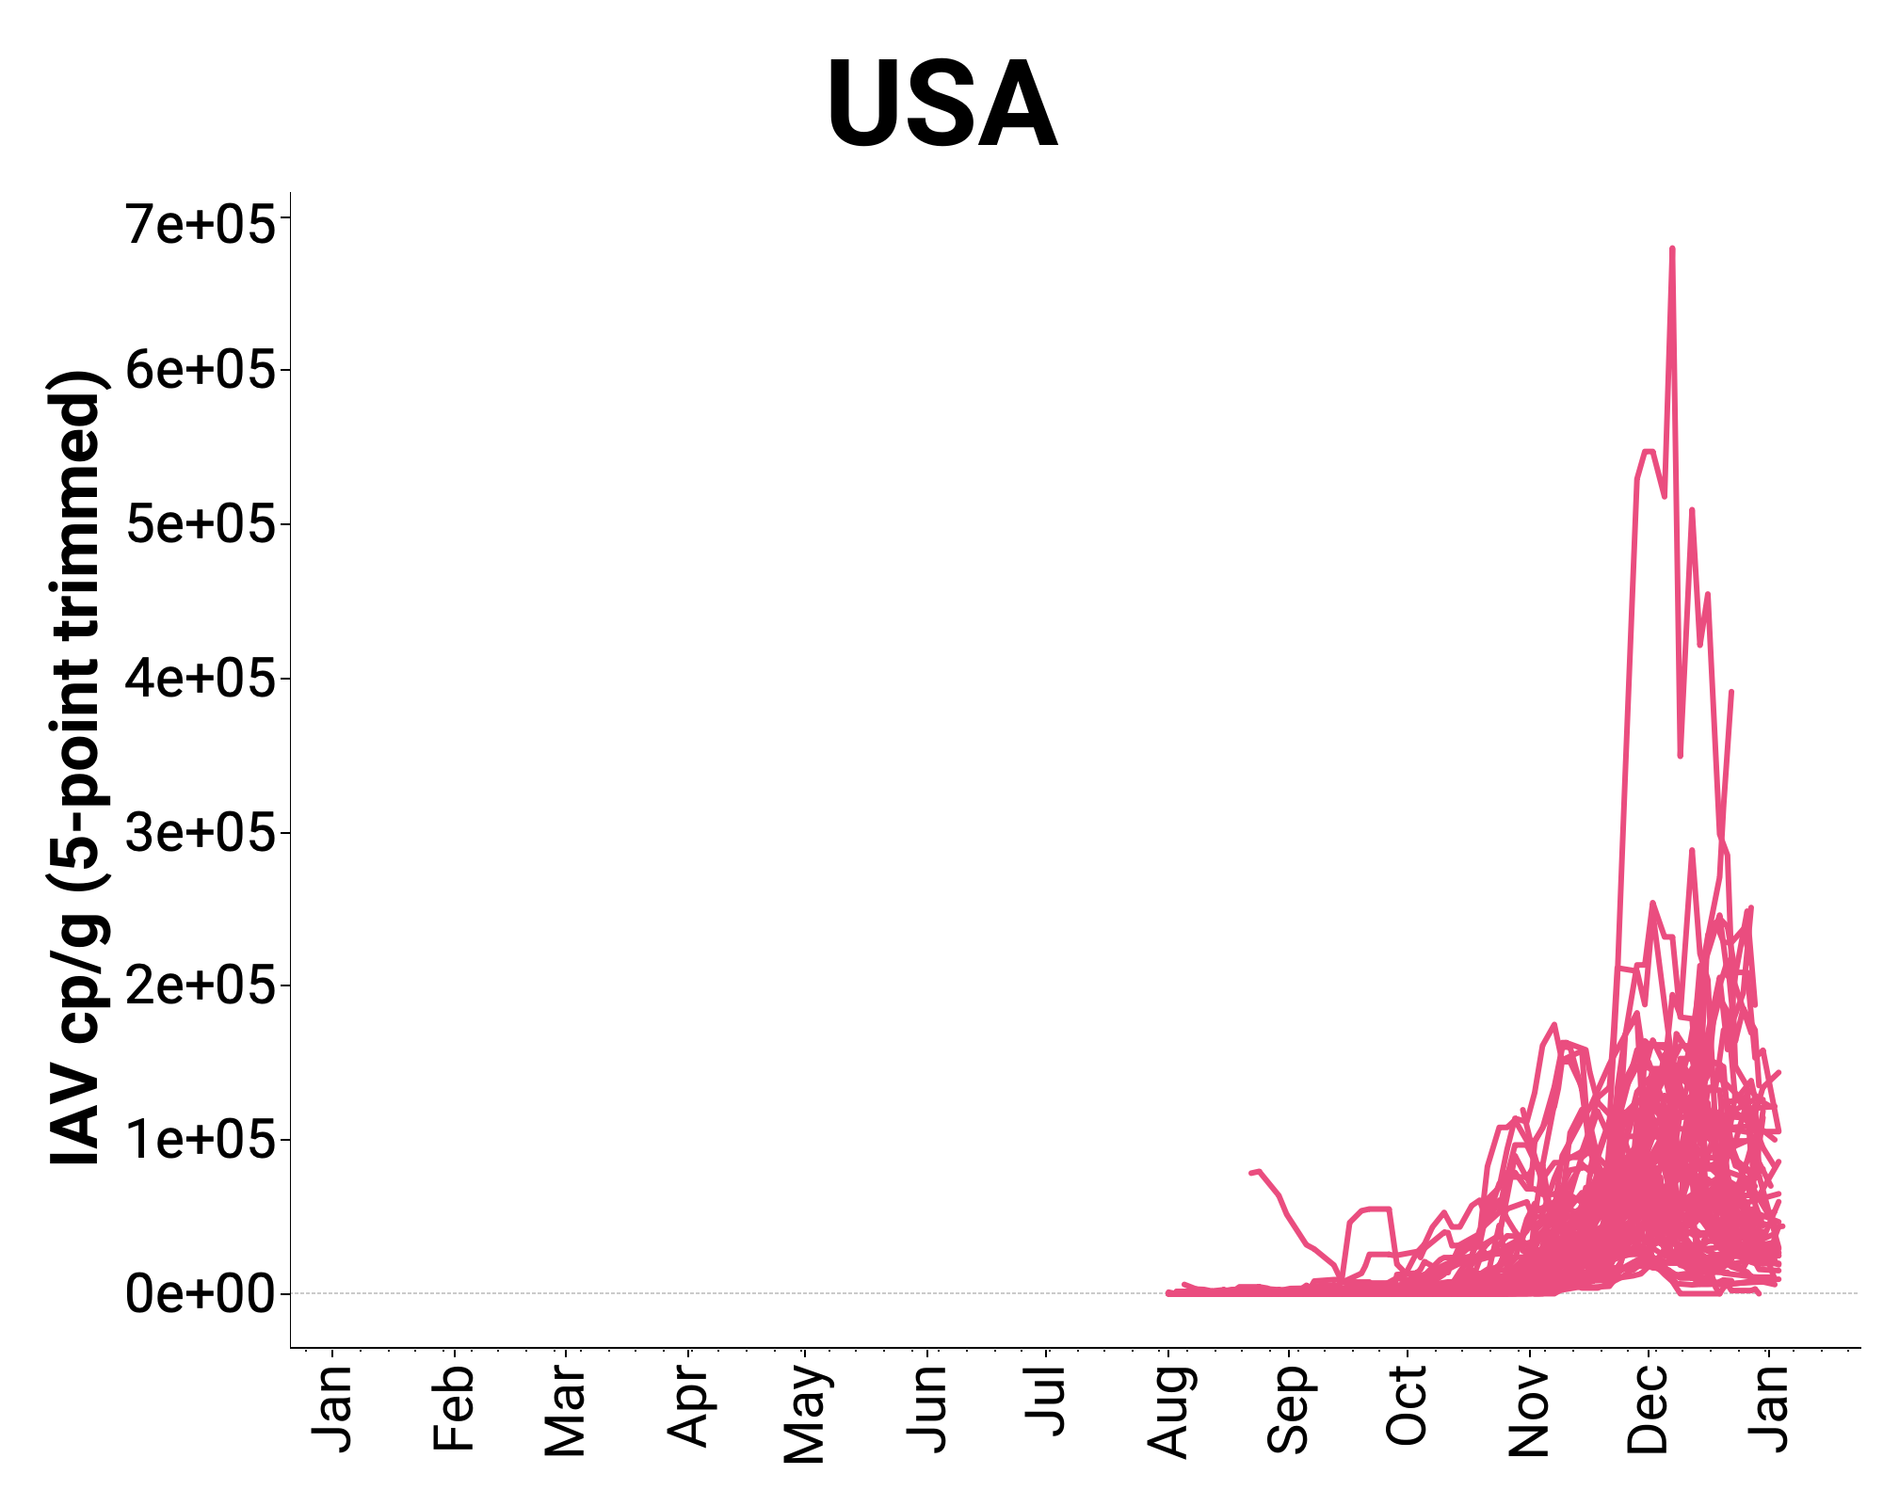
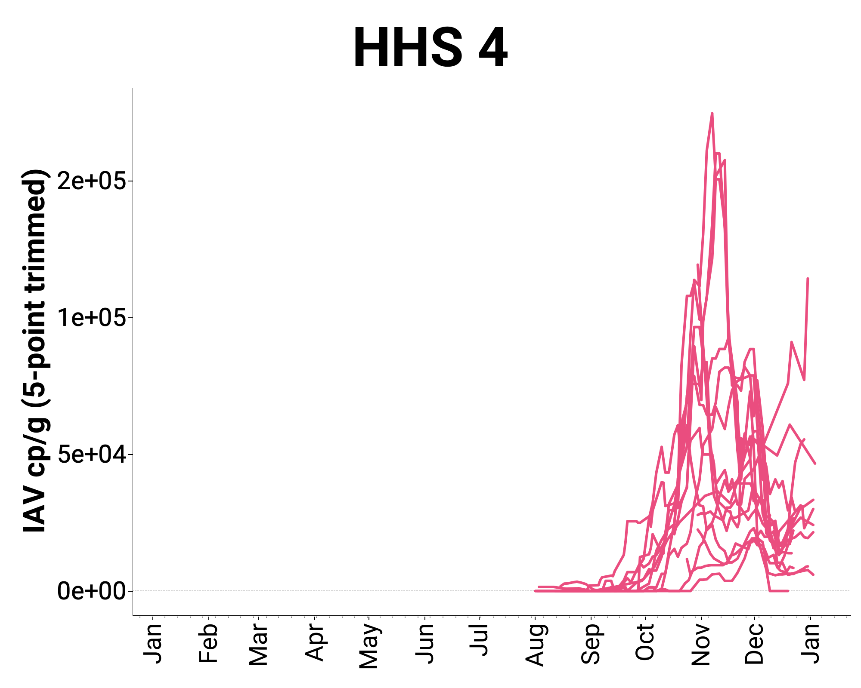
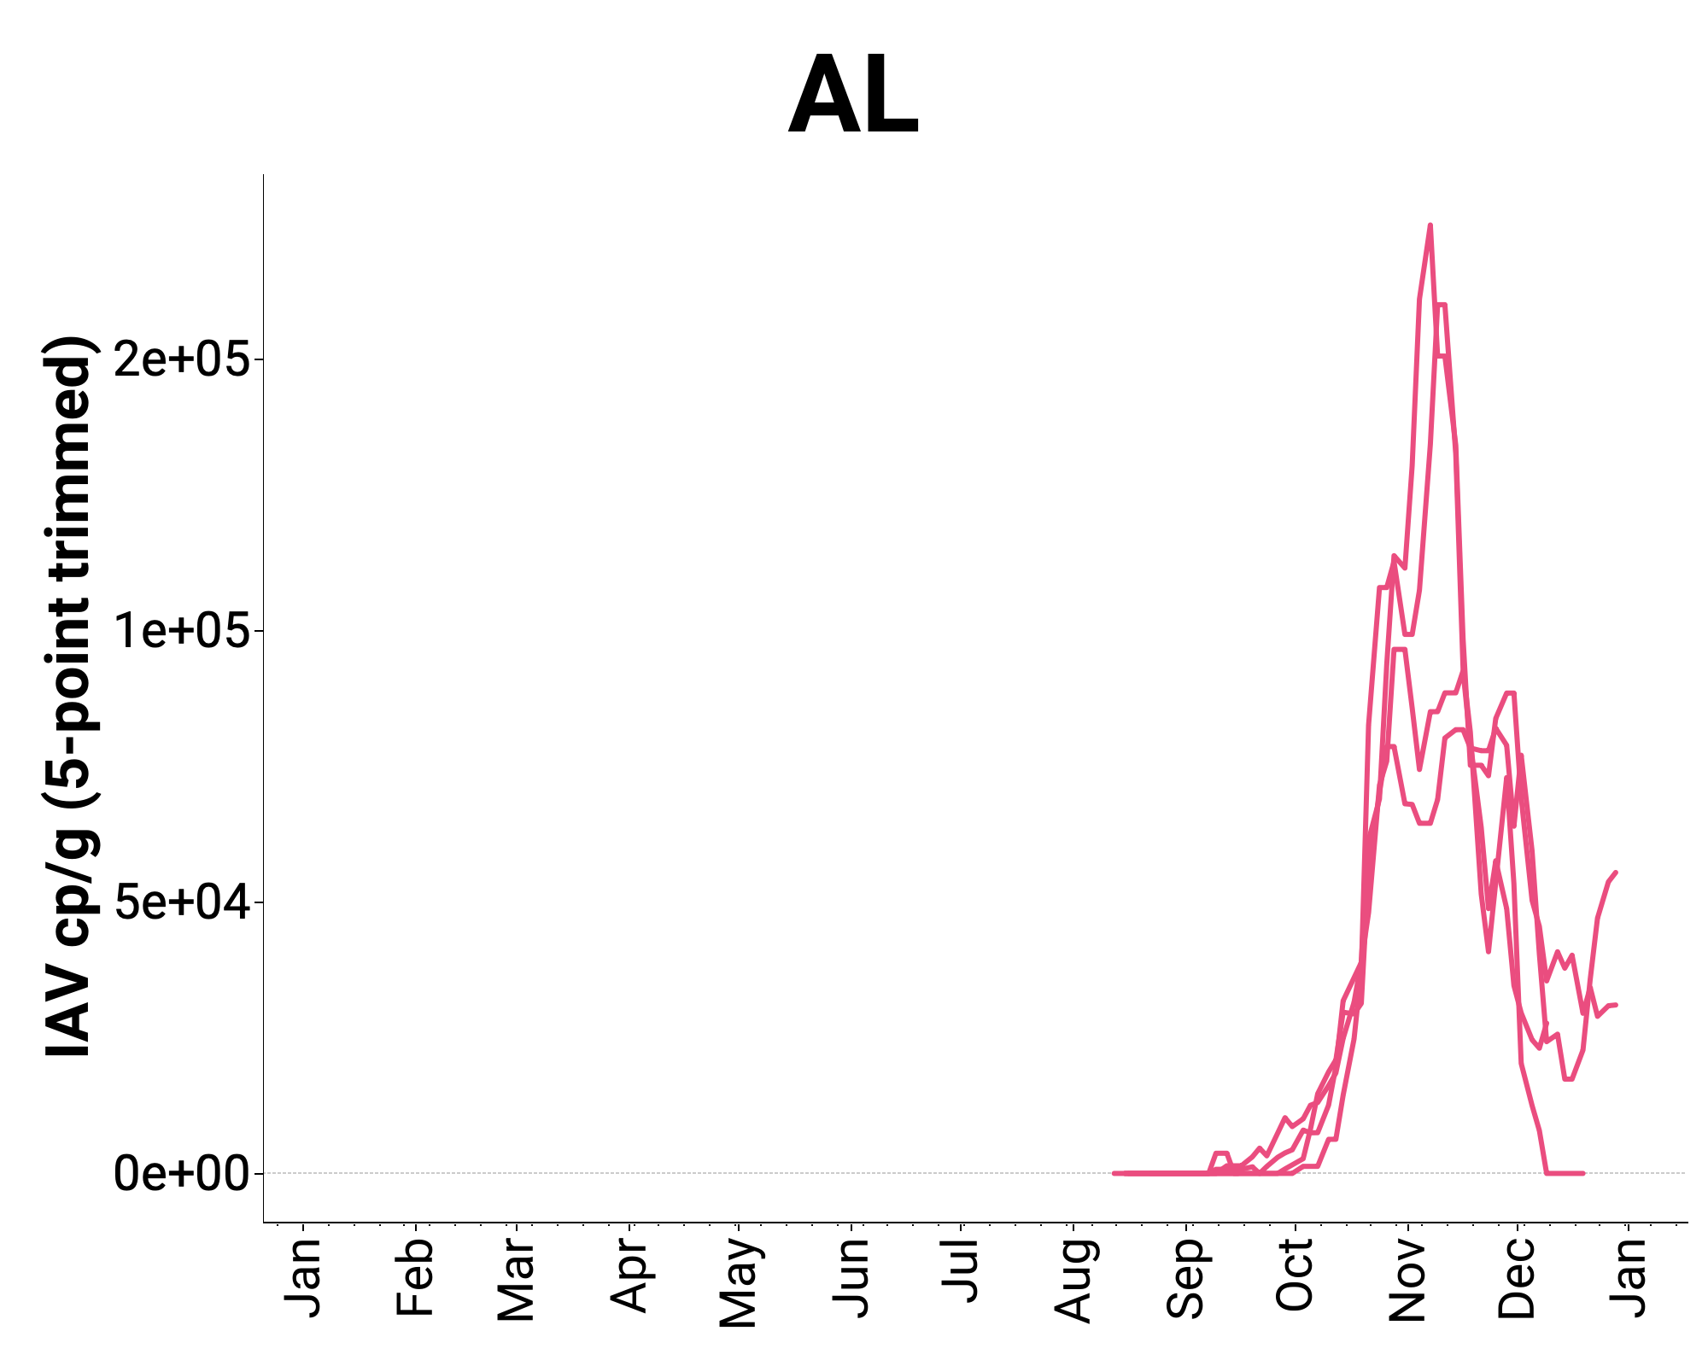
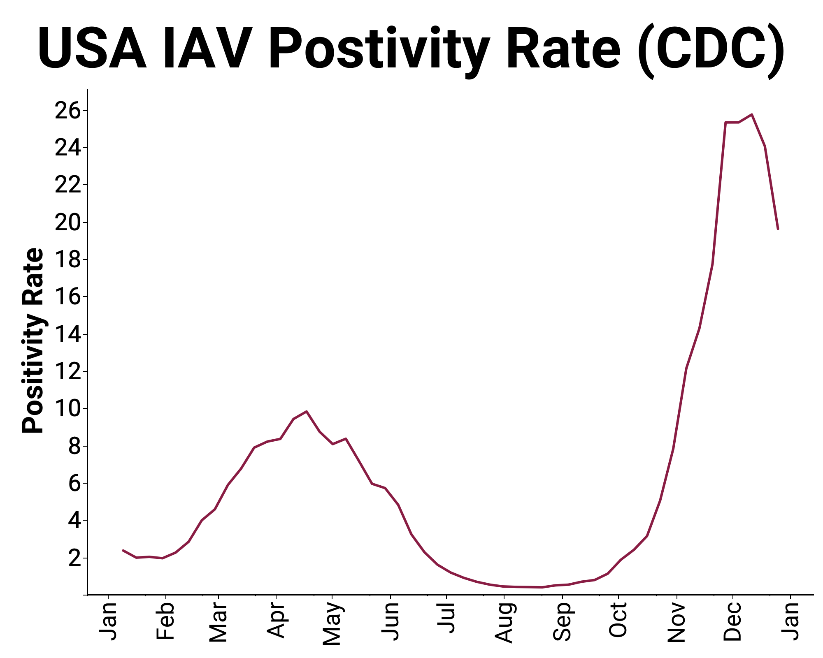
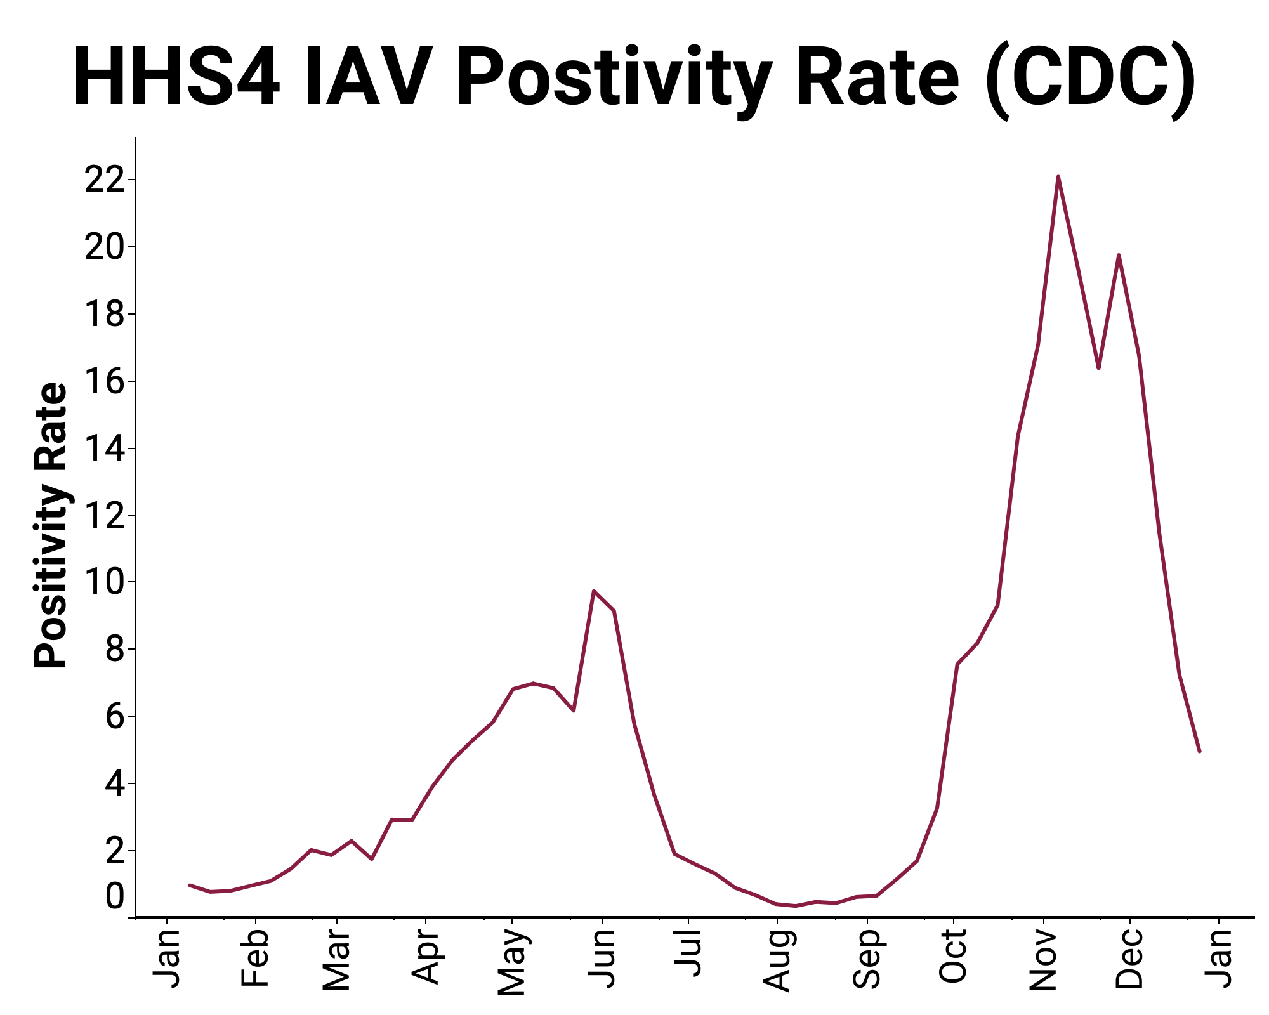
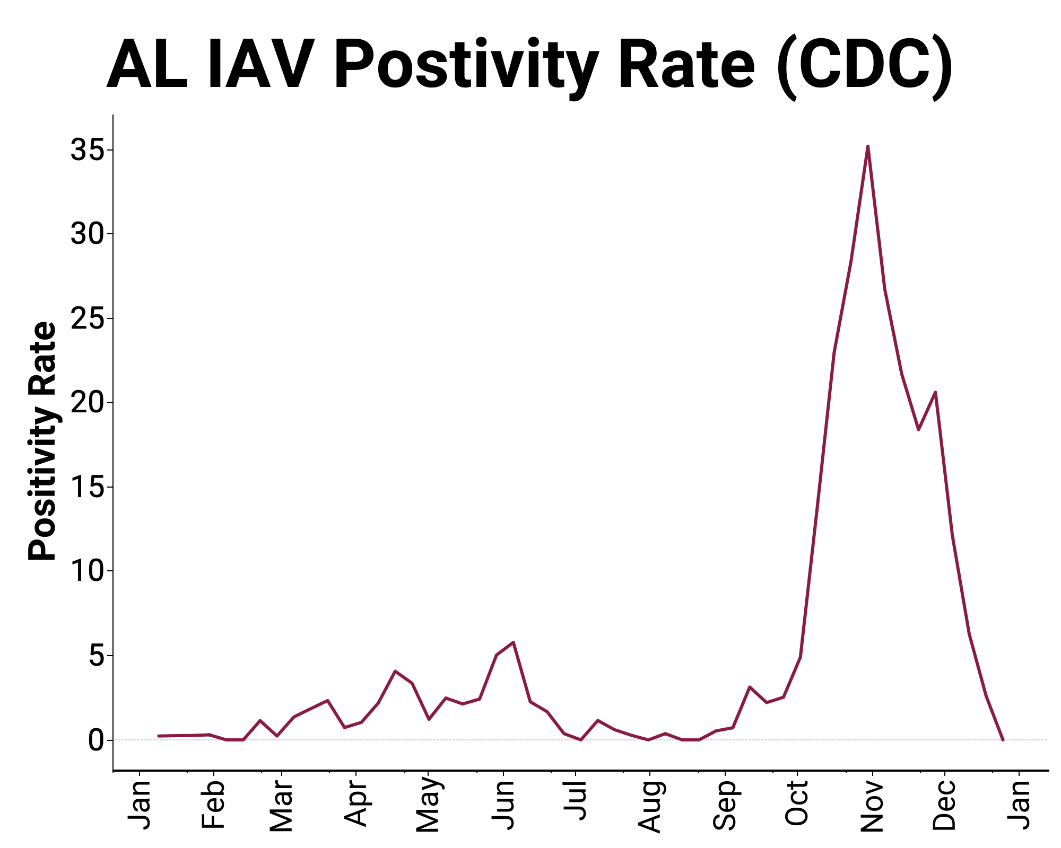
TARGET: Influenza A
WW & IAV
Surveillance
21-d trends are
⬇ 29/114
⬆ 11 /114
Remainder No trend
Clinical data through Dec 25, 2022

Slide 38
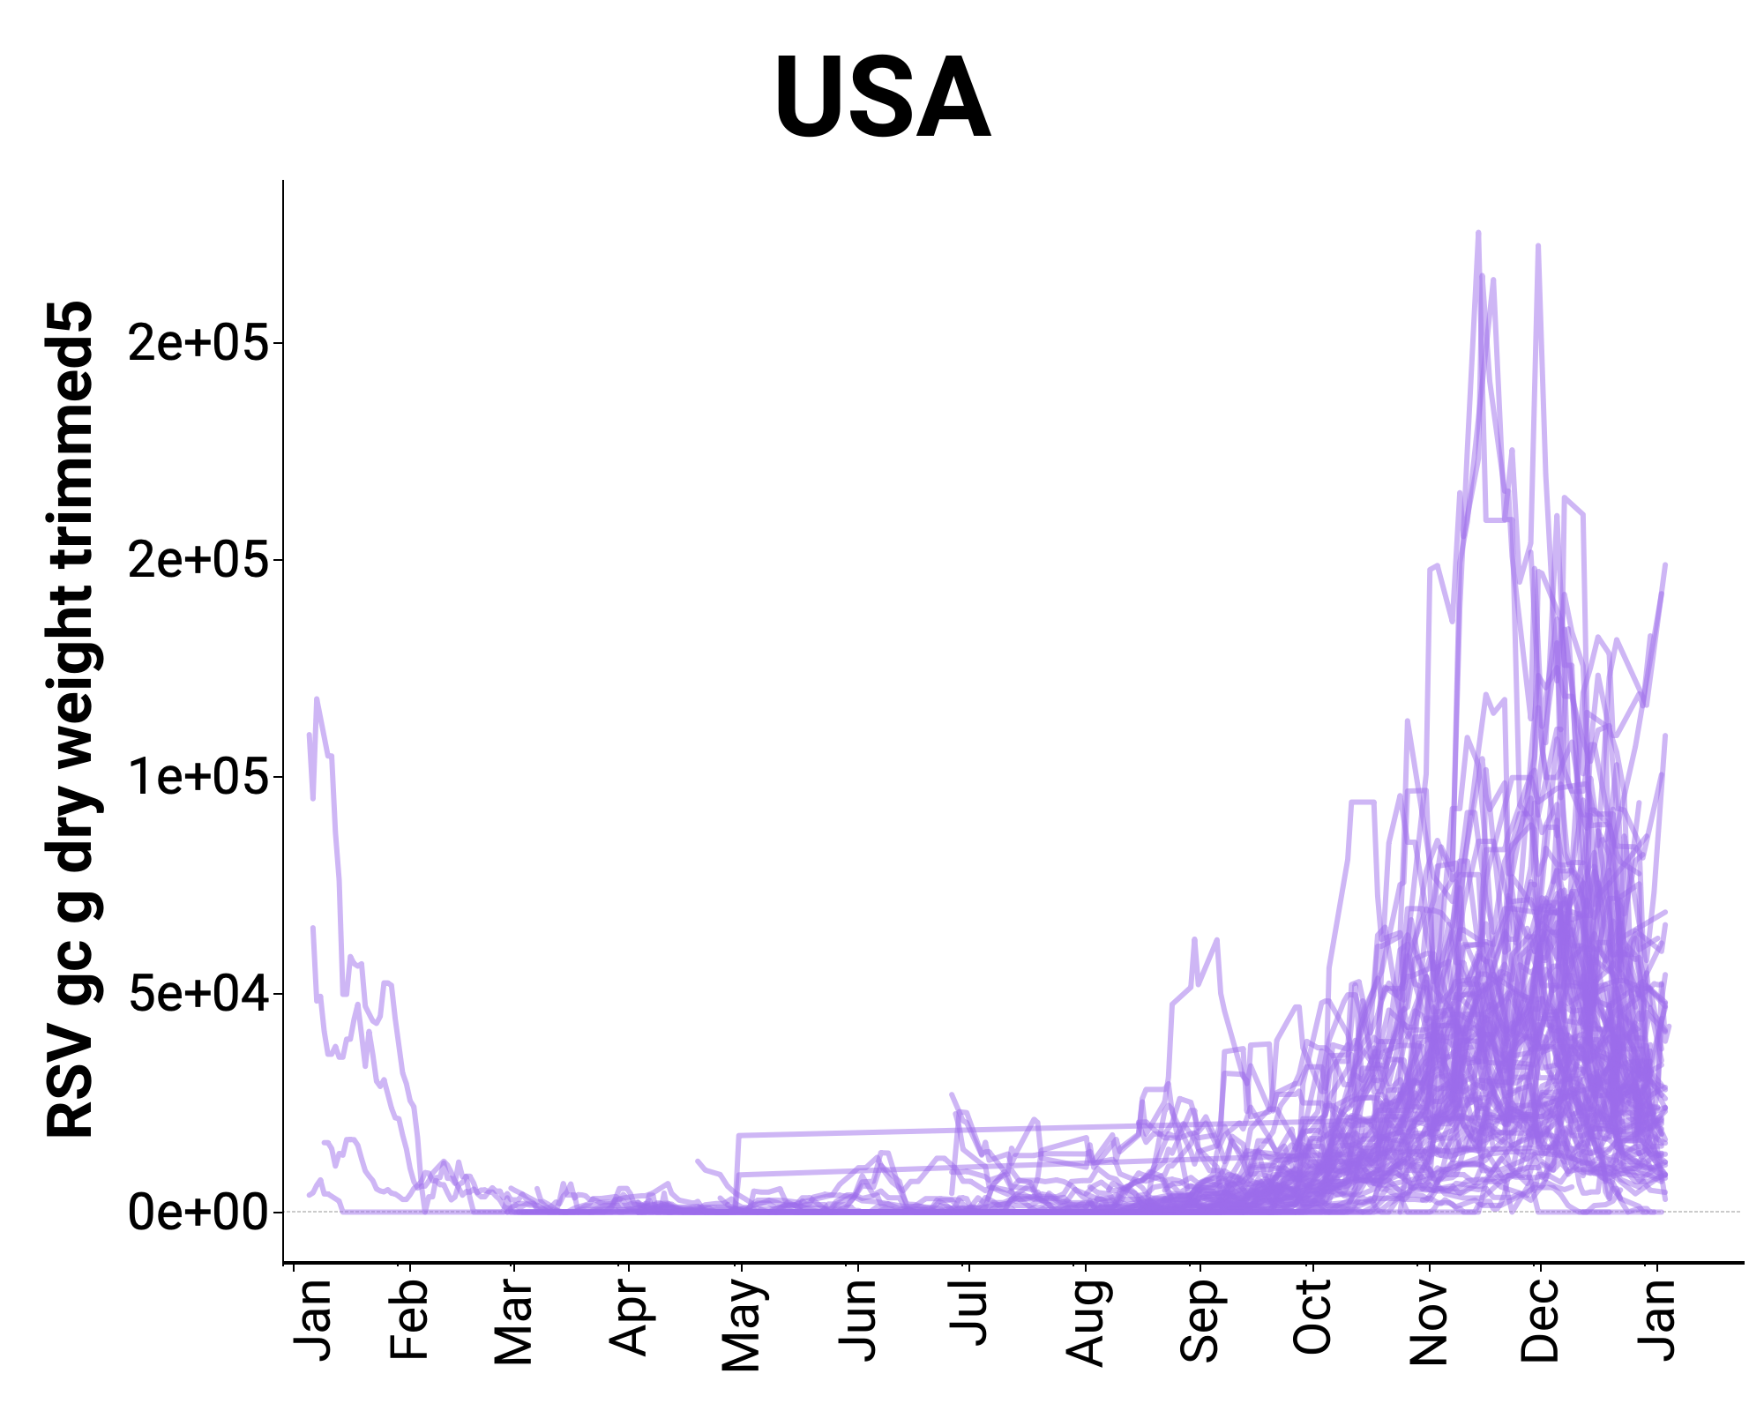
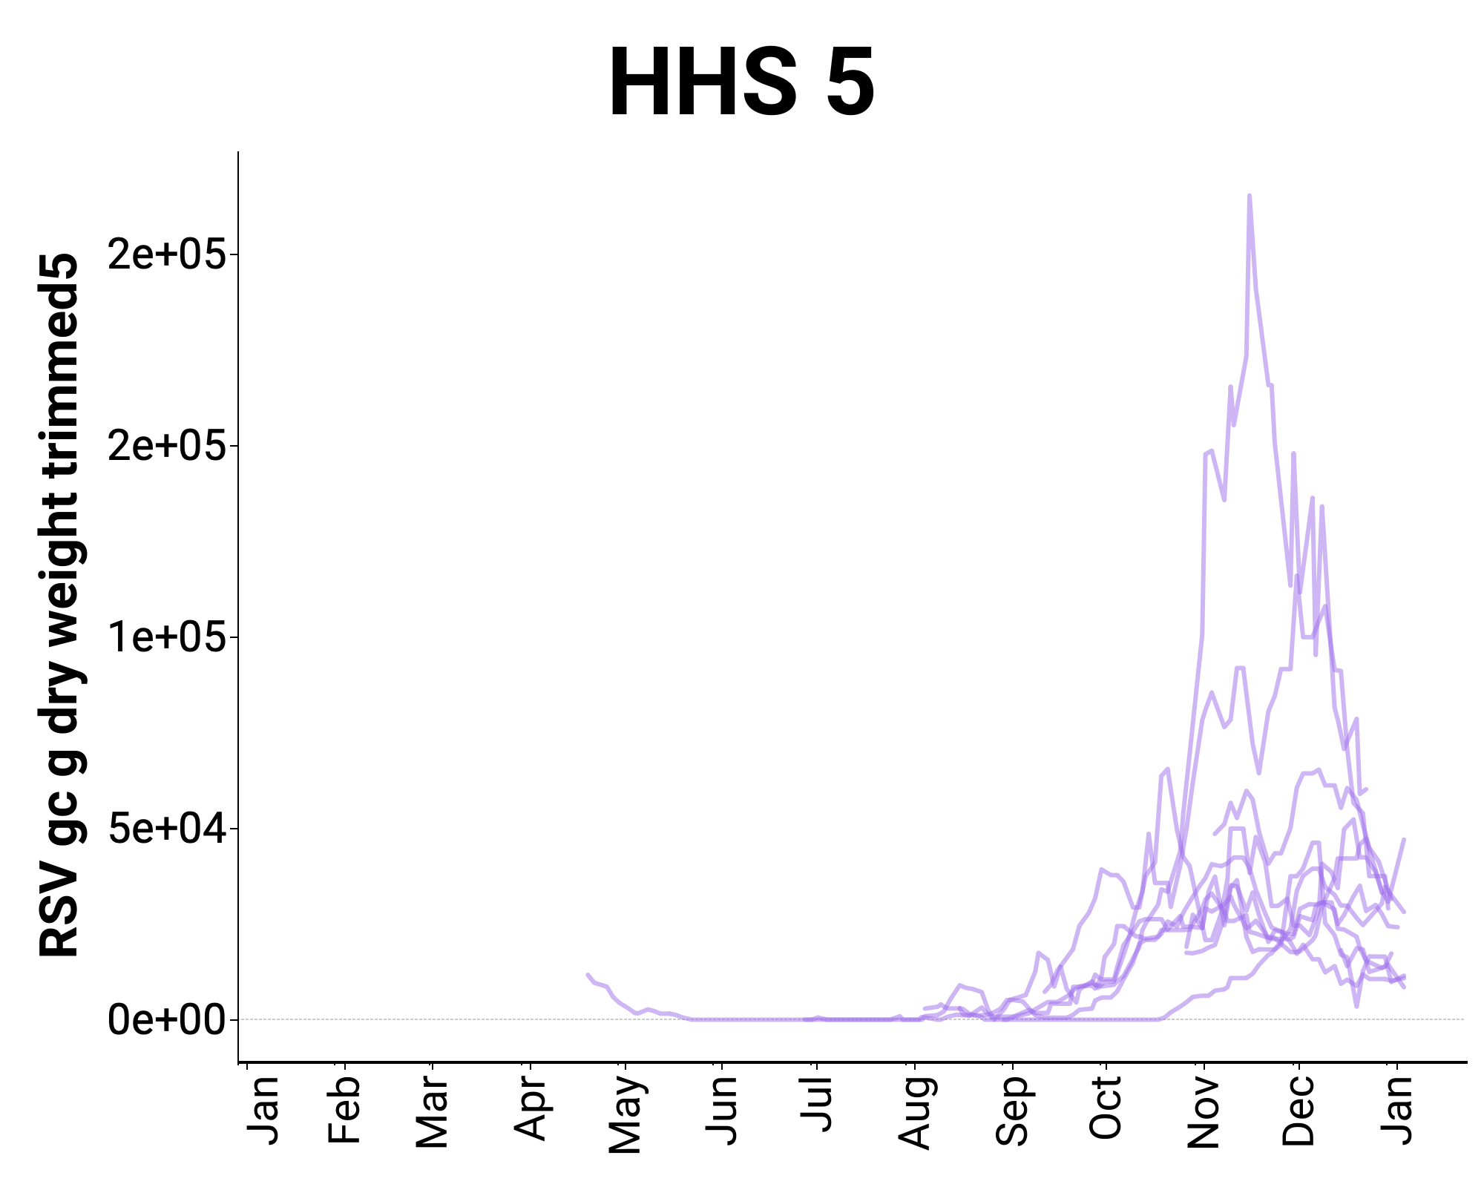
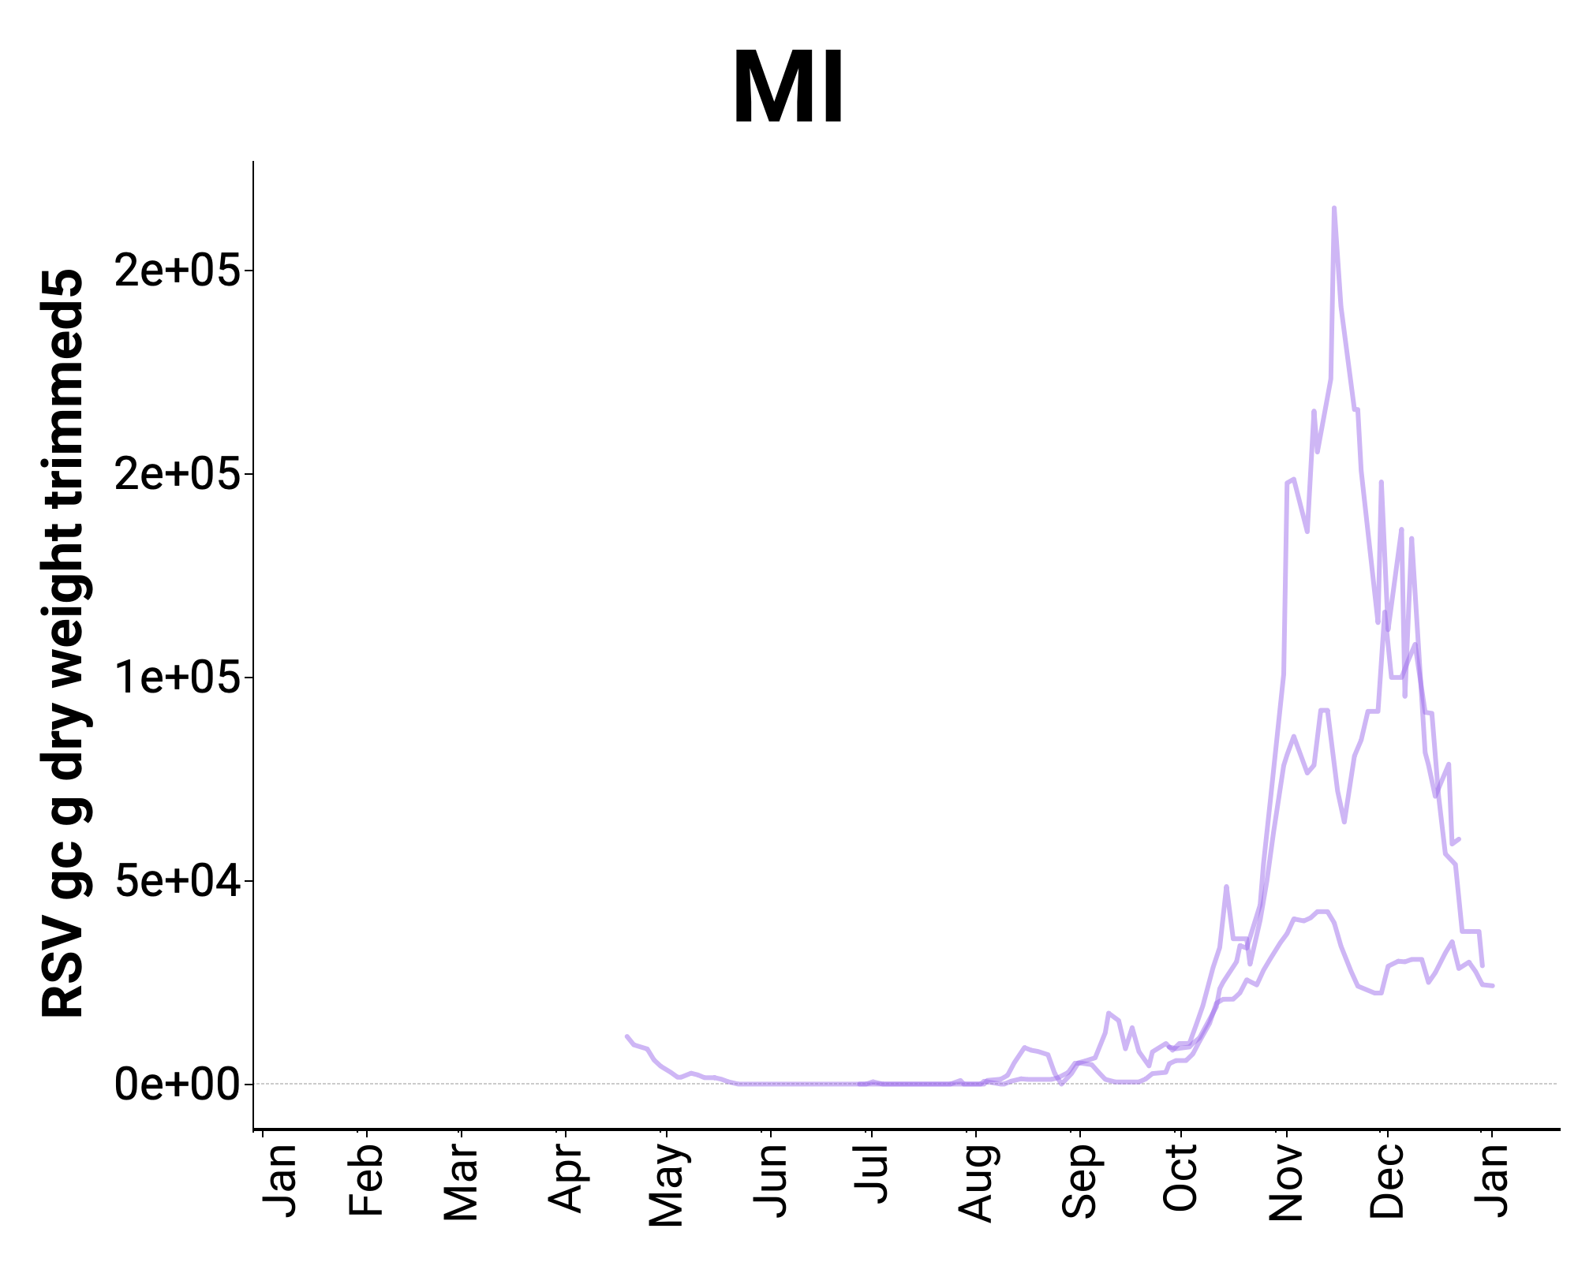
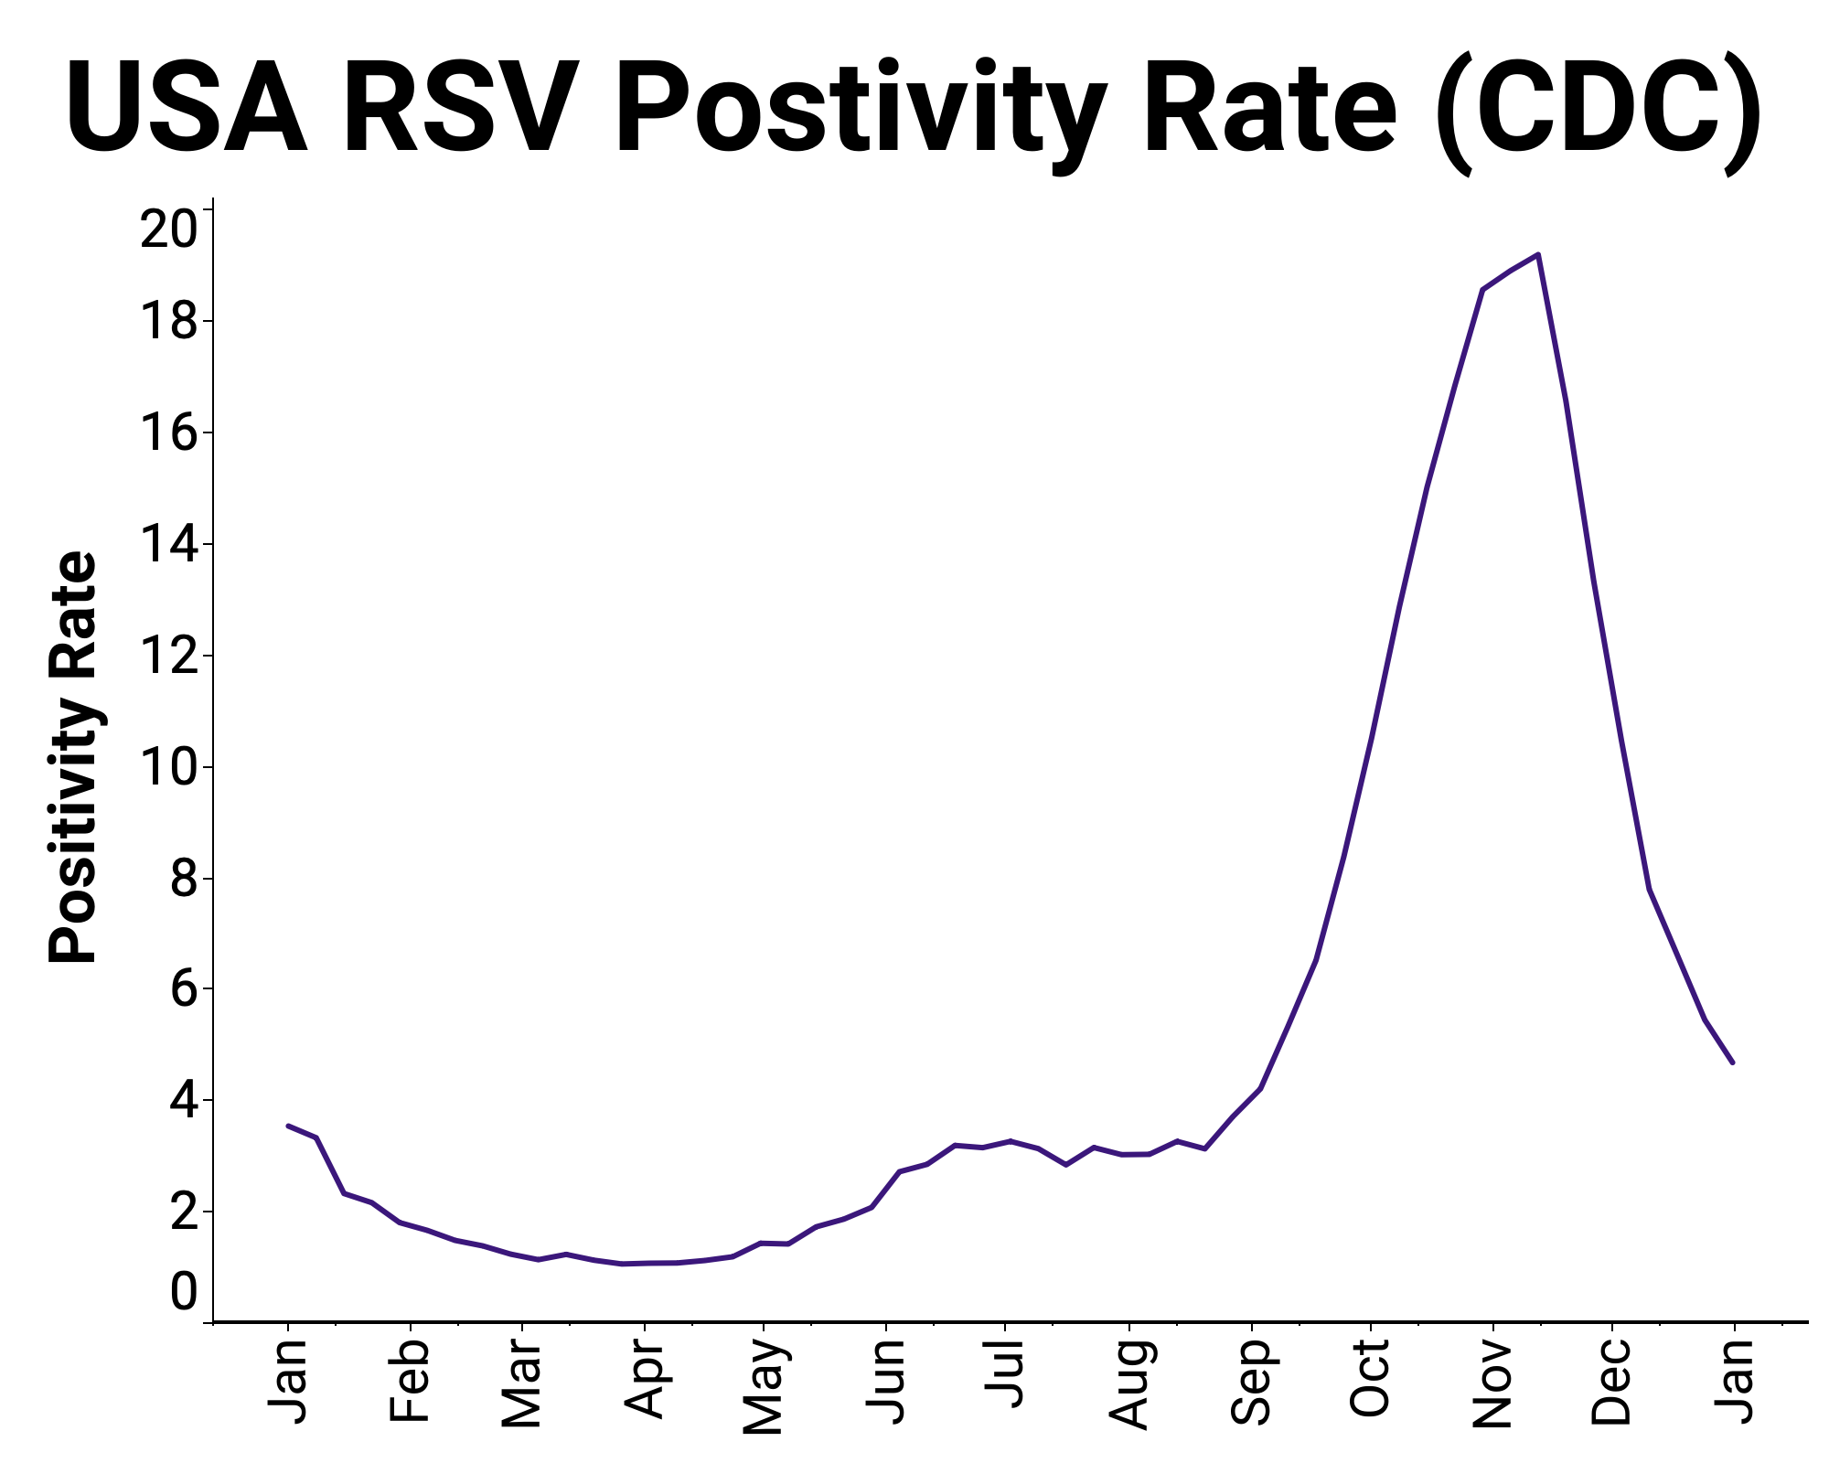
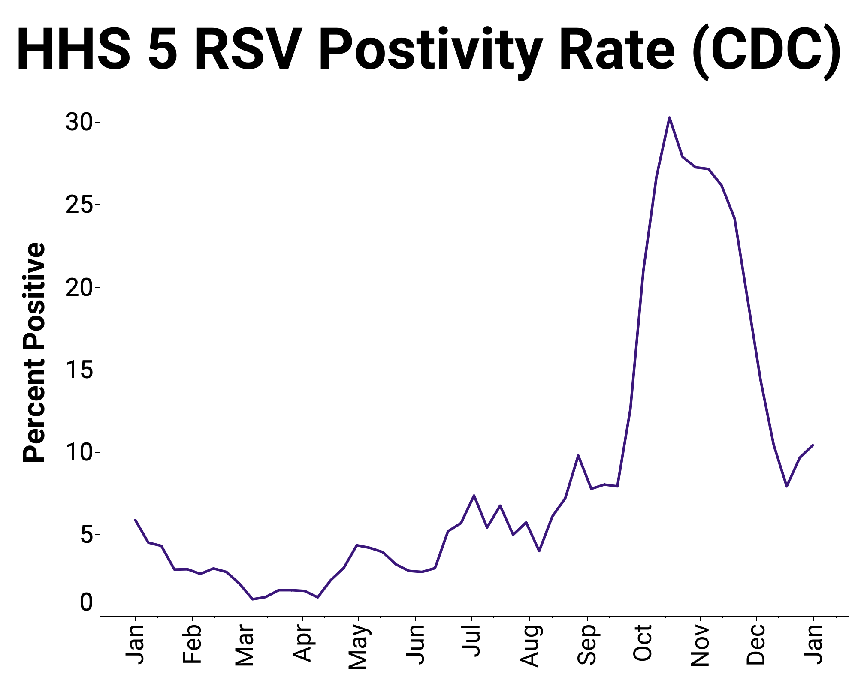
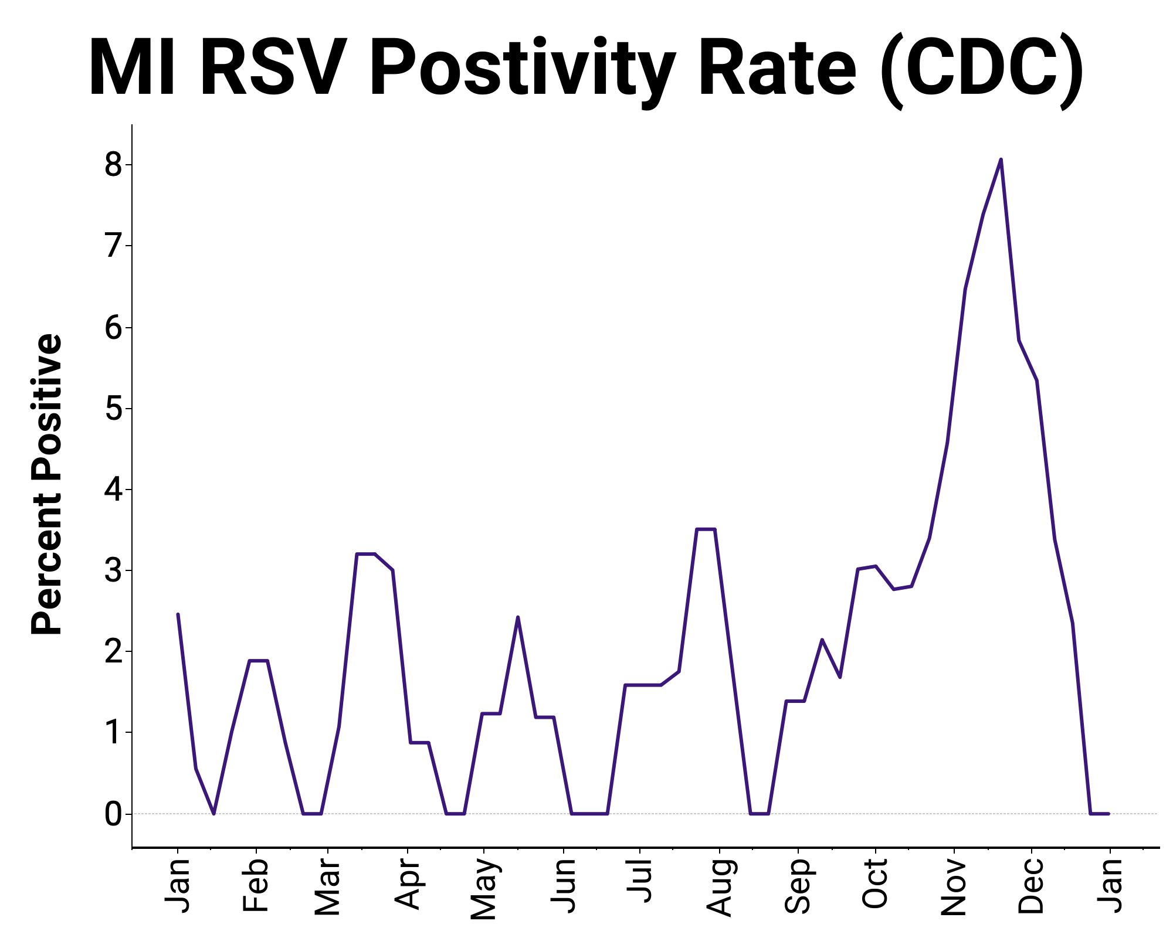
TARGET: RSV
WW & RSV
Surveillance
21-d trends are
⬇ 27/114
⬆ 9/114
Remainder No trend
Clinical data through Dec 31, 2022

Slide 39
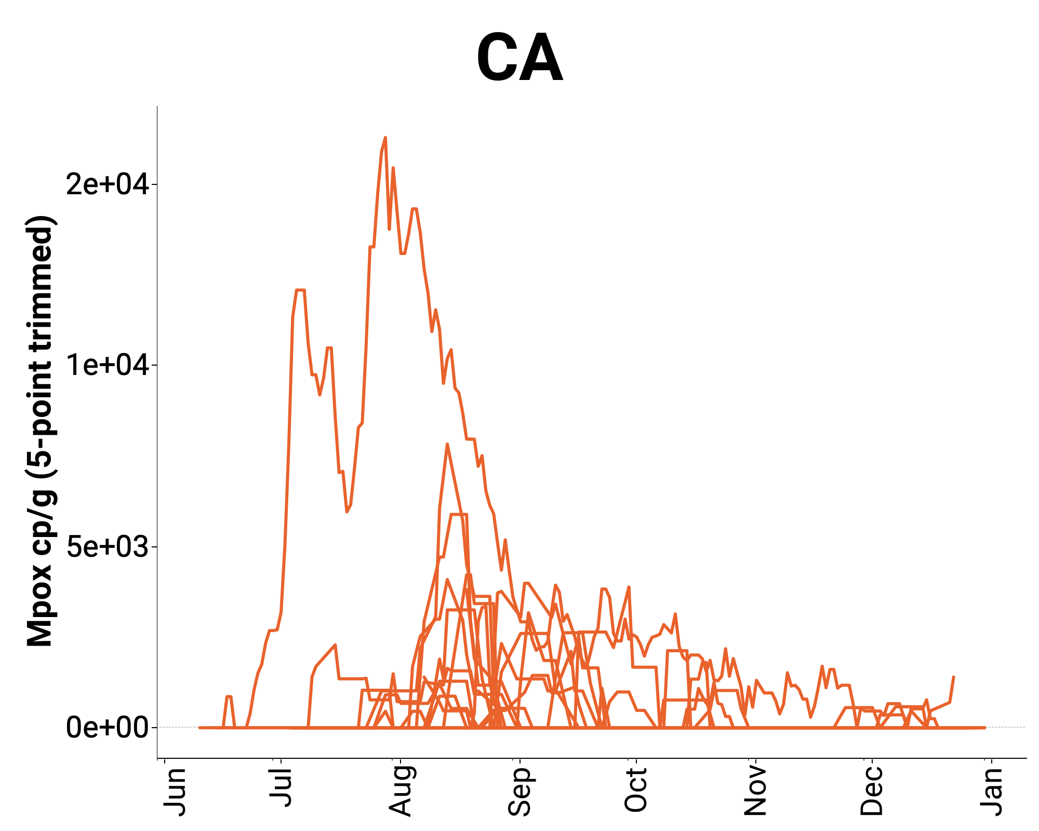
mpox is now the preferred term for “monkeypox,” the usage of which is being phased out by the WHO
TARGET: mpox
Mpox Surveillance
Very few detects (30 positive out 1,219 samples from month of December)
Very few reported cases

Slide 40
WW Surveillance
TARGET: IBV, HMPV, Norovirus
Mid Dec 2022, expanded analysis to include Influenza B, Human Metapneumovirus, and Norovirus GII
Approximately 7 - 9 samples per plant so far
Trend analysis coming soon
 | # Samples | # Detections | Minimum (cp/g) | Maximum (cp/g) | Median Concentration (cp/g)
IBV | 928 | 24 | Non-detect | 42,653 | Non-detect
HMPV | 1365 | 953 | Non-detect | 604,712 | 4,673
Noro | 908 | 908 | 4,928 | 400,532,858 | 9,258,161

Slide 41
Data availability and website

Slide 42
Data are available within 48 hours of sample receipt at the lab
https://wastewaterscan.org/Access to temporary data visualization for all targets
CSV download
of all data is available at the above site, as well.
BUT NEW WEBSITE LAUNCH THIS FRIDAY…

Slide 43
New website - designed by Stamen

Slide 45
Notes:
People will be able to look at sites either individually or plotted together. You can adjust the timeline, look at the data normalized or not, look at the smoothed trendline or individual data points (with or without error bars) either together or separately. You will be able to do this for all of the viruses that we offer. You can also export data and plots, create groups of plots that you can come back to, and embed those plots if you want. We will continue to expand the options for data visualization available here.

Slide 46
Four things to remember
WastewaterSCAN uses scientific approaches described in the peer-reviewed literature
Our flexible measurement platform enables us to scale new assays nationally quickly
We are committed to collaboration with scientists and translation to our utility and public health partners to build capacity across the country
Our methods and data are open and shared with stakeholders
Please contact me if your are interested in participating
aboehm@stanford.edu or join@wastewaterscan.org

Slide 47
Thank you!
Thank you to all of our amazing utility and public health partners participating in this program!
Special thanks to Amanda Bidwell for making numerous plots!
aboehm@stanford.edu
47

Slide 48
Anna Mehrotra, PhD, PE
Wastewater Surveillance Program Director Water Environment Federation

Slide 49
Wastewater Surveillance Challenges and Opportunities for Utilities CWEA/CASA National Webinar on Wastewater Based Epidemiology January 11, 2023 Anna Mehrotra, PhD PE Wastewater Surveillance Program Director Water Environment Federation

Slide 50
“Typical” utility participating in wastewater surveillance
Is located
in any state
but probably in 1 of 11 states
Takes samples at the treatment
plant influent rather than upstream
Serves a larger population than the median population served by all treatment plants

Slide 51
NWSS data
1,246
Sites with current data on COVID Data Tracker
1,222 (98%)
Sites at wastewater treatment plants vs. upstream (% of total)
34,100 (vs. 1,990)
Median population served by NWSS sites (vs. all US WWTPs)
NWSS data based on 1/8/23 download for SARS-CoV-2 from bit.ly/wwmetrics; doesn’t include all NWSS sites or sites not submitting data to CDC
Population data for all US WWTPs based on 2021 WEF data based on NPDES data from EPA’s ECHO database and other sources

Slide 52
Data from 10 state programs*
Number of WWTPs
(total = 4,031)
Total Population Served
by WWTPs (million; total = 109)
Median Population Served
per WWTP
575
28,100
2,540
65.0
*California, Colorado, Missouri, Nebraska, New York, North Carolina, Ohio, Oregon, Utah, Wisconsin
Information for individual state programs taken from public facing dashboards
Count of, and population data for, all WWTPs in each state based on 2021 WEF data based on NPDES data from EPA’s ECHO database and other sources

Slide 53
Challenges
Utilities not participating
Utilities participating

Slide 54
Challenges for utilities not participating
“
”
Not knowing where to start or who to contact
I spoke with our local environmental health department, but they did not have any knowledge of the program.
Laboratory Director at Maryland utility

Slide 55
Challenges for utilities not participating
“
Not knowing where to start or who to contact
Not having enough time/staff/resources
”
I … have quarterly sampling that needs to be done and out that day and I'm the only licensed operator that’s able to collect samples. I appreciate the invite.
Chief Operator at Virginia utility

Slide 56
Challenges for utilities not participating
Not knowing where to start or who to contact
Not having enough time/staff/resources
Not being able to convince leadership of the value in participating
“
”
There is a belief that COVID is over and so it doesn’t make sense to use our resources for this.
Superintendent at South Dakota utility

Slide 57
Challenges for utilities already participating
Understanding how all the programs fit together
“Do you know anything about ____?”

Slide 58
Challenges for utilities already participating
Understanding how all the programs fit together
Consistently interpreting data for, and communicating data to, the public
“If we’ve had some hang up … and the [dashboard] is not updated … we will hear about it.”
Kyle Curtis from nwbe.org podcast episode #2

Slide 59
Challenges for utilities already participating
Understanding how all the programs fit together
Consistently interpreting data for, and communicating data to, the public
Addressing questions about long-term funding and the value beyond COVID
“There’s a huge desire to … be involved. It’s always about resources.”
Norma Ruecker from nwbe.org podcast episode #10

Slide 60
Challenges for utilities already participating
Understanding how all the programs fit together
Consistently interpreting data for, and communicating data to, the public
Addressing questions about long-term funding and the value beyond COVID
Managing concerns about archived samples being tested without the utility’s knowledge

Slide 61
Opportunities
Support utility mission
Poll results from May 2022 Utilities CoP meeting

Slide 62
Opportunities
it brings great awareness to the importance of our wastewater collection and treatment systems
“It brings great awareness to the importance of our wastewater collection and treatment systems.”
Operations Administrative Manager of Oklahoma utility
Engage with public
“‘I love looking at the wastewater data,’ said no one prior to the Covid pandemic…. but here we are.”
Dr. Vincent Chiang, Chief Medical Officer at Boston Children’s Hospital

Slide 63
Opportunities
Expand collaborations
Poll results from May 2022 Utilities CoP meeting
Responses on Utilities CoP enrollment form (as of 1/8/23)

Slide 64
Opportunities
Inform potable reuse
it brings great awareness to the importance of our wastewater collection and treatment systems
Gerrity, Papp & Pecson
ACS EST Water January 2022

Slide 65
Get in touch Anna Mehrotra, PhD PE amehrotra@wef.org nwbe.org

Slide 66
Naoko Munakata
Supervising Engineer, Wastewater Research Section Los Angeles County Sanitation Districts

Slide 67
Wastewater Surveillance:
A Utility Perspective on Implementation
Naoko Munakata
January 11, 2023

Slide 68
LACSD work on wastewater surveillance
Data sharing started
Utilities Community of Practice
Lab method developed
Jan 2020
Jan 2021
Jan 2022
Research Support
Routine sampling & analysis started
Phase 1
Phase 2
Phase 3
HHS/CDC National sampling programs

Slide 69
Considerations for Wastewater Surveillance
$
Logistics & Planning
Data Sharing
Data Limitations
Resources & Information
Credit, right image derived from: https://www.opennetworkedlearning.se/blog/author/nosiphiwo/ by Unknown Author is licensed under CC BY-NC

Slide 70
Considerations: logistics and planning
Sampling
Frequency: How often? Which days?
Type: influent/solids, composite/grab
Volume
Integrate into existing sampling if possible
Other Logistics
Meta-data
Shipping
Planning
Staffing/costs/ resources
Program duration
Credit, right image: https://www.pngall.com/team-work-png/download/13214 by Unknown Author is licensed under CC BY-NC

Slide 71
Considerations: data sharing
Who can access the data?
Utility
Health department
CDC
Public
How will data be shared?
Lab to utility
Lab to health department
Lab to CDC’s DCIPHER database
Public dashboard
Other
Turnaround time
Privacy/ethical issues
Credit, left image: https://virgiliocervantes.co.uk/index.php/tag/data-transfers/ licensed under CC BY
Credit, middle image: derived from image obtained from Rasha Maal-Bared

Slide 72
Considerations: data limitations
Data quality and noise
Solutions: statistics (averaging, trimming), context

Slide 73
Considerations: data limitations
No standardized method
73

Slide 74
Considerations: resources
Public Health Departments
Labs
Wastewater Sector Groups
Utilities Community of Practice

Slide 75
Utilities Community of Practice: nwbe.org
Monthly virtual meetings with presentations, discussions, and updates from CDC
Answers to Frequently Asked Questions
Cost calculator and budgeting guidance
Online library with templates, videos, other resources
Discussion board
Regular email updates

Slide 76
Example: Joining a Surveillance Program
Logistics
Targets
Sampling
Metadata
Cost
Program duration
Courier handling
Turnaround time
Communication
Is the Public Health Department on board?
Are they responsive to questions/issues?
Do they share timely info?
Data Sharing/Privacy
Are data accessible to Public Health, the utility, & public?
Are samples archived, and how can they be used in the future?
Could results lead to stigma?
Credit, middle image: derived from image obtained from Rasha Maal-Bared
Credit, right image: https://virgiliocervantes.co.uk/index.php/tag/data-transfers/ licensed under CC BY

Slide 77
Example: Poliovirus Surveillance – To Do or Not to Do?
Data
CDC method under development
Possible false positives – strains look similar
Data interpretation - positive hit may not be a concern, only very targeted surveillance appropriate
Privacy/ethical concerns
Communication
Is Public Health coordinating?
Does Public Health have communication and response plans?
Logistics
Wastewater or clinical samples could trigger containment guidance for PPE and sample handling, storage, access, reporting, and disposal
Credit, left image: https://virgiliocervantes.co.uk/index.php/tag/data-transfers/ licensed under CC BY
Credit, middle image: derived from image obtained from Rasha Maal-Bared

Slide 78
Summary
Utilities play a key role in wastewater surveillance
Issues to consider for surveillance decisions: logistics, data sharing and limitations, resources and information
Resources are available: sample shipping/analysis, information
Wastewater surveillance can be used for a variety of public health issues and will continue for the long-term

Slide 79
Andrew Abram
Wastewater Surveillance Epidemiologist
California Department of Public Health
Coronavirus Science Branch, Surveillance Section

Slide 80
California Surveillance of Wastewaters
(Cal-SuWers)
CWEA/CASA: Wastewater Based Surveillance Webinar
January 11, 2023
Andrew Abram
Wastewater Surveillance Epidemiologist
California Department of Public Health
Coronavirus Science Branch, Surveillance Section
andrew.abram@cdph.ca.gov

Slide 81
Outline
Advantages of Wastewater Based Epidemiology and informing public health action
Wastewater Surveillance for SARS-CoV-2 in CA -Timeline of progress
Building & maintaining the CA Surveillance of Wastewaters (Cal-SuWers Network)
Data streams, reporting & information sharing
Expansion to new locations -incentivizing Utility partner participation
Additional targets & integration into existing PH infrastructure (cross Dept. collaboration)

Slide 82
Advantages of Wastewater Surveillance
Timely
Faster – no need to collate individual data
Potential Early indicator
Complete
Independent of symptoms, test kit availability, access to health care, test-seeking behavior
Variant detection
Other pathogens
Affordable
Less Expensive
One sample – broad coverage
Community-level information
Actionable
Informs Public Health decision making
Increases awareness
Guides messaging
Directs resource allocation
Notes:
Some of the advantages of ww surveillance over other forms of ph surveillance.
Completeness; Unless on a septic system, people are shedding into the sewage system.
Actionable; Directs resource allocation (should we scale up clinical testing in an area? Should we be expecting a hospital surge and scale up resources to brace for the impact? Should we increase vaccination campaigns in an area? Should we change masking guidance based on what is happening in our surveillance systems?

Slide 83
Wastewater surveillance milestones & roadmap
Researchers in Netherlands, Australia & US successfully detect virus in wastewater
CDPH partners
with SWRCB &
six treatment
plants –
pilot project
CDPH routinely
monitoring at
13 sites. CDPH
WBE lab established
CDPH awarded
continued funding,
expansion planning
Mar 2020
Jan 2021
Jan 2022
July 2022
Sept 2020
July 2021
Mar 2022
Spring 2023
U.S. CDC
establishes
the NWSS
CDPH receives
funding for
expansion
CA SMARTER
Plan includes
wastewater
surveillance
CDPH WBE lab
expands capacity
to routinely
monitor at ~75 sites
Notes:
Brief summary of wastewater based epidemiology progress in CA.
Early in the pandemic in Mar 2020, Researchers were able to detect SARS-CoV-2 RNA in wastewater and many groups across the country began work to validate their methods of wastewater surveillance
In Sep. of 2020 the CDC National Wastewater Surveillance System (NWSS) was established to guide and provide national leadership for WBE. Jurisdictions applied for pilot funding including in CA
In Jan 2021 the State Water Resources Control Board (SWRCB) & CDPH initiate a partnership to pilot WBE at six treatment plants across the state
In July 2021 CDPH received funding for an expansion of this pilot project through CDC (Epidemiology and laboratory capacity (ELC))
Jan 2022 we were then able to monitor at 13 sites with the opening and establishment of our CDPH Wastewater Based Epidemiology lab (WBE) housed in the Drinking Water and Radiation Lab (DWRL) at CDPH
In Mar 2022 The CA Gov.’s SMARTER plan began including ww surveillance, and in July of 2022 we were awarded funds to further expand ww surveillance in CA
By Spring 2023 we hope to expand our CDPH lab to have capacity to take over the surveillance of the roughly 75 sites in CA
This track record shows a growing interest in funding WBE in CA and a growing belief that ww based epidemiology is a useful and integral tool in the toolkit of public health surveillance and action. But how did we manage to get here? The short answer is through partnership and collaboration across a wide swath of different institutions which I will outline here

Slide 84
Network of Partnership & Collaboration
Cal-SuWers Network consists of:
CDPH National Wastewater Surveillance System (NWSS):
Includes 13 Local health jurisdictions and 16 wastewater utilities
Laboratory analysis conducted at CDPH Drinking Water and Radiation Lab (DWRL)
Collaboration w/ California State Water Resources Control Board for collation and management of data (ODP)
Additional SMARTER-plan expansion sites (analyzed by Verily)
Cal-SuWers Network Partners: Independent wastewater analysis, contribute data to CDPH
SCAN (Sewer Coronavirus Alert Network) - Stanford University, Emory University and University of Michigan – Dashboard
Including: 8 long standing research sites
WastewaterSCAN
Expansion of SCAN nation-wide with ~30 CA sites- Dashboard
SCAN, HCVT and WastewaterSCAN data processed by Verily
UC Davis / UC Merced - Healthy Central Valley Together (HCVT) – Dashboard
Including: 7 sites
All Verily monitored sites currently measure for SC2 variants, MPXV, Flu, RSV, hmpv, norovirus
UC San Diego/SEARCH - Dashboard
UC Berkeley Covid-WEB (Wastewater Epidemiology for the Bay Area) – Dashboard
No longer analyzing data, dashboard with historical data only
CDC Contract Laboratory (Biobot)
Including: ~20 sites (currently in transition)
Overall Coverage
~70 WWTPs
31/58 Counties
Approximately 26 Million
<60% of CA Population
Cal-SuWers Network is part of CDC’s National Wastewater Surveillance System (NWSS)
CDPH Wastewater Website and Dashboard
CA NWSS data publicly available on CA Open Data Portal
Notes:
Data for all these network sites are compiled by CDPH, and reported to CDC’s NWSS DCIPHER platform which is then displayed on the nationwide COVID data tracker which is a public facing dashboard

Slide 85
California Surveillance of Wastewaters (Cal-SuWers) Network
CDPH Expansion Goals
Represent 50% of CA population
At least one site in 50% of counties of each HO region (Northern CA, Greater Sac and San Joaquin Valley)
Improve equity
Transition all sites to state lab (DWRL) by Spring 2023
Add sequencing
Influenza/RSV surveillance by Winter 2022 at DWRL
Notes:
Here I would like to present where we are heading with our SMARTER plan goals and outline our California Surveillance of Wastewaters or Cal-SuWers network.
Our first goal has been reached with wastewater surveillance of SARS-CoV-2 covering 50% or more of the Ca population

Slide 86
Benefits of Joining
Covering cost of sample collection materials, shipping and lab analysis
Provide logistic support for pick up and shipping
Flexible & alternative sampling schedules
Monthly office hours for local partners (health departments and utilities)
Teams channel & forum
Resource repository (utility safety documents, protocols, talking points, articles/journals)
Financial support (stipend, auto-sampler)
Protecting public health
Questions? Contact:
wws@cdph.ca.gov
Notes:
Here I would like to point out the benefits of joining from a utility perspective, and cover any barriers to joining and how they might be reduced
•Flexible & alternative sampling schedules – We can be a bit flexible about frequency and which days are easiest for utility to sample; integrate into existing sampling if possible. Also, which sampling type is most reasonable for a utility?: influent sampling using an autosampler, or solids sampling taken from primary clarifier as a grab sample.
We have some different ways to connect, discuss and troubleshoot:
•Monthly office hours for local partners (health departments, utilities, and labs)
•Teams channel & forum – which includes a discussion board for Utilites & LHJs and a lab focused discussion board
•Also, within this forum we have a Resource repository (utility safety documents, protocols, talking points, articles/journals)
•Financial support (stipend, auto-sampler)
And finally, knowing that by participating, you are protecting public health. The more we know about what is happening in our communities the more we can act.

Slide 87
Acknowledgements
CDPH
Cal-SuWers (Wastewater Team)
Duc Vugia, MD, MPH
Alexander Yu, MD, MPH
Angela Rabe, MS
Andrew Abram, MPH
Kelvin Wong, PhD
Madhura Rane, PhD
Elisabeth Burnor, MS
Joel Rojas, MS
Caroline Collins, MPH
Marisa Donnelly, PhD
Isobel Routledge, PhD
Stephanie Bertsch-Merbach
State Water Resources Control Board
Academic Partners
SCAN/Stanford/Emory/Umich
UC Berkeley
UC Davis, UC Merced
UC San Diego
Local Health Departments
Utilities
Many, many thanks to the hard work of our Utility partners
Epi, Data and Surveillance Teams
Modeling
Genomic Epidemiology
VRDL
Leadership
CDC
Epidemiology and Laboratory Capacity Grant
NWSS

Slide 88
Thank You!
Sponsored by
gtmolecular.com

Slide 89
Sponsored by
gtmolecular.com
© 2023 California Water Environment Association (CWEA)

