Slide 1

One Water: The Power of One and the Promise of Many
CWEA WEBINAR, August 24, 2022

Slide 2
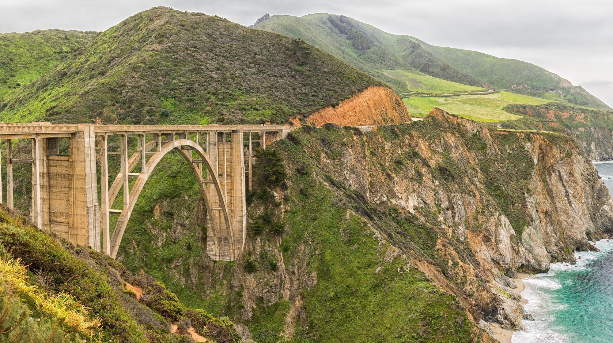
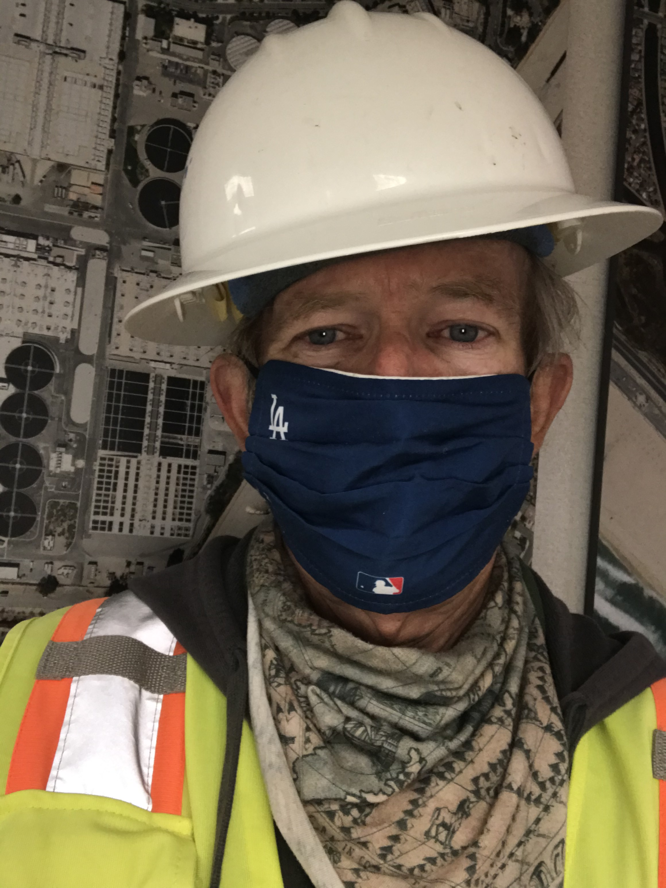

Brian Peck
MODERATOR
Project Manager
Project Partners
Notes:
Please DON’T put speakers agency logo on the slide. It will not look good.

Slide 3

UPCOMING EVENTS
Oct
18th
Seismic Considerations For Water
Infrastructure: Displacement Hazard
Analysis And Soil Liquefaction
SARBS Online Webinar Series
TBD
Achieving Class A Biosolids With Temperature
Phased Anaerobic Digester Facility
SARBS Online Webinar Series

Slide 4






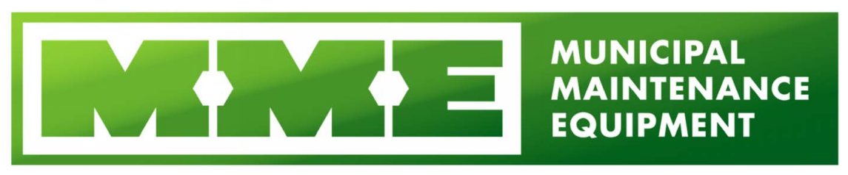



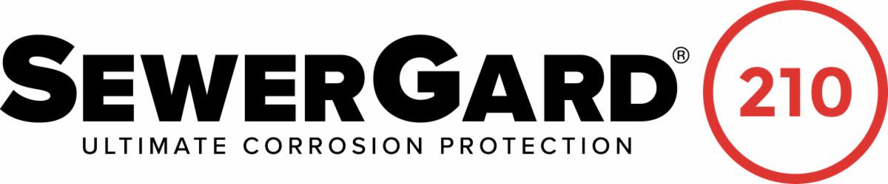





This is made possible by the following sponsors

Slide 5
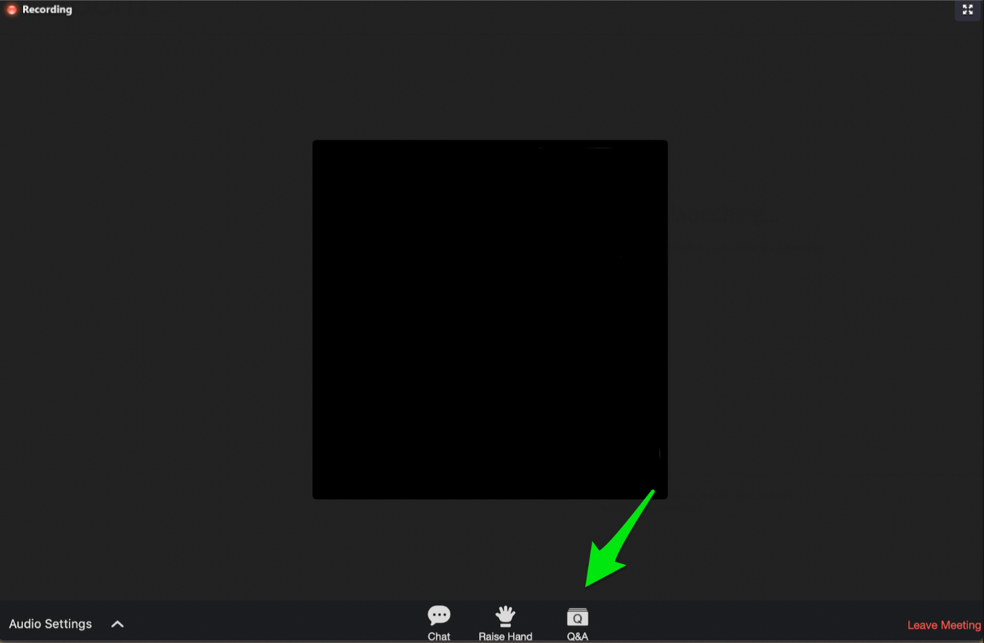
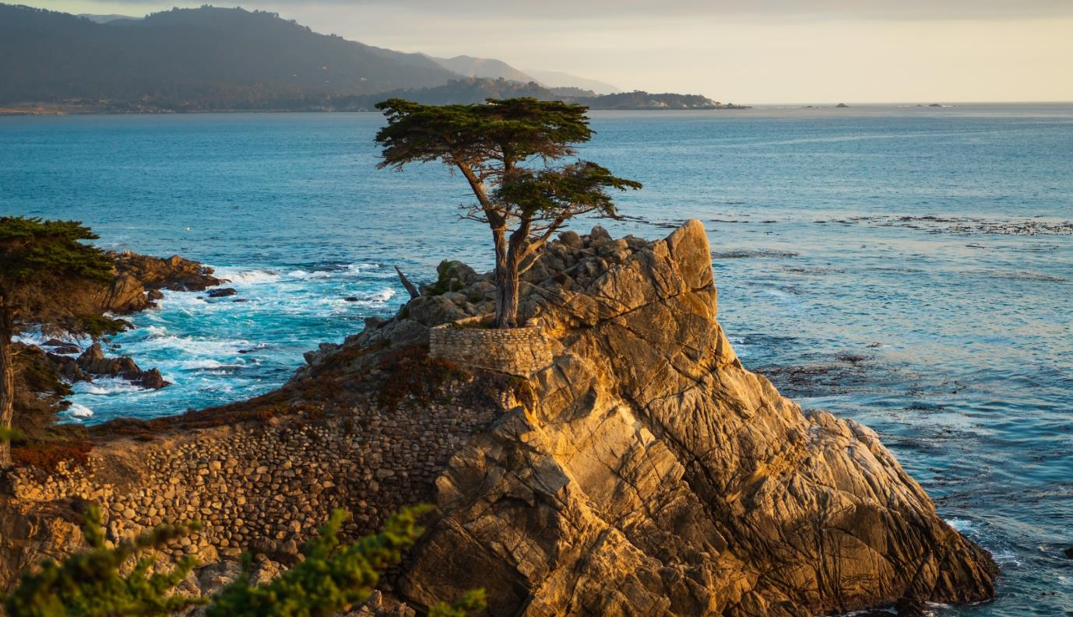
Zoom Controls: Chat for Comments

Slide 6
Zoom Controls: Q&A for Questions

Slide 7
Zoom Controls: Raise Hand Feature Not Used in Today’s Webinar

Slide 8

Attention Check Code
####
Watch for The Attention Check Code in Top LEFT Corner of Screen

Slide 9

Process for Claiming Contact Hours for
this Webinar
Note the different attention check code(s) that will appear for 60-90 seconds in the top left or right corner of the presentation.
Log in to https://owen.cwea.org/ the Online Wastewater Education Network (OWEN) with your mycwea.org account info and find this program in “Your Dashboard”.
Under the "Contents" tab, enter the correct attention check codes in the “Attention Check Code” component within 48 hours of the live webinar.
Your contact hours will be reflected in your mycwea.org account within 2-3 weeks following completion.

Slide 10
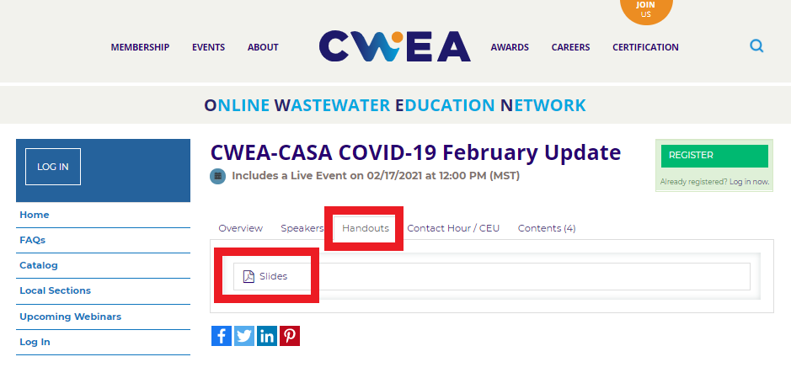
Slides/Handouts Can Be Found on OWEN under the Handouts Tab

Slide 11
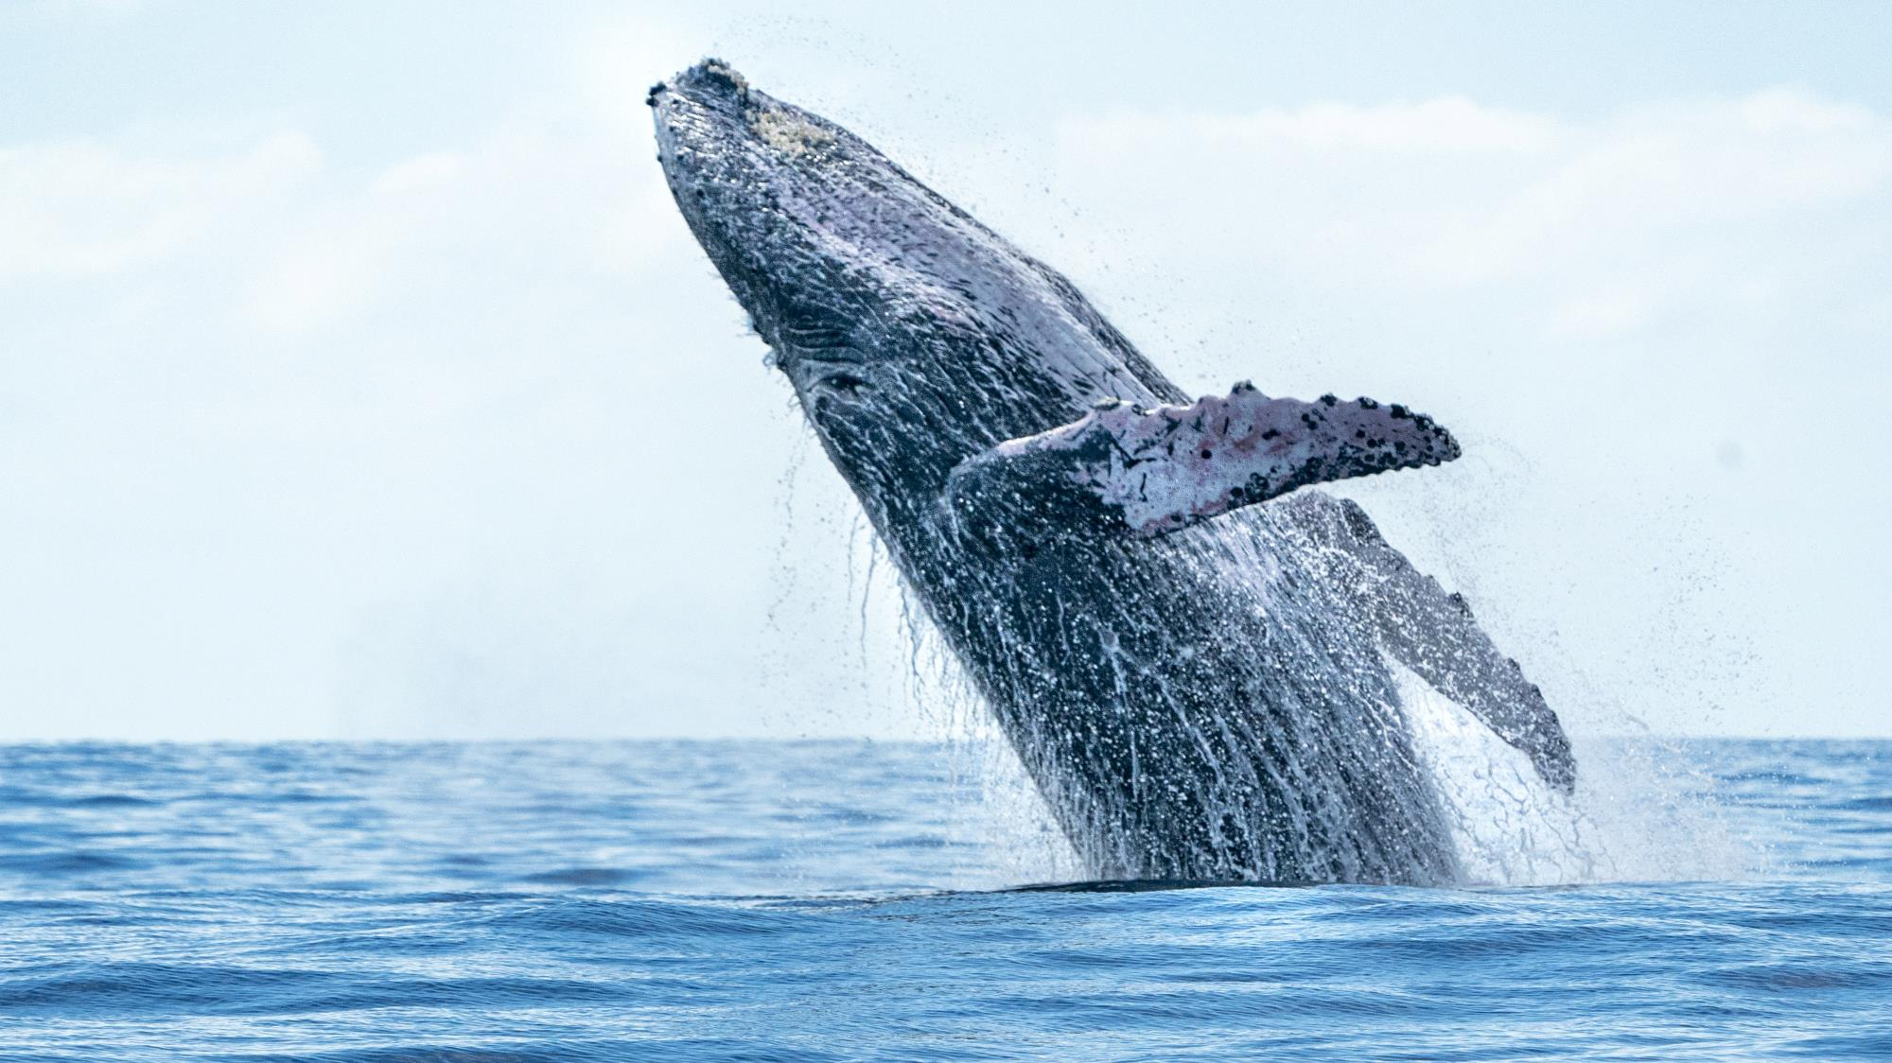
CWEA, its Board members and
volunteers are not responsible for the
actions of speakers or the content of their
sessions. No endorsement is implied or
given of any persons or their philosophies,
ideas or statements; nor of any products
or processes; nor of any organizations
or companies who volunteer to serve as
speakers in educational programs.
For reporters: all speakers today are off the record.

Slide 12
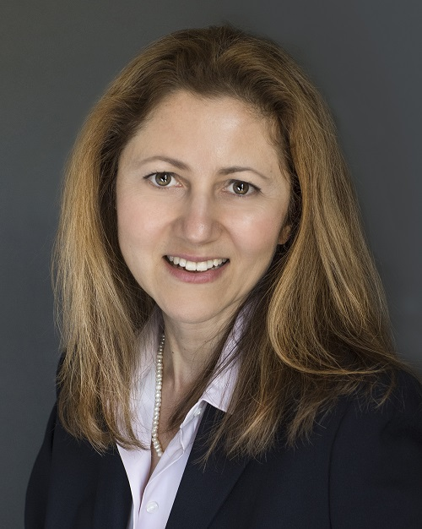
Zeynep Erdal
Integrated Solutions Director
Black & Veatch

Slide 13
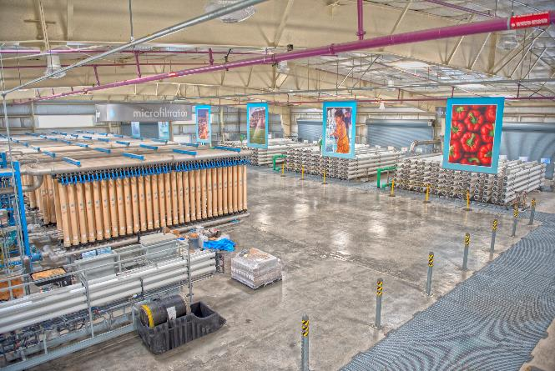
SARBS Professional Development Committee
One Water: The Power of One and the Promise of Many
August 24, 2022
Zeynep Erdal, PhD, PE
Santa Clara Valley Water District – Advanced Water Purification Center
Integrated Solutions Director

Slide 14
Agenda
What Is Water Resilience - Defining the Problem
One Water Improving Water Resilience
Case Studies
Q&A

Slide 15
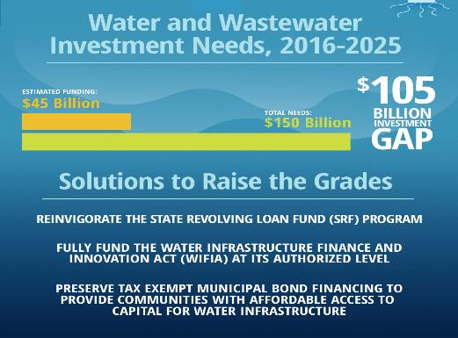
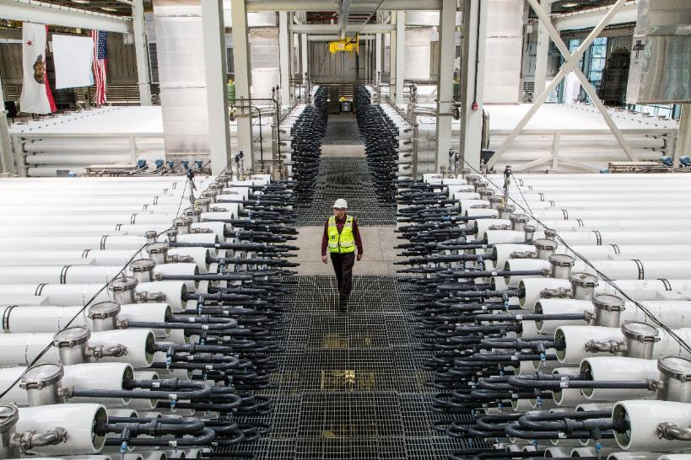
What is Water Resilience?
Having a reliable water supply that can adapt and respond to change
Reliability/Adaptability
  Affordable
  Treatment flexibility to manage variable feed water quality
  Robust to produce high quality treated water
  Minimize environmental pollution
OCWD/OCSD – Groundwater Replenishment System

Slide 16
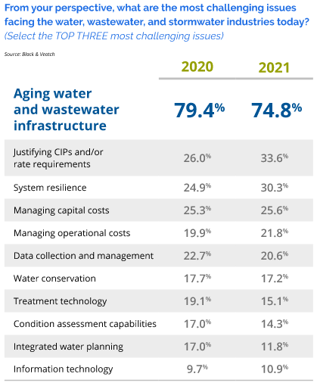
State of Water Industry
$$ is the main concern
Treatment technologies – “we got this!”
Additional challenges on the way
Bridging “today” to a resilient future – how to best do it?

Slide 17
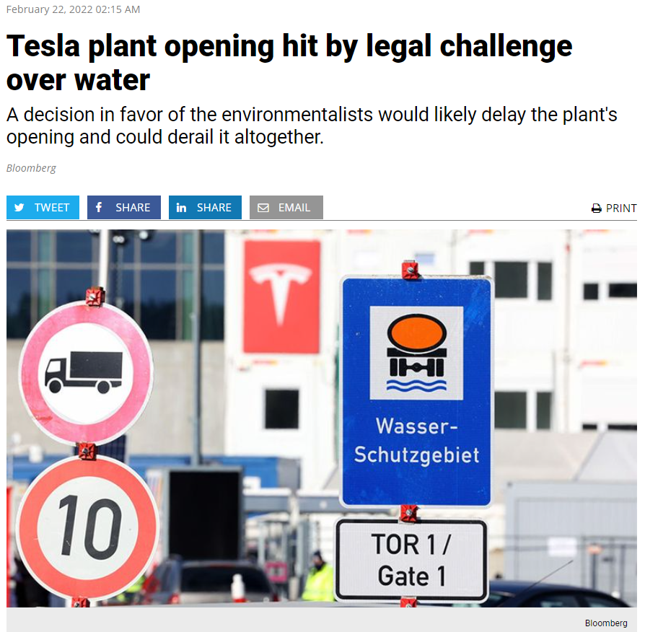
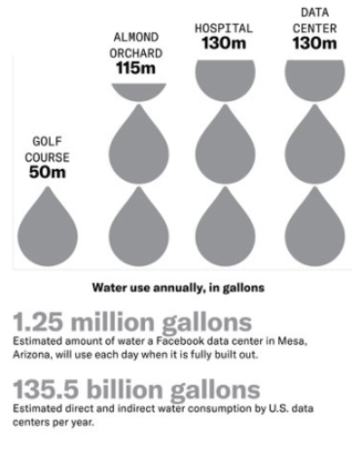
Increasing Demand on Water Resources

Slide 18
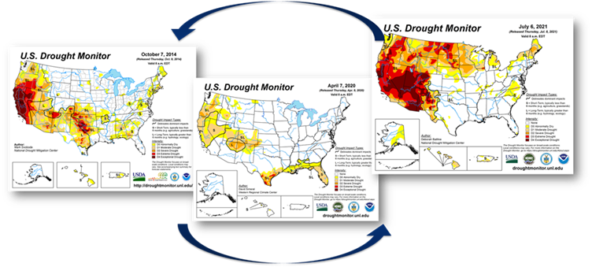

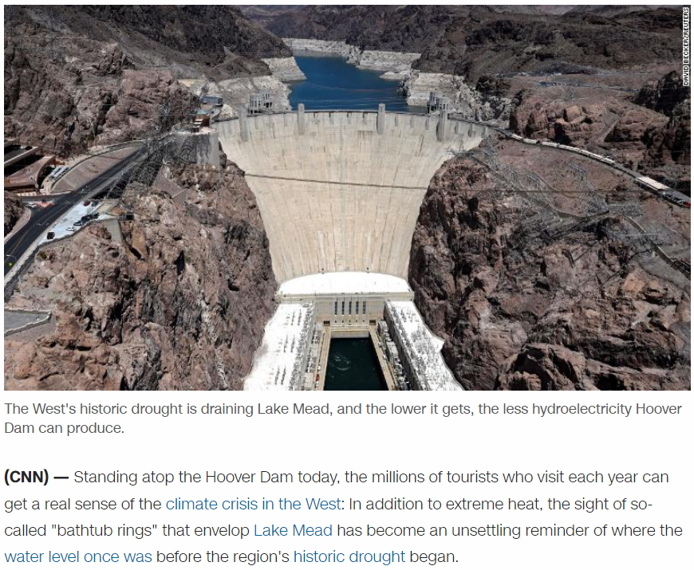
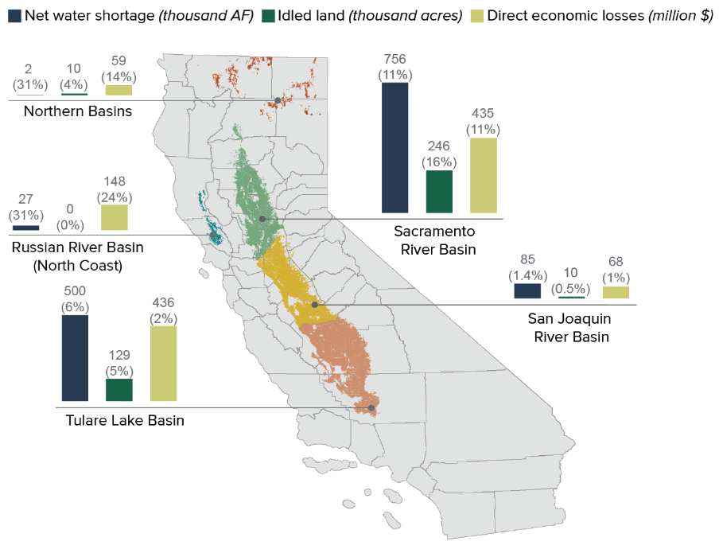

Water Resources are Inextricably Tied to Other Resources – Energy, Nutrients and Food

Slide 19
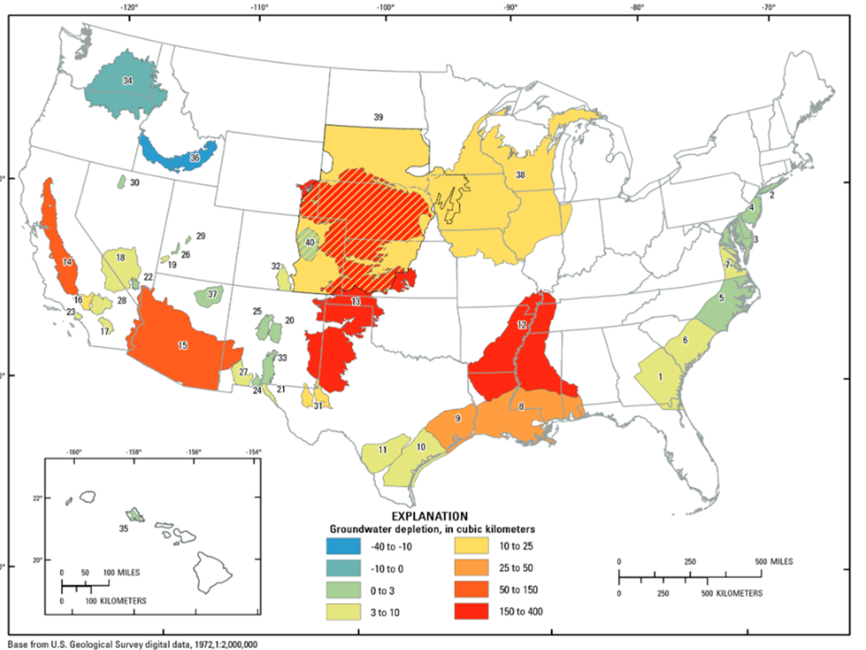
Groundwater Extractions and Subsidence
Limited withdrawals
Subsidence
Seawater intrusion
Source: USGS.gov

Slide 20
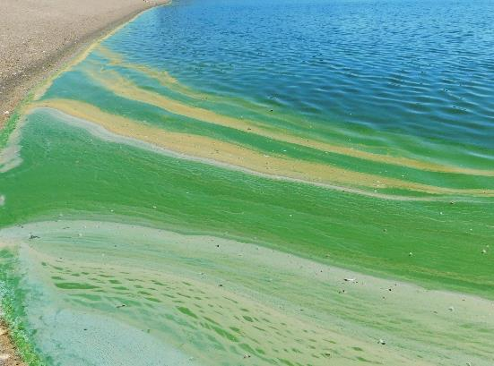
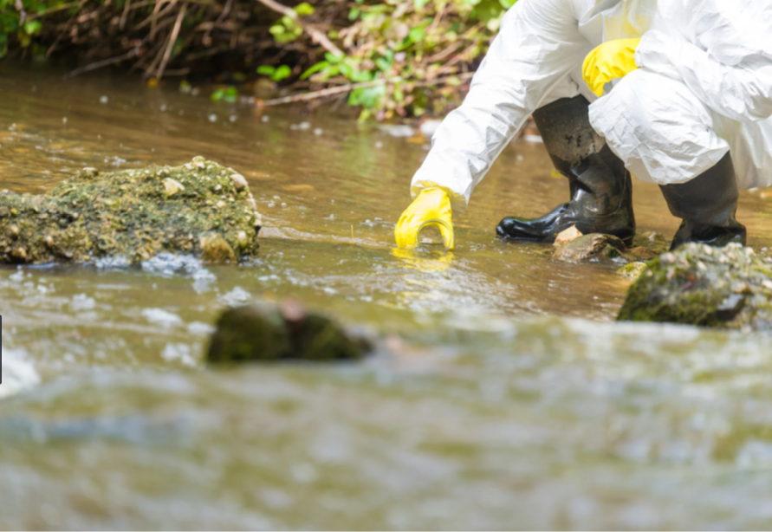
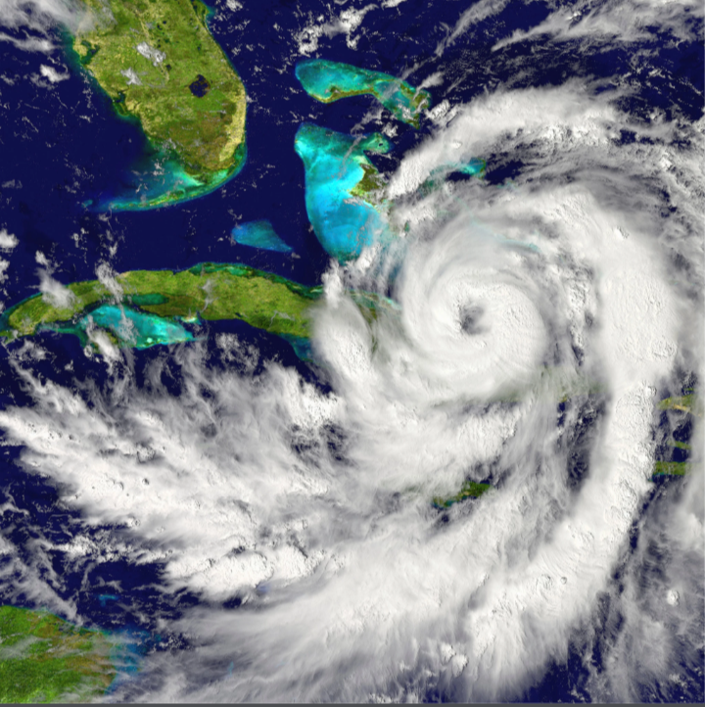
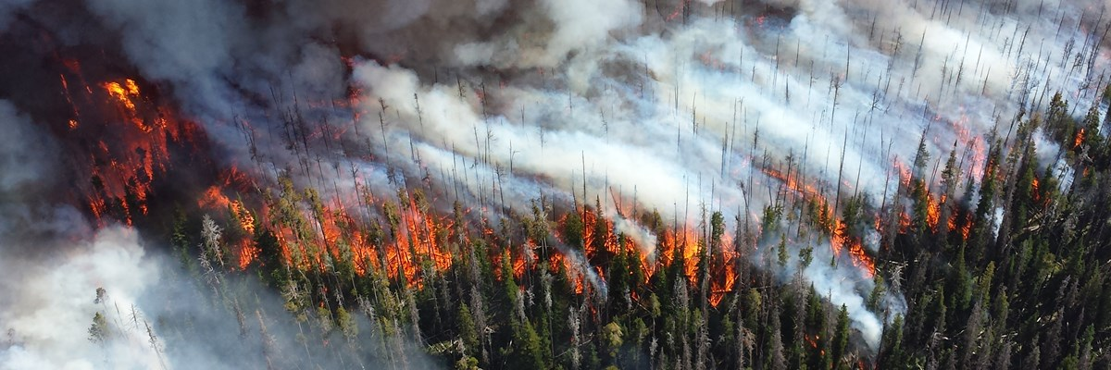
Climate Change Resulting in Water
Quality Changes
Algal blooms
Point- and non-point sources of pollution
Fires and hurricanes

Slide 21
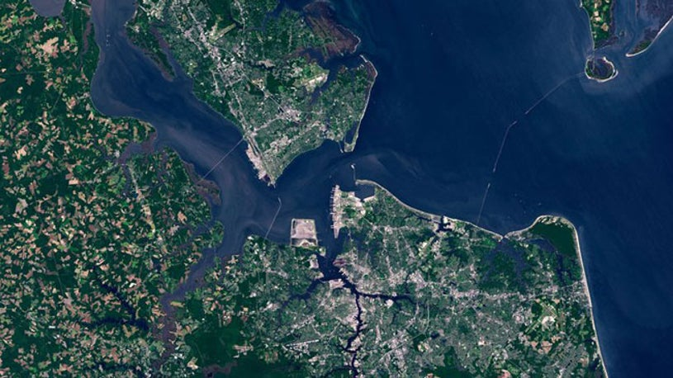
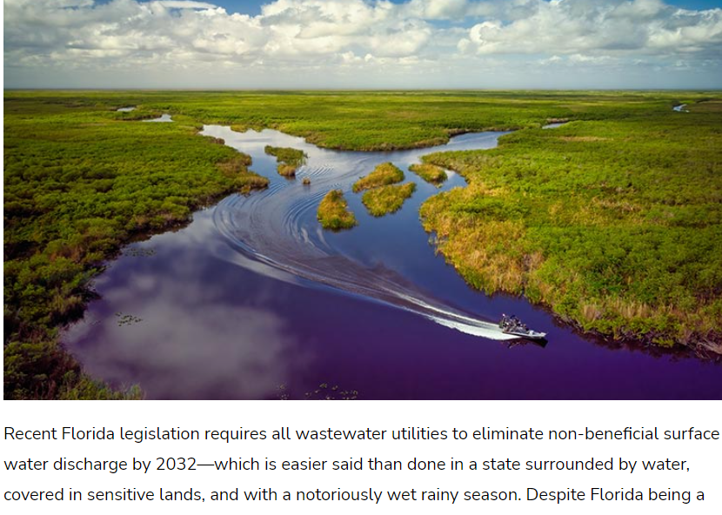
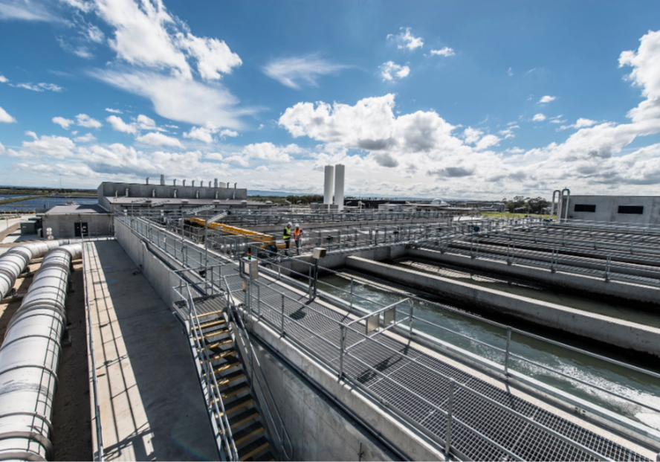
Wastewater Discharge Limitations
Increasingly restrictive water quality requirements for municipal effluent
Elimination of WW discharges and ocean outfalls through regulatory action
Hampton Roads and Norfolk, VA
Eastern Treatment Plant – Melbourne, AU

Slide 22
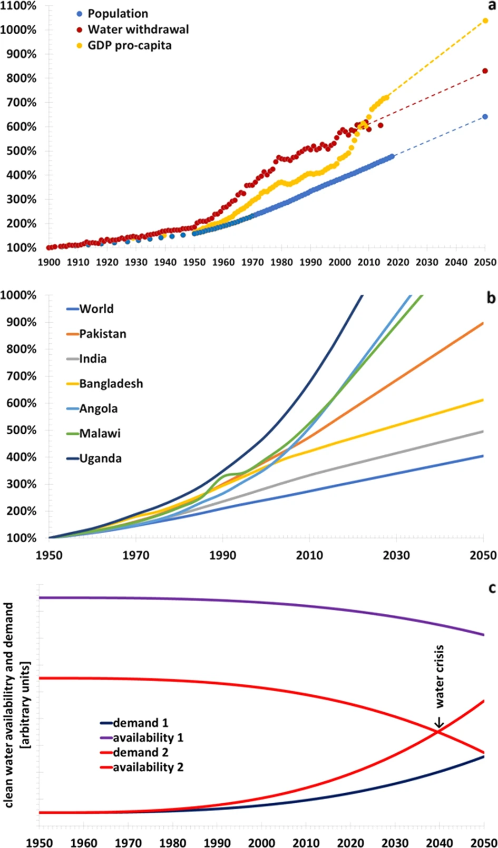
Managing Future Water Challenges
Water challenges are inevitable
Growing water stress
Climate change amplifying and extending pressure on our systems
These challenges drive utilities to evaluate water reuse to provide a resilient water supply – even in locations previously considered water rich.
Source: A. Boretti and L. Rosa, “Reassessing the projections of the World Water Development Report” NPJ Clean Water (2019)
Notes:
)

Slide 23
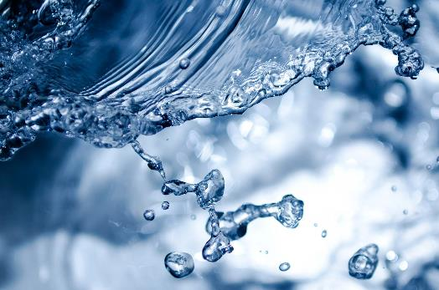
One Water
Improving System Resilience

Slide 24
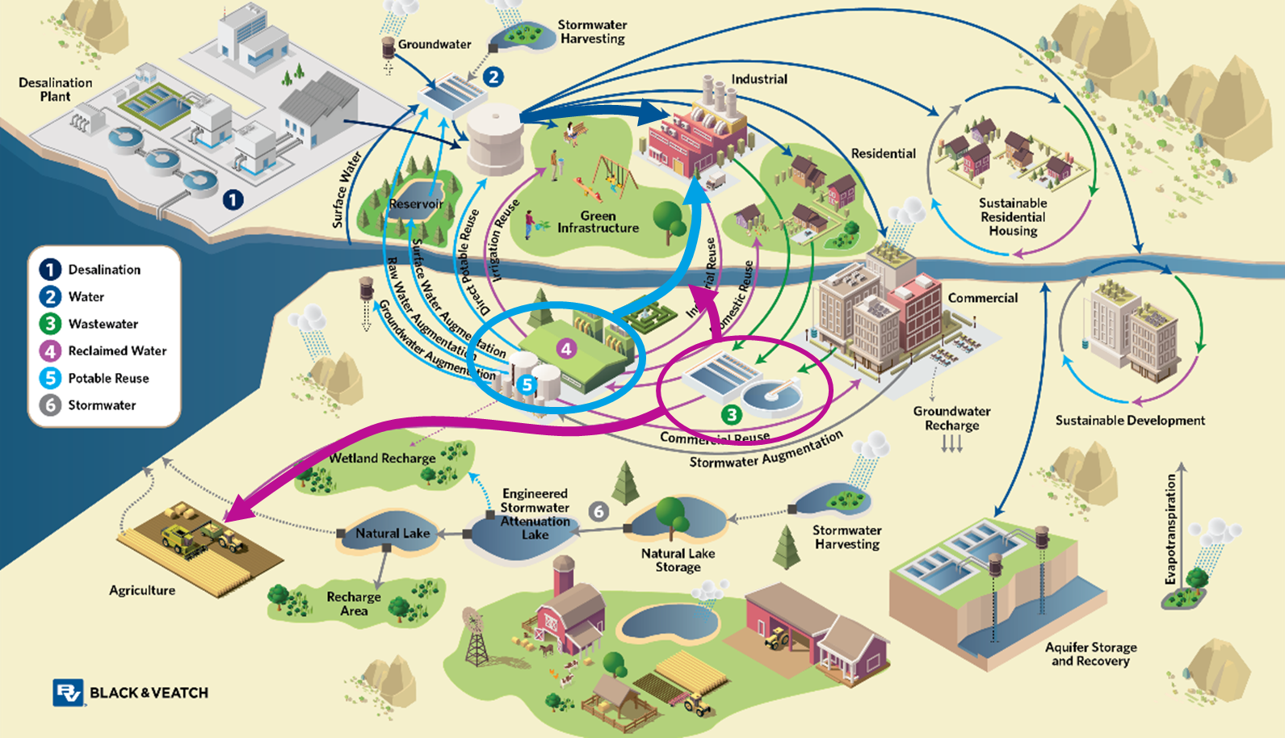
Our Water Cycle Is Connected, Driving Supply Reliability and Resilience

Slide 25
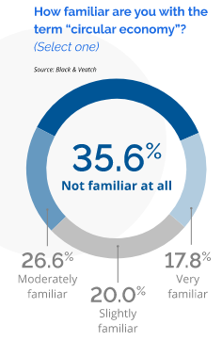
Circular Economy for Resource Circularity
“an industrial system that’s restorative or regenerative by intention
and design. It replaces the end-of-life concept with restoration,
shifts towards the use of renewable energy, eliminates the use of
toxic chemicals that impair reuse and return to the biosphere, and
aims for the elimination of waste through the superior design of
materials, products, systems and business models.”

Slide 26
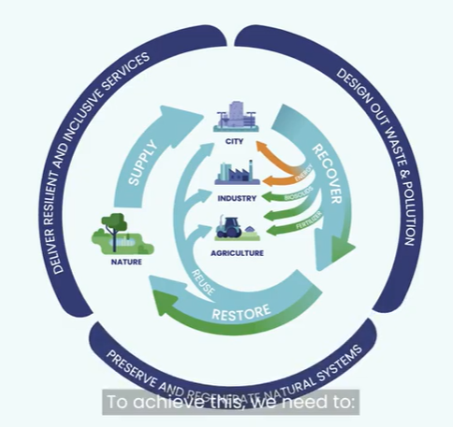

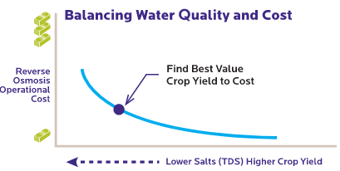
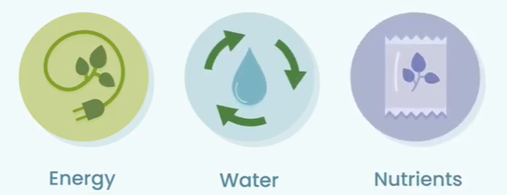
Resource Cycle for Larger Impact
Balancing Impacts and Costs
Facility
Costs
Optimum Point for the System?
Carbon Footprint
Resources Recovered

Slide 27
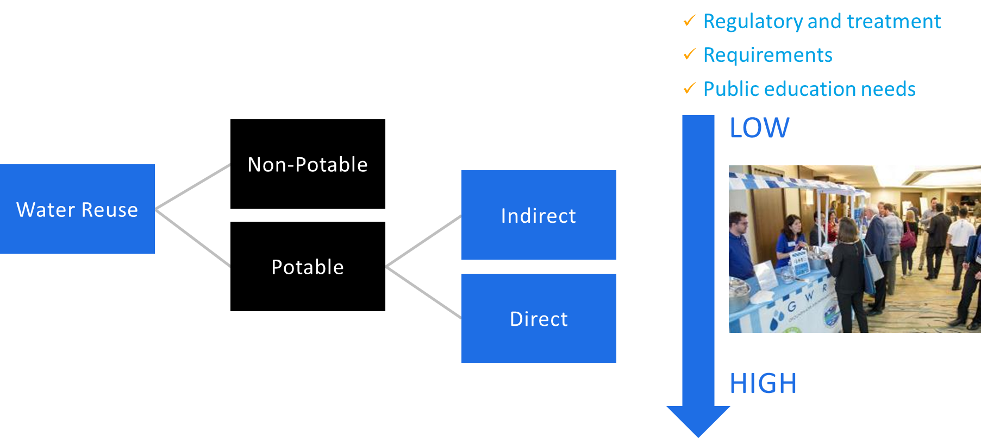
Water Reuse – All Types – Integral to One Water
Reuse increases water supply without requiring new water sources.

Slide 28
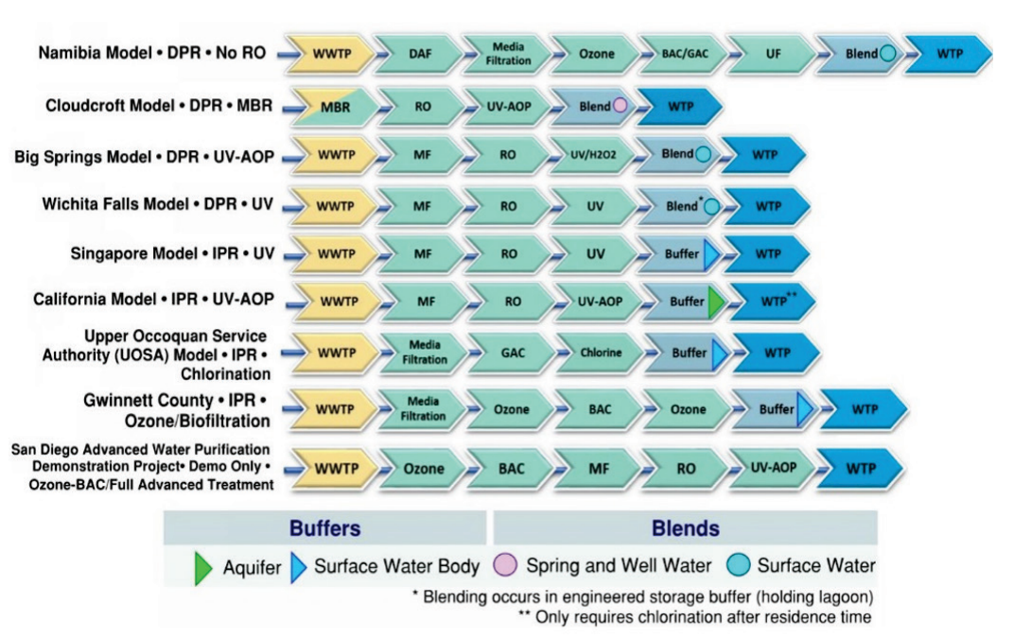
Example Potable Reuse Treatment Trains
Reverse Osmosis
TDS, inorganic, and organics removal
Ozone + BAF/GAC
Organics removal
Ozone + BAF/GAC + RO
Improved operation
Capital and operating cost savings
Multiple barriers
Source: 2017 Potable Reuse Compendium (USEPA 2017)

Slide 29
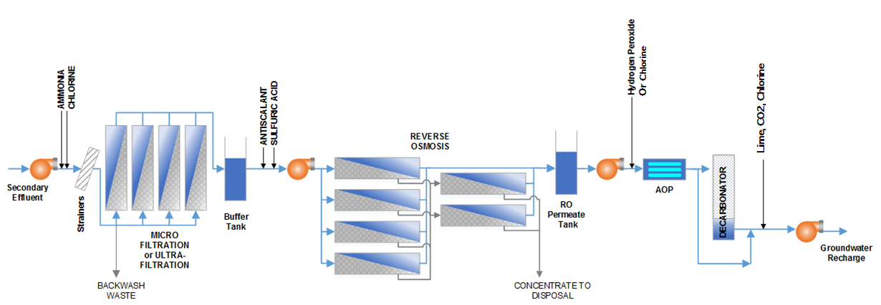
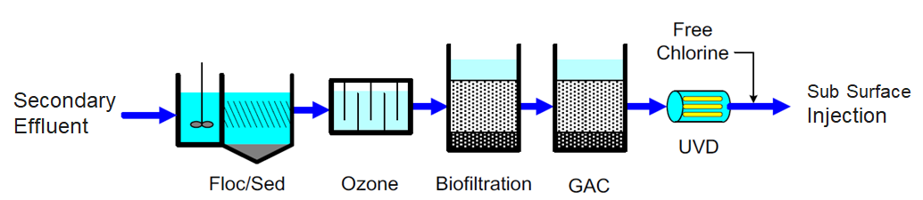
Full Advanced Treatment Is the Benchmark
Carbon Based Alternative Technology Can Reduce Implementation Costs

Slide 30
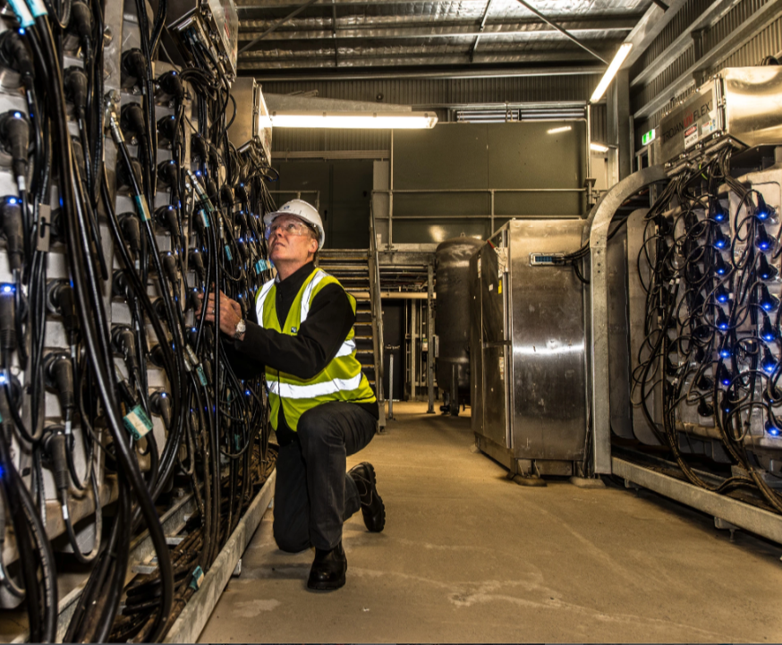
Case Studies

Slide 31
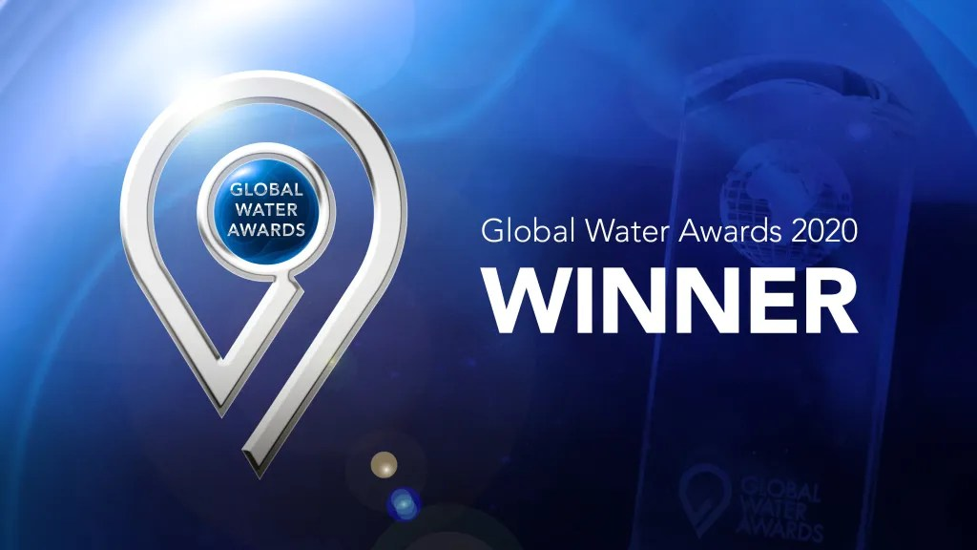
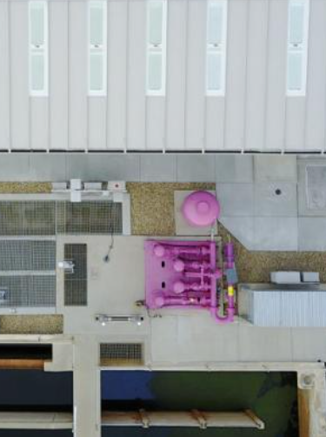
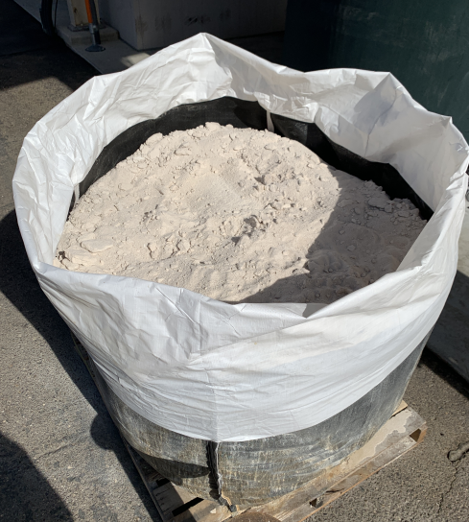
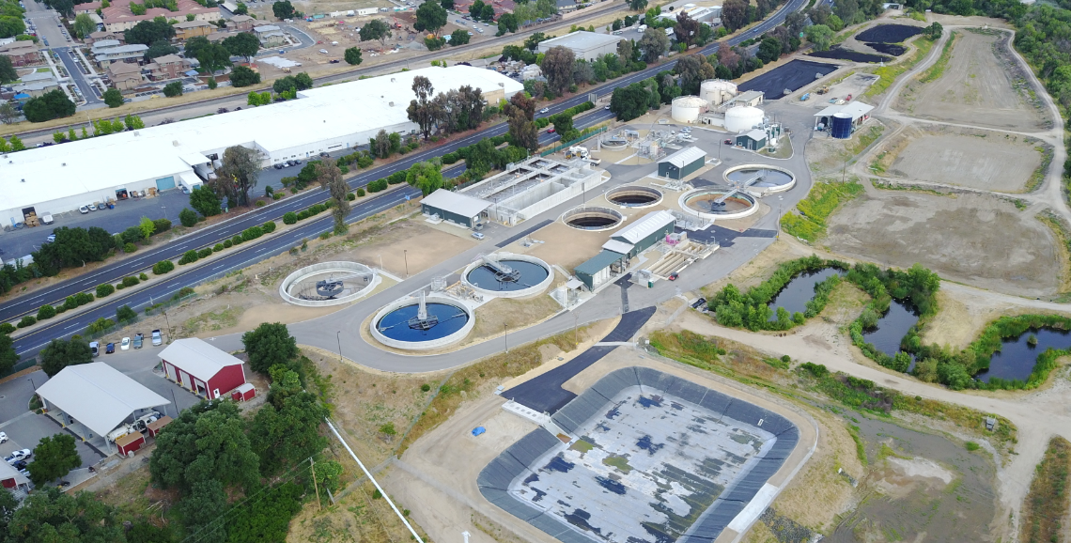
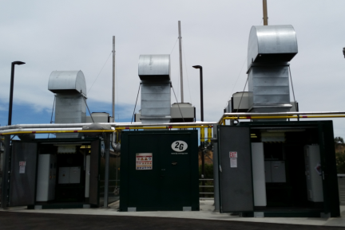
Paso Robles, CA
Reuse | Non-potable
Partners | Agricultural Local Commercial
Location | CA
Climate | Coastal
Recovered Resources | Water Nutrients Energy
Phased Implementation
- Phase 0: Recycled Water and Sustainability Plans
- Phase I: Facility upgrades, reuse system, sustainable solutions – renewable
energy, bioswales, permeable pavements, natural hot springs for heating,
nutrient recovery and fertilizer production
- Phase II: NPR pipe network
Sustainable by Design

Slide 32
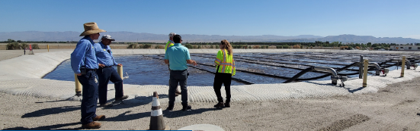
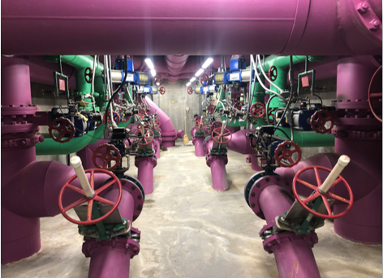
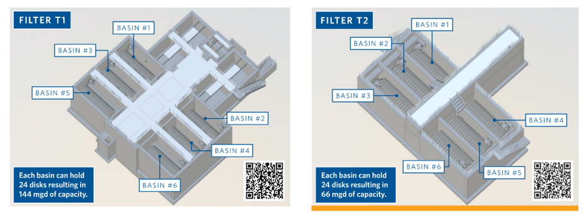
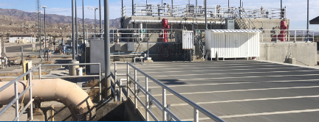
Coachella Valley Water District, CA
Reuse | Non-potable
Partners | Agricultural Local Community
Location | CA
Climate | Arid/Desert
Recovered Resources | Water (Nutrients, Energy)
Making low tech work for sustainable design
Reliable water supply for agriculture and local community

Slide 33
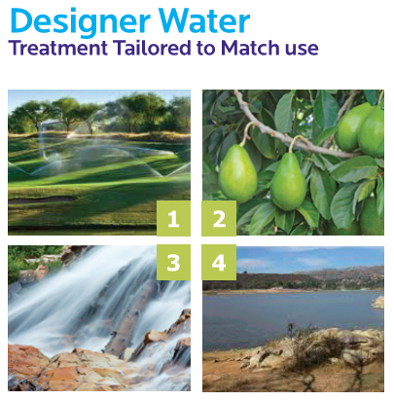
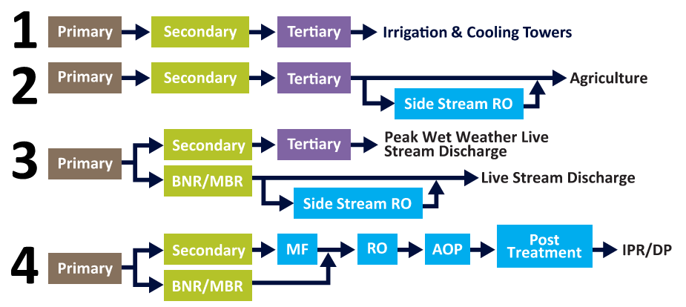
City of Escondido, CA
Reuse | Non-potable, Potable
Partners | Agricultural Local Community
Location | CA
Climate | Coastal
Recovered Resources | Water Energy
Phased Implementation
- Phase 0: One Water Plan and Implementation Roadmap
- Phase I: MF/RO facility for high-quality recycled water to irrigate
1,500 acres of avocado crops
- Phase II: AWT for highly purified water for IPR/DPR

Slide 34
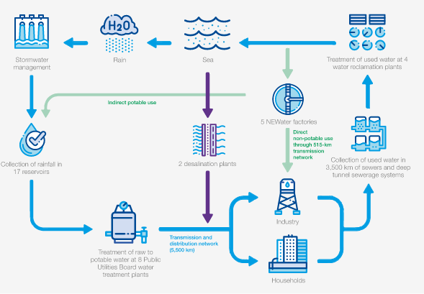
Reuse | Non-potable Potable
Partners | Agricultural Industrial Commercial Public
Location | Singapore
Climate | Tropical
Recovered Resources | Water Nutrients Energy Space/Land
Large Scale Impact Through Whole System Solutions -- Singapore

Slide 35







Large Scale Impact Through Regional Solutions – Examples from Southern California
87 mgd
150 mgd
180+ mgd
City of San Diego, CA, Pure Water Program
LACSD/MWD, CA, Regional Recycled Water Program
City of LA, CA, Operation NEXT Program

Slide 36

Orange County Water District
Ground Water Replenishment System
World’s largest system for IPR
Protect groundwater basins from seawater intrusion
Replenish local groundwater supplies
Provides new potable water for ~850,000 residents

Slide 37


Reuse can provide water resilience
Drought
Groundwater
Water Quality Change
Cost
Discharge Limitations
OCSD Clarifiers
Upon looking at holistic costs – utilities are finding reuse to be a financially attractive means to solve multiple issues.
OCWD/OCSD – Groundwater Replenishment System

Slide 38

NEWater
Singapore

Slide 39

Singapore’s One Water: “National Taps”
  Land size ~300 square miles
  Population ~ 5.5 million
Public Utilities Board (PUB)
  Provides management and regulation of water supply
Singapore Supplies
  Collected Rainfall
  Imported Water from Malaysia
  Reclaimed Water (NEWater)
  Desalinated Water
  Future sources
Singapore is a highly dense region that implements diverse water supply portfolio with reuse being a primary supply.

Slide 40

NEWater Factories of Singapore
Facility | CAPACITY (mgd) | Product Water Uses
¹Changi | 60 | Indirect potable reuse Wafer fabrication Other non potable and industrial applications
²Bedok | 22
¹Ulu Pandan | 38
² Kranji | 38
¹ Plants owned and operated by a concession company under DBOO arrangement
² Plant owned and operated by PUB
NEWater plants currently supply up to 40% of Singapore's current water needs; by 2060 this is expected to increase to 55%
Notes:
About 160 mgd of total capacity.

Slide 41
Deep Tunnel Sewerage System – Investment That Pays off
Massive network of deep tunnels to convey domestic water to centralized WRPs
Designed to provide “100 years of maintenance- free design life”
Phase 1 DTSS
  Provides used water to Changi WRP
Phase II DTSS
  Extends tunnels west to Tuas WRP and NEWater Factory
The DTSS was developed to meet Singapore’s long term clean water needs through collection, treatment, reclamation and disposal of industrial and municipal used water

Slide 42



Resource and Water Resilience
Ulu Pandan Wastewater Treatment Plant – Singapore
Tuas Integrated Facilities – Singapore
Changi NEWater Plant – Singapore

Slide 43

Attention Check Code:
9172
Advanced Water Purification Center (AWPC)
Santa Clara Valley Water District, CA

Slide 44


Silicon Valley Advanced Water Purification Center (AWPC)
Attention Check Code:
9172
Partnership Santa Clara Valley Water District (SCVWD) and the City of San Jose, CA
Source water secondary effluent from the San Jose-Santa Clara Regional Wastewater Facility
Goal: produce high purity recycled water to reduce existing recycled water salinity and increase marketability of existing recycled water supply
This project has won several awards including Water Reuse National Project of the Year and Global Water Intelligence Association Reuse Plant of the Year

Slide 45
Silicon Valley Advanced Water Purification Center (AWPC)
Attention Check Code:
9172
PURIFICATION PROCESS | FUNCTION | NET CAPACITY (MGD) | SPECIAL REQUIREMENTS
Microfiltration/ Ultrafiltration | Pretreatment of nitrified secondary effluent to reduce TSS | 10.5 | Preselection of MF/UF mfg’s
Reverse Osmosis | TDS reduction | 8 | Decarbonization process to stabilize product water
Ultraviolet Disinfection | Disinfection of product water | 10 | NWRI Guidelines UV Validation Preselection of mfg’s
Silicon Valley AWPC uses a multiple-barrier approach for advanced potable-ready reuse

Slide 46


Resilience
Attention Check Code:
9172
SJ/SC Water Pollution Control and Purification Facilities
Water quality and public perception were major drivers.
Diversify water sources
Secure drought-proof supply
Reduce discharge into San Francisco Bay
Improve public acceptance of recycled water

Slide 47


Eastern Treatment Plant
Melbourne Australia
Attention Check Code:
9172

Slide 48


Non-RO based Reuse – Melbourne
Attention Check Code:
9172
$10M pilot program with 16 processes
$440M x 220 MGD Reuse Facility
World’s Largest Reuse Facility
Upgraded in 2012 to provide Class A Water
REUSE FACILTY FLOW DIAGRAM
8-years of full-scale data

Slide 49

220 mgd Advanced Tertiary Treatment Plant
Attention Check Code:
9172
Class A Water
Fit-for-use
International Awards
Drought
Groundwater
Water Quality Change
Increasing Cost of Status Quo Approaches
Discharge Limitations

Slide 50

Conclusions and Recommendations
Whole system considerations result in larger scale impact – water, energy, food security essential
Need to replace the “single value” mindset with “multiple value” essential resources in planning
Instead of “taking the waste out” need to “supply, recover and restore resources”
Partnerships with industries to optimize water, resource and financial resilience
Interconnected infrastructure needs interconnected engineering and regional collaborations

Slide 51

© 2022California Water Environment Association (CWEA)

Slide 52

QUESTIONS & ANSWERS
Notes:
Please DON’T put speakers agency logo on the slide. It will not look good.

Slide 53
Process for Claiming Contact Hours for
this Webinar
Log in to https://owen.cwea.org/ the Online Wastewater Education Network (OWEN) with your mycwea.org account info and find this program in “Your Dashboard”.
Enter the attention codes (XXXX) in the “Attention Check Code” component under the "Contents" tab within 48 hours of the live webinar.
Your contact hours will be reflected in your mycwea.org account within 2-3 weeks following completion.

Slide 54
This is made possible by the following sponsors

Slide 55
© 2022California Water Environment Association (CWEA)

