Slide 1

Mechanical Technologist - Grade 2 Certification Training Webinar
March 15, 2022, 11:00 am – 1:00 pm

Slide 2



Robert Delgado
Speaker
Manager of Maintenance
Inland Empire Utilities Agency
Notes:
Please DON’T put speakers agency logo on the slide. It will not look good.

Slide 3
Mechanical Technologist Grade 2
CWEA – SD Section
March 15, 2022
Robert Delgado
Manager of maintenance

Slide 4

Mechanical Technologist candidate handbook

Slide 5

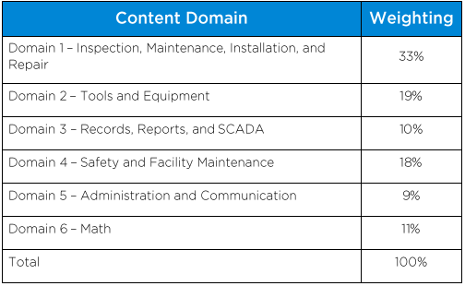
Mechanical Tech. 2 exam Blueprint

Slide 6

Domain 1 – inspection, maintenance, installation, and repair

Slide 7
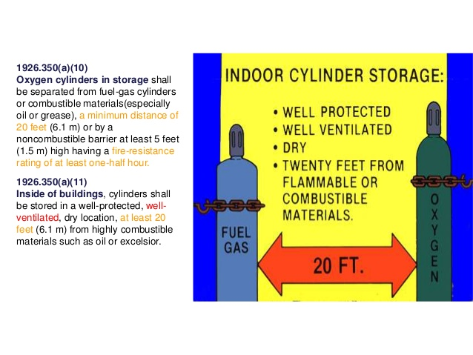
Domain 1: inspection, maintenance, installation, and repair
Welding Safety:
PPE (fire resistant clothing, leather gloves, approved safety glasses, welding helmet, ventilation, etc.)
Safety Data Sheets (SDSs)
Read and follow instructions on O&M manual.
Wear a safety harness if working at heights
Do not install or place machine on or over combustible surfaces.
Read safety information on all equipment
Use GFCI protection when operating auxiliary equipment in damp or wet locations
Use only genuine replacement parts

Slide 8
Domain 1: inspection, maintenance, installation, and repair
Shielding: The word “shielding” is used to describe the creation of an environment of controlled gas or gases around the weld zone to protect the molten weld metal from contamination by the oxygen and nitrogen in the atmosphere.
Arc Welding: Welding process that uses electricity to create enough heat to melt metal. Power creates an electric arc between the metal stick (electrode) and the base material to melt the metals at the point of contact.
Arc welders can use DC or AC current and can use consumable or non-consumable electrodes.
Oxy Acetylene Welding: Oxyacetylene welding, commonly referred to as gas welding, is a process which relies on combustion of oxygen and acetylene. When mixed together in correct proportions within a hand-held torch or blowpipe, a relatively hot flame is produced with a temperature of about 3,200 deg. C. The chemical action of the oxyacetylene flame can be adjusted by changing the ratio of the volume of oxygen to acetylene.

Slide 9
Domain 1: inspection, maintenance, installation, and repair
Common Arc Welding Methods
Shielded Metal Arc Welding (SMAW): Also known as "stick welding", uses an electrode that has flux, the protectant for the puddle, around it.
Gas Tungsten Arc Welding (GTAW): Also known as TIG (tungsten, inert gas), uses a non-consumable tungsten electrode to produce the weld. The weld area is protected from atmospheric contamination by an inert shielding gas such as Argon or Helium.
Gas Metal Arc Welding (GMAW): Commonly termed MIG (metal, inert gas), uses a wire feeding gun that feeds wire at an adjustable speed and flows an argon-based shielding gas or a mix of argon and carbon dioxide (CO2) over the weld puddle to protect it from atmospheric contamination.
Flux-cored arc welding (FCAW): Almost identical to MIG welding except it uses a special tubular wire filled with flux; it can be used with or without shielding gas, depending on the filler.
Submerged arc welding (SAW): Uses an automatically fed consumable electrode and a blanket of granular fusible flux. The molten weld and the arc zone are protected from atmospheric contamination by being "submerged" under the flux blanket.

Slide 10
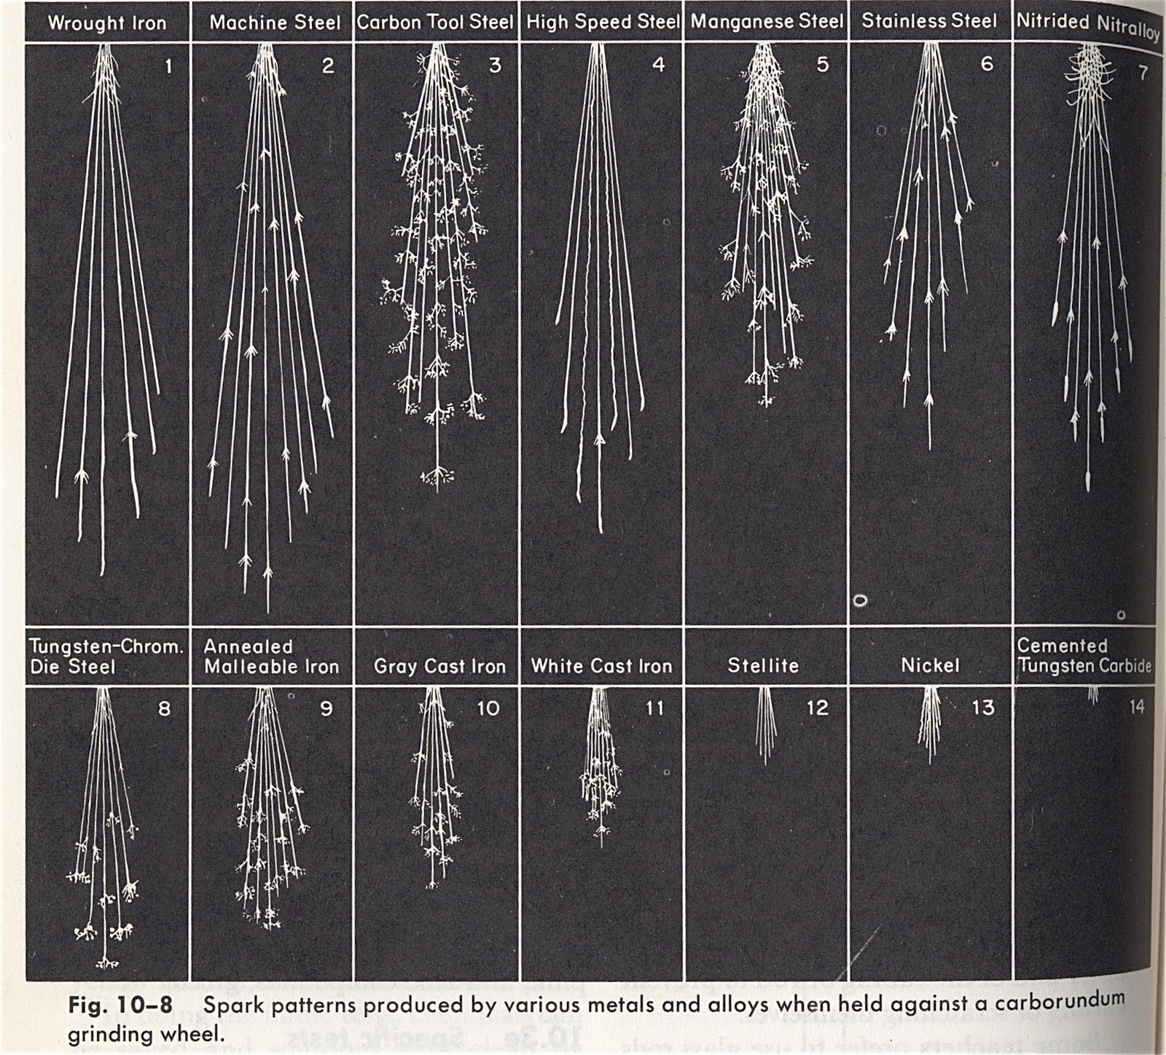
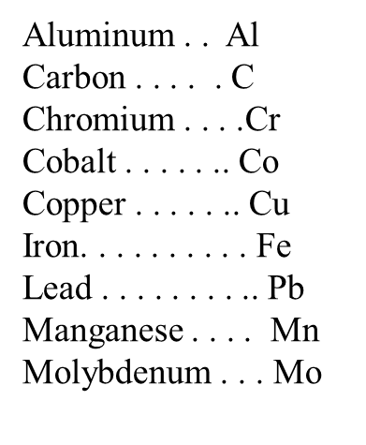
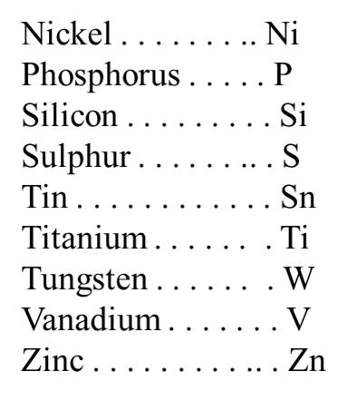
Domain 1: inspection, maintenance, installation, and repair
Nonferrous metals are generally grouped
according to their alloying elements. Examples of these groups are:
Brass, bronze, copper-nickel, and nickel-copper.
Specific designations of an alloy are described by the amounts and chemical symbols of the alloying elements. For example, a copper-nickel
alloy might be described as copper-nickel,
70 Cu-30 Ni. The 70 Cu represents the
Percentage of copper, and the 30 Ni
represents the percentage of nickel.

Slide 11
Domain 1: inspection, maintenance, installation, and repair
Troubleshooting and Repairing Engines
LO/TO - Remember that communications are vital with Plant Operators, coordinate any and all lock-out / tag-out with Plant Operations
An engine is defined as a machine designed to convert energy into useful mechanical motion.
Engine oil pumps are positive displacement which makes a fluid move by trapping a fixed amount and forcing (displacing) that trapped volume into the discharge pipe.
A maintenance program consists of two major parts: scheduling tasks and performing tasks.
A battery (especially emergency batteries) should be tested monthly.
When charging a battery make sure the area is well ventilated. It is best to slow charge a battery

Slide 12
Domain 1: inspection, maintenance, installation, and repair
Troubleshooting and Repairing Engines
Inspecting, Testing, and Repairing Valves & Valve Assemblies:
Regardless of differences existing in engine construction, there are certain troubles common to all assemblies.
Sticking Valves:
Sticking valves will produce unusual noise at the cam followers, pushrods, and rocker arms and may cause the engine to misfire. Sticking is usually caused by resinous deposits left by improper lube oil or fuel.
To free sticking valves without having to disassemble the engine, use one of several approved commercial solvents.
If the engine is disassembled, use either a commercial solvent or a mixture of half lube oil and half kerosene to remove the resins. Do NOT use the kerosene mixture on an assembled engine, since a small amount of this mixture settling in a cylinder could cause a serious explosion

Slide 13
Domain 1: inspection, maintenance, installation, and repair
Troubleshooting and Repairing Engines
Bent Valves:
Bent or slightly warped valves tend to hang open. A valve that hangs open not only prevents the cylinder from firing, but also is likely to be struck by the piston and bent so that it cannot seat properly. Symptoms of warped or slightly bent valves will usually show up as damage to the surface of the valve head.
To lessen the possibility that cylinder head valves will be bent or damaged during overhaul, NEVER place a cylinder head directly on a steel deck or grating; use a protective material such as wood or cardboard. Also, NEVER pry a valve open with a screwdriver or similar tool.
Weak Springs:
Valves may close slowly, or fail to close completely, because of weak springs. At high speeds, valves may “float,” thus reducing engine efficiency.
Valve springs wear quickly when exposed to excessive temperatures and to corrosion from moisture combining with sulfur present in the fuel.
Burned Valves:
Burned valves are indicated by irregular exhaust gas temperatures and sometimes by excessive noise. In
general, the principal causes of burned valves are carbon deposits, insufficient tappet clearance, defective valve seats, and valve heads that have been excessively reground

Slide 14
Domain 1: inspection, maintenance, installation, and repair
Troubleshooting and Repairing Engines
Piston Rings:
Over a period of time all piston rings wear. Some stick and may even break.
While you may be able to free stuck rings and make them serviceable, you must replace excessively worn or broken rings with new ones.
Insufficient Compression:
Proper compression pressures are essential if a diesel engine is to operate satisfactorily.
Insufficient compression may cause an engine to fail to start. If you
suspect low pressure as the reason, check the compression with the appropriate instrument. If the test indicates pressures below standard, disassembly is required for complete inspection and correction.

Slide 15
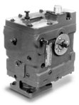
Domain 1: inspection, maintenance, installation, and repair
Troubleshooting and Repairing Engines
Inoperative Engine Governor:
There are many troubles that may cause a governor to become inoperative. The most frequent trouble associated with starting an engine is generally caused by bound control linkage or, if the governor is hydraulic, by low oil level.
Whether the governor is mechanical or hydraulic, binding of linkage is generally due to distorted, misaligned, defective, or dirty parts.
If you suspect binding, move the linkage and governor parts by hand and check their movement. Eliminate any undue stiffness or sluggishness in the movement of the linkage.

Slide 16
Domain 1: inspection, maintenance, installation, and repair
Troubleshooting and Repairing Engines
Engine Stalls Frequently or Stops Suddenly:
Look for troubles such as:
  Air in the fuel system
  Clogged fuel filters
  Unsatisfactory operation of fuel injection equipment
  Incorrect governor setting
  Misfiring
  Low cooling water temperature
  Improper application of load
  Improper timing
  Obstruction in the combustion space or in the exhaust system
  Insufficient intake air
  Defective auxiliary drive mechanisms.

Slide 17
Domain 1: inspection, maintenance, installation, and repair
Key concepts:
If a belt is squeaking what is the best product to use to remove the glaze that is present. Chalk - it is abrasive and will remove the glaze.
The most common failure of gear fuel pumps are seals leaking from worn shafts and or bushings.
Heat Exchanger are devices that transfer heat from one fluid to another.
A battery should never get below 12.45 volts (75%) before recharging and a charging voltage of 1 ½ to 2 volts greater than the battery voltage should be used. Once fully charged and rested a battery should read 12.7 to be considered fully charged.
Practice Questions
  Is a Radiator a heat exchanger? Why or Why Not?

Slide 18
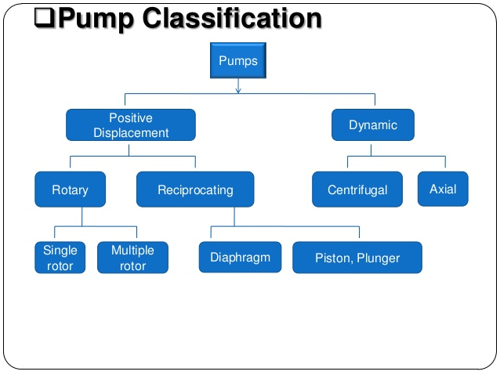
Domain 1: inspection, maintenance, installation, and repair
Pump Principles

Slide 19
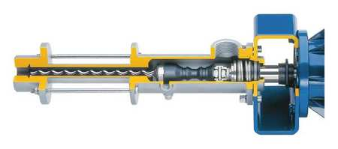
Domain 1: inspection, maintenance, installation, and repair
Pump Principles
Progressive Cavity Pumps consist of a screw-shaped rotor snugly enclosed in a “non-moving Stator” or housing.
The rotor is manufactured of chrome steel and makes contact with the stator which is made primarily of synthetic rubber.
The gaps between the rotor threads are called “cavities.” These pumps are recommended for materials that contain high concentrations of suspended solids and are used primarily on sludges.
They should never be started or ran with liquid or with a closed discharge valve.

Slide 20
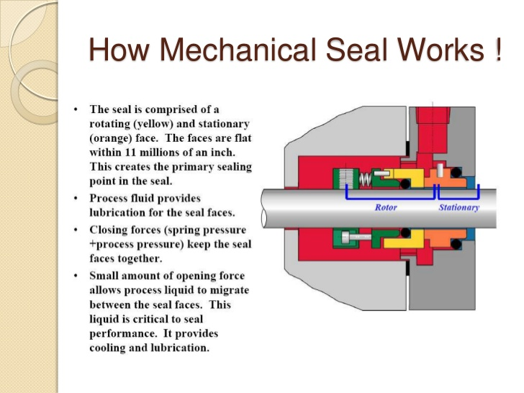
Domain 1: inspection, maintenance, installation, and repair
Pump Principles
Additional Facts:
AKA-Spring Loaded Check Valve
Provides the best sealing for pressures and speeds.
Costs are much higher than packing, but less than cartridge seals and split seals
Special care needs to be administered when installing
Seal face flatness is critical to prevent leakage, one face is carbon the other is a harder material like ceramic, tungsten carbide or silicon carbide.
Flatness is measured in “Light Bands.”

Slide 21
Domain 1: inspection, maintenance, installation, and repair
Pump Principles
Centrifugal Pumps -
Maintenance Rule #1: Never pump a liquid that the pump was not designed for.
Maintenance Rule #2: Keep the right amount of the “right” lubricant in the bearings at all times.
Maintenance Rule #3: See that pump and motor connections are parallel vertically and axially (aligned) and that they are kept that way.
Maintenance Rule #4: See that suction piping puts absolutely no strain on the pump casing.
Maintenance Rule #5: Never allow a pump to run dry, water is a lubricant between the rings and impeller.
Maintenance Rule #6: Packing should be replaced periodically, don’t push additional packing to stop leakage. Never overtighten the packing gland, excessive pressure will wear shaft sleeves.
Maintenance Rule #7: 75% of centrifugal pump problems come from the suction side of the pump from to high of a suctions lift, air entering the suction side and or cavitation which will cause the pump to be noisy and vibrate, it might also sound like rocks are in the casing.

Slide 22
Domain 1: inspection, maintenance, installation, and repair
Pump Principles
Pump Troubleshooting:
Centrifugal Pump loss of suction:
Air leak in suction line (Repair & replace)
Suction lift too high (Lower suction lift, install foot valve and prime)
Insufficient inlet pressure or suction head (Increase inlet pressure by adding more water to tank or increasing back pressure)
Clogged foot valve check valve or strainer (Unclog)
Defective foot valve or check valve (Replace)
Defective priming hose bibb on suction pipe (Replace)
Pump vibrates and/or makes excessive noise:
Mounting plate or foundation not rigid enough (Reinforce)
Foreign material in pump (Dismantle pump and clean)
Impeller damaged (Replace impeller)
Worn motor bearings (Replace bearings)
Suction lift too high ( Lower suction lift, install foot valve and prime)

Slide 23
Domain 1: inspection, maintenance, installation, and repair
Pump Principles
Pump will not prime:
No priming water in casing (Fill pump casing)
Mechanical seal leaking (Replace mechanical seal)
Leak in suction line (Repair or replace)
Discharge line is closed and priming air has nowhere to go (Open)
Suction line or valve is closed (Open)
Pump is down (Replace worn parts)
Foot valve or check valve is leaking ( Replace valve)
Suction screen clogged (Clean or replace)

Slide 24
Domain 1: inspection, maintenance, installation, and repair
Pump Principles
Cavitation:
The condition of cavitation is essentially an indication of an abnormality in the pump suction system, whereas the condition of low flow indicates an abnormality in the entire pumping system or process. The two conditions are also inter-linked such that a low flow situation can also induce cavitation.
Cavitation is a common occurrence but is the least understood of all pumping problems.
When cavitating, the pump not only fails to serve its basic purpose of pumping the liquid but also may experience internal damage, leakage from the seal and casing, bearing failure, etc.

Slide 25
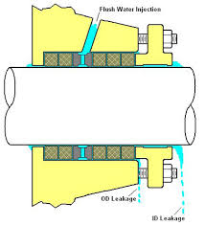
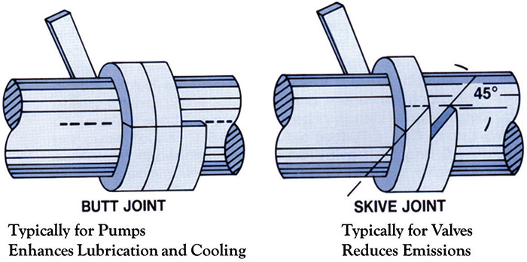
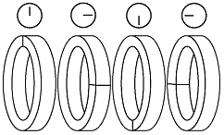
Domain 1: inspection, maintenance, installation, and repair
Pump Principles

Slide 26
Domain 1: inspection, maintenance, installation, and repair
Pump Principles
The function of the multiple rings of packing in a stuffing box is to brake down the pressure of fluid being sealed so that it approaches zero gage pressure or atmosphere at the follower end of the stuffing box.
It is better to have too much leakage from the stuffing box than not enough.
The lantern ring or seal cage (as it is sometimes called) provides additional lubricant or fluid directly to the interface of packing and shaft.
The lantern ring must be positioned between the packing rings so that its front edge is in line with the inlet port, as the packing wears and the follower is tightened, the lantern ring will move forward, when the packing is fully compressed, the lantern ring should still be inline with the inlet (flush) port.
Packing should not be rolled out flat and cut with square ends, this will create a wedge-shape void.

Slide 27
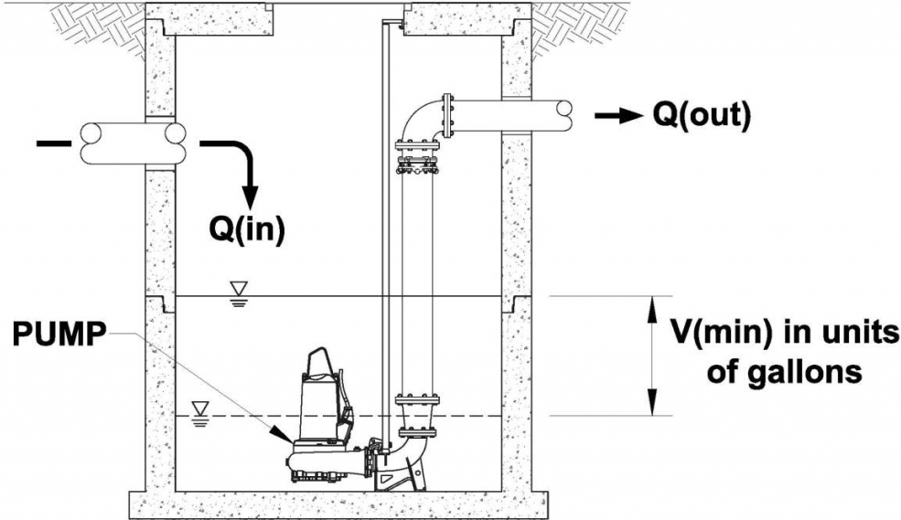
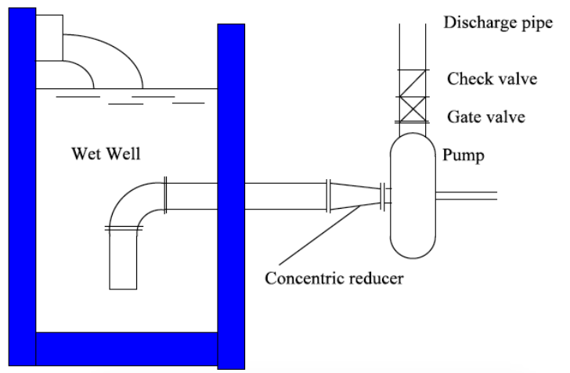
Domain 1: inspection, maintenance, installation, and repair
Wet Well Cleaning and Repair
Wet Wells are used in a sewer collection system. Typically known as Pump Stations.
Wet Wells can have fully submersible pumps or dry submersible.
Pump Stations of today require redundancy with additional pumps or bypass pumping capabilities and emergency power generator.
Level controllers can be either float activated, submersible elements, non-contact Ultrasonic or radar level transmitters.
The Air Quality Management District (AQMD) is the regulatory agency that permits odor control systems.

Slide 28
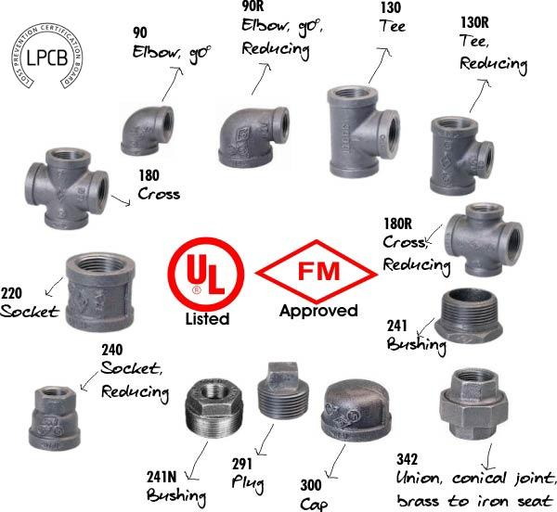
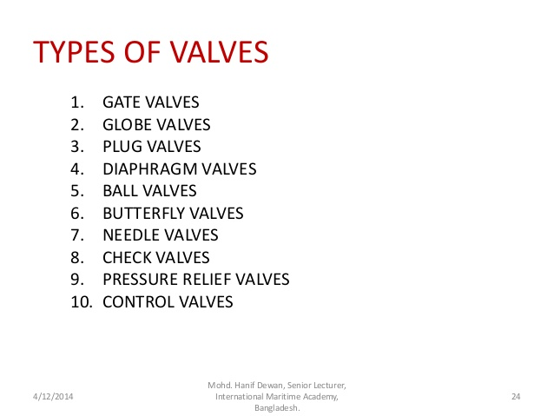
Domain 1: inspection, maintenance, installation, and repair
Know the different names of fittings by look and description.
Flux: A paste used to assist melting when soldering or brazing.
Solvent Weld: A chemical
process used to join two PVC connections.
O/C
Throttling
O/C
Throttling
O/C
Throttling
Throttling
O/C
O/C
O/C or throttling

Slide 29
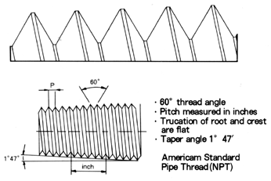
Domain 1: inspection, maintenance, installation, and repair
Standard pipe is made in different wall thicknesses and to standardized dimension. The actual outside diameter in these various wall thicknesses does not change, the internal diameter however does.
The ANSI B36-10 standard gives a meaning of specifying wall thicknesses by a series of “schedule numbers” which indicate the approximate strength of the pipe.
The lower numbers have the least strength, with the strength increasing as the numbers do.
Pipe threads (American Standard) has an angle of 60* and a slight flat at the crest and root. The threads are cut on a taper of 1/16 in. per inch measured on the diameter.

Slide 30
Domain 1: inspection, maintenance, installation, and repair
Piping Layouts:
Start with a basic sketch of your project, including general dimensions. For projects using flanged or precut threaded pipe, layout planning is much more critical.
Take some time to research various fittings.
Consider using sweeps or a pair of spaced 45s instead of close elbows to cut down on total dynamic head.
Include clean-outs and flushing points in your layout.
For threaded assemblies allow for twisting the pipes and fittings together — you will probably need to include a union or flanged joint to complete the assembly.

Slide 31
Domain 1: inspection, maintenance, installation, and repair
Pipe support or pipe hanger:
Element that transfer the load from a pipe to the supporting structures. The load includes the weight of the pipe, the content that the pipe carries, all the pipe fittings attached to pipe, and the pipe covering such as insulation.
The four main functions of a pipe support provides are: Anchoring, Guiding, Shock Absorption and Support
Primary Load - these are typically steady or sustained types of loads such as internal fluid pressure, external pressure, gravitational forces acting on the pipe such as weight of pipe and fluid, forces due to relief or blow down, pressure waves generated due to water/steam hammer effects.
Secondary Load - Just as the primary loads have their origin in some force, secondary loads are caused by displacement of some kind. For example, the pipe connected to a storage tank may be under load if the tank nozzle to which it is connected moves down due to tank settlement. Similarly, pipe connected to a vessel is pulled upwards because the vessel nozzle moves up due to vessel expansion. Also, a pipe may vibrate due to vibrations in the rotating equipment it is attached to.

Slide 32
Domain 1: inspection, maintenance, installation, and repair
Rigid Support:
Rigid supports are used to restrict pipe in certain direction(s) without any flexibility (in that direction). Main function of a rigid support can be Anchor, Rest, Guide or both Rest & Guide.
Spring Support:
Spring supports (or Flexible supports) use helical coil compression springs ( to accommodate loads and associated pipe movements due to thermal expansions). Types of spring supports include: Variable Spring Hanger or Variable Effort Support and Constant Spring Hanger or Constant Effort Support.
Shock Absorber:
It is designed to absorb and transfer sudden increases in load from the pipe into the building structure and to deaden any opposing oscillation between the pipe and the structure. Types of restraints are: Hydraulic Snubber, Mechanical Snubber, shock absorber, insulated pipe support (also called pre-insulated pipe support) and engineered spring support upholds a specific load.

Slide 33
Domain 1: inspection, maintenance, installation, and repair
An air compressor should be selected to run 1/3 to 1/2 of the time, based on average air consumption of a system.
Average air consumption is expressed in standard cubic feet per minute – SCFM.
Compressors are rated in SCFM at a given tank pressure, usually 80-110 psig.
Sizing a compressor is matching the compressor capacity to a system’s requirement. The consumption of each air-using device in a system is taken into consideration.
Relays, thermostats, switches, transmitters, and all devices that use air must be considered, and the compressor should be sized so that when operating, 1/3 to 1/2 of the time it will deliver enough air to satisfy the average air requirement of a system.
If a change in air volume output is required, it is accomplished by changing the motor to one with a higher or lower RPM or by changing out the sheaves to increase or decrease blower lobe or rotor rotation (rpm).

Slide 34
Domain 1: inspection, maintenance, installation, and repair
Air Compressor Troubleshooting:
Delivery Below Rate Capacity – Excessive system leaks, restrictions of air intake, intake air filters clogged, broken or worn valves, valves not seated in cylinder, unloader defective or improperly set, worn or broken piston rings, cylinder or piston worn or scored, slipping belts.
Noisy or Knocking Compressor – Pulley or flywheel loose, anchor bolt loose or foundation uneven, excessive crankshaft endplay, piston or piston nut loose, bearings loose, liquid in cylinder, inadequate lubrication.
Motor overheat – motor to small, wrong connections, low voltage, excessive number of starts, belts to tight, speed to low, High ambient temperature, poor ventilation, unloader set incorrectly, compressor mechanical problem.
Compressor overheats – Pressure setting above rating, restricted intake or clogged filters, broken or worn internal parts, insufficient water temperature to high, speed to high, belts misaligned bearing are worn and need replacing, poor ventilation, wrong rotation.
Low oil pressure – defective gauge, insufficient or wrong type of lubricant, defective oil relief valve, worn or defective oil pump, excessive clearances.

Slide 35
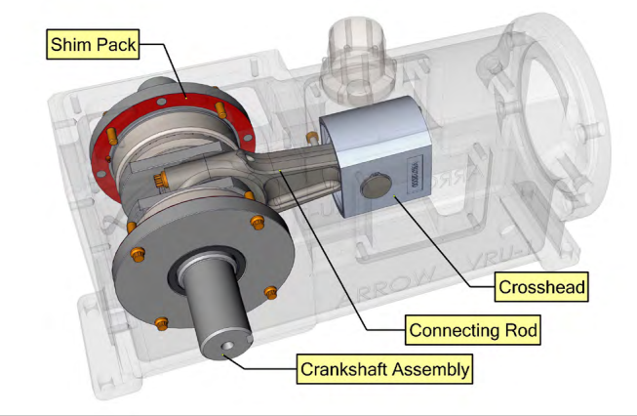
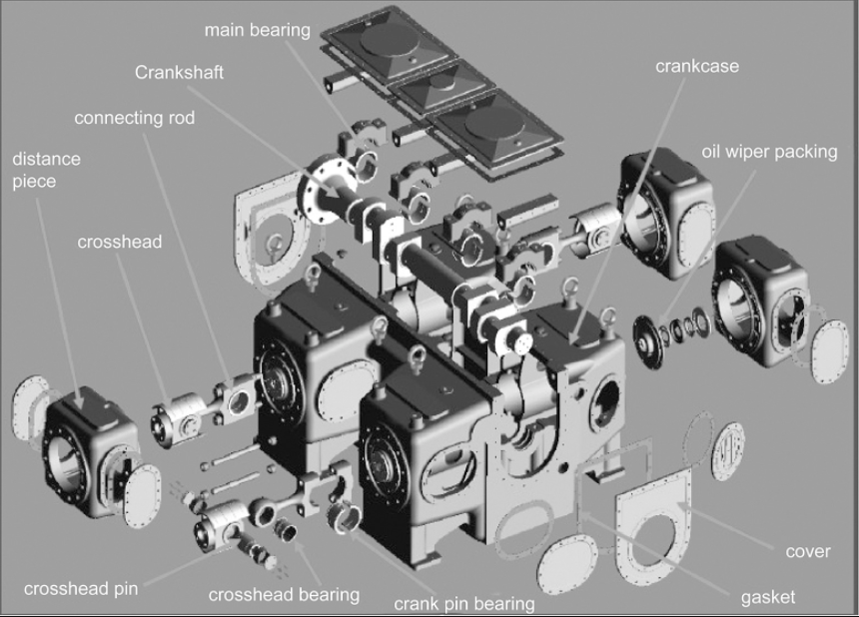
Domain 1: inspection, maintenance, installation, and repair
Reciprocating Compressor:
Crankshafts rotary motion provided by the driving power unit is converted into reciprocating motion by the crankshaft.
The connecting rod connects to the crankshaft to the crosshead, transforming the rotating reciprocation at the crank to a straight-line reciprocation at the crosshead. Crosshead acts like a sliding joint between the connecting rod and the piston rod.
Valves are the critical part of the compressor and perform on one of the most rugged operations.
Valves must have the ability to function satisfactorily for long periods of time.
Valves are one-way, or check-type, valves.

Slide 36
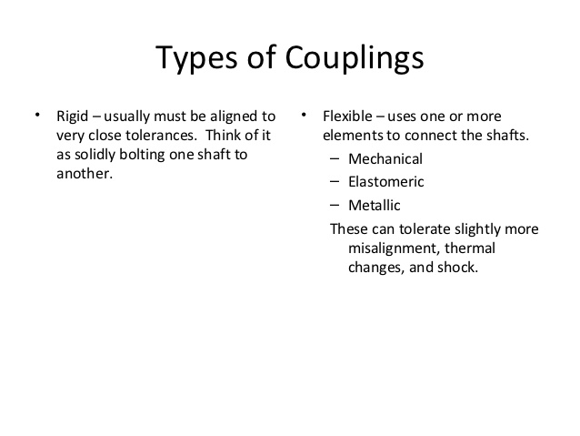
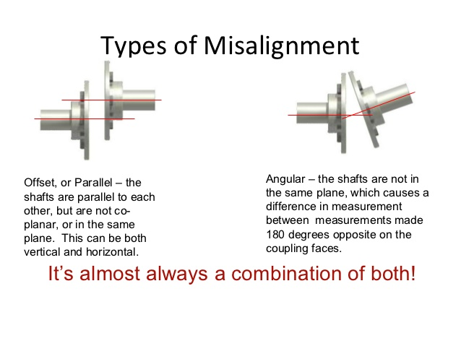
Domain 1: inspection, maintenance, installation, and repair

Slide 37
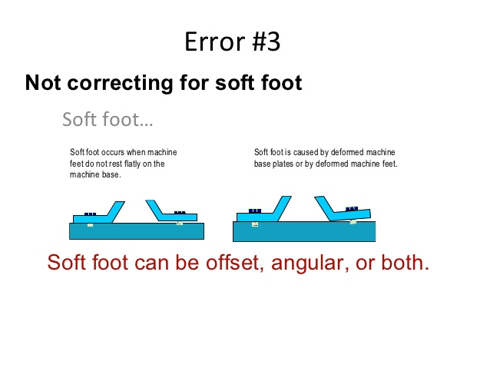
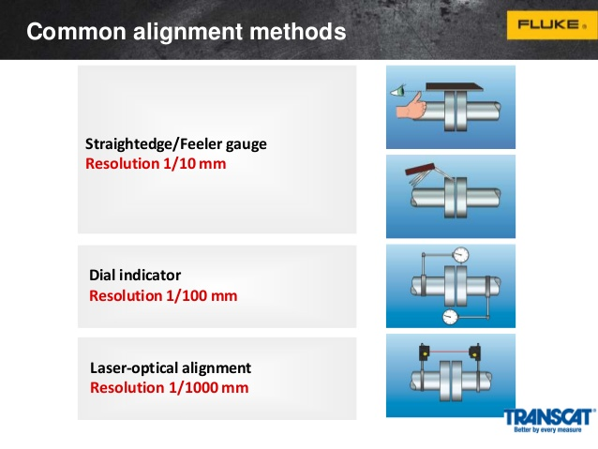
Domain 1: inspection, maintenance, installation, and repair

Slide 38
Domain 1: inspection, maintenance, installation, and repair
Gear types may be grouped into five main categories:
Spur
Helical
Bevel
Hypoid, and
Worm
Belt drives are simple, inexpensive, and do not require axially aligned shafts. Flat belts, Rope drives, Round belts, V belts, Multi-groove belts, Ribbed belt and Film belts.
All v-belts have a 40° angle between the faces, except the V series (aka "Harvester" or "Wedge" belts), which have a 30° angle between the faces. The inside edge of the belt is wider than the base of the V in a v-belt pulley - the belt touches the pulley only on the sides.
Accessory drive belts are of two types, V-belts (conventional, cogged and multi-ribbed) and serpentine (multi-ribbed) belts. A V-belt rides in V-shaped pulleys to rotate various accessories, such as the power steering pump, air conditioner compressor, alternator/generator, water pump, and air pump.

Slide 39
Domain 1: inspection, maintenance, installation, and repair
Unified Thread designation – When designating a screw thread , the standard method is to specify
in sequence the nominal size, number of threads per inch, thread series symbol and thread symbol class.
For example: a ¾ in. Unified Coarse series thread for a common fastener would be designated as follows:
¾ - 10 UNC 2A
Coarse-thread series is designated by the symbol UNC and is generally utilized for bolts, screws, nuts and other general applications.
Fined-threads series ids designated by the symbol UNF and applies to the same materials as coarse.
Extra-fine threads is designated by the symbol UNEF. It is used where even finer pitches of threads are desirable for a short length of engagement and for thin-walled tubes, nuts, ferrules or couplings .
Thread classes also establishes limit of tolerances called classes. Classes 1A, 2A and 3A apply to external threads only and classes 1B, 2B and 3B apply to internal threads only.
Classes 3A and 3B provide the closet tolerances and 1A and 1B are used on threaded components where quick and easy assembly is necessary .

Slide 40
Domain 1: inspection, maintenance, installation, and repair
Concrete Information:
Aggregate: The inert filler material that makes up the bulk of concrete. Usually sand, gravel, and rocks. Fibers and reinforcing bars are not considered aggregate.
Cement: This word can mean several very different things: the dry unreacted powder that comes in a sack, the sticky fluid stuff formed just after water is added, and the rocklike substance that forms later on.
Cement paste: Cement (see above) that has been mixed with water. Usually, the term implies that it has already become hard.
Concrete: A mixture of sand, gravel, and rocks held together by cement paste. The world’s most widely-used man-made material.

Slide 41
Domain 1: inspection, maintenance, installation, and repair
Curing/Hardening: Essentially interchangeable terms that mean the process of continued strength gain after the cement paste has set due to chemical reactions between cement and water.
Fresh: Refers to cement paste or concrete that has been recently mixed and is still fluid.
Hardened: Refers to cement paste or concrete that has gained enough strength to bear some load.
Heat of hydration: Like most spontaneous chemical reactions, the hydration reactions between cement and water are exothermic, meaning that they release heat. Large volumes of concrete can warm up considerably during the first few days after mixing when hydration is rapid. This is generally a bad thing, for reasons that will be discussed.
Hydration: The chemical reactions between cement and water. Hydration is what causes cement paste to first set and then harden.
Mature: Refers to cement paste or concrete that has reached close to its full strength and is reacting very slowly, if at all. An age of 28 days is a very rough rule of thumb for reaching maturity.
Mortar: A mixture of cement paste and sand used in thin layers to hold together bricks or stones. Technically, mortar is just a specific type of concrete with a small maximum aggregate size.

Slide 42
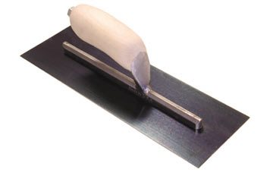
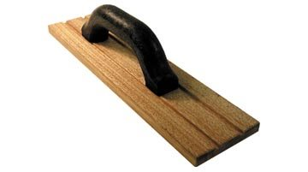
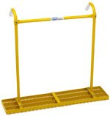
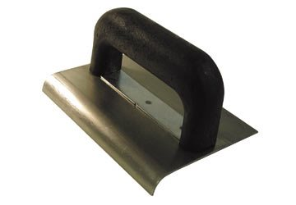
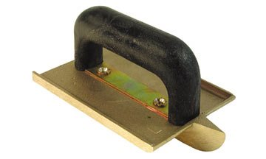
Domain 1: inspection, maintenance, installation, and repair
Floats purpose: To level ridges, fill voids, and smooth the surface in preparation for troweling. Unlike trowel finishing, floating won't close the surface, which is important at this stage to permit water to bleed out. A float also helps bring paste to the surface by pushing down the coarse aggregate
Steel trowels purpose: Used after floating to produce a smooth, hard, dense slab surface.
Tampers push the coarse aggregate in the concrete below the concrete surface and consolidate the concrete.
Edgers produce a neat rounded edge along the slab perimeter which helps the slab resist chipping and spalling damage after the forms are removed. Perform edging after the bleed water disappears from the concrete surface, but before the forms are removed
Groovers
Jointing the concrete is accomplished by grooving tools (unless the slab will be sawcut later). The purpose is to control the location of cracks that may form when the slab "contracts" due to drying shrinkage or temperature changes.

Slide 43
Domain 1: sample questions
What is the source of most bearing failure?
Excessive shaft speed
Improper installation
Under lubrication
Some form of contamination entering the bearing
What is the advantage of a split mechanical seal compared to a cartridge mechanical seal?
The seal can be installed without removing the pump
Seal flush is not required
The packing gland is easier to adjust
The split seal allows additional cooling
Which of the following is the most likely cause for pump to quickly become noisy and vibrate?
Over lubrication
Worn parts
Cavitation
Loss of foundation bolts

Slide 44

Domain 2 – tools and equipment

Slide 45
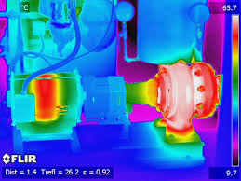
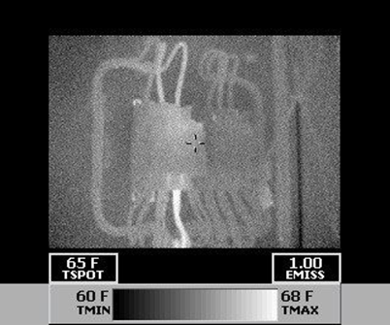
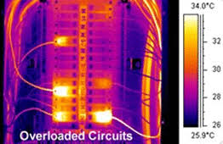
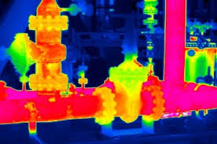
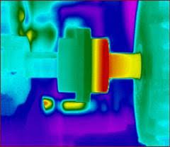
Domain 2: Tools & equipment

Slide 46
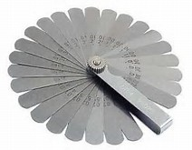
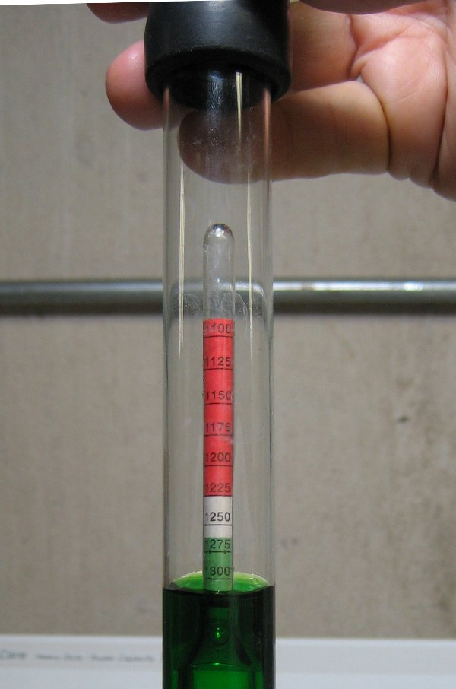
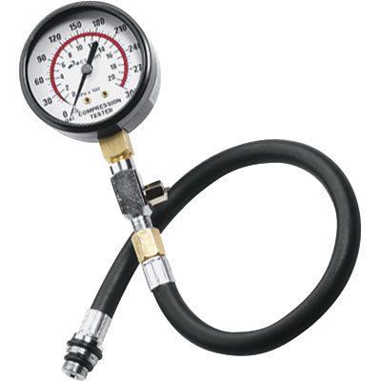
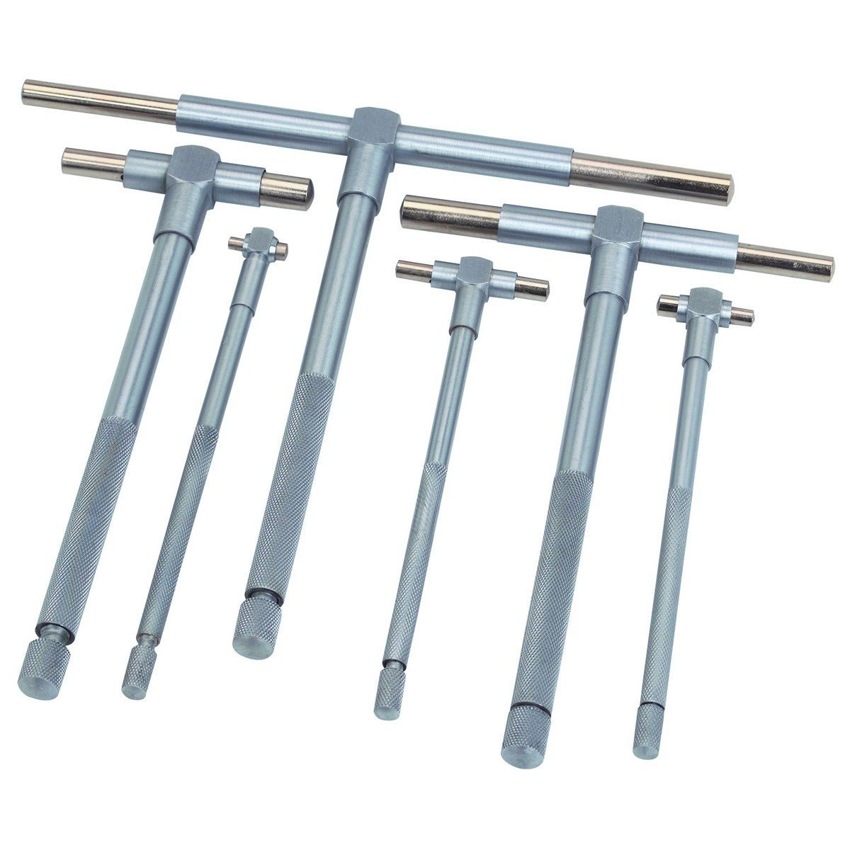
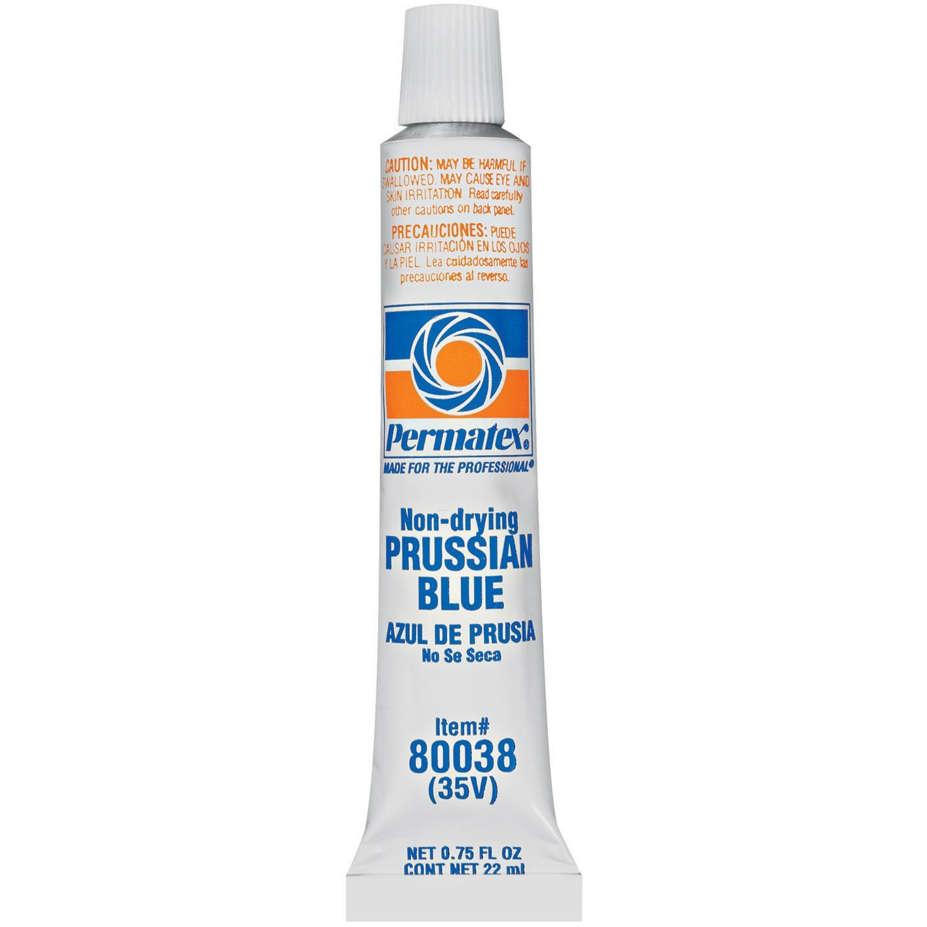
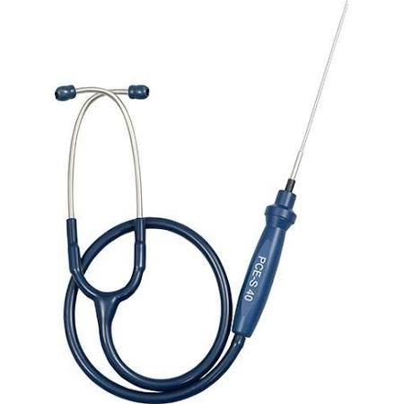
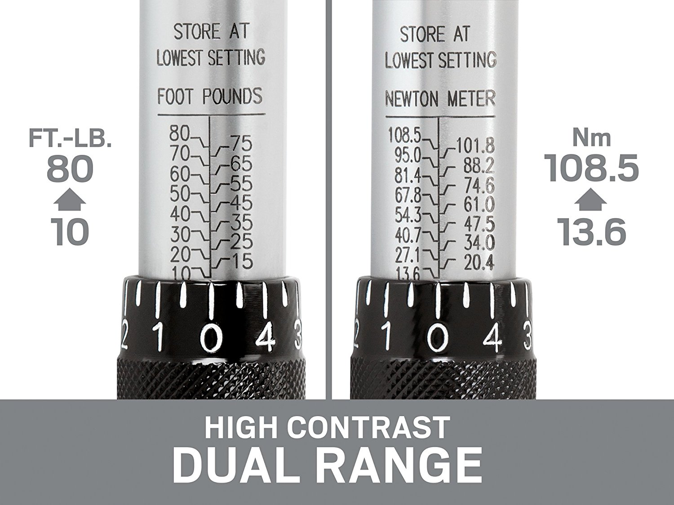
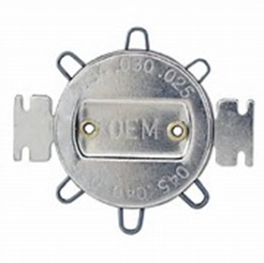
Domain 2: Tools & equipment

Slide 47
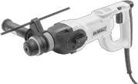
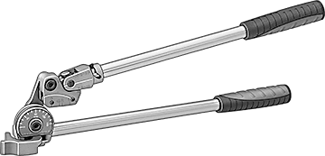

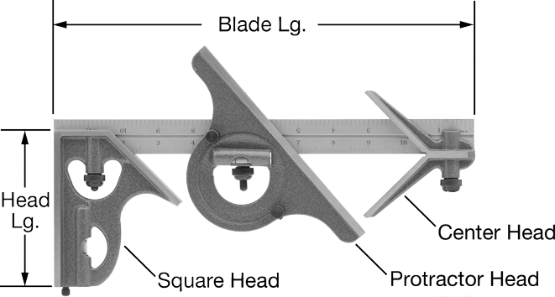
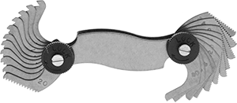
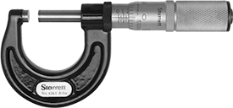
Domain 2: Tools & equipment
Electric Rotary Hammers
Tube Benders
Electrical and Data Cable Cutters
Micrometer
Combination Squares
Threads per Inch and Thread Pitch Identifiers

Slide 48
Domain 2: Tools & equipment
Wrenches – Open-end, Box and Combination
  Always try to pull on wrenches that way your body weight and foot are sound.
  Wrenches between ¼ in. to 1 ¼ IN. are in increments of 1/16 of an inch.
  Metric wrenches span from 7mm to 32mm and are stepped in 1-mm increments.
Ratchets are made in ¼, 3/8, ½, ¾, and 1-inch square drives, the large the size the greater the capacity of the ratchet.
Sockets are regular and extra deep, with openings of 12, 8, 6-point, and square.
Adjustable wrenches, provide a wide range of single tool usage. When using this type of wrench always make sure you apply the force to the fixed jaw.
Screwdrivers are a must for every toolbox, they are intended for one simply use: driving and withdrawing threaded fasteners.

Slide 49
Domain 2: Tools & equipment
Portable Power Tools: Battery-Powered Tools have made the mechanics job safer in the fact that “electrical tools are not carried by their power cords” and that “extension cords don’t need to be deployed creating a tripping hazard.” The weight and flexibility of these tools are ever advancing with longer battery life and power.
A hammer drill is used to drill “blind” holes in concrete that are used as a base for anchors to attach machine base or structural member to the concrete. Hole are drilled to a prescribed depth.
A “thread chaser” is used to repair damaged internal threads, while a “tap” repairs external threads.
Hammers come in many styles: ball-peen, cross-peen and straight peen, finishing, claw, sledge, etc. The word “peen” means the end of a hammer head opposite the face when adapted for striking; it is usually shaped for indenting when pointing, conical, hemispherical or wedged shaped.

Slide 50
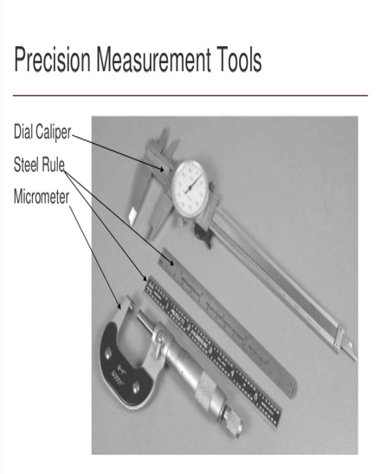
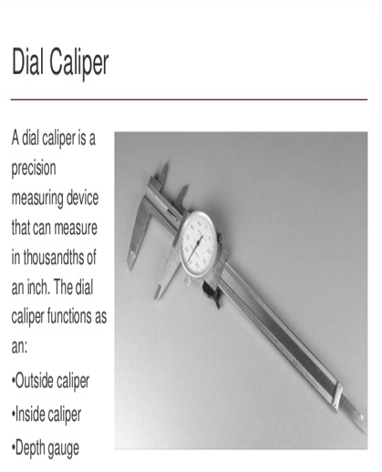
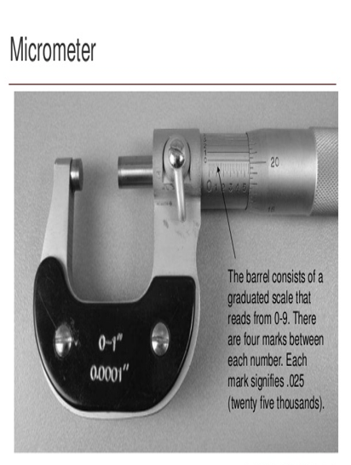
Domain 2: Tools & equipment

Slide 51
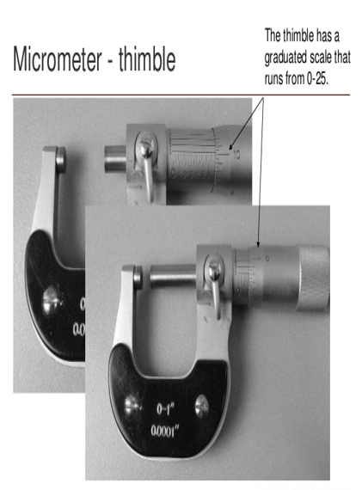


Domain 2: Tools & equipment

Slide 52

Domain 2: Tools & equipment

Slide 53







Domain 2: Tools & equipment
Rigid Coupling
Flexible (Disc) Coupling
Roller-Chain Coupling
Spider coupling
Grid-align Coupling
Grid Coupling
Gear Coupling

Slide 54


Domain 2: Tools & equipment

Slide 55



Domain 2: Tools & equipment

Slide 56



Domain 2: Tools & equipment

Slide 57

Domain 2: Tools & equipment
Safety Practices for the Operator
Only trained authorized personnel are permitted to operate a forklift.
The operator should not drive the truck up to a person standing in front of a bench or other object.
The operator should not carry loads heavier than those for which the truck is rated.
The operator should avoid making fast starts, sudden stops and quick turns.
The operator should report all accidents involving personnel, building structures and other equipment immediately.
Operation on main roads outside the facility should be permitted only with proper authorization from local transport authority.

Slide 58

Domain 2: Tools & equipment

Slide 59



Domain 2: Tools & equipment

Slide 60


Domain 2: Tools & equipment

Slide 61


Domain 2: Tools & equipment

Slide 62

Domain 2: Tools & equipment
Weir (WEER)
A wall or plate placed in an open channel and used to measure the flow of water. The depth of the flow over the weir can be used to calculate the flow rate, or a chart or conversion table may be used to convert depth to flow.
A wall or obstruction used to control flow (from settling tanks and clarifiers) to ensure a uniform flow rate and avoid short-circuiting.

Slide 63




Domain 2: Tools & equipment
Measures flows in open channels

Slide 64
Domain 2: sample questions
What is a thread chaser likely to be used for?
Adjust die stocks
Repair damaged threads
Remove broken belts
Flare tubing

Slide 65

Domain 3 – Records, Reports, and Scada

Slide 66
Domain 3: records, reports, & scada
Maintenance Management
The installation of a Maintenance Management system of either a manual or computerized system. Whatever mode(s) your facility chooses, the overall outcome is to have a Preventative, Predictive and Corrective Maintenance Program that will assist in making valued decisions.
Preventative Maintenance is time based. Certain tasks such as lubrication, inspection or adjustments are made at a required time or frequency on a piece of machinery.
Predictive Maintenance makes use of physical measurements on a machine, such as vibration levels, bearing conditions, noise emission reading, oil sample results or temperature and compares these readings to the norm. It also trends readings to determine impending failure in a machine or components.

Slide 67
Domain 3: records, reports, & scada
Logical steps on establishing a successful Maintenance Management Program:
Get a process drawing, building equipment location drawing or other “map” of the plant or process that list all the equipment and shows the location.
Make a list of equipment that will need to be implemented into the program. It is beneficial to group the equipment by name, number, location and type.
If equipment has never been numbered, it might be a smart idea to “adopt” an intelligent numbering system that helps in sorting or locating the equipment.
  PU-2004. A Pump located on the second and the fourth one in the process train.
  100-EX-405. A heat Exchanger in building 100 on the fourth floor and the fifth item in the process train.
  100-AC-405. An AC motor used to drive the gear pump on the heat exchanger shown in the previous entry

Slide 68
Domain 3: records, reports, & scada
Logical steps on establishing a successful Maintenance Management Program (Cont.):
Locate all maintenance manuals for the equipment: Make sure to ask for “cut sheets” or “exploded diagrams” to make spare-part identification easier when working on the equipment.
Schedule a meeting with the O&M personnel: Review the manufacturers’ information with others and see if the recommended PM strategies makes sense. Some manufacturers will use an overkill approach and suggest much more PM than is necessary.
Begin setting up the maintenance activities: Pay attention to common types of equipment (gear boxes, motors) and common activities (greasing, oil changes, chain inspections).
Setup work orders with routes: Scheduling things to be accomplished so that staff use their time properly. Incorporate the entire Maintenance Management system into the daily planning and scheduling of personnel.
Conduct audits every three to six months to determine the efficiency of the program and modify the program to change tasks, change frequencies, add or remove equipment, change routes or change personnel based on results of the audits.

Slide 69
Domain 3: records, reports, & scada
The goal of managing maintenance is to minimize investments in labor, materials, money and equipment. In other words, we want to manage our human and material resources as effective as possible, while delivering a high level of service to our customers.
The benefits of an effective operation and maintenance program are as follows:
Ensuring the availability of facilities and equipment as intended.
Maintaining the reliability of the equipment and facilities as designed.
Obtaining full use of the system throughout its design life.
Collecting accurate information and data on which to base the operation and maintenance of the system and justify requests for the financial resources necessary to support it.

Slide 70
Domain 3: records, reports, & scada
Contingencies and Emergency Plans
Emergency Planning Process:
The chief motivation behind emergency planning is to reduce the likelihood of lives being lost. A second motivation is to reduce damage to the infrastructures.
An emergency plan in its broad sense is to inform, instruct and direct participants in the measures needed to manage the direct and flow-on effects of emergency events that may lead to disasters. A plan is also a means of coordinating and advoiding the duplications of effort and resources. By its very nature, an emergency plan must be devised, implemented and tested.
Planning needs to be undertaken for each of the four emergency management cycles:
  Reduction
  Readiness
  Response
  Recovery
  Inefficiencies' in planning lead to loss or damage that could have been adverted. Thus, it is a moral responsibility for those involved with public or employee safety to ensure that emergency planning is carried, effectively and appropriately.

Slide 71
Domain 3: records, reports, & scada
Under 40 CFR Part 122.26, stormwater from certain industrial activities is required to be under a National Pollution Discharge Elimination System (NPDES) permit.
All NPDES permits that include stormwater are required to have a stormwater pollution prevention plan (SWPPP).
The key elements of an SWPPP are:
  A detailed site map showing drainage areas and hazardous material storage areas
  A materials inventory
  Identification of past spills and leaks
  The location of non-storm discharges
  Details of existing monitoring data
  An evaluation of the site for potential spills and leaks
  Best management practice procedures
  Conducting an annual site compliance evaluation
  Inspection procedures
  Recordkeeping and internal reporting, and
  Employee training

Slide 72
Domain 3: records, reports, & scada
Risk Management Plan (RMP): 40 CFR Parts 68.150 to 68.195 under the chemical accident prevention program, require the development of a risk management plan (RMP).
The regulations require that the RMP be submitted to the U.S. EPA, certified by the owner/operator and updated at a minimum of every 5 years.
Water and Wastewater facilities that handle or store above a threshold quantity from a specific list of chemicals may be subject to RMP requirements.
The key elements of an RMP are:
  An executive summary
  A registration form
  An offsite consequence analysis
  5-year accident history
  Prevention program depending on the type of process being used
  An emergency response program, and
  A certification statement from the owner or operator.

Slide 73
Domain 3: records, reports, & scada
The most important principle of good disaster preparedness planning is that it must include training as a key component.
The goal of training in emergency management is to bring order to chaos during a disaster.
Training must focus on a specific system the organization is using to manage a disaster
For most organizations, the incident command system (ICS) is used to manage disasters.

Slide 74
Domain 3: records, reports, & scada
Drawings
Drawings made up of lines to describe shape and contour must also have dimensions and notes to supply sizes and locations.
Three systems of writing dimension values are in general use.
The first is the “common fraction” system, with all dimension values written as units and common fractions.
The second system uses decimals to express fractions when distances require precision greater than plus or minus 1/64 of an inch.
The third system , the complete decimal system, uses decimal fractions for all dimensional values.
The foot (‘) and inch (“) marks may be used to identify the units.
Feet and inch dimensions should only be used for distances exceeding 72 inches.

Slide 75
Domain 3: sample questions
Which of the following is most true about predictive maintenance?
Results in more downtime than preventative maintenance
Costs less than preventative maintenance
Ensure less downtime than breakdown maintenance
Requires more spare parts on hand than breakdown maintenance
Which of the following best describes the efficiency of preventative maintenance for plant equipment?
The accumulation and analysis of equipment performance data designed to schedule equipment repairs
Timely response to equipment failure, returning equipment to service with a minimum of downtime
Periodic inspection of facilities to discover developing defects that could lead to equipment failures
Depends upon just-in-time parts delivery

Slide 76

Domain 4 – safety and facility maintenance

Slide 77
Domain 4: safety & facility maintenance
Lock-out/Tag-out Procedures:
Notification of all affected employees that a lockout or tagout is going to be performed and the reason why.
Operate switches, valve, or other energy isolating device(s) so that the equipment is isolated from its energy source(s).
Sometimes stored energy from flywheels, hydraulic systems, air gas and steam or water pressures need to be dissipated or restrained by methods such as repositioning, blocking or bleeding down.
LO/TO the energy isolating device with assigned individual lock or tag.
Make sure all affected staff is away from the equipment and conduct a start-up process in a normal sequence to verify that the system is disconnected/isolated.
After the work is completed, confirm all tools have been removed, guards have been reinstalled, and employees are in the clear, remove all lockout or tag out devices.
Energize the equipment and restore to operation.
Locking and tagging devices shall only be removed by the person issued the devices.

Slide 78

Domain 4: safety & facility maintenance
Per CCR8 Title 7 Section 3314 requires annual inspection of The lockout/tagout program to determine its continuity and if any changes are needed to procedures. This inspection needs to be performed by an “Authorized Employee or a person other than the one(s) utilizing the hazardous energy control procedures being inspected.”
The employer must certify that the periodic inspections have been performed. The certification shall:
Identify the machine or equipment on which the hazardous energy control procedure was being utilized,
The date of the inspection,
The employees included in the inspection, and
The person performing the inspection.

Slide 79
Domain 4: safety & facility maintenance
Confined space:
(1) Is large enough and so configured that an employee can bodily enter and perform assigned work; and
(2) Has limited or restricted means for entry or exit; and
(3) Is not designed for continuous employee occupancy”
Permit-required confined space: Means a confined space that has one or more of the following characteristics:
(1) Contains or has a potential to contain a hazardous atmosphere;
(2) Contains a material that has the potential for engulfing an entrant;
(3) Has an internal configuration such that an entrant could be trapped or asphyxiated by inwardly converging walls or by a floor which slopes downward and tapers to a smaller cross-section; or
(4) Contains any other recognized serious safety or health hazard”
When testing for atmospheric hazards, test first for oxygen, then for combustible gases and vapors, and then for toxic gases and vapors.
The employer shall retain each canceled entry permit for at least 1 year to facilitate the review of the permit space program.

Slide 80
Domain 4: safety & facility maintenance
The California Manual on Uniform Traffic Control Devices for Streets and Highways, defines the standards used by road managers in the State of California to install and maintain traffic control devices on all public streets, highways, bikeways, and private roads open to public travel.
Traffic Flaggers are required to wear the following:
The apparel background (outer) material color shall be fluorescent orange-red, fluorescent yellow-green, or a combination of the two (Class 2 or 3) as defined in the ANSI 107-2004 standard.
The retroreflective material shall be orange, yellow, white, silver, yellow-green, or a fluorescent version of these colors, and shall be visible at a minimum distance of 1,000 feet.
The retroreflective safety apparel shall be designed to clearly identify the wearer as a person.
The traffic control zone is the area between the first advanced warning sign and the point beyond the work area where traffic is no longer affected.
Traffic control zones are divided into these specific areas: Advanced Warning, Transition, Buffer Zone, Work, and Termination Area

Slide 81


Domain 4: safety & facility maintenance

Slide 82

Domain 4: safety & facility maintenance

Slide 83


Domain 4: safety & facility maintenance

Slide 84


Domain 4: safety & facility maintenance

Slide 85
Domain 4: safety & facility maintenance
Chlorinators - leaks around chlorinators will cause corrosion of equipment, check everyday for leaks. Large leaks will be detected by odor, small may go unnoticed until damaged results. A green or reddish deposit on metal indicates a chlorine leak.
Digesters and their related equipment include many hazards and fall under NFPA 820 Fire Protection in Wastewater Plants and Collection Facilities, which lists the requirements for electrical classifications, ventilation, gas detection, and fire control methods in sludge and gas handling areas.
Note: standard Electrical systems are “ PROHIBITED” on anaerobic digesters under this statue. All electrical systems within 5 ft. of this Digester “MUST” be rated a Class 1, Division 1 location.
Aerators should have at least two people doing the work. US Coast Guard approved life preservers must be provided with at least 90 feet of hand line and be located no more than 200 feet apart.
Note: If you work in areas where the danger of drowning exists, you MUST wear a US Coast Guard –approved life jacket or buoyant work vest.

Slide 86

Domain 4: safety & facility maintenance
Electric motors are machines most commonly used to convert electrical energy into mechanical energy.
Motor Types:
Alternating Current (AC)
Direct Current (DC)
The most common motor is the AC induction motor.

Slide 87


Domain 4: safety & facility maintenance

Slide 88
Domain 4: safety & facility maintenance
Motor Nameplate Data:
Serial Number – This is a unique number assigned by the manufacture based on their numbering system to identify that specific motor.
Type – This maybe a combination of letters and numbers, to identify the enclosure and or modifications
Model Number – Manufacture assigned identification number.
Frame – This identifies the frame size in accordance with established NEMA Standards and does not vary from manufacturer to manufacturer.
Horsepower – Rated Horsepower is the horsepower that the motor is designed to produce at the shaft when power is applied at a rated frequency, voltage and service factor of 1.00
Service Factor – Service factors of 1.0 and 1.15 means that a motor can be operated at its rated horsepower without causing damage to the insulation system. A 1.15 SF can be operated occasionally at the rated horsepower times the service factor with no insulation damage.
Class of Insulation – Classes A,B,E,F and H determine the operating temperature of the motor
Duty – Continuous (24 hours a day, 365 days a year) or Intermittent (specified time of on and off cycle)
Ambient Temperature – Maximum surrounding ambient air temp, exceeding this temp will damage insulation

Slide 89

Domain 4: safety & facility maintenance
Check the outside of the motor. If the motor has any of the following issues on the outside, they may be problems that can shorten the life of the motor because of previous overloading, wrong application, or both.
Look for:
Broken mounting holes or feet
Darkened paint in the middle of the motor (indicating excessive heat)
Evidence of dirt and other foreign matter having been pulled into the motor windings through openings in the housing

Slide 90
Domain 4: safety & facility maintenance
What does NEC stand for?
A. National Electrical Code
B. National Engineering Code
C. Natural Electronic Computers
D. National Electronics Code
Which of the following can burn the insulation on the supply connections at the motor starter?
A. Having the incorrect insulation
B. The voltage running through the connections is too high
C. The connections are loose or have poor contacts
D. The voltage through the connections is too low
What does EMT stand for?
A. Electrical Metal Tubing
B. Electrical Measurement Timing
C. Electrical Meter Timing
D. Electrical Metal Transmitting
What does GFI stand for?
A. Ground Fault Indicator
B. Great Failure Indicator
C. Ground Fault Interrupter
D. Great Fault Interrupter
What device would be used to measure AC current flow in a large diameter conductor?
A. A solenoid type tester
B. A clamp-on type ammeter
C. An ohmmeter
D. A potentiometer

Slide 91
Domain 4: sample questions
Which task does not require Lock-Out/Tag-Out in order to complete?
Clear a blocked pump impeller
Collecting vibration data from a pump/motor assembly
Replace a mechanical seal
Adjust the tension on a v-belt
Why should an electric hand tool, such as a drill, never be lifted or carried by its service cord?
The tool might swing and be damaged by striking some hard object
The cord might be pulled off its terminals and become short-circuited
The rubber covering the cord might overstretch
The tool might slip out of your hand because the cord is slick

Slide 92

Domain 5 – Administration and communication

Slide 93
Domain 5: administration & communication
Collection of data without analysis, interpretation, and use of results is a waste of time and money.
When reporting data, always write clearly and neatly. Records are not useful unless the are evaluated and used as indicators of plant operations and maintenance.
Remember these records are public, so what you write needs to be professional.
An excellent way to review of daily records and detect sudden changes or trends is a prepared chart showing values plotted against days. Unless results are plotted slight changes can go undetected.
Effective O&M programs are based on knowing what components make up the system, where they are located and the condition of the components. With that information, proactive maintenance can be planned and scheduled, rehabilitation, needs identified and long-term Capital Improvement Programs (CIP) planned and budgeted.
Wastewater Treatment Plant maintenance can either be proactive or a reactive activity.
There are three types of maintenance classifications: corrective maintenance, preventative maintenance and predictive maintenance.
Two type of emergency maintenance involves normal emergencies and extra-ordinary emergencies.
Normal emergencies are blockages, power failures and can be reduced with an effective maintenance program.
Extra-ordinary emergencies are those such as high-intensity rainstorms earthquakes, lighting strikes, heavy winds.

Slide 94


Domain 5: administration & communication

Slide 95
Domain 5: administration & communication
If it is not written down “IT DID NOT OCCUR” this must not be taken lightly! At the end of the day your hand should hurt, from logging pertinent information.
DON’T just look or write down a number from a pressure gauge or other instrument, know what that means.
Log Books are legal binding documents that need to be treated like such. Clear writing, single line corrections with initials (example: Serviced grit pump, checked v-belt RAD cog-belt tension, deflection of 1 inch recorded.)
Never ever use correction fluid (white out). It is like saying I am trying to hide something.

Slide 96
Domain 5: administration & communication
Hazardous Communication and Workers Right to Know laws were established to ensure that employers provide their employees with the training and PPE to properly handle and store chemicals.
The basic elements of this program are:
Identify Hazardous Materials – What chemicals are you exposed to on a daily basis in your work environment.
Obtain Safety Data Sheets – These are provided by the chemical manufacturers and are required by Cal-OSHA. They detail the chemical make-up of the product and all safety aspects that need to be followed to properly used.
Properly Label Hazards – Specialized identification on the containers that identify their contents.
Training – Making information available to staff for them to use in everyday maintenance routines.

Slide 97
Domain 5: administration & communication
Conducting meetings:
Before the meeting: Prepare an agenda and distribute it to all participants, find an adequate
meeting room, set a beginning and end time.
During the meeting: Start the meeting on time, clearly state the purpose and objectives of the meeting,
involve all the participants, do not let one or two individuals dominate the meeting, keep the discussions
on track and on time with the agenda, when the group makes a decision or reaches consensus,
restate your understanding of the results, make clear assignments for participants and review them
with everyone during the meeting.
After the meeting: Send out minutes of the meeting, send out reminders about assignments given, if any.
Communication – Oral and Written
Communication is a two-part process; information must be given and it must be understood. Good listening skills are as important in communication as the information you need to communicate.
During oral communication observe your audience of one or many to insure what you are saying is getting across.
If you are talking to an operator or supervisor, it is a good idea to ask for feedback
Written communication is more difficult and requires more organization since you cannot clarify and explain ideas in response to the person reading your report or document.

Slide 98
Domain 5: administration & communication
Telephone Contacts: First impressions are extremely important and frequently a person’s first contact with a wastewater plant is over the telephone.
A person who answers the phone in a courteous, pleasant and helpful manner goes a long way toward establishing a friendly, cooperative atmosphere.
Answer calls promptly, your conversation will get off to a better start if you answer by the third or fourth ring.
Identify yourself, this adds a personal note and lets the caller know whom he or she is talking to.
Pay attention, don’t conduct side conversations, minimize distractions, giving the caller your full attention and talk notes so that you have clarity of the call once it ends. Minimize transfers, no body likes to get run-around.
Accident Reporting: should be simple and record all details required by law and all data needed for statistical purpose. The report must show the name of the injured, employee number, division, time of injury, nature of injury, cause of incident, first aid administered and remarks for items not covered elsewhere.
Worker’s compensation reports will be required and any other state or federal requirements.

Slide 99
Domain 5: sample questions
Two major components of a maintenance program are performing tasks and:
scheduling tasks
ordering renewal parts
equipment failure analysis
completing the paperwork
Which of the following is the best description of a total head?
It is equal to static head minus dynamic head
It is the amount of energy in water due to water pressure
It is the amount of energy in water due to velocity
It is equal to the static head plus dynamic head minus friction loses

Slide 100

Domain 6 – math

Slide 101
KSA 208 – math
Grade 2 math problems are pump and motor efficiency, horsepower (brake/motor), flow rates, measurements, drive ratios and pressure.
What is the area of a triangle with a base of 13 feet and 7 inches and a height of 9 feet and 8 inches.
Area = ½ x B x H
Area = ½ x 13’ 7” (7/12=.58) x 9’8” (8/12= .667)
Area = ½ x 13.58 x 9.67
Area = ½ x 131.3
Area = 65.66 sq. ft.
H: 9ft. 8 in.
Base: 13 ft. 7 in.

Slide 102
KSA 208 – math
The exterior walls of an open top tank are to be painted. If the tank is 25 feet in diameter
and 12 feet high, what is the total surface work area of the tank in square feet?
25 ft.
Area of a circle = π x d x h
Area Circle = 3.14 x 25 x 12
Area Circle = 78.5 x 12
Area Circle = 942 sq. ft.
12 ft.

Slide 103
KSA 208 – math
How much more water will a 6-inch diameter pipe carry compared to a 3-inch diameter
pipe under the same conditions.
Area = π x r2
Area = 3.14 x 1.5 x 1.5
Area = 7.065
Area = .785 x d x d
Area = .785 x 3 x 3
Area = .785 x 9
Area = 7.065
3 inch diameter
or
Area = .785 x d x d
Area = .785 x 6 x 6
Area = .785 x 36
Area = 28.26
6 inch diameter
Area = π x r2
Area = 3.14 x 3 x 3
Area = 28.26
28.26 / 7.065 = 4.00 times

Slide 104
KSA 208 – math
What is the decimal equivalent of 13/16 of an inch?
Decimal = 13/16
Decimal = 0.8125
What is the fraction equivalent of 0.875
Fraction = 0.875 x 4 or 8 or 16
Fraction = 0.875 x 4 = 3.5 x common denominator 2 = 2 x 3.5 / 2 x 4 = 7/8
Fraction = 0.875 x 8 = 7/8
Fraction = 0.875 x 16 = 14 x common denominator 2 = 14/2 / 16/2 = 7/8

Slide 105
KSA 208 – math
How many gallons of wastewater is in a 1,500 foot long 6-inch pipe?
1500 ft.
Formula = Volume cylinder = 3.14/4 x diameter² x length
Volume = .785 x .50 x .50 x 1500
Volume = .785 x 0.25 x 1500
Volume = .785 x 375
Volume = 294.37 = 294.4 ft³
1 cubic foot = 7.48 gallons
294.4 ft³ x 7.48 gallons = 2,202.1 gallons
6 in.
6 in. / 12 in. = 0.5 ft.

Slide 106
KSA 208 – math
A Bioxide tank has a full working capacity is 20,000 gallons. Its current level is at 2,200 gallons. How many gallons does the delivery driver need to add to bring it to 60% capacity?
A. 10,800 gal.
B. 16,100 gal.
C. 9,800 gal.
D. 15,800 gal.
20,000 gallons
60 %
20,000 / 100% capacity = 200 gallons in 1%
200 gallons x 60 % = 12,000 gallons
12,000 gallons – 2,200 gallons = 9,800 gallons
2,200 gallons

Slide 107
KSA 208 – math
The training room at your plant needs new carpet. If the room is rectangular in shape and measures 30 feet by 54 feet, how much carpet is needed in square yards?
Formula:
Area rectangle = (length x width)
AR = (30 X 54)
AR = 1620 sq. ft.
Square yards = 3 ft. x 3 ft.
Square Yards = 9
AR (Sq. Yards) = 1620 / 9
AR (Sq. Yards) = 180
54 ft.
30 ft.

Slide 108
Domain 5: sample questions
Two major components of a maintenance program are performing tasks and:
scheduling tasks
ordering renewal parts
equipment failure analysis
completing the paperwork
Which of the following is the best description of a total head?
It is equal to static head minus dynamic head
It is the amount of energy in water due to water pressure
It is the amount of energy in water due to velocity
It is equal to the static head plus dynamic head minus friction loses

Slide 109
Questions?
Thank You, Best wishes on your upcoming Test!
Robert Delgado
rdelgado@ieua.org

Slide 110
Thank You!

