Slide 1
Supercritical Water Oxidation Converting waste into water, energy and nutrients
pioneering a new era in sustainability
January 17, 2023, 12:00 pm – 1:00 pm

Slide 2
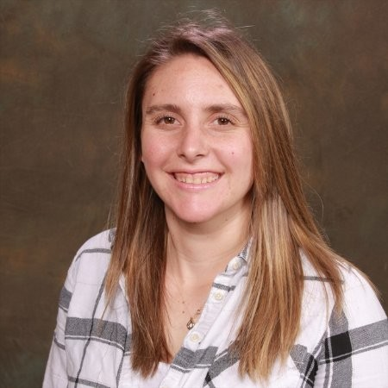
Stephanie Douglass
Mott MacDonald
CWEA Students and Young Professionals Chair
Notes:
Please DON’T put speakers agency logo on the slide. It will not look good.

Slide 3
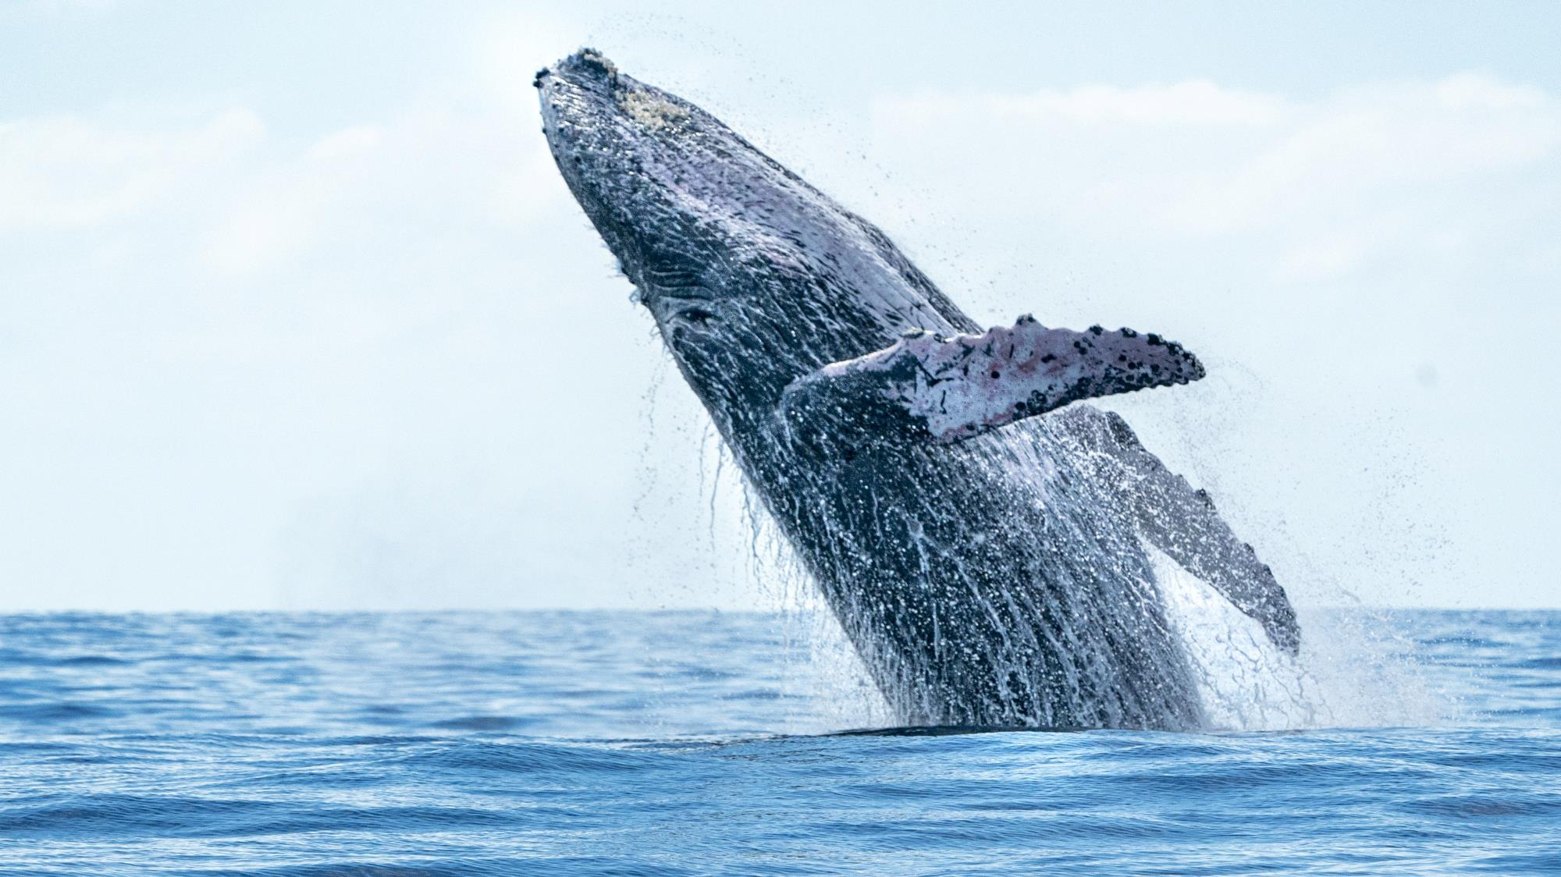
CWEA, its Board members and
volunteers are not responsible for the
actions of speakers or the content of their
sessions. No endorsement is implied or
given of any persons or their philosophies,
ideas or statements; nor of any products
or processes; nor of any organizations
or companies who volunteer to serve as
speakers in educational programs.
For reporters: all speakers today are off the record.

Slide 4
Sudhakar Viswanathan
Process for Claiming Contact Hours for
this Webinar
Note the different attention check code(s) that will appear for 60-90 seconds in the top left or right corner of the presentation.
Log in to https://owen.cwea.org/ the Online Wastewater Education Network (OWEN) with your mycwea.org account info and find this program in “Your Dashboard”.
Under the "Contents" tab, enter the correct attention check codes in the “Attention Check Code” component within 48 hours of the live webinar.
Your contact hours will be reflected in your mycwea.org account within 2-3 weeks following completion.
VP of Sales
374Water

Slide 5
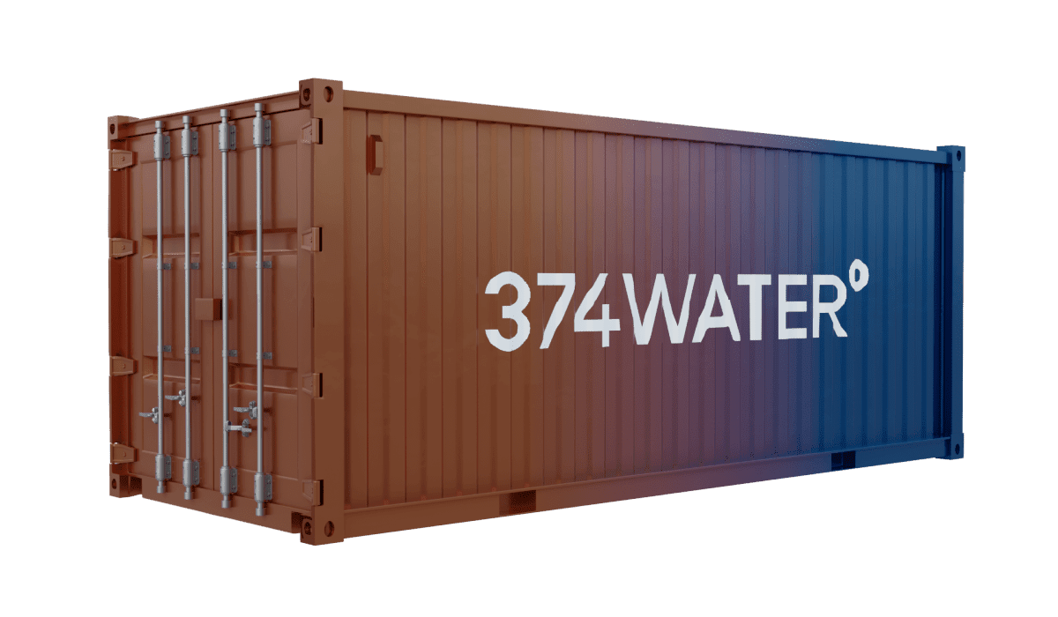
Who are we?
Social impact, cleantech, vision/mission driven company in Durham, NC
2015
Today ($SCWO)
2013
2018

Slide 6
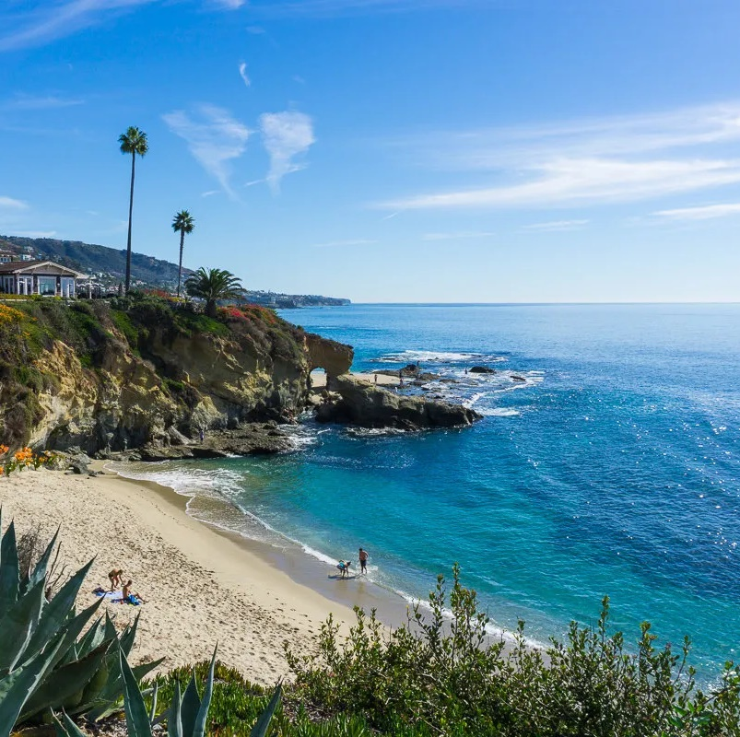
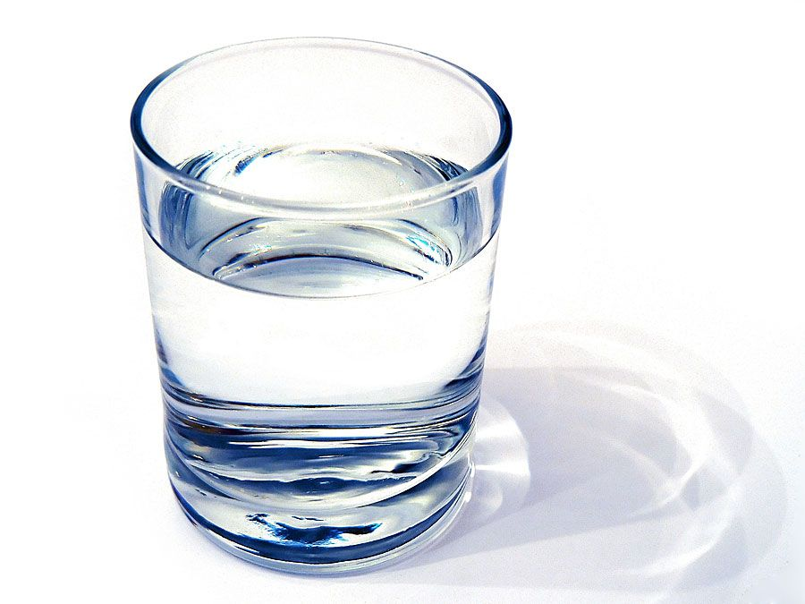
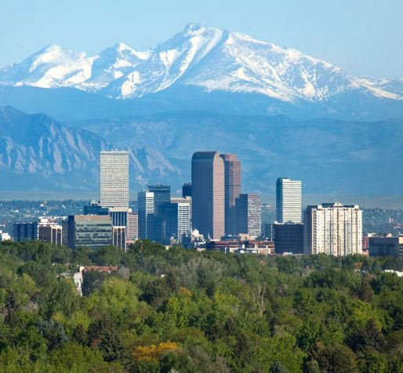
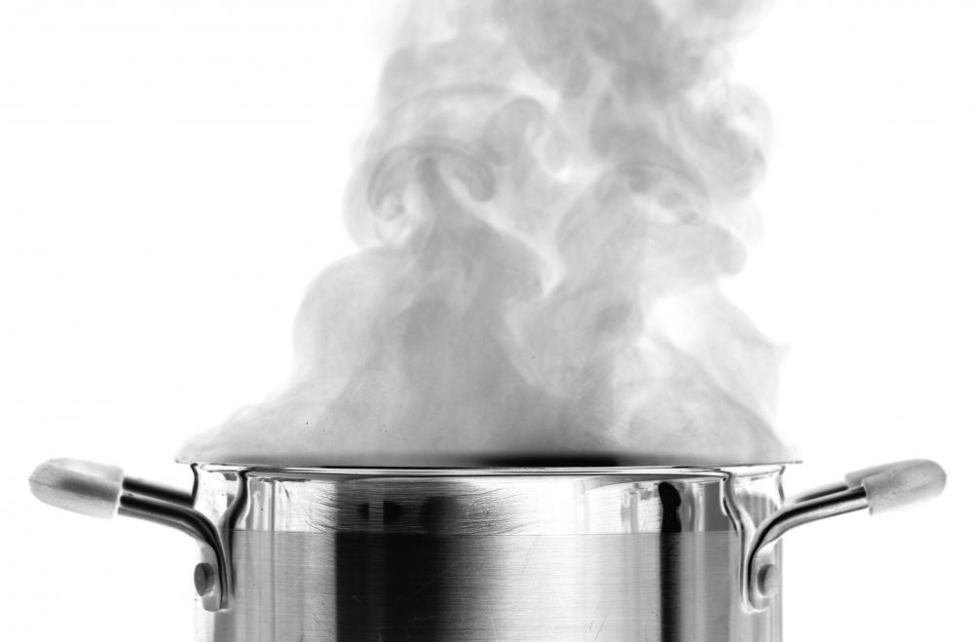
Water 101
Temperature
vs. Pressure
ice
100ºC/212ºF
water
94.4ºC/ 202ºF
vapor

Slide 7
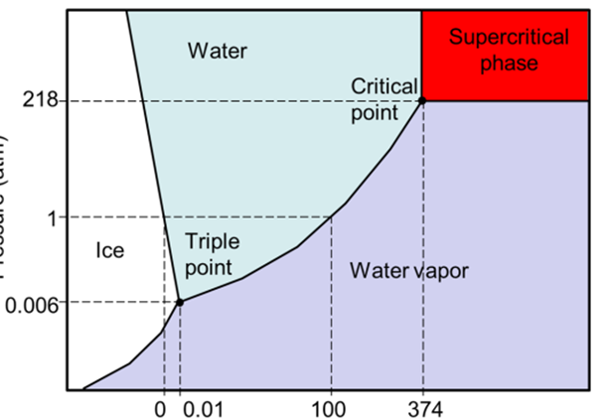
What is Supercritical Water?
Water
Universal solvent
Readily dissociates salts (inorganic)
Oil (organics) don’t mix
Supercritical water
Gas like behaviour
Liquid like density
Salts come off solution
Readily dissociates organics
Source: Public Domain, enviro.wiki

Slide 8
SCWO for Organic Waste
AirSCWOTM converts organic waste into clean water, heat, electricity and CO₂ in seconds!

Slide 9
PFAS specific wastes
PFAS + O₂ (air) H₂O + CO₂ + F⁻ + CaF₂ + heat
AirSCWOTM eliminates PFAS from spent GAC, spent IEX, RO reject, diluted AFFF, landfill leachate, groundwater, wastewater sludges & biosolids, rinsates from decontamination

Slide 10
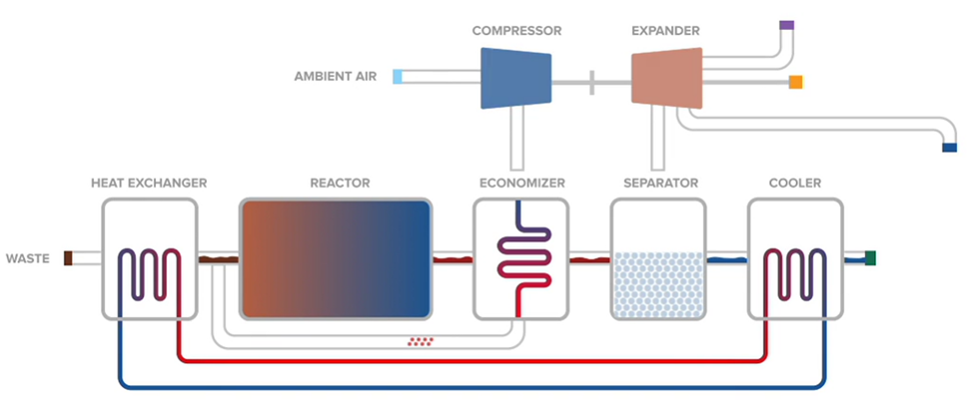
AirSCWOTM

Slide 11
Sludge Chemical Transformation
Parameter | Influent | Effluent
COD (mg/L) | 220,000 | 200
VSS | 18 | 0%
Total N (mg-N/L) | 15,000 | 500
NH₃ (mg-N/L) | 600 | 100
NO₂⁻ (mg-N/L) | 50 | 5
NO₃⁻ (mg-N/L) | 300 | 10
PO₄³⁻ (mg-P/L) | 6000 | 150
pH | 8 | 7
Conductivity (μS/cm) | 5000 | 300
99.9% COD conversion to CO₂ + energy
>95% TN converted to N₂
>85% PO₄ precipitated as phosphorus pentoxide

Slide 12
Sludge Mineral Content
 | Percent (%) | Pounds per Ton | Nutrients (lbs/ton)
Nitrogen - Total | 0.14 | 2.8 | 0.84
P2O5 - Total | 19.3 | 386 | 231.6
K2O - Total | 0.4 | 8 | 6.4
Calcium | 8.9 | 178 | 106.8
Magnesium | 2.31 | 46.2 | 27.72
Sulfur | 1.3 | 26 | 15.6
Boron | 0.01 | 0.2 | 0.12
Zinc | 0.17 | 3.4 | 2.04
Manganese | 1.34 | 26.8 | 16.08
Iron | 16.68 | 333.6 | 200.16
Copper | 0.07 | 1.4 | 0.84
Sodium | 1.57 | 31.4 | 31.4

Slide 13
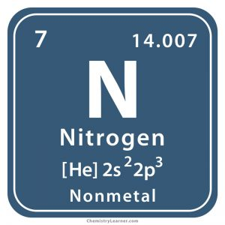
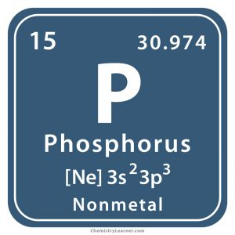
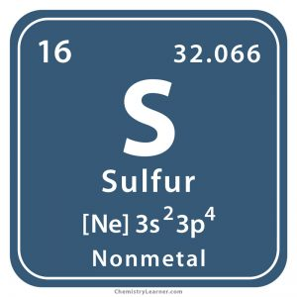
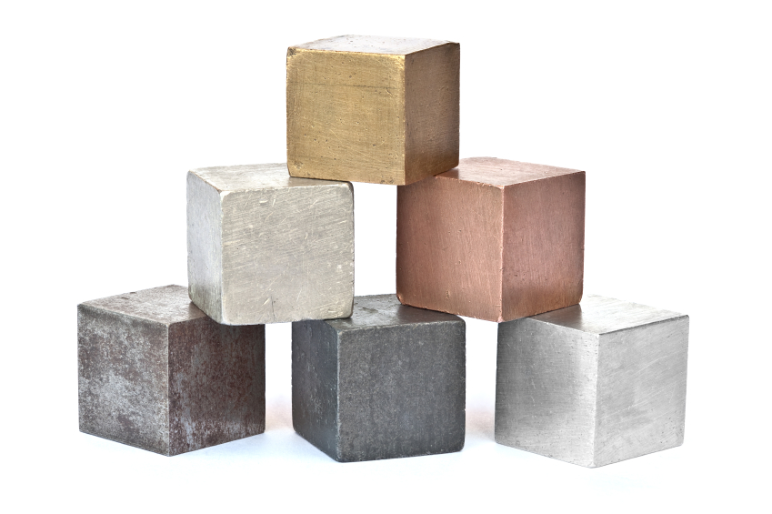
Fate of Other Pollutants
Organic
Urea, ammonium
Heterocycles
Vent gas
N species are mostly transformed to N₂ gas
Typ. Gas composition
<3 ppm_{v} NH₃
<5 ppm_{v} NO_{x}
<3 ppm_{v} SO_{x}
No odor
Organic
Phosphate
Solid minerals
Phosphate precipitates Ca₃(PO₄)₂
MgNH₄PO₄·6H₂O
HS⁻, COS, organic
Mercaptans
Sulfates, Hydrates
CaSO₄
Emerging contaminants
Pharmaceuticals
PFAS, 1,4-D
Mineralized to CO₂
Fluoride dissolved, CaF₂
Metals
Dissolved
Precipitates
Non-leachable forms

Slide 14
Fate of PFAS in solids/liquids
>99.9% PFAS destruction
99.99% elimination of PFOS
99.95% elimination of PFOA
Pollutant | In | Out*
PFBA | 5,000 - 8,000 | 99.86%
PFHxA | 3,000 - 7,000 | 99.89%
PFNA | 500 - 1,500 | 99.90%
PFDA | 3,000 - 5,000 | 99.97%
PFUnA | 500 - 1,500 | >99.89%
PFBS | 500 - 1,500 | >99.98%
PFPes | 3,000 - 5,000 | >99.98%
PFHxS | 3,000 - 5,000 | 99.99%
PFOS | 150,000 - 230,000 | 99.99%
PFOA | 2000 – 4000 | 99.95%
* Includes water, air and minerals

Slide 15
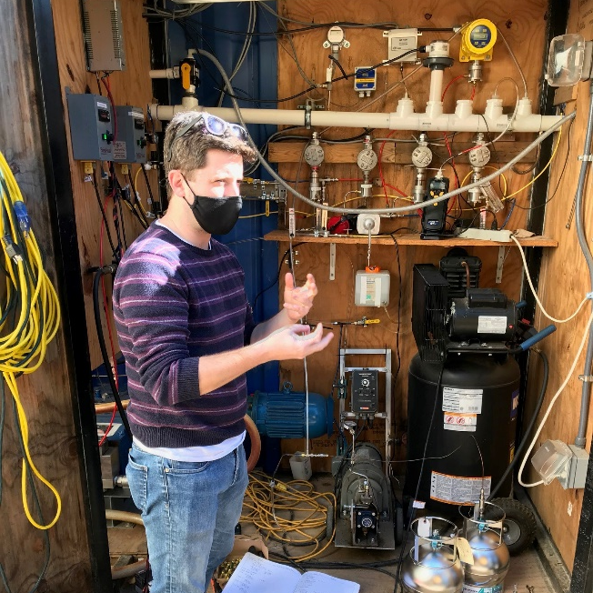
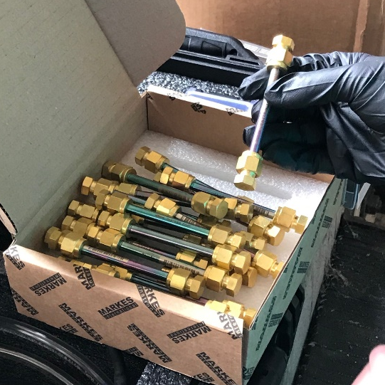
Fate of PFAS in gasses
EPA PITT emission tests, deployed 2 methods:
Passivated, evacuated canisters
Sorbent tubes
Mass flux of volatiles organic compounds as percent of input total organic fluorine: <0.2%
Only traces were detected in vent gas

Slide 16
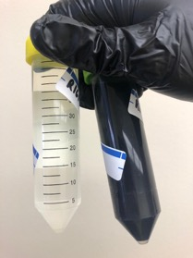
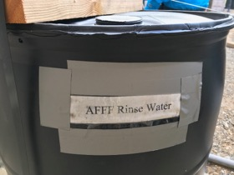
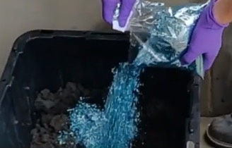
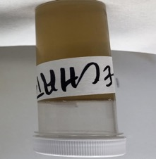
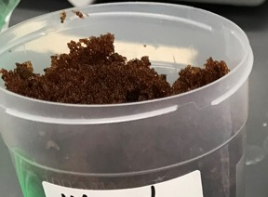
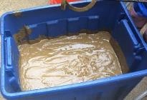
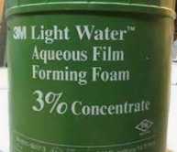
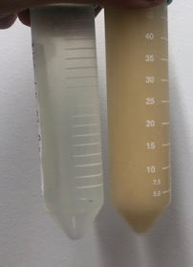
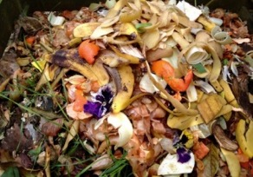
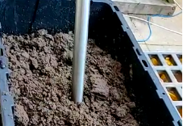
What else can SCWO treat?
Wastes Treated to Date
AFFF
AFFF Rinsate
Animal Waste
Food Waste
GAC
Ion Exchange Resin
Landfill Leachate
Microplastics
Pharmaceuticals
Straw Water
Sludges & Biosolids

Slide 17
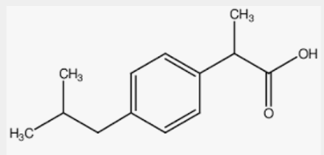
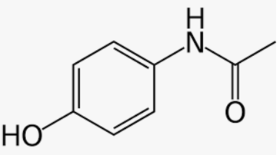
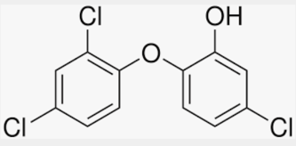
Other Micropollutants
Spiked contaminants in IPA/water and in biosolids
Ibuprofen and acetaminophen:
Feedstock: 10 mg/L each
Effluent: ND at < 1 µg/L
DRE: >99.99%
Triclosan:
Feedstock: 100 µg/L
Effluent: ND at < 0.1 µg/L
DRE: >99.9%
Ibuprofen
Acetaminophen
Triclosan

Slide 18
AirSCWO™ Commercial Offerings
1 wtpd*
~264 GPD
@ 15%
6 wtpd
(~1600 GPD @ 15%)
Ideal for 1 MGD WW facility
30 wtpd
(~8000 GPD @ 15%)
Ideal for 5 MGD WW facility
200 wtpd
(~53,000 GPD @ 15%)
Ideal for 30 MGD WW facility
Losses 20 kW
1 tpd
26 kW
624 kW-h/day
10 kW
300 kW-h/day
12.5 kW
300 kW-h/day**
167 kW
4000 kW-h/day **
*Pilot unit – not optimized for energy efficiency
Heat: 2.4 MWh/day
Heat: 12 MWh/day
Heat: 80 MWh/day
** Net electric energy after parasitic use

Slide 19
AirSCWO™ Commercial Offerings
 | AirSCWO™ 6 | AirSCWO™ 30
Capacity for liquid or slurry Dry solids capacity | 6 wet tons/day or 1600 gal/day ~0.5-1.5 tons/day | 30 wet tons/day or 8000 gal/day ~2.5-7.5 tons/day
Footprint | One 40 ft container | Three 40 ft container
Operation | up to ~8000 hours/year
Typical organic or calorific content of feedstock | ~160 g COD/L 2.5 MJ/L
Power usage/produced | Uses ~240 kWh/day | Produces ~300 kWh/day
Availability | Late 2022 | Late 2023

Slide 20
AirSCWO™ Installations
Demonstration Scale (1 WTPD)
Duke University, Durham, NC:
2013 to 2022
< 200 runs
Kokomo, IN:
2022 to current
Semi-permanent install for pilot studies
Full Scale (6 WTPD)
CA - 2Q 2023
FL - 2Q 2023
ME - 2Q 2023
DoD 1 - 3Q 2023
NC - 4Q 2023
DoD 2 - 4Q 2023
4+ units to be deployed elsewhere

Slide 21
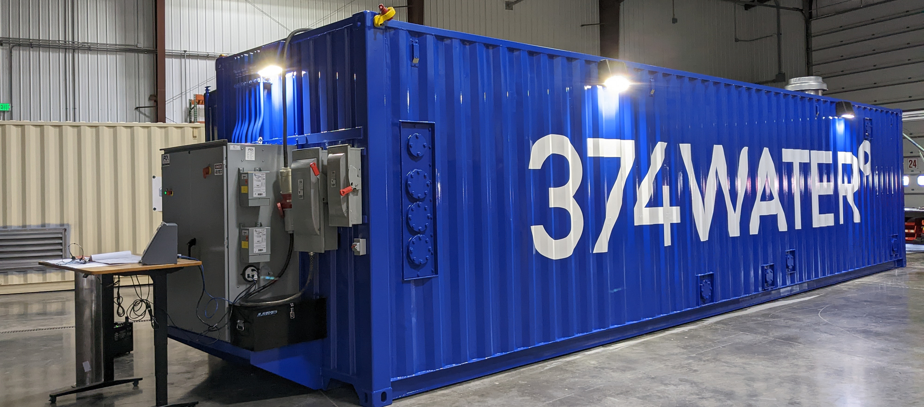
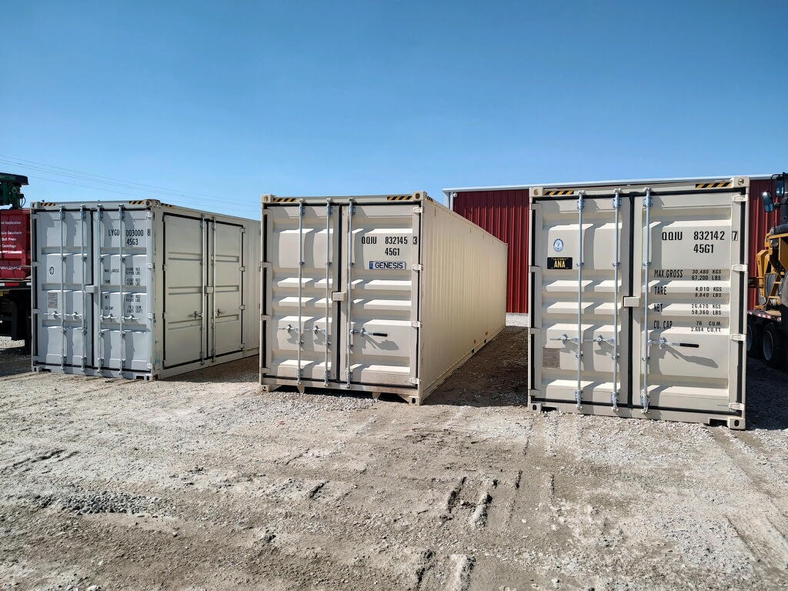
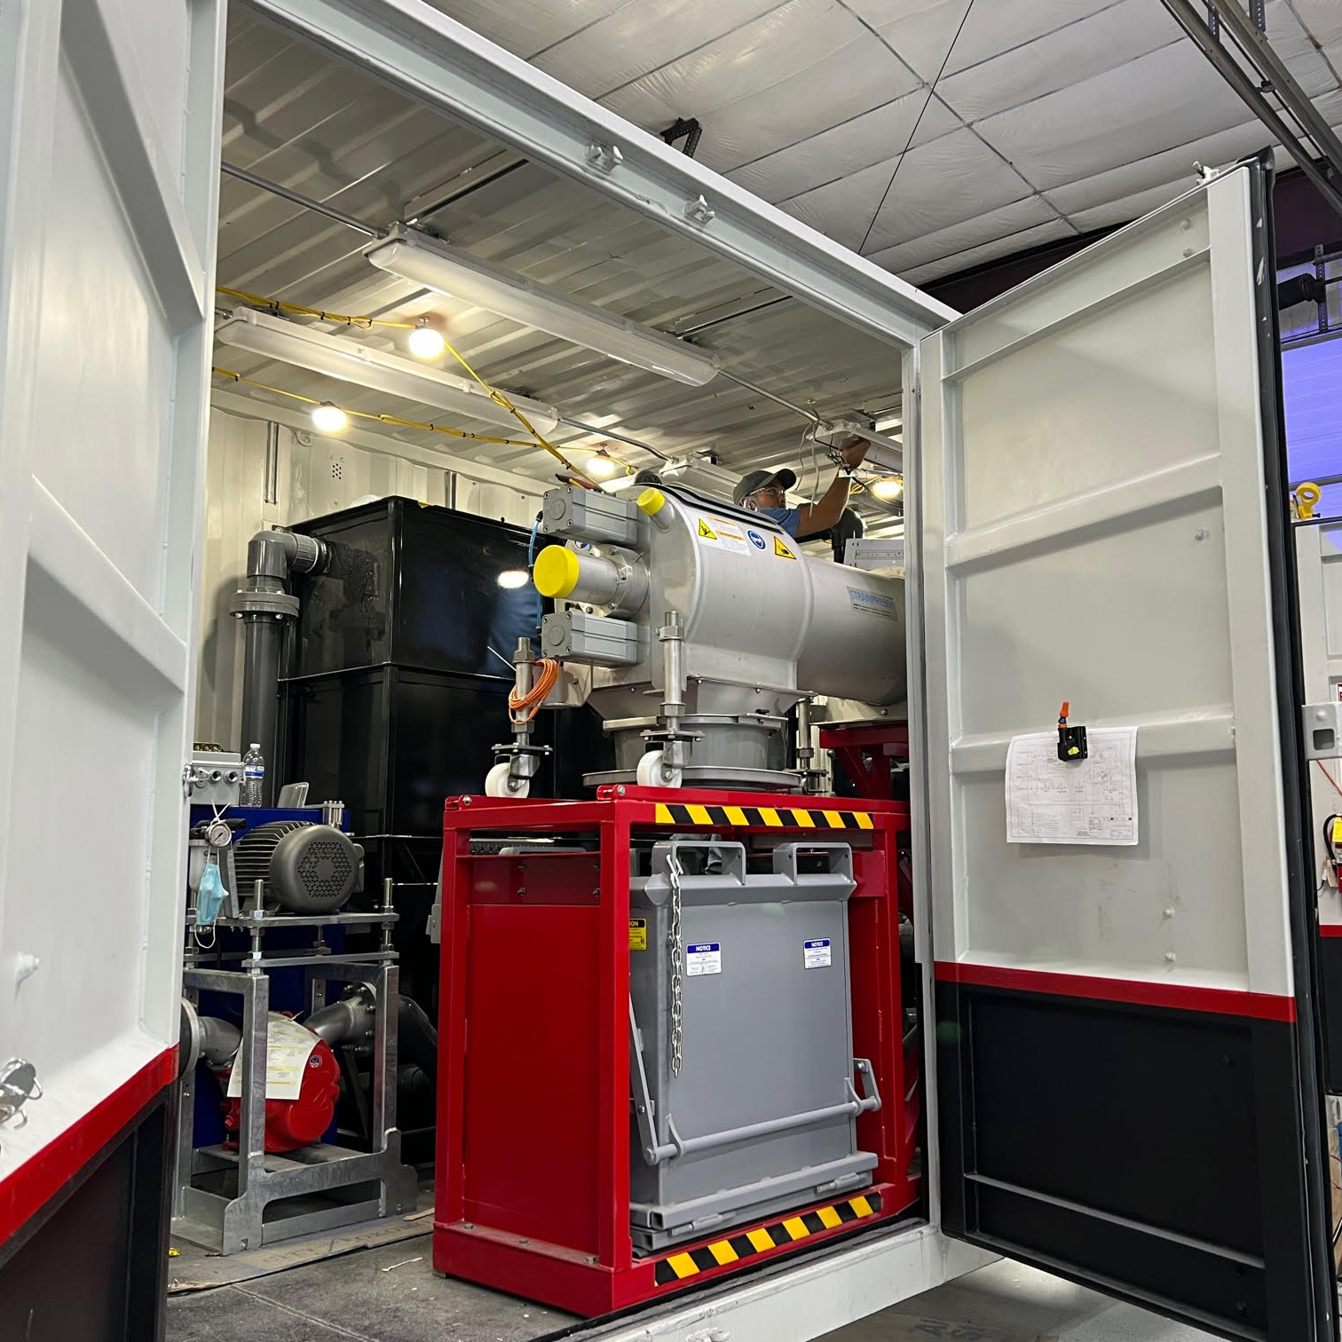
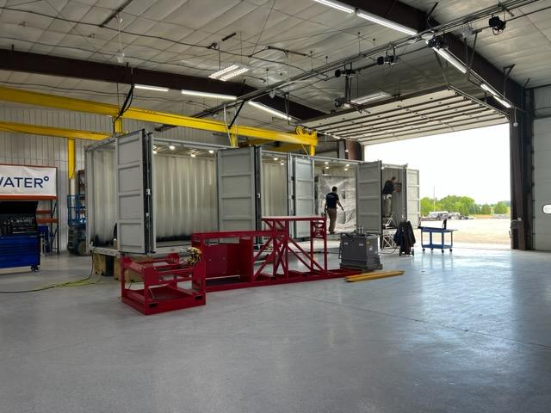
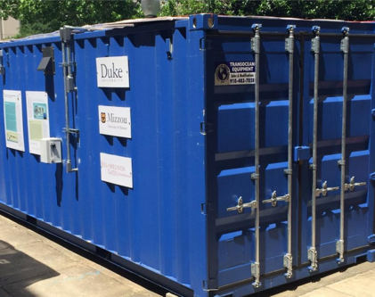
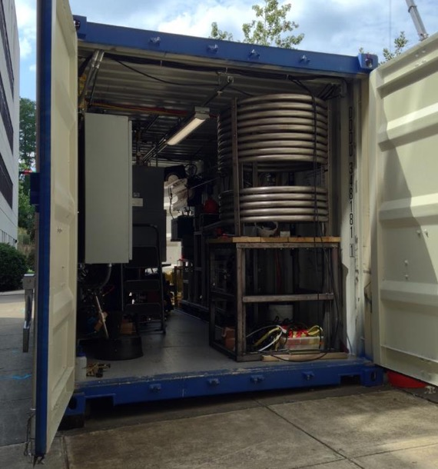
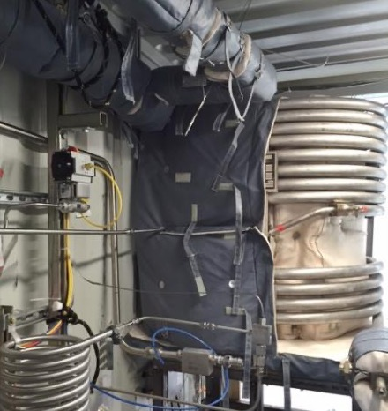
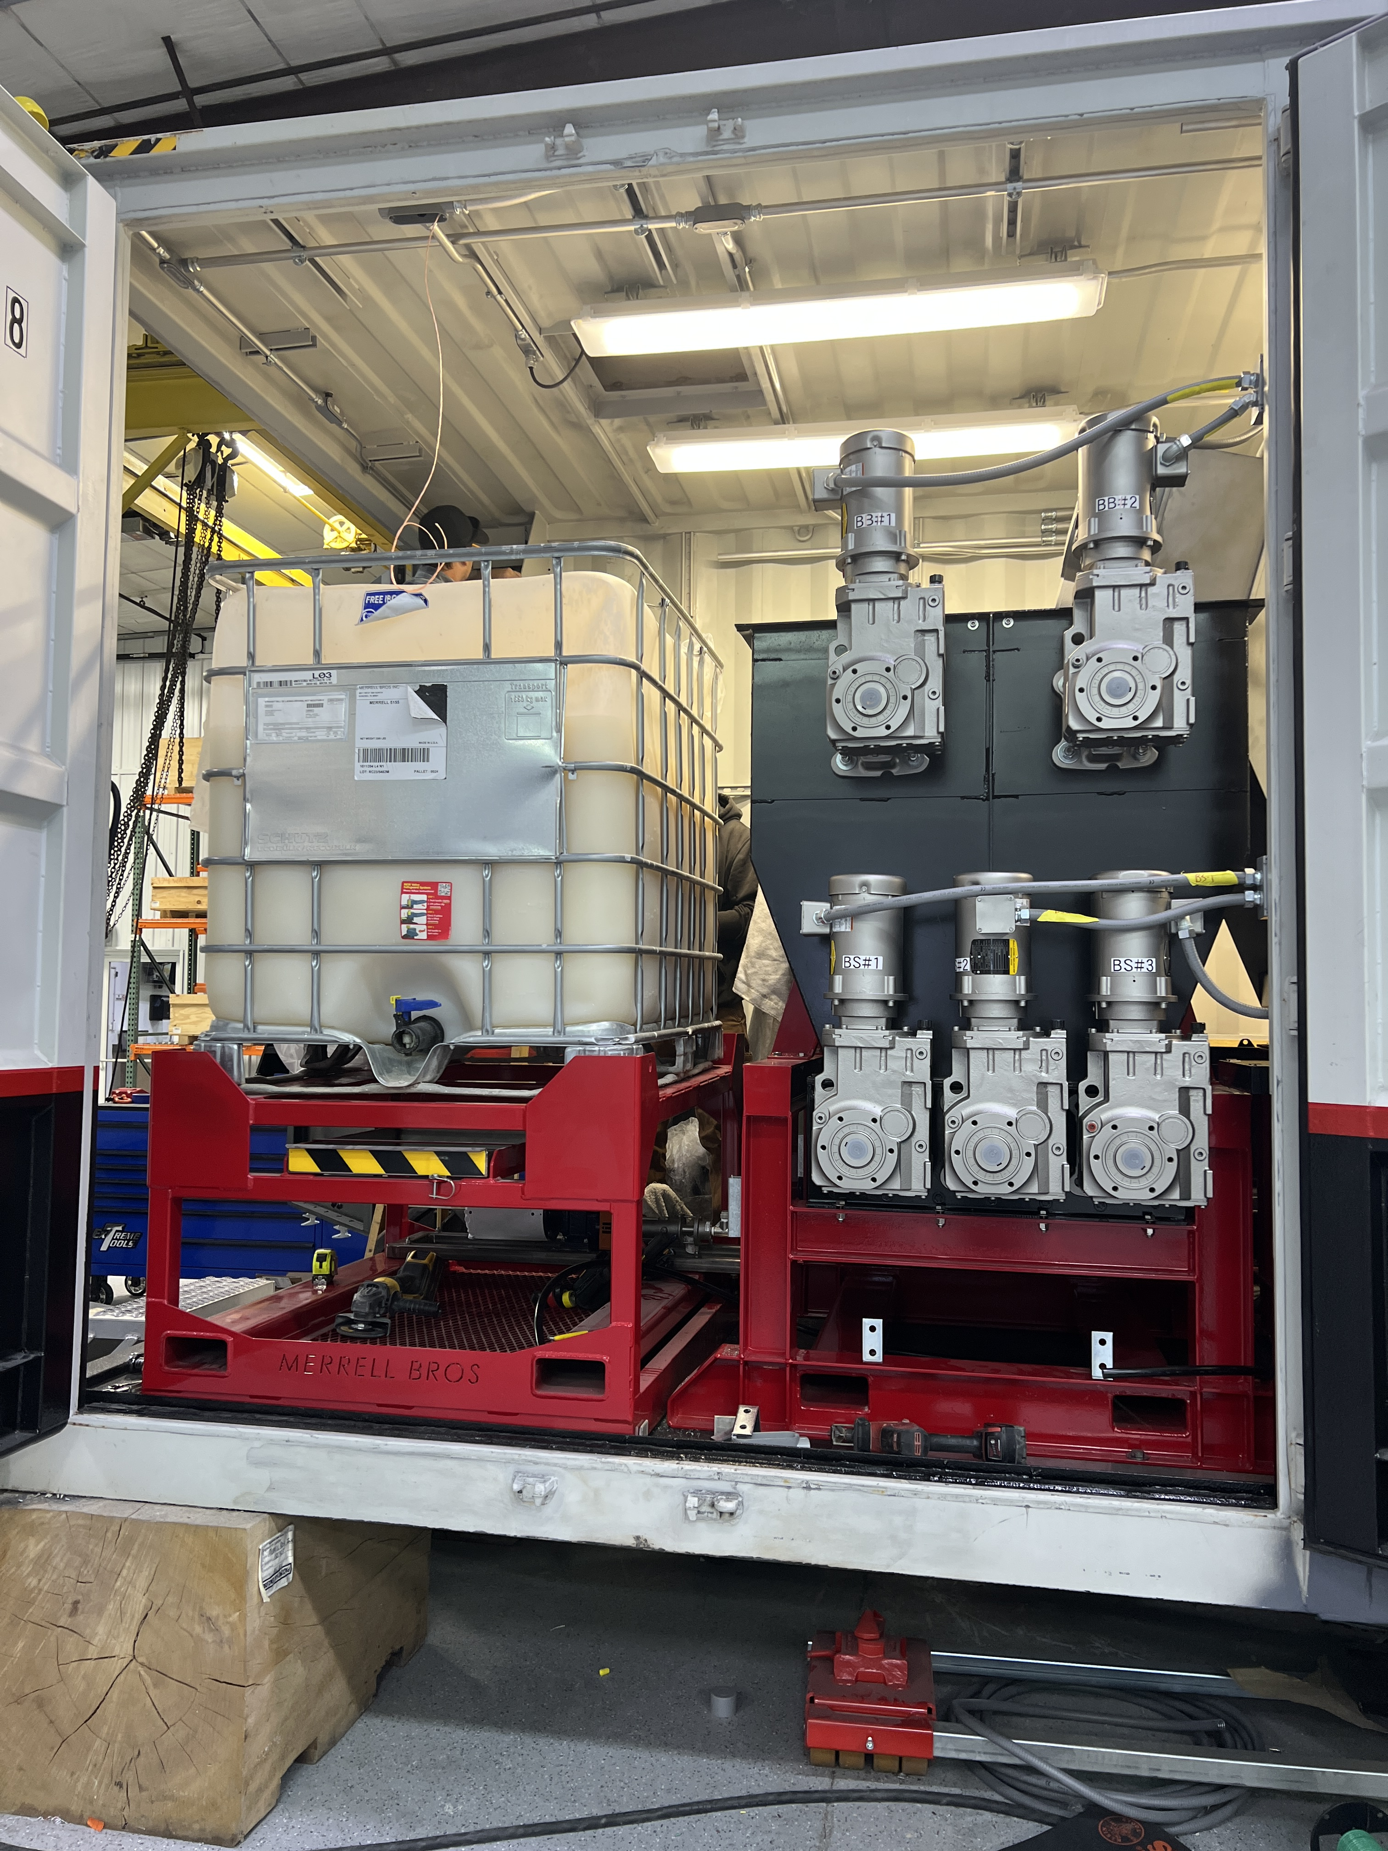
Prefabricated, Compact & Modular
AirSCWO™ 1 metric ton per day operating on the Duke campus from 2015
AirSCWO™ 6 metric ton per day assembled at MB facility 2022

Slide 22
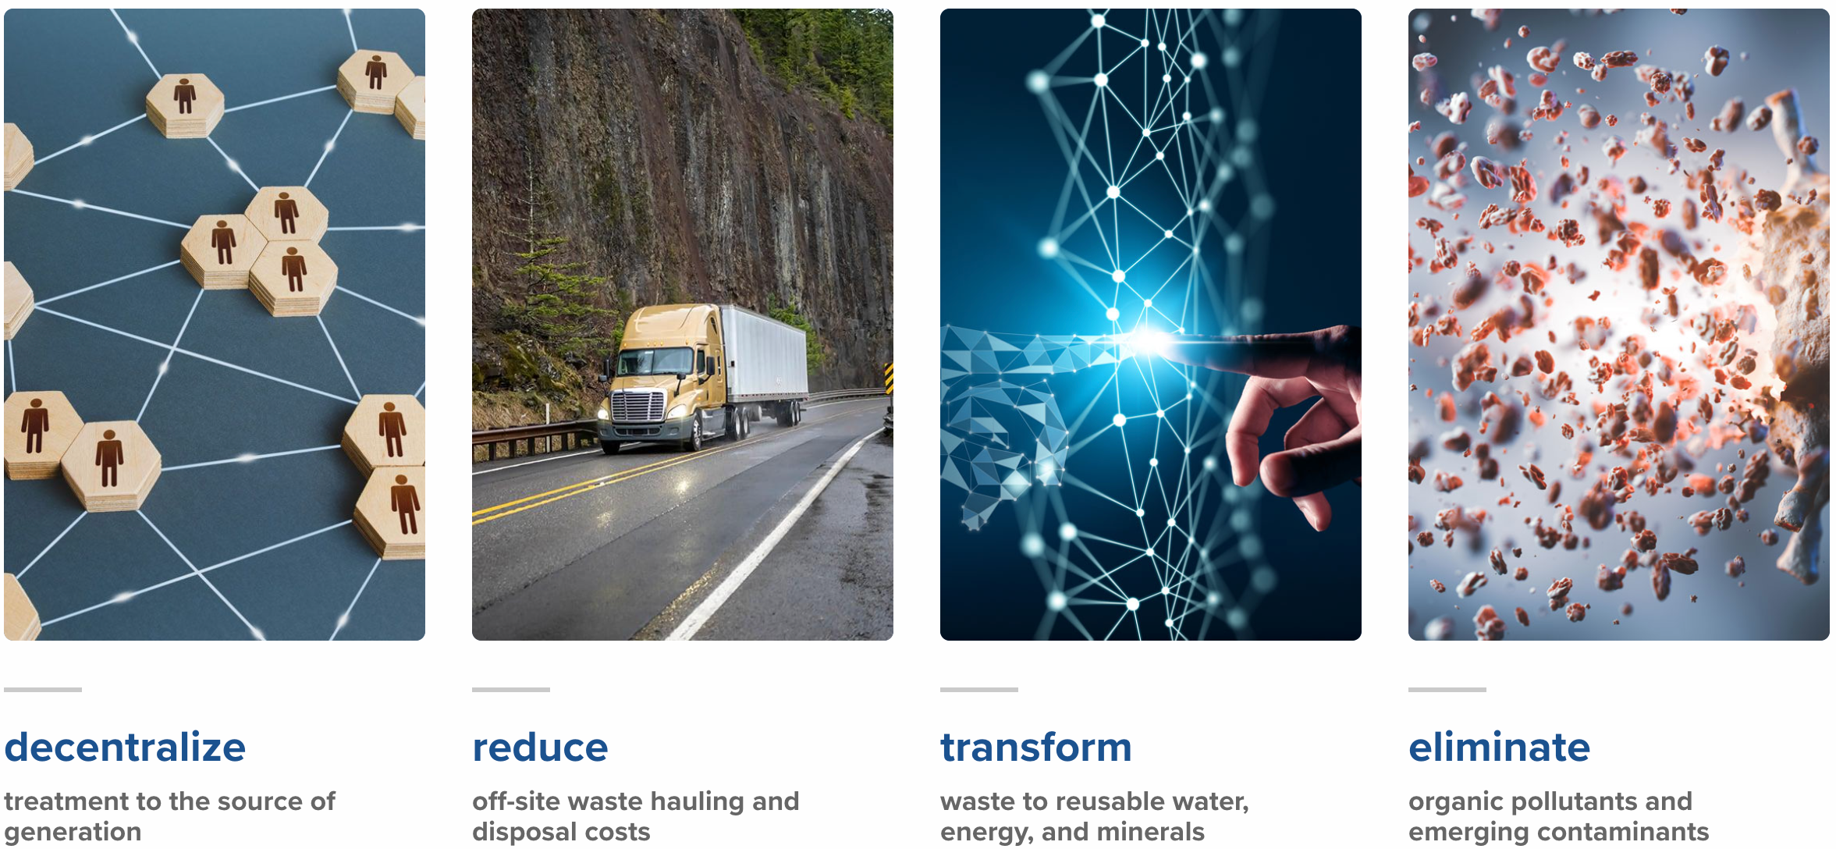
Key Benefits

Slide 23
Summary
Omniprocessor – waste agnostic
Compact modular containized system for easy deployment
Energy efficient and self sufficient
Ideal technology to meet Sustainable Development Goals

Slide 24
pioneering a new era in sustainability
Sudhakar (Sunny) Viswanathan VP of Sales
+1 919-800-9221
sv@374water.com
374water.com

Slide 25
THANK YOU
© 2023 California Water Environment Association (CWEA)

