Slide 1

AWTO Training: Overview of Advanced Water Treatment Technologies and Regulations
November 10, 2022, 10:00 am – 12:00 pm

Slide 2
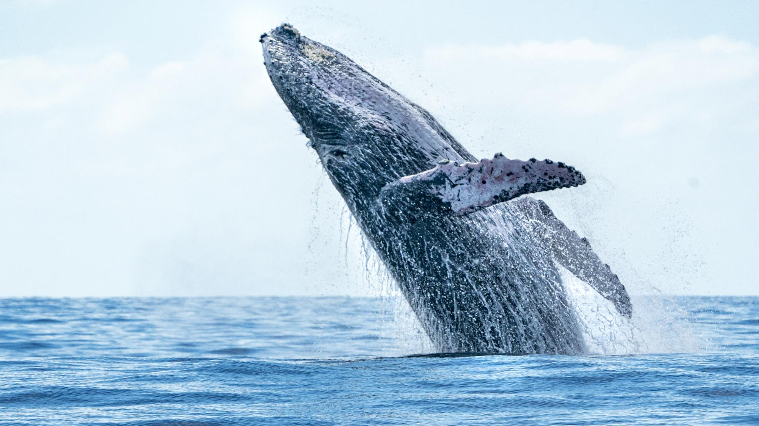

CWEA, its Board members and
volunteers are not responsible for the
actions of speakers or the content of their
sessions. No endorsement is implied or
given of any persons or their philosophies,
ideas or statements; nor of any products
or processes; nor of any organizations
or companies who volunteer to serve as
speakers in educational programs.
For reporters: all speakers today are off the record.

Slide 3
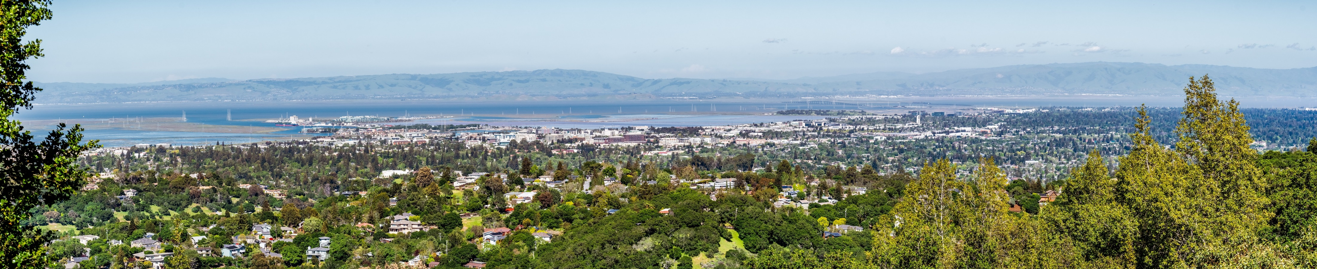
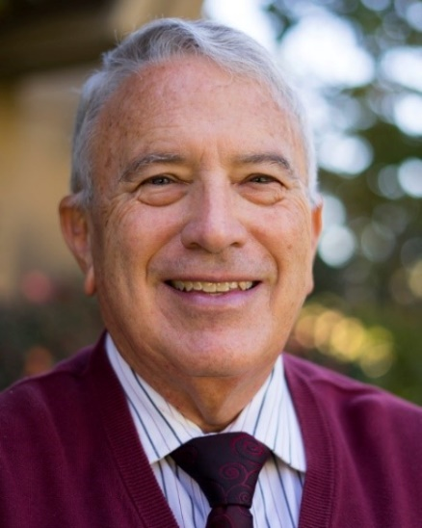
John Rowe, Ph.D
Process Engineer
Office of Water Programs at Sacramento State

Slide 4
Advanced water treatment (AWT)
1-Introduction to AWT Processes

Slide 5
Objectives
After completion of this webinar, you should be able to:
Define advanced water treatment (AWT), advanced water treatment technology, & reclaimed wastewater
Identify water sources for AWT applications
Identify regulatory rules & framework for AWT
Compare AWT systems
Identify treatment processes that are associated with AWT
Describe critical control points in AWT
Identify critical control points & their purpose

Slide 6
Definitions
AWT is additional engineered water treatment processes after secondary or tertiary treatment of wastewater to:
1) Remove contaminants of
concern
2) Protect public & environmental
health or meet specific beneficial
reuse parameters
Advanced Treatment Technology (wastewater) is processes capable of reducing specific constituents in wastewater not achieved through other treatment options
Reclaimed water or recycled water is wastewater that is treated to remove solids & impurities for reuse

Slide 7
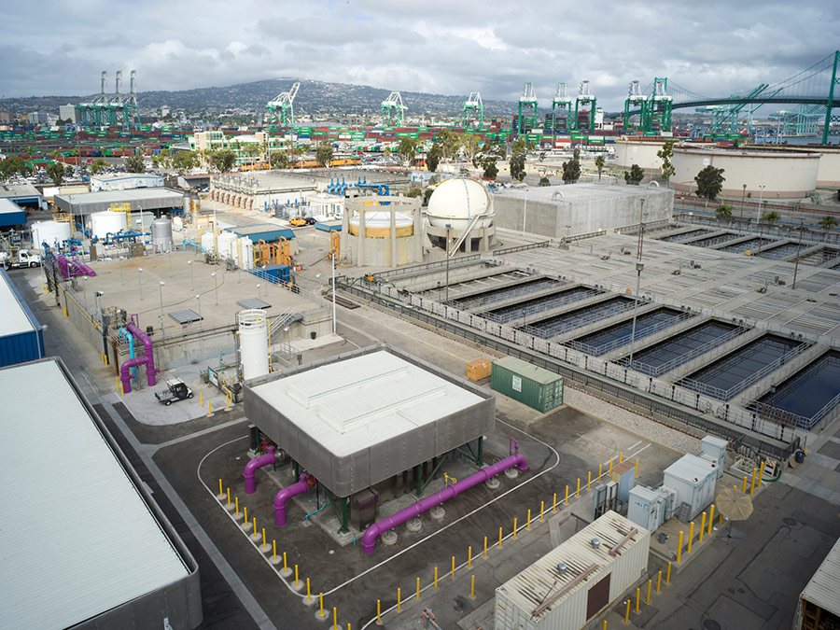
Introduction
Water has been used as if supply would not run out
Drought has illuminated conservation of water resources
Water reclamation has increased importance & significance
Strict effluent discharge limits have pushed development of treatment technologies – AWT
https://www.suezwatertechnologies.com/Water/Recycling

Slide 8
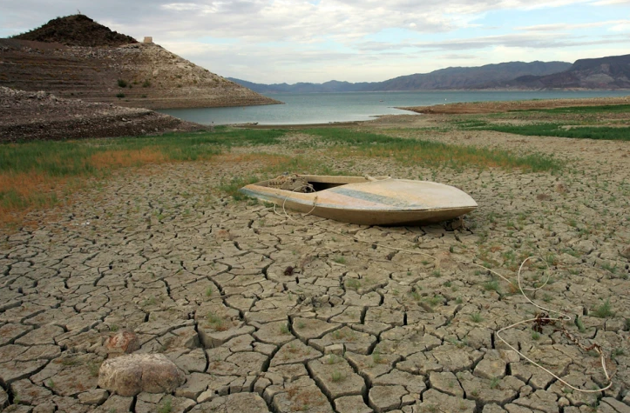
Lake Mead
(castlebaysinks.com)

Slide 9
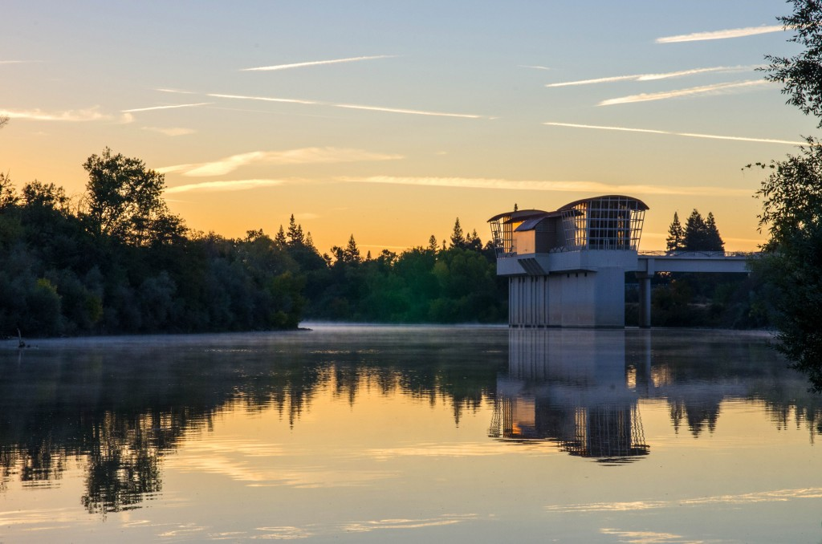
Raw Water Sources
All water on earth is potential source of drinking water
Surface water & groundwater are primary sources
Large cities depend on large rivers for water supplies
Reclaimed water use is growing as treatment technologies evolve

Slide 10
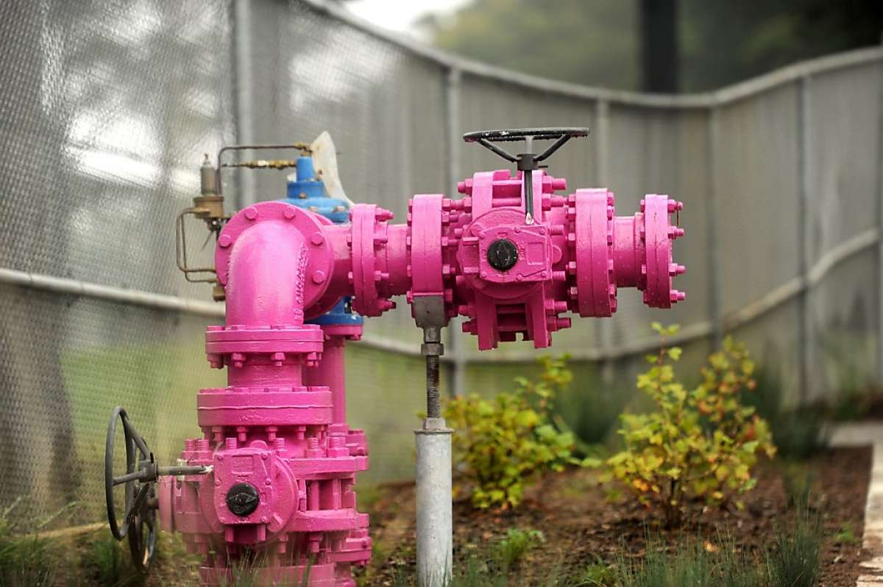
Wastewater Reuse
Reuse of wastewater effluent is not new
Treated wastewater effluent is used in processes where freshwater has been used in past
https://www.suezwatertechnologies.com/Water/Recycling

Slide 11
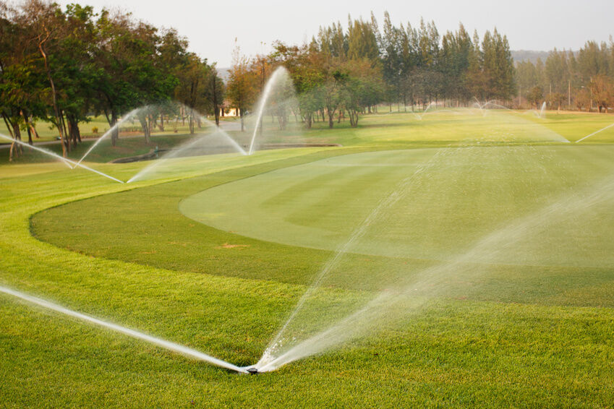
Irrigation
Wastewater effluent is used for:
1) Irrigation
2) Industrial make-up water
3) Impoundments for landscaping
4) Gray water systems
5) Wash water
Wastewater effluent can be used for indirect (IPR) & direct (DPR) potable reuse
IPR – AWT effluent discharged to environmental barrier used as water source
DPR – AWT effluent discharged to water distribution
https://www.suezwatertechnologies.com/Water/Recycling

Slide 12
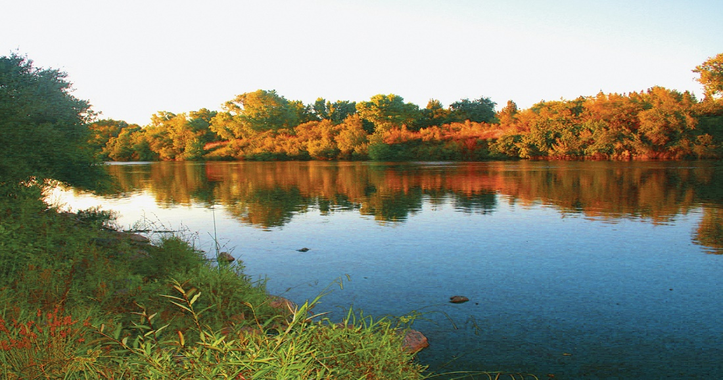
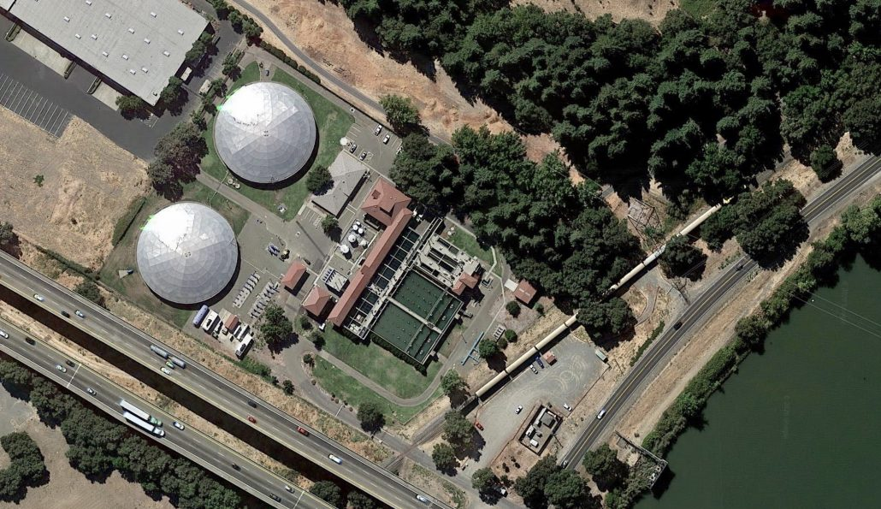
Wastewater Reuse
Indirect reuse occurs as reclaimed water is discharged to streams, impoundments, or aquifers
In indirect potable reuse, finished effluent is diluted & mixed with freshwater prior to its reuse
news.wef.org
news.wef.org

Slide 13
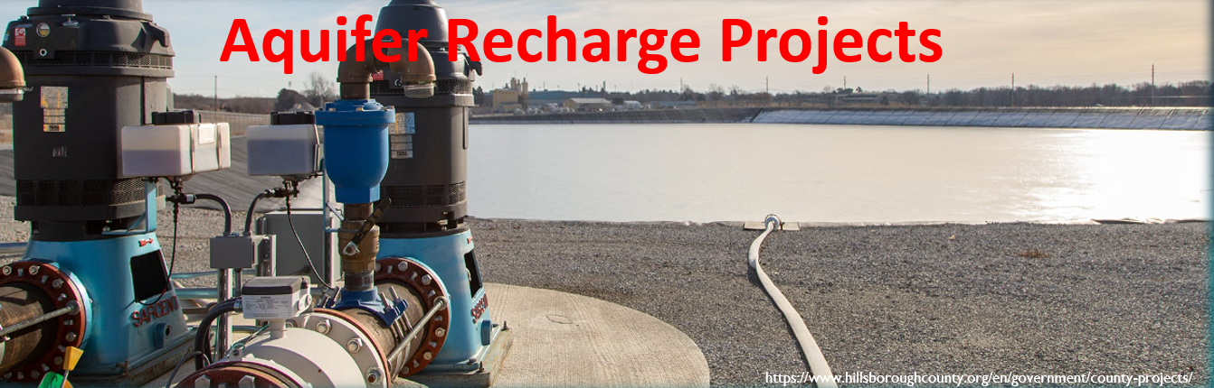
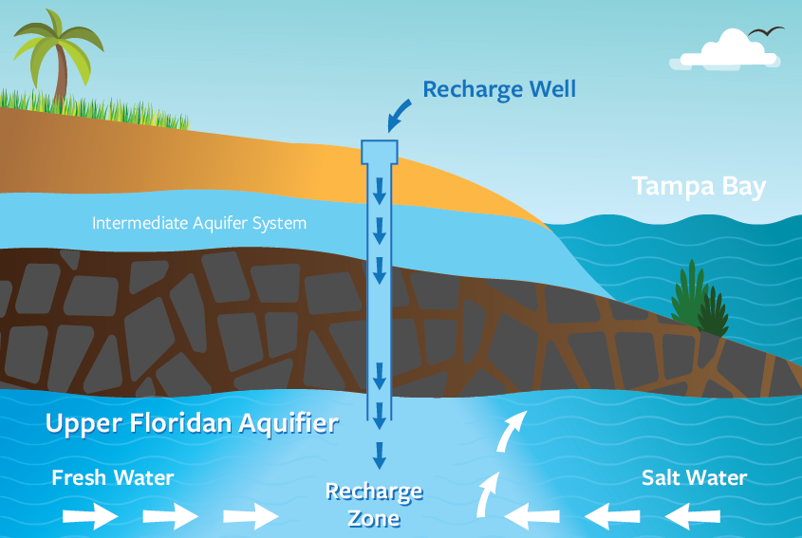
Aquifer Recharge Projects
https://www.hillsboroughcounty.org/en/government/county-projects/
https://www.hillsboroughcounty.org/en/government/county-projects/

Slide 14
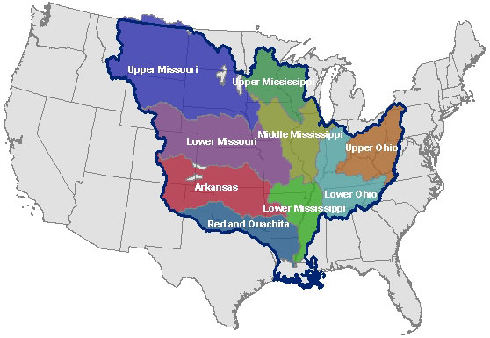
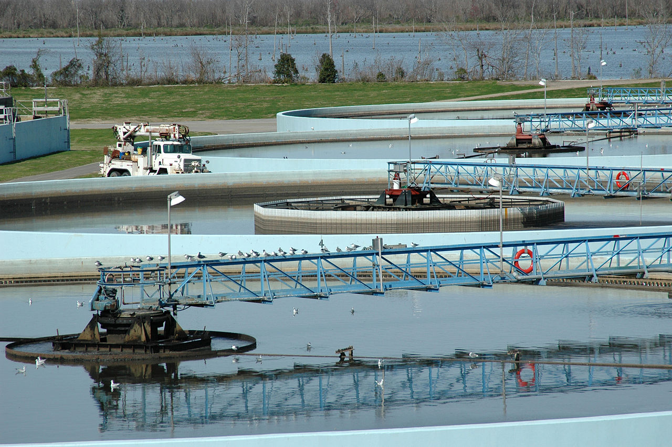
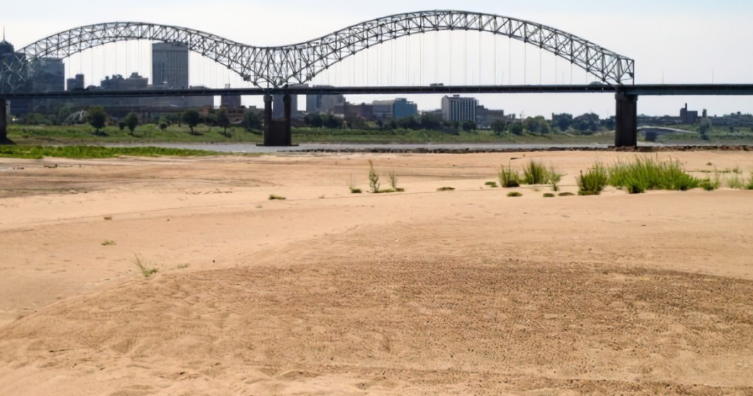
Indirect & Unplanned Reuse
Mississippi River Watershed
Most wastewater reuse is unplanned & indirect reuse (IPR)
Mississippi River receives municipal & industrial wastewater generated between Rocky & Allegheny Mountains
New Orleans produces potable water from mixture of influent
news.wef.org
New Orleans WTP
news.wef.org

Slide 15
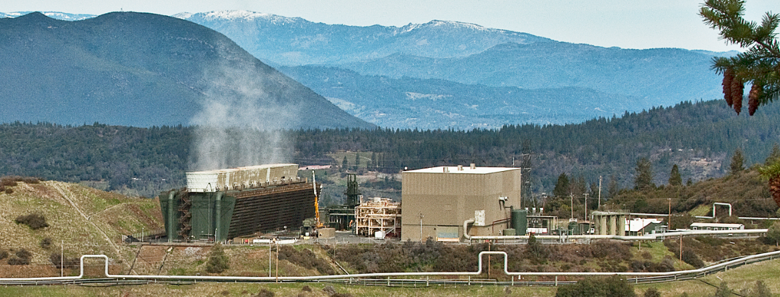
Fit-for-Purpose
Diminished water supplies & evolving technology have led to use of reclaimed water
AWT is applied to reused as fit-for-purpose
Fit-for-purpose is reclaimed wastewater that is treated to specific criteria & is reused for purposes according to its treatment
news.wef.org

Slide 16
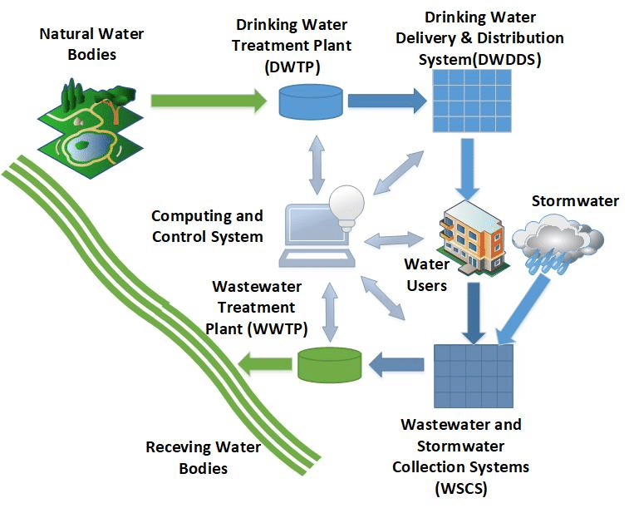
DPR
IPR
AWT
Recycle Water Cycle
researchgate.net

Slide 17
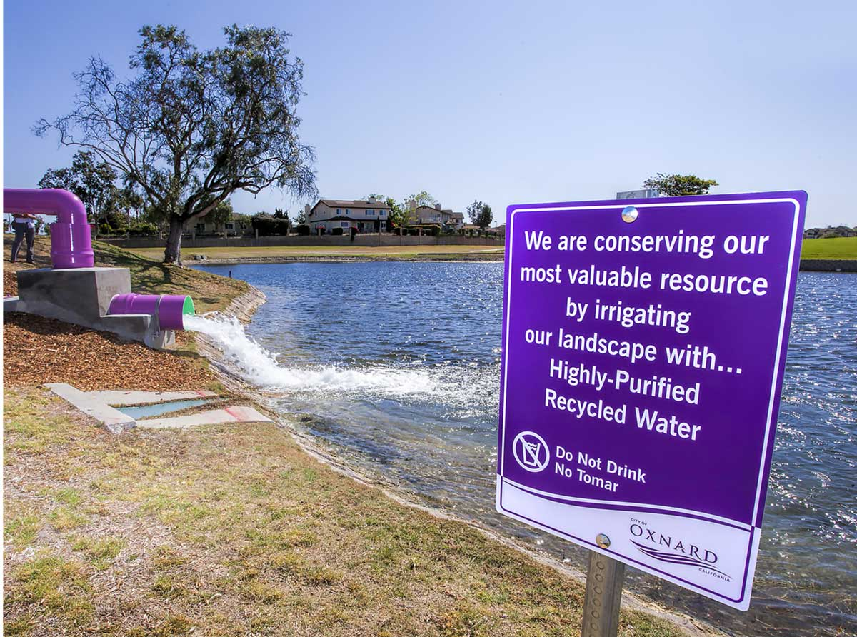
Source Water
In arid regions, increasing uses of wastewater reclamation are occurring
Reuse is part of water resource management strategies
Wastewater reclamation involves treatment to level acceptable for reuse
Ventura County Star

Slide 18
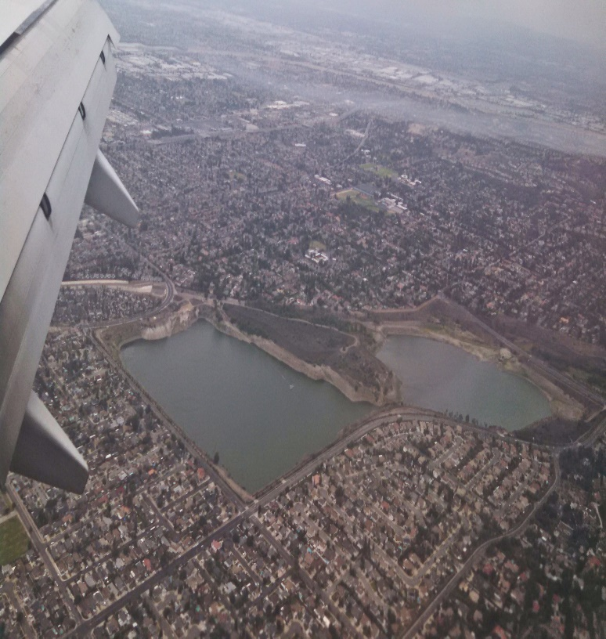
Indirect Wastewater Reuse
Groundwater aquifers in Los Angeles basin are over-pumped
Treated wastewater is discharged to spreading basins to recharge aquifers
AWT processes allow direct discharge into aquifers & spreading basins of wastewater effluent
Daily Mail

Slide 19


Water Reuse Treatment
Tertiary Treatment
Pre-treatment
Disinfection
Primary
Activated sludge
Clarifier
Chemicals
Sand filter
Conventional Reuse
Sedimentation
Reuse
MF/UF
Disinfection
Advanced Treatment Processes
Indirect Potable Reuse
Reverse Osmosis
Disinfection/ Oxidation (AOP)
Reuse
Raw Sewage
Screening
MBR
Disinfection
Indirect Potable Reuse
Reverse Osmosis
Disinfection/Oxidation (AOP)
Advanced Treatment Processes
Notes:
TREATMENT (Nonpotable)
Proven technology , conservative retrofit: Tertiary filtartion & disinfection of conventional II effluent.
That is the most common treatment, often implemented as retrofit of existing conventional WWTP.
No hi-tech, little R&D needed, extremely reliable, but expensive.
For new reclamation plants, innovative treatment trains exist, more compact and streamlined to operate, such as in particular :
- MBR, for most high quality nonpotable applications
- APT, for agricultural applications

Slide 20
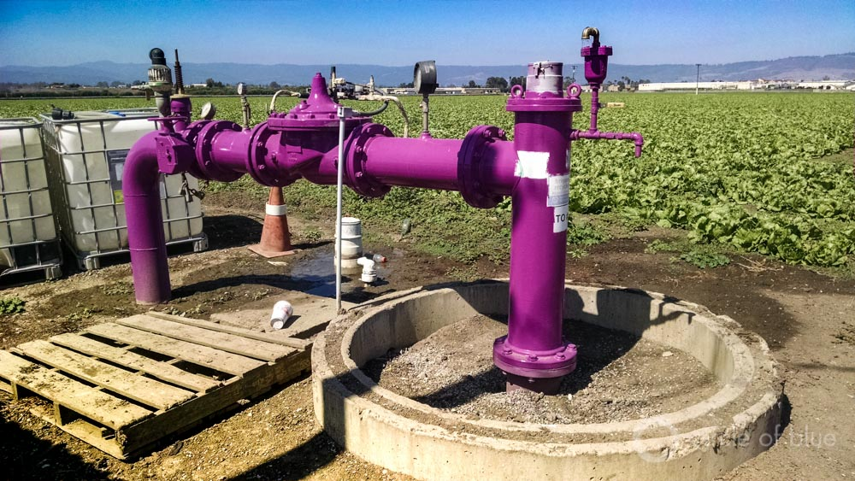
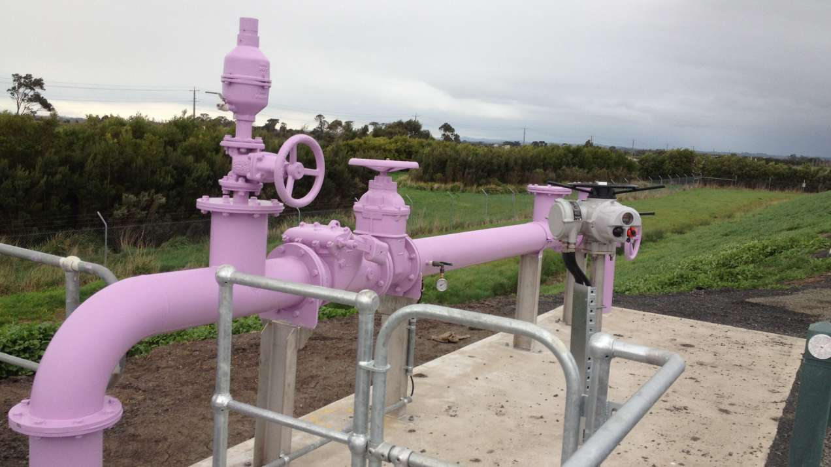
Reuse Fit-for-Purpose
Reuse water sources include:
1) Municipal wastewater
2) Industry process water
3) Stormwater
4) Agricultural runoff
5) Water from natural resource
extraction
Fit-for-purpose is requirement for water to ensure public health, environmental protection, & specific user needs
Ventura County Star
Ventura County Star

Slide 21
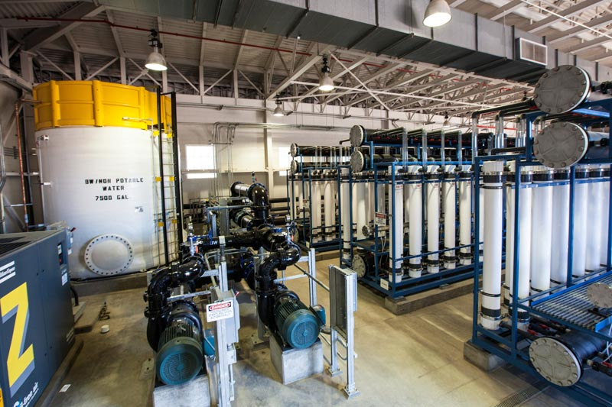
USEPA
EPA does not require or restrict wastewater reuse
Most states maintain primary regulatory authority over water resources
Most states are establishing programs to address treated wastewater reuse
Ventura County Star

Slide 22
Awt Processes
Portfolio of treatment options are available for wastewater reuse
Engineered treatment processes remove microbial & chemical contaminants to make possible reuse
Processes:
1) Microfiltration (MF)/
Ultrafiltration (UF)
2) Reverse Osmosis (RO)/
Nanofiltration (NF)
3) Advanced Oxidation (AOP)
4) Biological Aerated Filtration
(BAF)
5) Stabilization
6) Disinfection

Slide 23
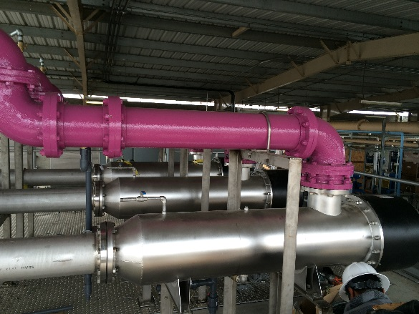
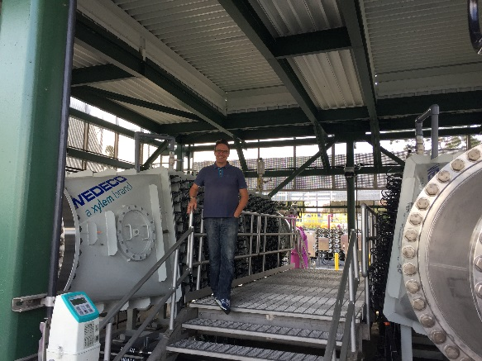
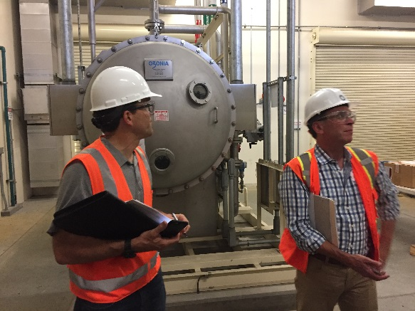
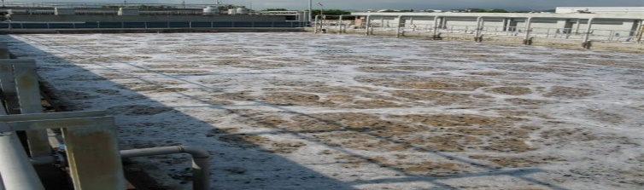
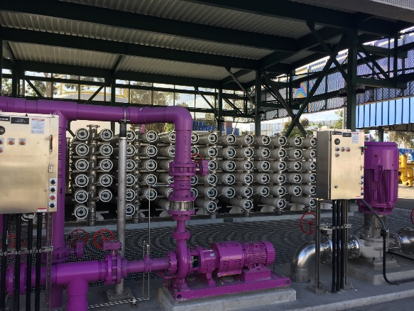
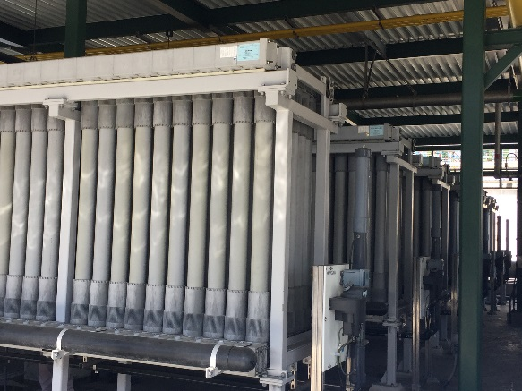
AWT Processes
Ventura County Star
Ultraviolet Light
Ozone
Advanced Oxidation
Daily Mail
Daily Mail
Ventura County Star
Reverse Osmosis
Microfiltration/ Ultrafiltration
Biological Aerated Filtration
Daily Mail
Ventura County Star
Daily Mail

Slide 24
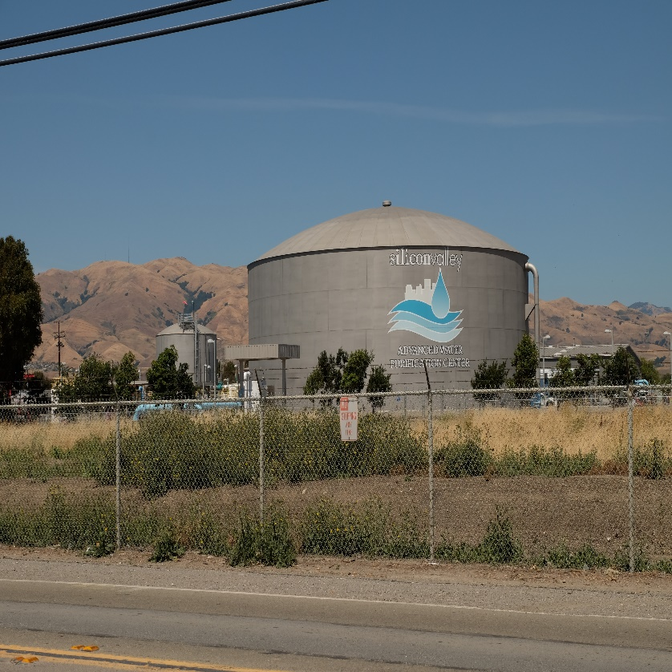
Wastewater Reuse
Wastewater reuse as potable water is direct or indirect
Indirect reuse involves environmental barrier between reclamation & processing
Direct reuse has direct link between reclamation & processing
Level of treatment depends on end-use of treated water
Daily Mail

Slide 25
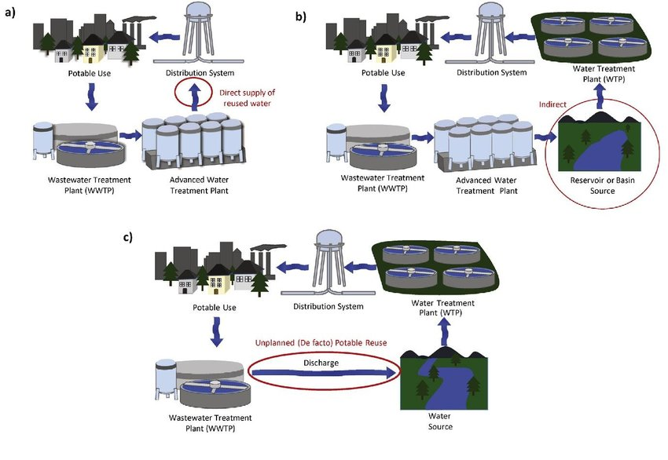
DPR
IPR
30-days
Unplanned IPR
IPR– Indirect
Potable Reuse
DPR-Direct
Potable Reuse
Battling Water Scarcity: Direct Potable Reuse Poised as Future of Water Recycling | WaterWorld

Slide 26
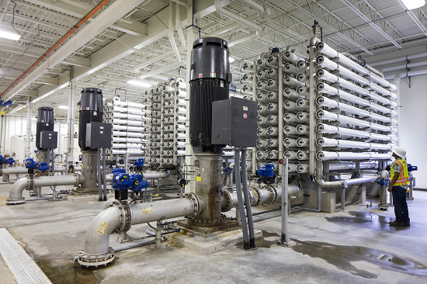
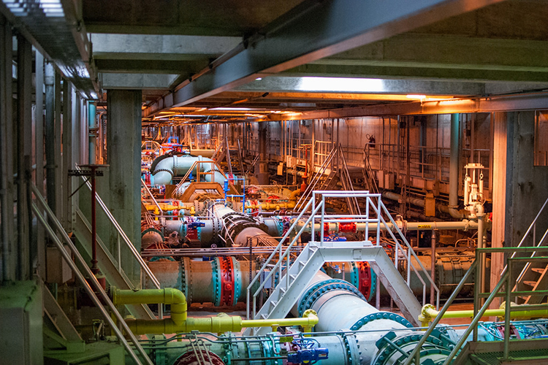
Potable Reuse Water
Water from AWT trains is discharged into raw water sources upstream of water plant & is retained > 30-days (indirect reuse)
It can be blended with water from treatment plant or introduced into potable distribution system (direct reuse)
Treatment must satisfy drinking water regulations (Safe Drinking Water Act)
Daily Mail
Daily Mail

Slide 27
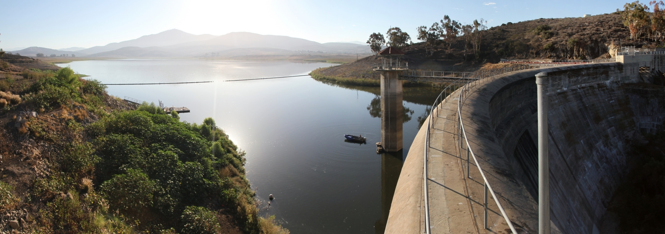
Reuse Regulations
California requires 12-10-10-log removal for viruses, & Cryptosporidium & Giardia, respectively
Log removal is reduction or removal of microorganisms
Processes are assigned log reduction levels for microorganisms
Sum of processes are used to comply with 12-10-10-log removals rule
obrag.org

Slide 28
Log Removal Values (LRV)
Effectiveness of treatment processes are measured using log removal values
Log removals are determined by taking logarithm of ratio of pathogen concentration or contaminate in influent & effluent concentration after treatment process

Slide 29
Example

Slide 30
Log Removal value (LRV)
Treatment schemes & process barriers are selected to satisfy water quality requirements influenced by environmental risks, like:
1) Nutrients
2) Aesthetics
3) Risks to human health, like
pathogen removal
Difference between initial wastewater quality & target water quality determines level of treatment required
Treatment target is expressed as LRV
System treatment needs to provide specified LRV

Slide 31
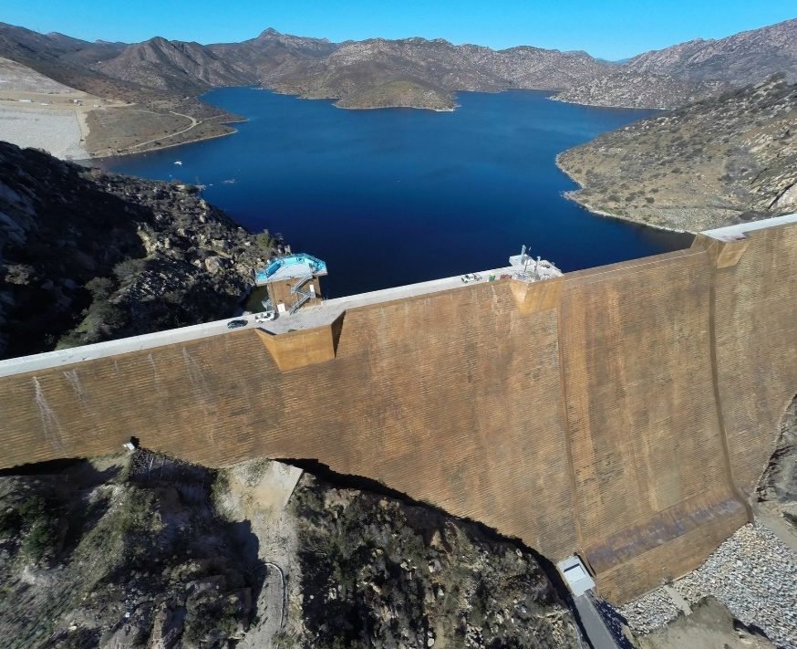
Reuse Regulations
Conventional wastewater treatment, filtration, & disinfection account for 6-log virus removal credit
Agencies award 1-log of virus removal credit for each month water is retained underground
In California, reuse regulations & site acceptance testing are used to calculate log removals
1) Robustness - expanding variety of
contaminant removal processes in train
2) Reliability - proving degree that processes
are able to remove contaminates
obrag.org

Slide 32
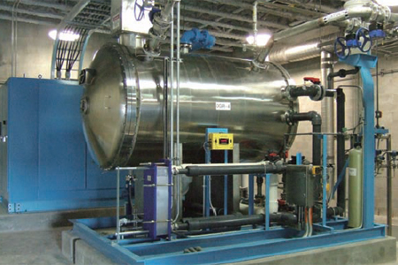
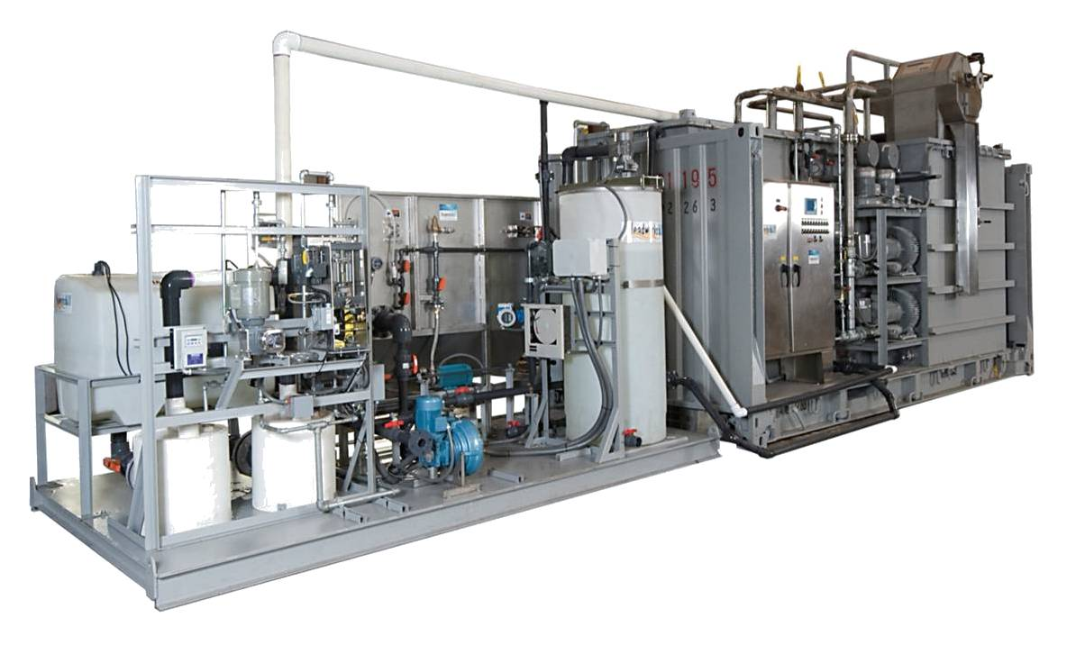
Advance Water Treatment Processes
MF/UF & RO/NF are more robust filter systems than multimedia filtration
Ozone & UV are reliable disinfection alternatives to chlorine
Ozone is reliable & effective for TOC removal along with RO & Advanced Oxidation (AOP)
AOP removes TOC & is barrier to microorganisms
Multibarrier approach to treatment
Ozone
obrag.org
AOP
obrag.org

Slide 33
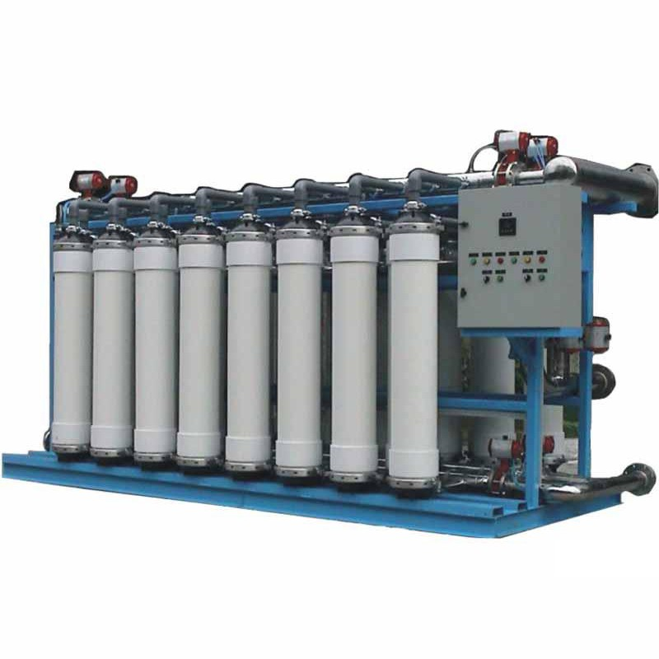
Advanced Water Treatment
Standard treatment train for potable reuse is MF, RO, & UV/H₂O₂ prior to disinfection, stabilization, & groundwater replenishment
Treatment is defined as full advanced treatment (FAT) by California
Only treatment train currently permitted for groundwater injection in California
Microfiltration
obrag.org

Slide 34
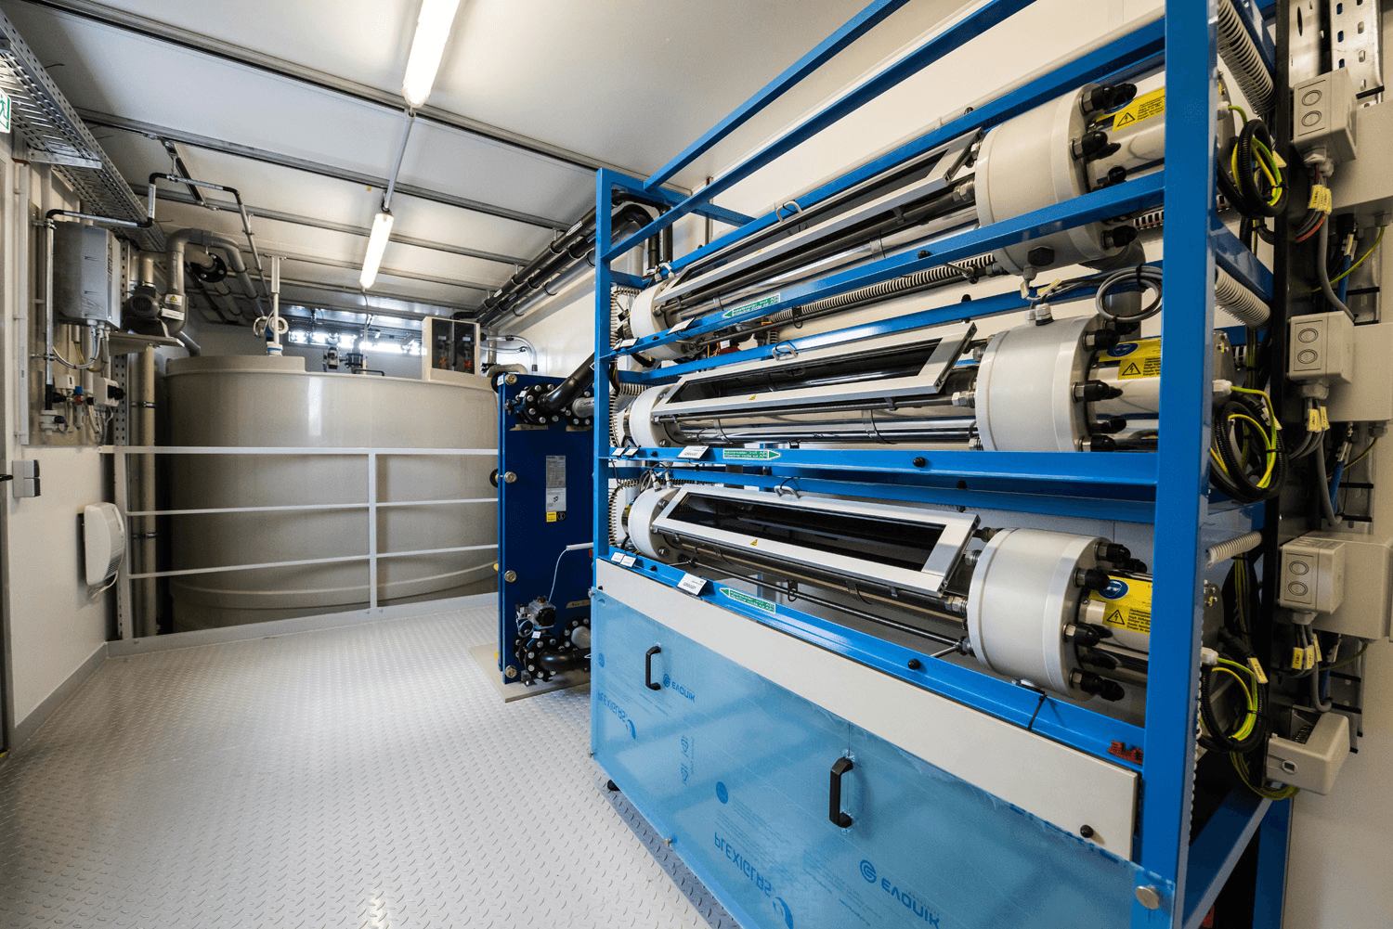
Advanced Water Treatment Processes
RO trains provide nearly complete total organic carbon (TOC) removal; <0.5 mg/L
RO provides reductions in total dissolved solids (TDS); Conductivity <250 mg/L
MF, RO, & UV/H₂O₂ provide multiple barriers to pathogens
In UV/H₂O₂, UV is intended for NDMA mitigation, & H₂O₂ achieves AOP conditions capable of TOC oxidation
AOP
obrag.org

Slide 35
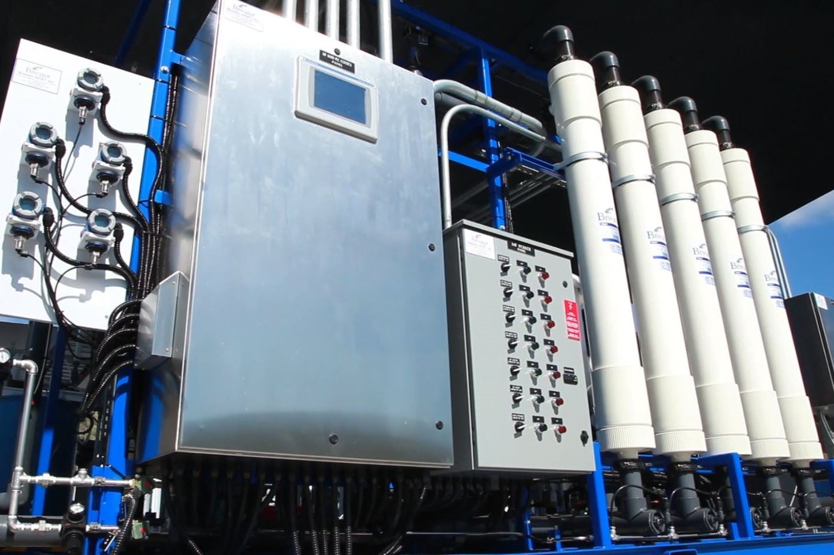
Advanced Water Treatment Facilities
Orange County’s Advanced Water Purification Facility is benchmark MF-RO-UV/H₂O₂ system
San Diego operates system as demonstration (?) facility to validate process for reservoir augmentation
California has only implemented reuse groundwater injection or spreading applications for recharge
obrag.org

Slide 36
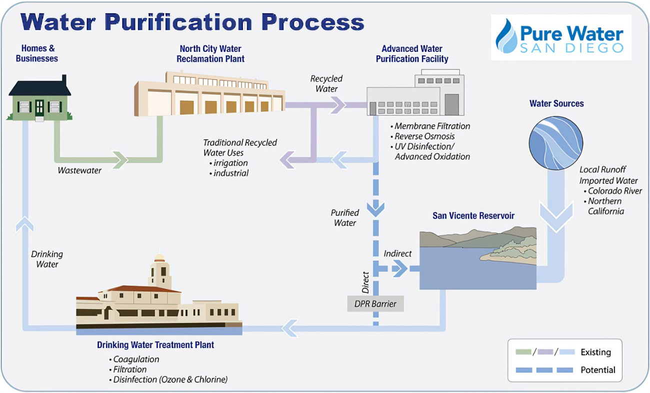
Water Purification Process

Slide 37
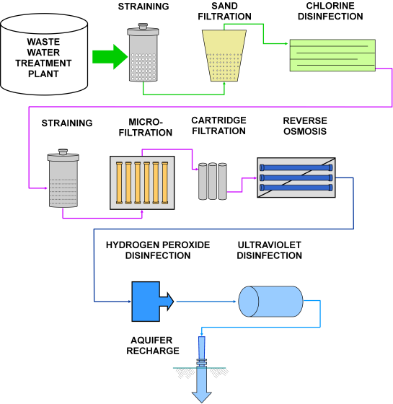
Advanced Water Treatment processes (AWT)
CONVENTIONAL
WASTEWATER
AWT Processes
+
= AOP
H₂O₂
UV
ENVIRONMENTAL BARRIER

Slide 38
Critical Control Points (CCP)
Critical control points are unit processes under direct control that require effective policy, procedures, practices, monitoring, & measuring to assure quality requirements
When treating wastewater effluent as reclaimed wastewater hazards will appear
Hazards are presence of contaminates, pathogens, & chemicals

Slide 39
Critical Control Points
Wastewater reuse systems require multiple barriers to control microbial & chemical contaminants of concern (CEC)
Multiple barriers function through:
1) Robustness - expanding
variety of contaminant
removal processes in train
2) Reliability - proving degree
that processes are able to
remove contaminates

Slide 40
Critical Control Points (CCP)
Influent quality variability, treatment process upsets, extreme events, & human error affect treatment performance
CCPs are fundamental to design practices & responses for upset events to ensure system reliability
CCP are part of formal framework used to ensure operation quality
Framework is Hazard Analysis & Critical Control Point (HACCP)

Slide 41
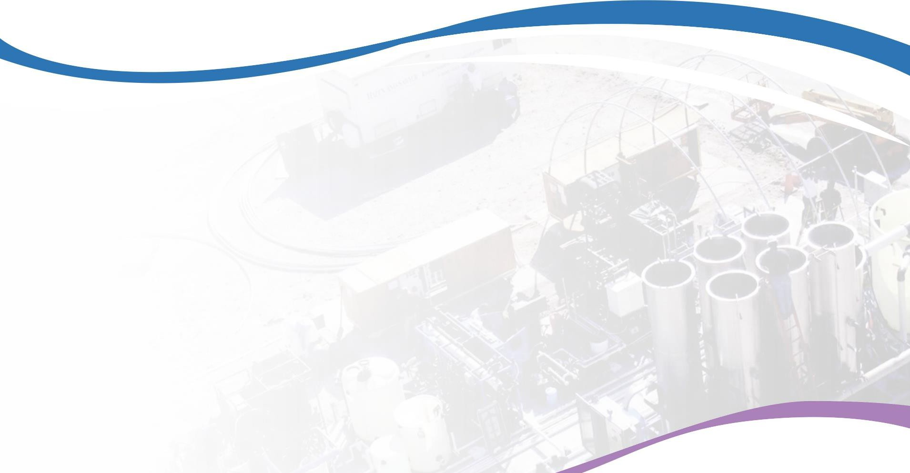
Treatment train for AWT
Critical Control Points (CCP)
CCP 3
Reverse Osmosis
Permeate
Conductivity
<250 mg/L , TOC
<0.5 mg/L
Monochloramine
Acid & Antiscalant
CCP 1
Ammonia
<3 mg/L
Influent
Activated Sludge
Effluent
Ammonia 1
Chlorine
MF
RO
Strainer
CCP 2
Microfiltration
Pressure Decay
Integrity Test - 5 min
Bubble Test - 0
AOP
Storage
Chlorine
CT
Effluent
H₂O₂
UV
CCP 4
Advanced Oxidation Peroxide & UV Dose
Stabilization
CCP 5
Chlorine Dose (CT)
4-Log Removal - virus
Engineered
Storage

Slide 42
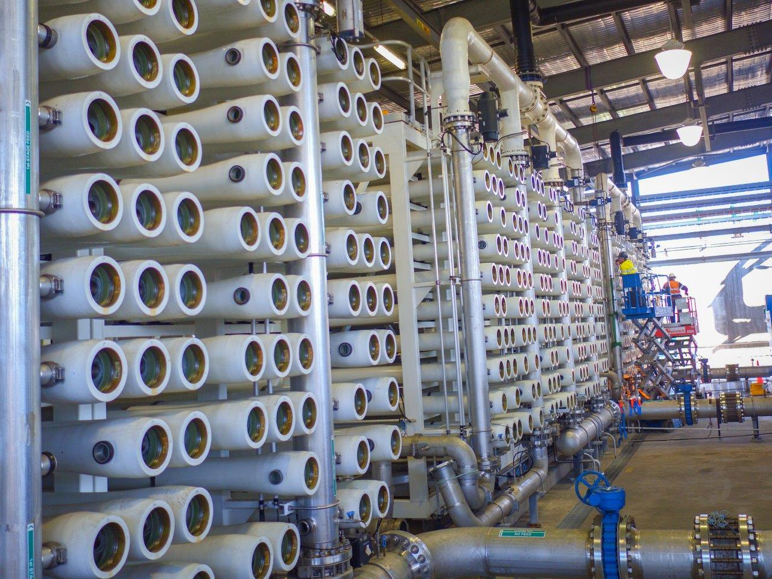
Additional treatment trains
RO is included in majority of treatment trains for AWT in order to meet TDS goals
Development of non-RO based trains is critical because RO is impractical at inland locations
obrag.org

Slide 43
Additional treatment trains
Micro-filtration
Reverse
Osmosis
Advanced
Oxidation
Stabilization
Engineered
Storage Storage
WW
WW
WW
WW
WW
WW
Ozone Oxidation
Biological Filtration
Micro-filtration
Reverse Osmosis
Stabilization
WW
WW
WW
WW
WW
WW
Ozone Oxidation
Biological Filtration
Ultra-filtration
Advanced Oxidation
Engineered Storage
WW
WW
WW
WW
WW
WW

Slide 44
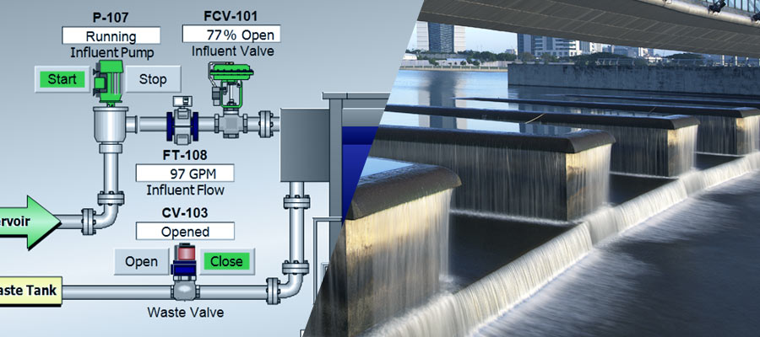
Instrumentation & controls
Instruments & controls are essential for AWT
Instruments:
1) Indicate
2) Measure
3) Monitor
4) Record
5) Control
6) Signal process breakdowns - alarms
Instrumentation & controls are devices that transmit data that allows operators to control treatment functions
obrag.org

Slide 45
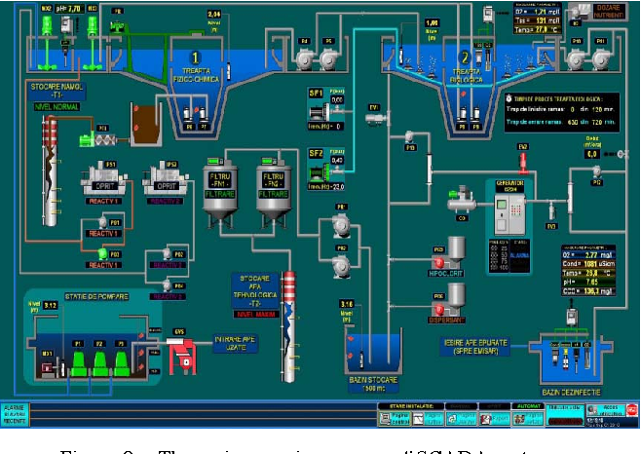
Instrumentation & controls
Central data collection point is main control panel
From control room, operators monitor & control process functions through SCADA system
obrag.org

Slide 46
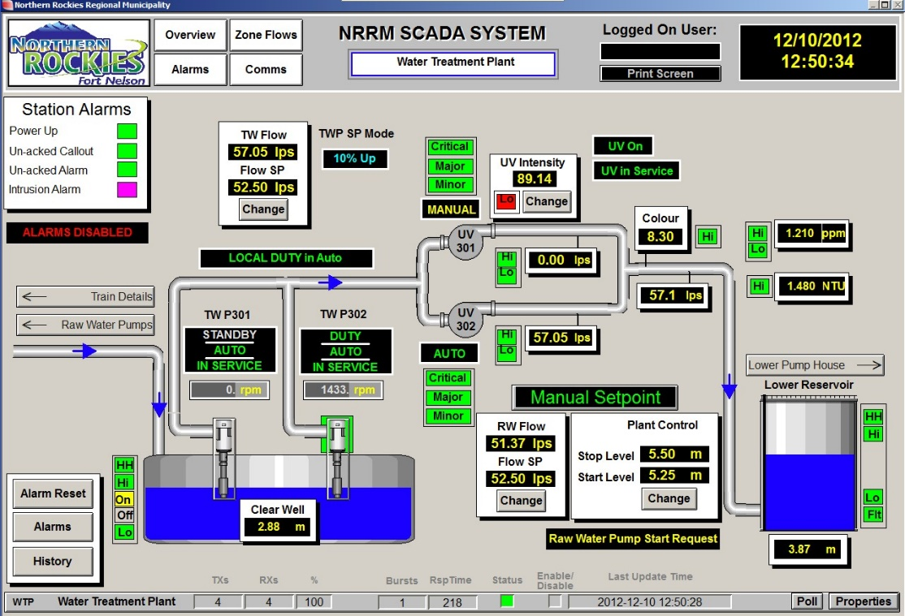
Instrumentation & controls
Sophisticated electronics provide automatic controls over process functions
Manual controls backup critical functions
Operators can override automatic systems when necessary
obrag.org

Slide 47
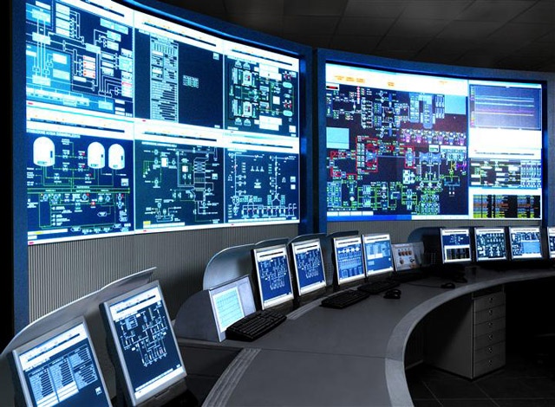
SCADA system
obrag.org

Slide 48
Awt Processes
Membrane Filtration (MF, UF, RO)
Ozone
UV Light
Advanced Oxidation
Biological Filtration/Oxidation/Carbon
Activated Carbon

Slide 49
Membrane filtration processes
Membrane filtration processes are classified on basis of size of particles separated from water stream
Separation technique involves thin, semipermeable membranes that are selective barriers to particles based on molecular size
Membrane blocks passage of large particles & molecules, letting water pass

Slide 50
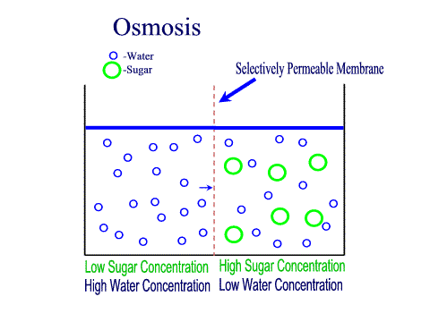
Osmosis
Water Molecule
Sugar Molecule
Selectively Permeable Membrane
Water Molecule
Sugar Molecule
Low Sugar High Sugar
High Water Concentration Low Water Concentration
www.bigbrandwater.com

Slide 51
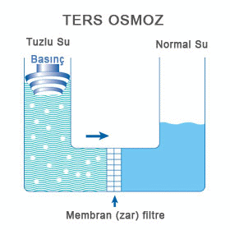
Reverse Osmosis
Pressure applied > Osmotic Pressure
Pure Water
Water Flow
Mineral Concentrated Water
Semipermeable Membrane
www.bigbrandwater.com

Slide 52
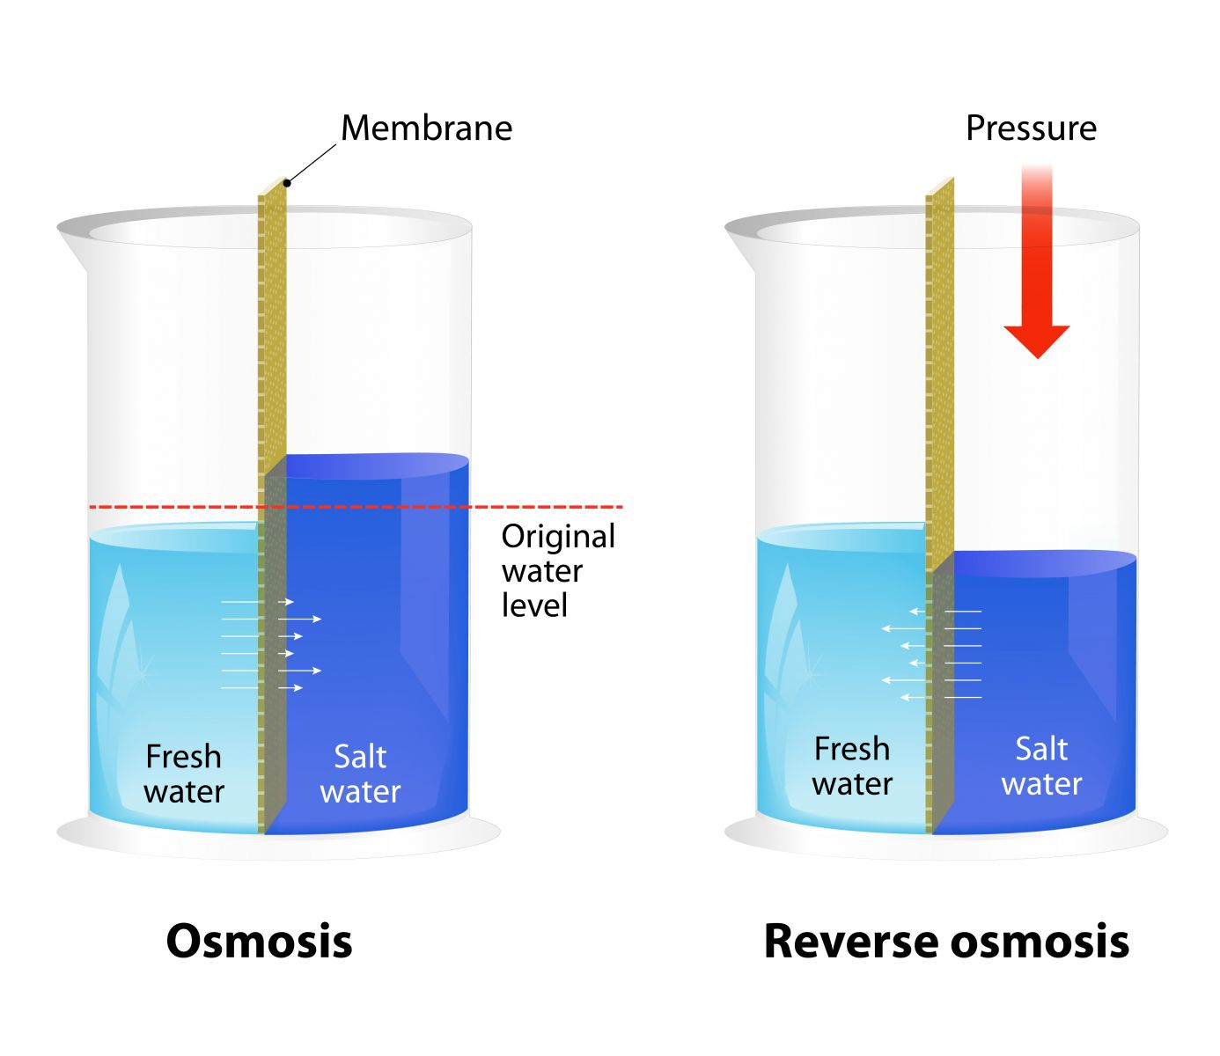
Osmotic Pressure
> Osmotic Pressure
Water Flow - Osmosis
Water Flow -Reverse Osmosis
Reverse Osmosis - Assignment Point

Slide 53

Types of membranes
https://www.gotocompletefiltration.com

Slide 54

Filtration spectrum
Reverse Osmosis
< 1 nm
Microfiltration
10 um – 100 nm
Ultrafiltration
100 - 10 nm
Nanofiltration
10 - 1 nm
Giardia, Crypto,
Bacteria
Giardia, Crypto,
Bacteria
Colloids,
Viruses
Giardia, Crypto,
Bacteria
Colloids,
Viruses
Divalent salts
Color,
Hardness,
Pesticides, Salts
Colloids,
Viruses,
Color,
Hardness,
Pesticides,
Salts,
Water
Color,
Hardness,
Pesticides,
Salts,
Water
Salts,
Water
Water
WERF

Slide 55
Primary modes of membrane filtration
Scouring
Cake Formation
https://www.gotocompletefiltration.com
https://www.gotocompletefiltration.com

Slide 56

Raw Water
Water Treatment Using Membranes
Membrane Water Treatment
Pure Water
Contaminates – microbes, organics, minerals, pesticides, CECs, disinfection byproducts
Semi-permeable Membrane
Waste Stream
High Contaminate Concentration on Membrane
Low Contaminate Level & Water
https://www.gotocompletefiltration.com

Slide 57
Microfiltration (MF)
Microfiltration membrane pores ranging from 0.1 to 2.0 microns
Membrane process is used with settling agents, polymers, & activated carbon to assist in removing constituents
When using membranes, preventing membrane pore blockage by wastestream components is important
MF or UF process is used as pretreatment for RO

Slide 58

Microfiltration
Removes Pathogens other than virus
WWT Effluent

Slide 59

Microfiltration
waterworld.com

Slide 60
Log removal
 | ClNH₂ _{Monochloramine} | MF | RO | UV/AOP | Cl₂ | Total
Virus | 0 | 0 | 1-2 | 6 | 4 | 11-12
Crypto | 0 | 4 | 1-2 | 6 | 0 | 11-12
Giardia | 0 | 4 | 1-2 | 6 | 3 | 14-15
Log reduction relates to percentage of microorganisms physically removed or inactivated by given process:
1-log reduction = 90% removal
2-log reduction = 99%
3-log reduction = 99.9%
4-log reduction = 99.99%

Slide 61
Ultrafiltration (UF)
UF is most common membrane-based treatment process
Process membrane pore sizes range from 0.005 to 0.1 micron
Particles larger than pores, like emulsified oils, metal hydroxides, proteins, starches, & suspended solids, are retained
Membrane used in membrane bioreactors (MBR)

Slide 62



MBR
(castlebaysinks.com)
(castlebaysinks.com)
(castlebaysinks.com)

Slide 63
ultrafiltration
Removes Pathogens & Some Virus
WWT Effluent
Ultrafiltration

Slide 64


Ultrafiltration
Membrane Bioreactor (MBR)
waterworld.com
waterworld.com

Slide 65
Log removal
 | ClNH₂ _{Monochloramine} | UF | RO | UV/AOP | Cl₂ | Total
Virus | 0 | 0 | 1-2 | 6 | 4 | 11-12
Crypto | 0 | 4 | 1-2 | 6 | 0 | 11-12
Giardia | 0 | 4 | 1-2 | 6 | 3 | 14-15
Log reduction relates to percentage of microorganisms physically removed or inactivated by given process:
1-log reduction = 90% removal
2-log reduction = 99%
3-log reduction = 99.9%
4-log reduction = 99.99%
Ultrafiltration

Slide 66

Nanofiltration (NF)
NF uses membrane pore size between UF & RO
Membranes remove divalent salts from water stream
Membrane concentrates components like sugars, nitrogen components, & constituents causing high BOD/COD
Membrane is known as softening membrane
Presently not used in AWT
waterworld.com

Slide 67

Nanofiltration
waterworld.com

Slide 68

Reverse osmosis (RO)
Reverse osmosis is tightest membrane process
Membrane allows only water to pass
Membrane retains salts & higher molecular weight components
RO membranes are used for tertiary treatment producing water with low BOD/COD & near-potable water quality
RO is used as post-treatment process following coarser filtration processes like MF or UF
waterworld.com

Slide 69
Log removal
 | ClNH₂ _{Monochloramine} | MF & UF | RO | UV/AOP | Cl₂ | Total
Virus | 0 | 0 | 1-2 | 6 | 4 | 11-12
Crypto | 0 | 4 | 1-2 | 6 | 0 | 11-12
Giardia | 0 | 4 | 1-2 | 6 | 3 | 14-15
Log reduction relates to percentage microorganisms physically removed/ inactivated by given process:
1-log reduction = 90% removal
2-log reduction = 99%
3-log reduction = 99.9%
4-log reduction = 99.99%

Slide 70

Reverse osmosis
waterworld.com

Slide 71

Membrane technology
Microfiltration (MF) & ultrafiltration (UF) are effective in removal of Giardia & Cryptosporidium & bacteria
Reverse osmosis (RO) membranes are used for desalination /demineralization & virus removal
RO membranes are used to remove dissolved organic matter & dissolved contaminants like arsenic, nitrate, pesticides, & radionuclides
waterworld.com

Slide 72

Ro Membrane
Membrane removes ions like calcium, magnesium, sodium, & chloride
Membrane is used to reduce concentration of natural organic matter (NOM) & to control formation of disinfection byproducts (DBP)
waterworld.com

Slide 73
Ozone
Ozone is unstable form of oxygen (O₃)
Ozone is used to address disinfection, disinfection by-products, taste & odors, color, & micro-coagulation
Ozone reacts to oxidize inorganic compounds like iron, manganese, & sulfides
Difficult-to-oxidize organic compounds include solvents, pesticides, & compounds that cause tastes & odors

Slide 74

Ozone
Ozone has high disinfectant capacity
Ozone residuals between 0.3 to 2.0 mg/L inactivate viruses
Microorganisms in natural waters are very sensitive to ozone
Giardia & enteric viruses are inactivated by ozone
waterworld.com

Slide 75
Multiple barrier approach to Treatment
Target | WWTP | Ozone | BAF | UF | GAC | UV & H₂O₂ AOP
Protozoa | X | X | X | X |  | X
Virus | X | X |  | X |  | X
MCLs | X | X | X |  | X | X
CECs | X | X | X |  | X | X
Target | WWTP | MF | RO | UV & Ozone AOP
Protozoa | X | X | X | X
Virus | X |  | X | X
MCLs | X |  | X | X
CECs | X |  | X | X

Slide 76

Ozone
waterworld.com

Slide 77

Log removal
 | Ozone | Coagulation/Flocculation | BAF | UV | Cl₂ | Total
Virus | 4 | 2 | 1-2 | 4 | 4 | 15-16
Crypto | 2 | 2 | 3-4 | 3 | 0 | 10-11
Giardia | 3 | 2.5 | 2-3 | 3 | 3 | 13.5-14.5
Log reduction relates to percentage microorganisms physically removed/ inactivated by given process:
1-log reduction = 90% removal
2-log reduction = 99%
3-log reduction = 99.9%
4-log reduction = 99.99%

Slide 78

Ultraviolet Light (UV)
Ultraviolet (UV) light is electromagnetic radiation with wavelength shorter than visible light (10 to 400 nm)
Water is disinfected using:
1) UV-C from 200-300 nm
2) UV-B from 280-300 nm
3) Ideal wave length is 254 nm
waterworld.com

Slide 79

Ultraviolet Light (UV)
UV light damages nucleic acid, preventing microbe replication
Effectiveness of UV light is determined by dose
Dose is calculated as UV intensity multiplied by time of exposure, expressed as millijoule per square centimeter
waterworld.com

Slide 80

Ultraviolet light
UV light’s effectiveness is based on UV transmittance in water
Transmittance is influenced by UV absorbing organic chemicals
Water must be free of suspended solids, which form deposits on UV lamp sleeves & alter UV transmittance
UV disinfection inactivates viruses
waterworld.com

Slide 81

Ultraviolet light
waterworld.com

Slide 82
Log removal
 | Ozone | Coagulation/Flocculation | BAF | UV | Cl₂ | Total
Virus | 4 | 2 | 1-2 | 4 | 4 | 15-16
Crypto | 2 | 2 | 3-4 | 3 | 0 | 10-11
Giardia | 3 | 2.5 | 2-3 | 3 | 3 | 13.5-14.5
Log reduction relates to percentage microorganisms physically removed/ inactivated by given process:
1-log reduction = 90% removal
2-log reduction = 99%
3-log reduction = 99.9%
4-log reduction = 99.99%
BAF

Slide 83


Advanced oxidation (AOP)
Advanced oxidation utilizes oxidizing intermediates, like hydroxyl radicals (OH⁻), to oxidize organic pollutants
Advanced oxidation is used because chemical oxidation takes place slowly in environment
Ozone
Ozone
AOP
OH⁻
AOP
H₂O₂
UV
H₂O₂
UV

Slide 84

Advanced Oxidation
Facilitates destruction of target pollutants & mineralization of pollutants & byproducts
Treats organic contaminants:
1) Trichloroethylene, perchloroethylene
2) 1,4-dioxane, methyl-tert-butyl ether
  (MTBE), acetone, phenols, N-
  nitrosodimethylamine (NDMA), &
  BTEX
waterworld.com

Slide 85
Treatment trains - Multiple barrier approach
Target | WWTP | Ozone | BAF | UF | GAC | UV & H₂O₂ AOP
Protozoa | X | X | X | X |  | X
Virus | X | X |  | X |  | X
MCLs | X | X | X |  | X | X
CECs | X | X | X |  | X | X
16
11
4
2
2
3
4
0
6
6
Target | WWTP | MF | RO | UV & Ozone AOP
Protozoa | X | X | X | X
Virus | X |  | X | X
MCLs | X |  | X | X
CECs | X |  | X | X
4
0
2
2
6
6
12
8

Slide 86

Types of AOP
UV/H₂O₂ process treats low levels of contaminants:
1) Pesticides
2) Herbicides
3) Endocrine disruption compounds
4) Pharmaceutical products
5) Emerging contaminates (CEC)
Other AOP systems are:
1) O₃/H₂O₂
2) UV/O₃
3) HOCl⁻/UV
waterworld.com

Slide 87

Types of aop
UV/H₂O₂ AOPs require UV doses 10-50 times more than for UV disinfection
Water treatment processes that use AOP achieve high levels of pathogen inactivation
UV/ H₂O₂ systems are used to treat seasonal taste & odor problems as well as organics
waterworld.com

Slide 88
Log removal
 | ClNH₂ _{Monochloramine} | MF & UF | RO | UV/AOP | Cl₂ | Total
Virus | 0 | 0 | 1-2 | 6 | 4 | 11-12
Crypto | 0 | 4 | 1-2 | 6 | 0 | 11-12
Giardia | 0 | 4 | 1-2 | 6 | 3 | 14-15
Log reduction relates to percentage microorganisms physically removed/ inactivated by given process:
1-log reduction = 90% removal
2-log reduction = 99%
3-log reduction = 99.9%
4-log reduction = 99.99%
AOP

Slide 89

Advanced oxidation
waterworld.com

Slide 90
Biological Aerated Filtration
Biological aerated filtration (biofiltration-BAF) is fixed–film process
Biofilm is formed by community of microorganisms (bacteria, fungi, yeast), macro-organisms (protozoa, worms, insect larvae) & extracellular polymeric substances (EPS)
Water is applied intermittently or continuously over media, via up-flow or downflow
Process is aerobic

Slide 91

Biological aerated filtration
waterworld.com

Slide 92

Biological aerated filtration
waterworld.com

Slide 93

Biological filtration/oxidation
Organic matter & water components diffuse into biofilm where treatment occurs through biodegradation
Biofiltration processes are aerobic
Oxygen is supplied to biofilm, concurrently or counter-currently with water flow
Aeration occurs passively by natural flow of air through process or by forced air supplied by blowers
BAC
superiorwater.com

Slide 94

Biological aerated flooded filter (BAFF)
superiorwater.com

Slide 95

Biological filtration/Oxidation
Microorganisms' activity is key
Process can maintain performance & rapidly return to initial levels following period of no flow, intense use, toxic shocks, & media backwash
Structure of biofilm protects microorganisms from environmental conditions
It retains biomass inside process
Process control based on empty
bed contact time (EBC - 15min)
Biofilm
superiorwater.com

Slide 96

Biological filtration/oxidation
Microbial growth attached to filter media (biofilm) consumes organic matter
End products are carbon dioxide, water, biomass, & simple organics
Particle filtration takes place on bare filter media & biofilm
To promote biological activity ozone is added upstream to filter
superiorwater.com

Slide 97

Biological filtration/oxidation
Ozone may be applied prior to rapid mix, or it may be applied prior to biofilter
Biologically active carbon filters are used in place of conventional filtration, or are downstream of conventional (or membrane) filters
superiorwater.com

Slide 98
Biological Activated Carbon Filtration (BAC)
Biological activated carbon (BAC) filtration has been used for many years in drinking water treatment, usually after ozonation
Process is able to significantly remove natural organic matter, ozonation transformation products, disinfection by-product precursors, & taste & odor compounds, like geosmin & 2-methylisoborneol

Slide 99
Biological activated Carbon
Granular activated carbon (GAC) is support material favorable for colonizing of bacteria
Bacteria found in environment are responsible for metabolizing biodegradable organic matter
Combination of ozonation & GAC is referred to as biological activated carbon (BAC) process or biologically enhanced active carbon process

Slide 100

Biological filtration/Oxidation
Granular Activated Carbon
superiorwater.com
WERF

Slide 101
Log removal
 | Ozone | Coagulation/Flocculation | BAC | UV | Cl₂ | Total
Virus | 4 | 2 | 1-2 | 4 | 4 | 15-16
Crypto | 2 | 2 | 3-4 | 3 | 0 | 10-11
Giardia | 3 | 2.5 | 2-3 | 3 | 3 | 13.5-14.5
Log reduction relates to percentage microorganisms physically removed/ inactivated by given process:
1-log reduction = 90% removal
2-log reduction = 99%
3-log reduction = 99.9%
4-log reduction = 99.99%
15 min EBCT
superiorwater.com

Slide 102

Activated carbon
Activated carbon is extremely porous & able to readily adsorb, or capture, impurities
Activated carbon attracts known contaminants & naturally dissolved organic matter
Monitoring is needed to ensure that carbon doses are high enough to adsorb contaminants
superiorwater.com

Slide 103
Multiple barrier approach
Target | WWTP | Ozone | BAF | UF | GAC | UV & H₂O₂ AOP
Protozoa | X | X | X | X |  | X
Virus | X | X |  | X |  | X
MCLs | X | X | X |  | X | X
CECs | X | X | X |  | X | X
Target | WWTP | MF | RO | UV & Ozone AOP
Protozoa | X | X | X | X
Virus | X |  | X | X
MCLs | X |  | X | X
CECs | X |  | X | X

Slide 104

Activated carbon
Powdered activated carbon (PAC) is treatment option that is added to treatment system
PAC is useful to treat taste & color deficiencies
PAC is limited to lower removal rates than granular activated carbon (GAC)
superiorwater.com

Slide 105

Activated carbon
GAC attracts known contaminants & dissolved organic matter
Monitoring is needed to ensure that enough carbon remains active to adsorb contaminants
superiorwater.com

Slide 106

Adsorption & exchange
Adsorption is physical process where adhesion of atoms, ions, or molecules from gas, liquid, or dissolved solid to carbon surface occurs
Process creates film of adsorbate on surface of adsorbent
superiorwater.com

Slide 107

Adsorption & Exchange
Adsorbents combine chemical & physical processes to remove organic contaminants & compounds that cause color, taste, & odor
Commonly used adsorbent is activated carbon, granular activated carbon (GAC) & powdered activated carbon (PAC)
superiorwater.com

Slide 108

Activated carbon
Granular Activated Carbon/Result

Slide 109

Activated carbon
superiorwater.com

Slide 110
Ancillary processes in AWT
Corrosion Control
Manganese & Iron Removal
Critical Control Points

Slide 111
Corrosion Control & water stabilization
Corrosion is complex involving chemical, electrical, physical, & biological factors
Corrosion is gradual decomposition or destruction of material by chemical action, due to electrochemical reaction
Corrosion caused by:
1) Stray current electrolysis
2) Galvanic corrosion caused by dissimilar metals
3) Differential-concentration cells

Slide 112

Corrosion cell
Metallic corrosion in potable water is result of electrochemical reaction
Electrochemical reaction is chemical reaction where flow of electric current is essential part of reaction
If electric current is stopped by breaking circuit, chemical reaction will stop
+
-
superiorwater.com

Slide 113

Corrosion
If chemical reaction is stopped by removing one reacting chemical, flow of electric current will stop
For corrosion to occur, electric current & chemical reaction must be present
superiorwater.com

Slide 114
Water stabilization
Corrosion from un-stabilized water can be predicted by amount of calcium carbonate saturation
Water is considered to be stable when it is just saturated with calcium carbonate
Two approaches to determine calcium carbonate saturation level
1) Calcium Carbonate Precipitation Potential (CCPP = 0)
2) Langelier Index (+ or -) is indicator of corrosivity of water; it measures
ability of water to dissolve or deposit calcium carbonate; negative
Langelier Index (LI) is corrosive water

Slide 115

stabilization
To control corrosion, chemicals like polyphosphates can be added to water column
Selection of chemical to achieve calcium carbonate saturation depends on water quality characteristics
superiorwater.com

Slide 116

Iron & Manganese
Iron & manganese are found in water systems supplied by wells & springs
Iron bacteria can make use of ferrous ion (Fe⁺²)
Bacteria oxidize iron & use energy for reducing carbon dioxide to organic forms (slimes)
superiorwater.com

Slide 117

Iron & Manganese
Manganous ion is used similarly by certain bacteria
Small concentrations of iron & manganese can cause problems because bacteria obtain nutrients from water to grow
Iron bacteria are found where combination of dissolved oxygen & dissolved iron are available
Bacterial Slime
superiorwater.com

Slide 118
Iron & Manganese removal
If water contains manganese up to 0.3 mg/L & less than 0.1 mg/L of iron, effective control is achieved by feeding water with polyphosphates
Chlorine is fed with polyphosphate to prevent growth of iron bacteria
Effect of polyphosphate is to delay precipitation of oxidized manganese
Ion exchange can be used to remove iron & manganese

Slide 119
Iron & manganese removal
Iron & manganese ion exchange units are downflow pressure filters
Water enters unit through inlet distributor & is forced down through ion exchange resin
Primary advantage of ion exchange for iron & manganese removal is that process requires little attention
Disadvantages are danger of fouling ion exchange resin with oxide

Slide 120

Ion Exchange for Iron & manganese removal

Slide 121
Critical control points

Slide 122
Critical Control Points (CCP)
Critical control points are where failure of standard operations could cause harm to public health; it is points where controls can be applied & hazard prevented, eliminated, or reduced to acceptable
Systematic preventative approach to water safety
Focuses on process barriers rather than end of pipe quality

Slide 123
Critical Control points (CCP)
Determining critical control points in AWT systems is means used to focus on processes of treatment train that are most important in protecting public health
Points in treatment train where process results are monitored & can be controlled
CCPs are processes in AWT systems that are important for operator training & certification

Slide 124
Critical control points (CCP)
Monochloramine
Acid & Antiscalant (sequestering agent)
CCP 1
Ammonia-3mg/L 1
Ammonia 1
Chlorine
CCP 3 Reverse Osmosis
Permeate
Conductivity-250 mg/L,
TOC-0.5 mg/L
Activated Sludge
Effluent
Strainer
CCP 2
Microfiltration
Pressure Decay
Integrity Test-5 minutes, Bubble Test-0 integrity test
Engineered Storage
30-days
Engineered
Storage
Chlorine
Contact time
H₂O₂
CCP 4
Advanced Oxidation Peroxide Dose & UV Dose
CCP 5
Chlorine Dose (CT)
4-Log Virus removal (CT)
Stabilization
WERF

Slide 125

CCp Limit Triggered

Slide 126
ccp
When considering reclaimed water as source, engineers are concerned about monitoring because of higher concentrations of pathogens & trace organic chemicals
Multi-barrier approach is advocated so that if problem occurs with one step in process, water is still able to be produced safe

Slide 127
Multiple barriers
Reuse facilities provide multiple barriers to pathogens & organics (CEC)
Barriers are treatment processes designed to remove particular contaminates of regulatory & public health concern
Specific technologies are employed at AWT facilities that are dependent on local regulations & site-specific requirements
Primary means of meeting low regulatory limits of 0.5 mg/L TOC requires use of RO

Slide 128


Treatment Train
Acid Antiscalant
RO
Sequestering
agent
Conductivity
RO
Effluent
Influent
Monitoring Conductivity
Concentrate
superiorwater.com

Slide 129

Monitoring ccp
Process is coupled with monitoring water standards & technology that alerts operators in real-time, if quality falls below standards
Analytical instruments for inline monitoring are improving, allowing operators to stop or divert water, if something is wrong
superiorwater.com

Slide 130
Multiple barriers
Alternative technologies like ozone & biological aerated filters (BAF) or granular activated carbon (GAC) can be used at locations with higher limits for TOC, like 2-3 mg/L
Non-RO treatment processes are more suitable for inland locations where disposal of RO concentrate is expensive & environmentally challenging

Slide 131
Multiple barriers
Potable water reuse requires multiple barriers for public safety
Targets in potable reuse treatment strategies are removal of contaminates of emerging concern (CEC), protozoans, viruses, & primary contaminates
Ultrafiltration is designed to remove protozoans & some viruses
Ozone is used to remove protozoans, viruses, primary contaminates, & CEC

Slide 132

Multiple barriers
Biological aerated filters (BAF) are designed to remove protozoans, primary contaminates, & CEC
Granular activated carbon (GAC) is used to remove primary contaminates & CEC
superiorwater.com

Slide 133

Multiple barriers
RO, removes protozoans, viruses, primary contaminates, organics, & CEC
Protozoans, viruses, primary contaminates, & CEC are removed in advance oxidation – H₂O₂/UV
superiorwater.com

Slide 134
© 2022 California Water Environment Association (CWEA)

