Slide 1

October 2021 Virtual ECI Tool Belt Training
October 13, 2021, 9:00 am – 11:00 am

Slide 2

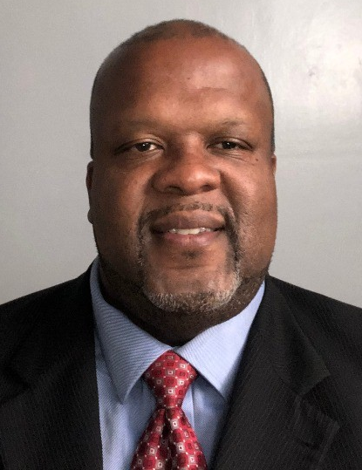

Theodore Higgins
Chief Environmental Compliance Inspector I
City of Los Angeles / LA Sanitation & Environment / Industrial Waste Management Division
Notes:
Please DON’T put speakers agency logo on the slide. It will not look good.

Slide 3

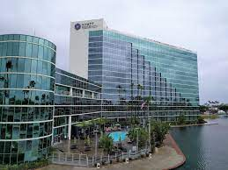


P3S Conference 2022
LONG BEACH
Monday January 31 – Wednesday, February 2, 2022
Hyatt Regency Long Beach

Slide 4
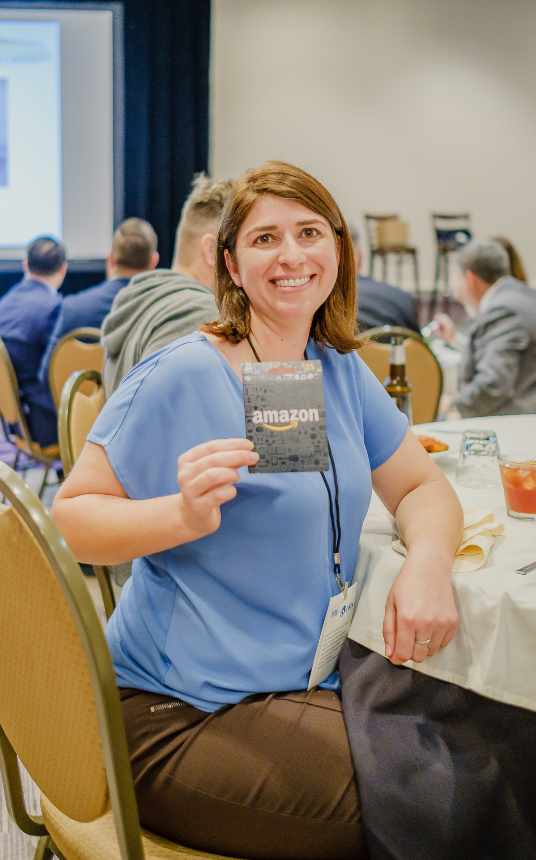
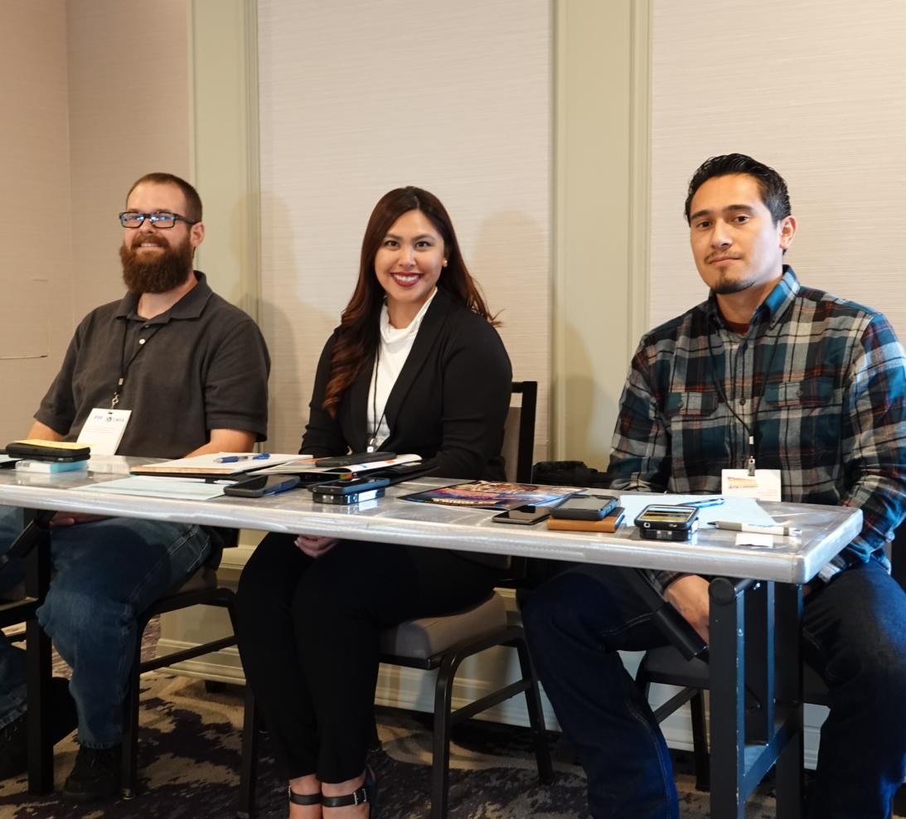
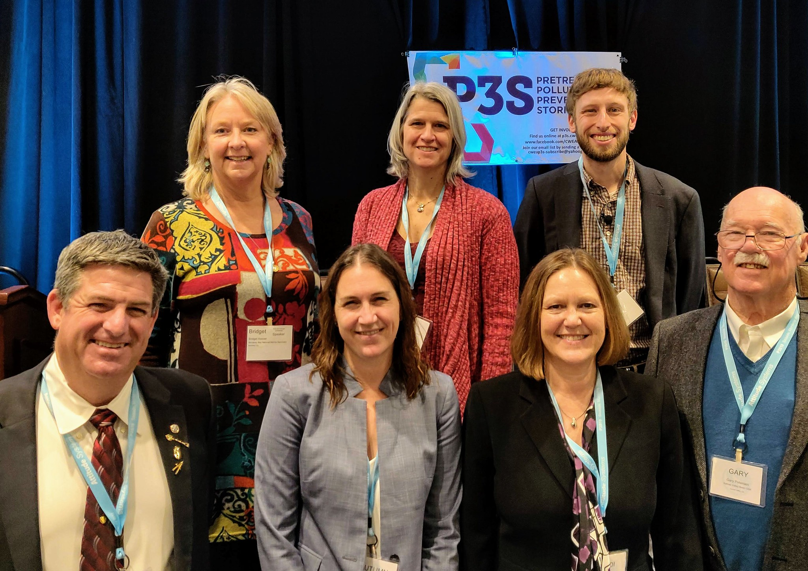
Call for Proposals
Due Today – October 13th

Slide 5
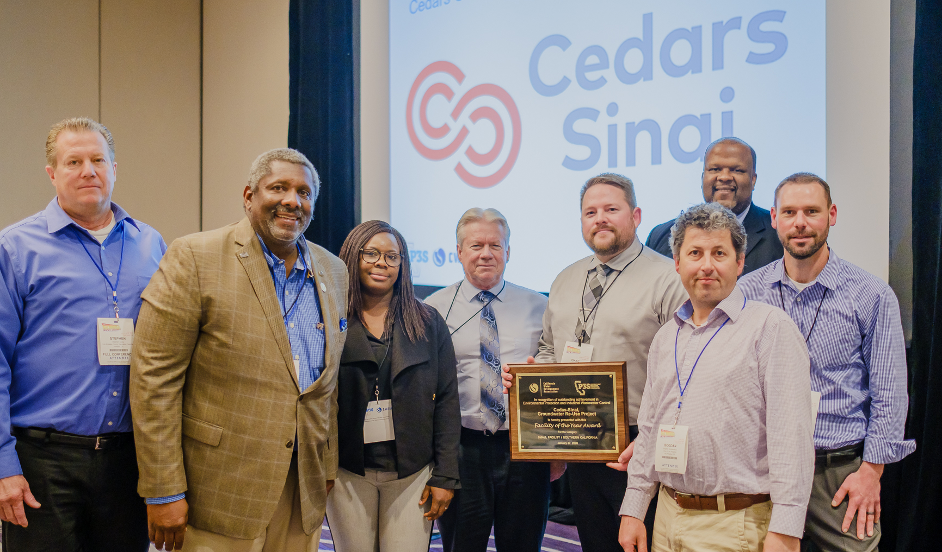
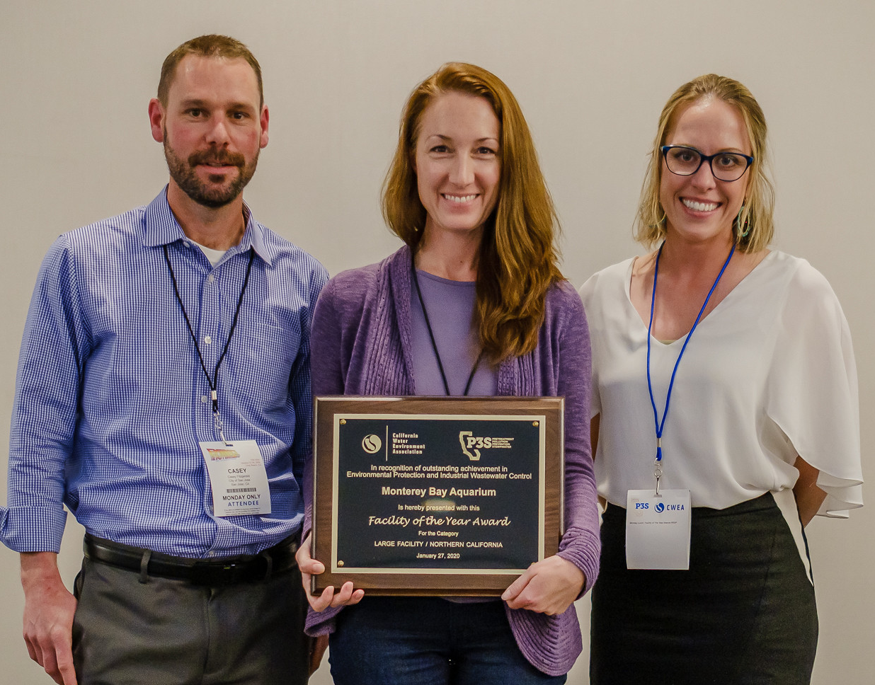
Call for Nominations
FACILITY OF THE YEAR AWARDS
NORTH AND SOUTH FACILITIES
awards.cwea.org

Slide 6

Learn more at awtoperator.org
Notes:
Learn more about the new Advanced Water Treatment Operator Certification program
At awtoperator.org

Slide 7
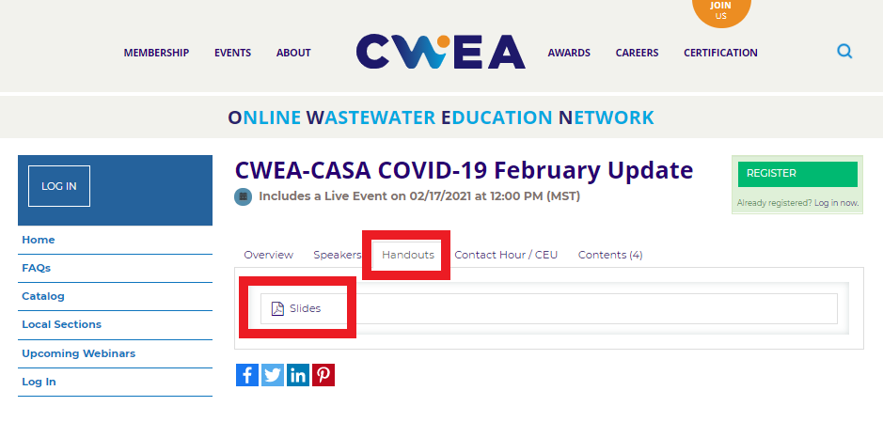
Slides/Handouts Can Be Found on OWEN under the Handouts Tab

Slide 8

CWEA, its Board members and
volunteers are not responsible for the
actions of speakers or the content of their
sessions. No endorsement is implied or
given of any persons or their philosophies,
ideas or statements; nor of any products
or processes; nor of any organizations
or companies who volunteer to serve as
speakers in educational programs.

Slide 9
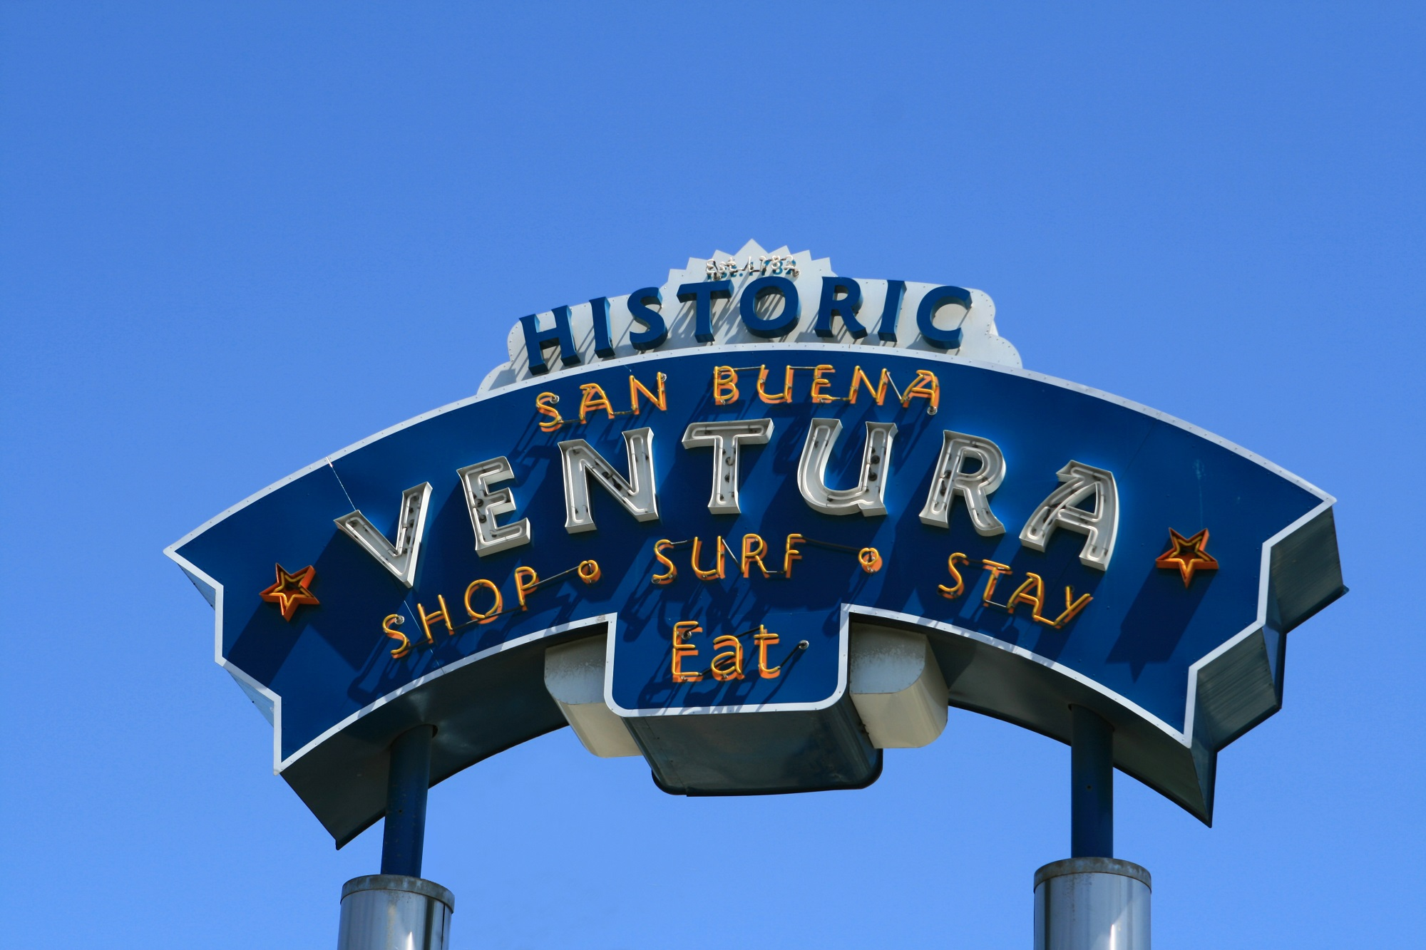
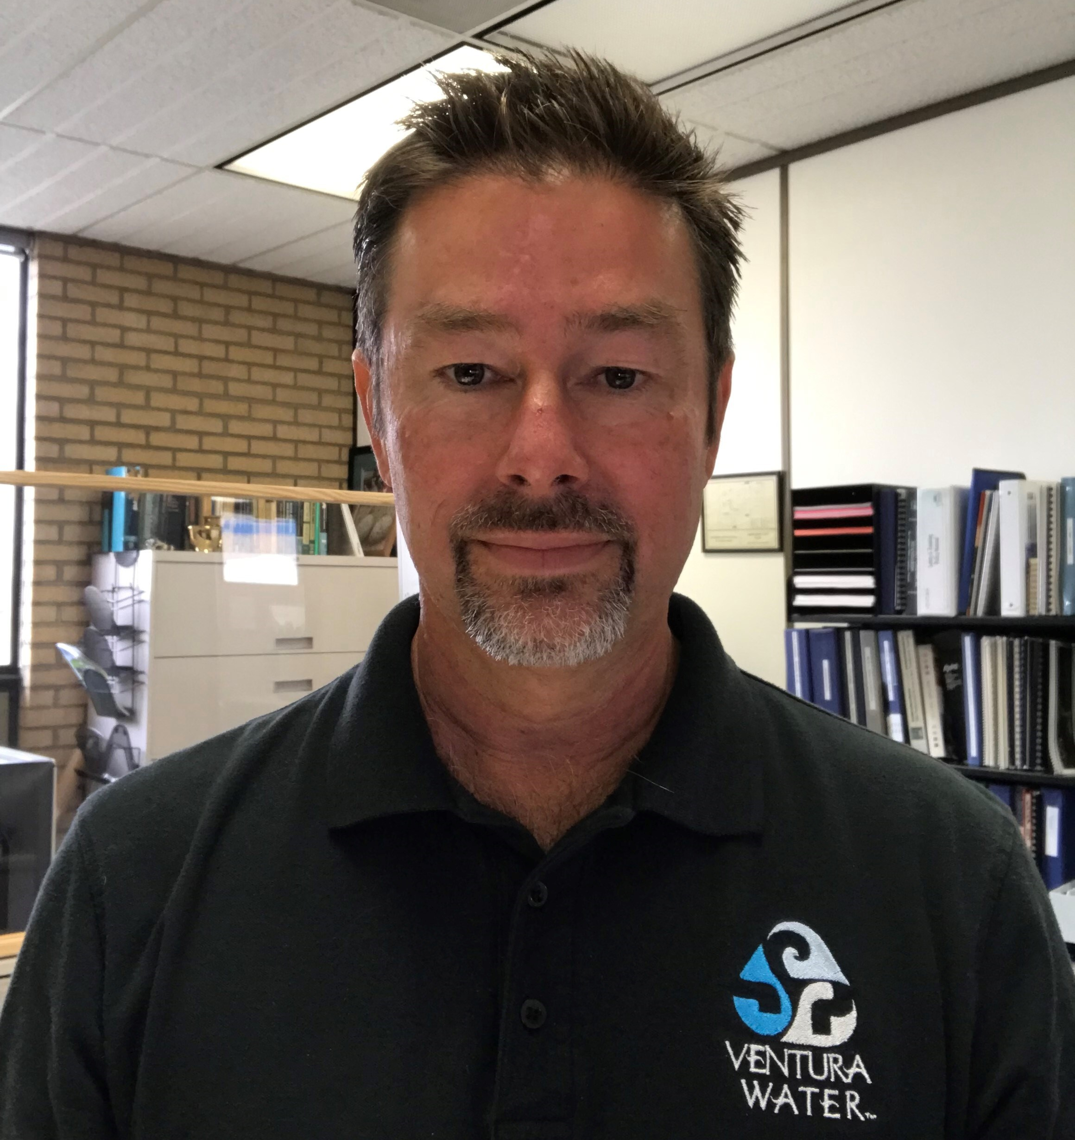
Jeremy Grant
Environmental Compliance Supervisor
Ventura Water
Notes:
Please DON’T put speakers agency logo on the slide. It will not look good.

Slide 10

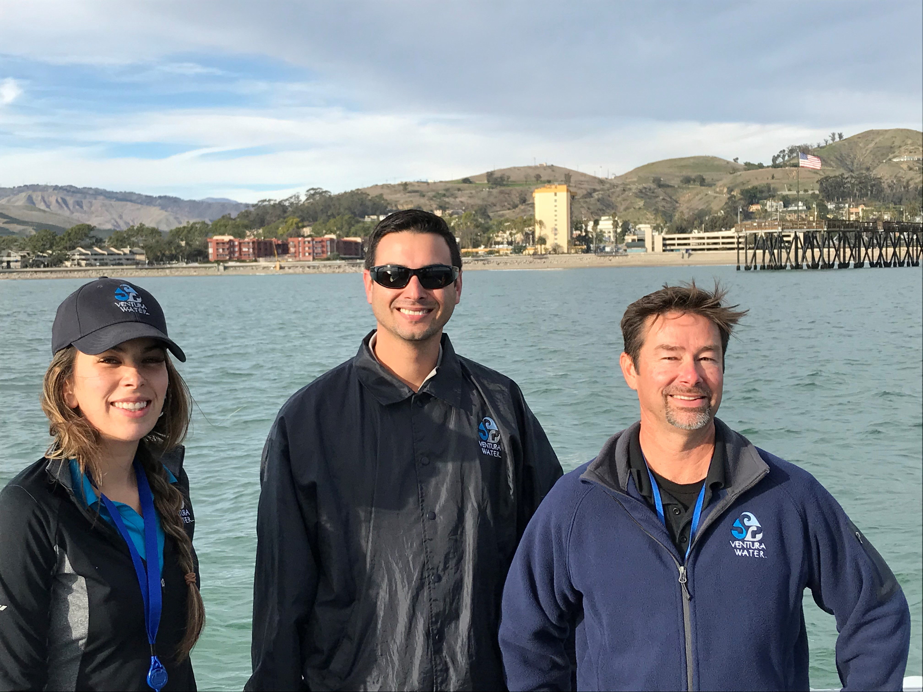
Ventura Water
Real-Time Collection System Monitoring and
Enhanced Source Control for Potable Reuse
Environmental Compliance Supervisor
Jeremy Grant
Sr. Environmental Compliance Inspector
Baylie Martinez
Environmental Compliance Inspector
Jason Wong

Slide 11
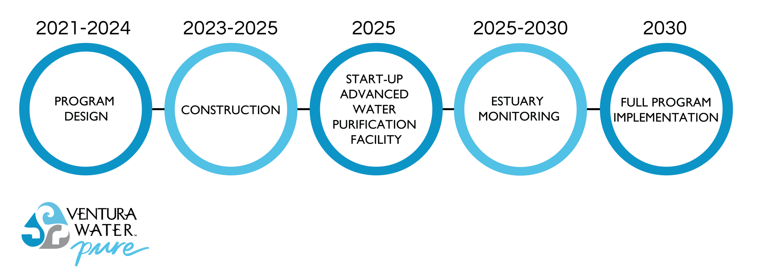
It is time to transition to Enhanced Source Control for Potable Reuse
A California State Water Resources Control Board Expert Panel has identified source control as one of six key areas needing increased focus for potable reuse (Olivieri et al., 2016).
A critical next step in the evolution of enhanced source control is developing the ability to monitor the water quality within the wastewater collection system in real time.

Slide 12


WRF-17-30/4908 October 8, 2018 – June 12, 2019
Demonstrating Real-Time Collection System Monitoring for Potable Reuse
Project Description
Deploy a sensor network consisting of three sensor stations in the collection system to monitor pH, electrical conductivity (EC), oxidation-reduction potential (ORP) and temperature. Collect grab samples to define “baseline” conditions. Thresholds on sensor signals were then set to trigger automated collection of grab samples for confirming laboratory analysis.
Ventura’s goal for this study was to evaluate the potential of sensor-based real-time collection system monitoring as a part of enhanced source control for potential inclusion in the new ESCP for VenturaWaterPure.

Slide 13
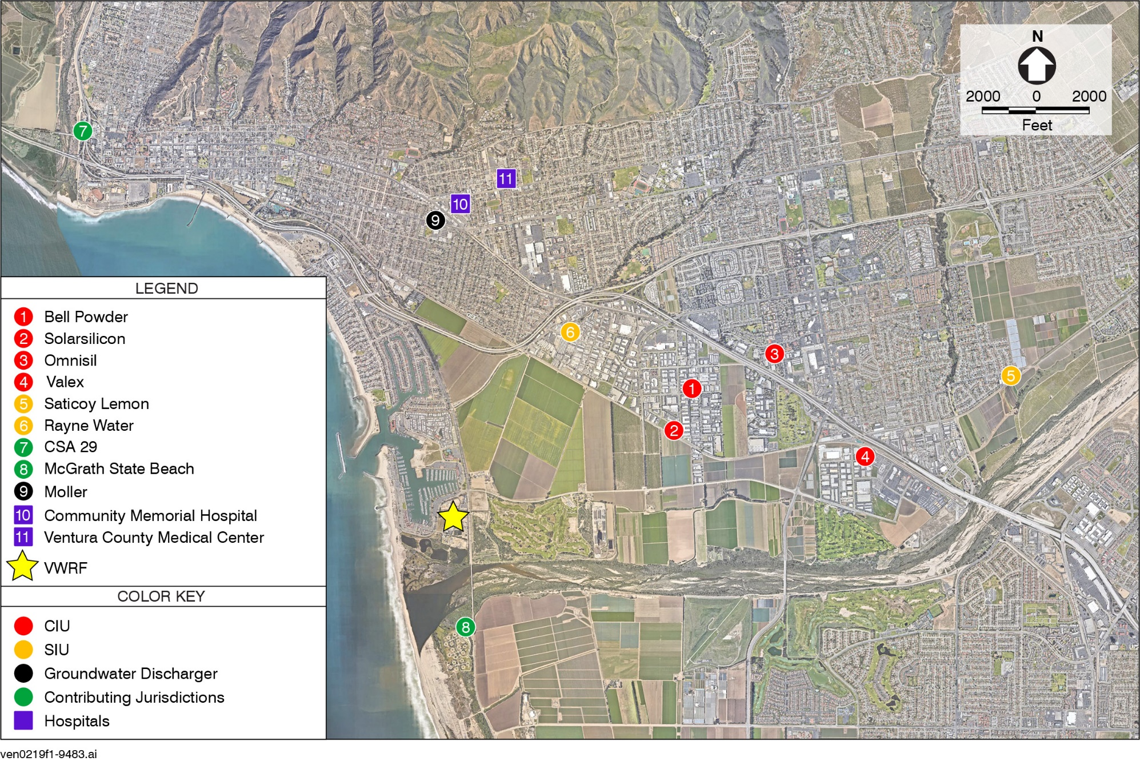
Study Focus Area

Slide 14
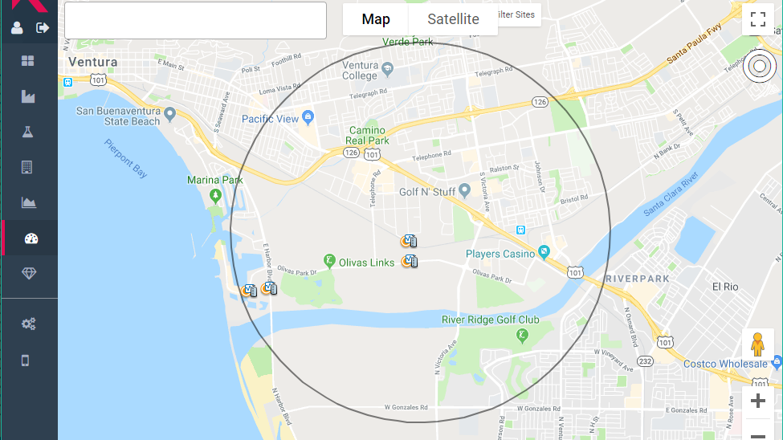
“Control Room” Page of Ventura System in Kando Web Interface

Slide 15
Notes:
.

Slide 16
We had three Kando monitoring stations consisting of two sensor probes, a data logger with antenna for data transmission via the cellular network, and an automated sampler.
Data is recorded in the loggers and transmitted to the cloud for storage and web-based display to users and Kando staff.

Slide 17
Most of our industrial and commercial dischargers are located in sewersheds P, Y, and R.
VWRF

Slide 18
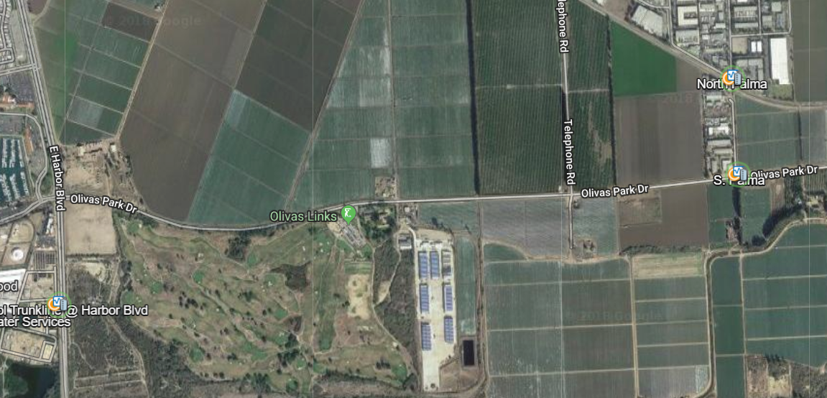
Initial location of the Kando Monitoring Stations

Slide 19
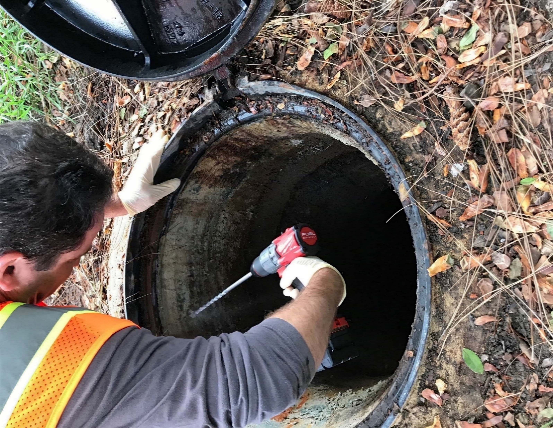
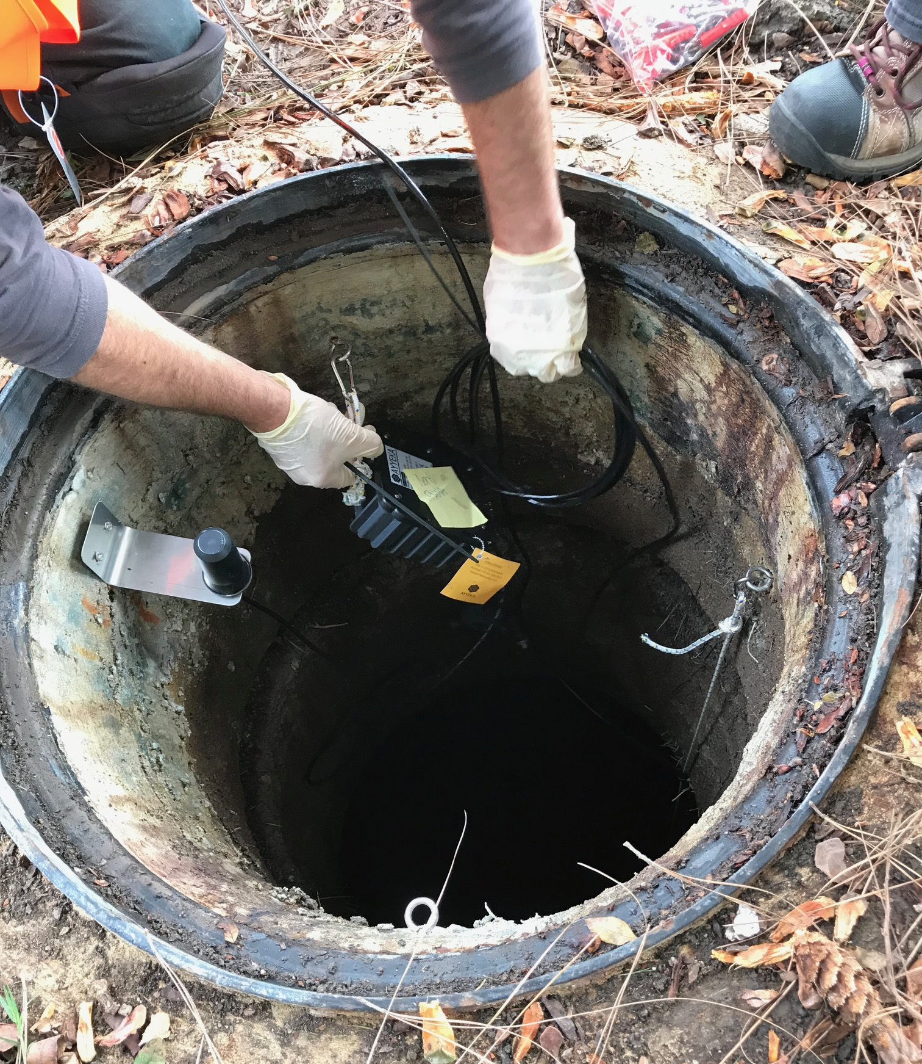
Field installation of Kando monitoring station

Slide 20
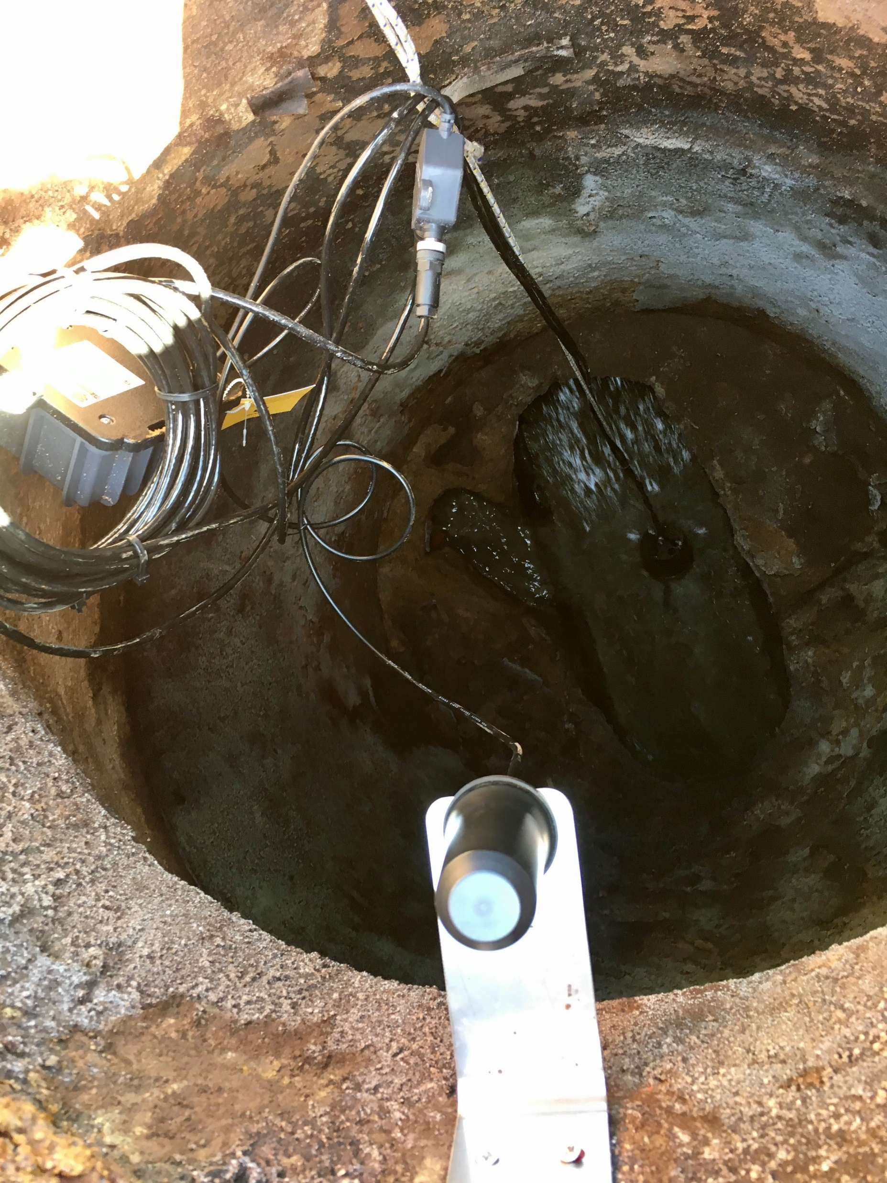
The sensors are inserted into an egg-shaped weight with holes drilled through the middle. It is designed so the sensors protrude through the bottom. The weight is suspended over the trough so that the sensors are continuously submerged in the wastewater. This could be problematic if the flow is too fast or too slow.
The wires send the sensor readings (pH, EC, ORP, Temp) to a splitter and then the data logger which communicates with 4G cell towers via the antenna pictured in the foreground.

Slide 21
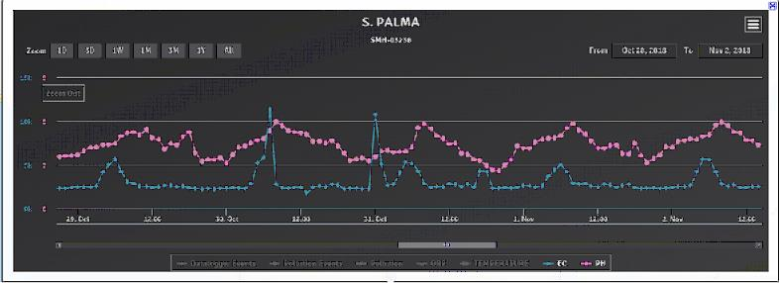
pH
EC
After installation of the sensors, the data loggers began recording data. This data is used to establish a baseline of pollutant levels. Once a baseline is established, any subsequent deviation from the baseline is considered a pollutant “event” . A regular consistent spike in Electrical Conductivity (EC) from background 2,500 uS/CM to a peak of 6,000 uS/CM or higher was observed daily at the S. Palma monitoring station.

Slide 22
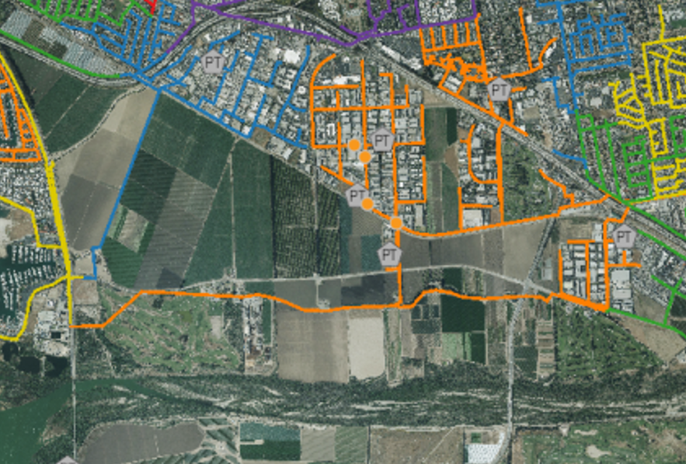
The Kando system uses a proprietary algorithm to track correlations between pollution events. The pollution tracking system calculated that 67% of the pollution events (EC) were observed in the S. Palma manhole.
2%
67%
33%

Slide 23
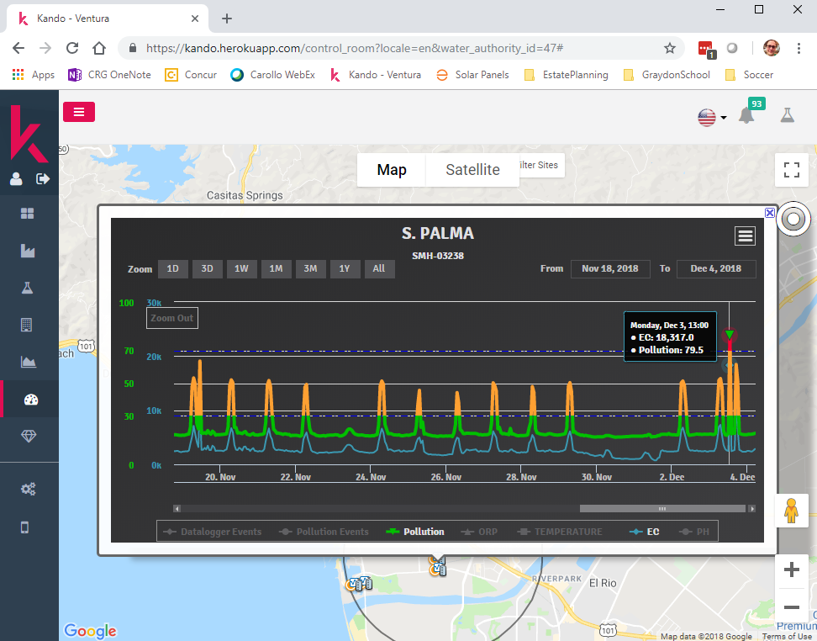
Data graph for the manhole named “S. Palma” showing the EC signal (blue) and “Pollution Index” (green/orange/red). ORP, temperature, and pH can also be shown but are turned off.

Slide 24
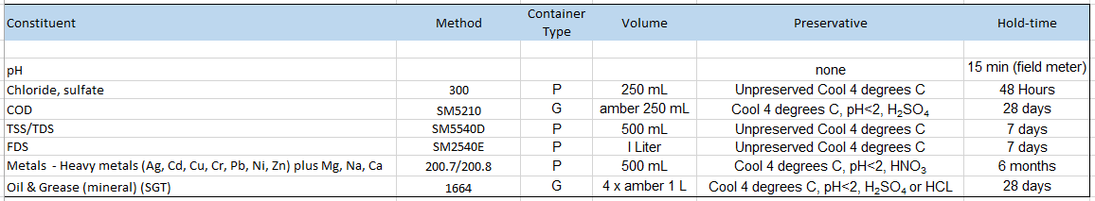
Three rounds of grab samples were collected at sensor station locations to determine baseline conditions. Triggered autosampler events could then be compared to the baseline data.

Slide 25
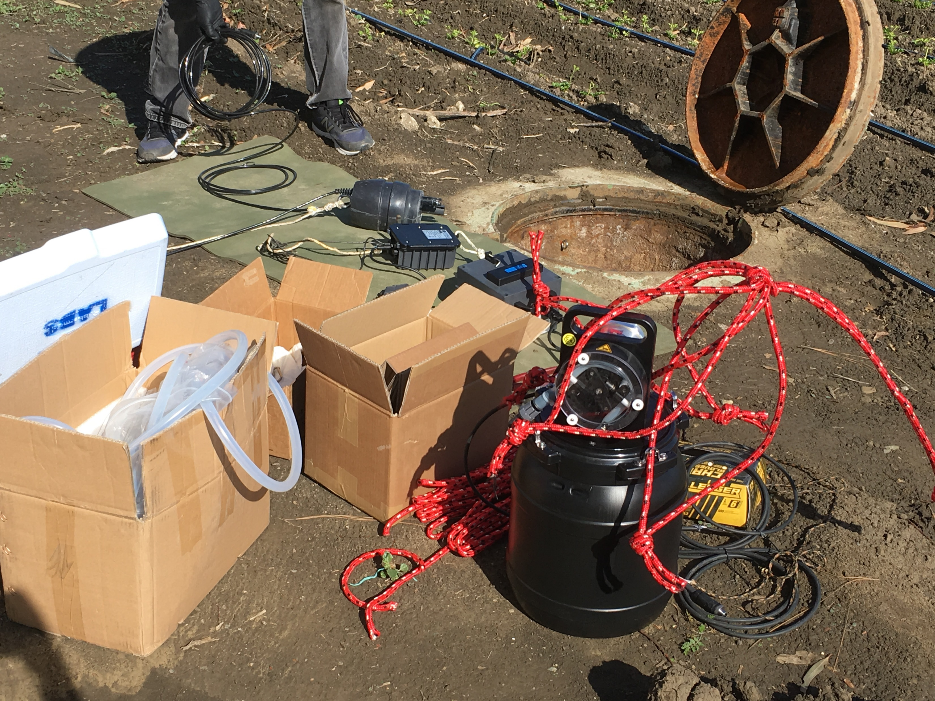
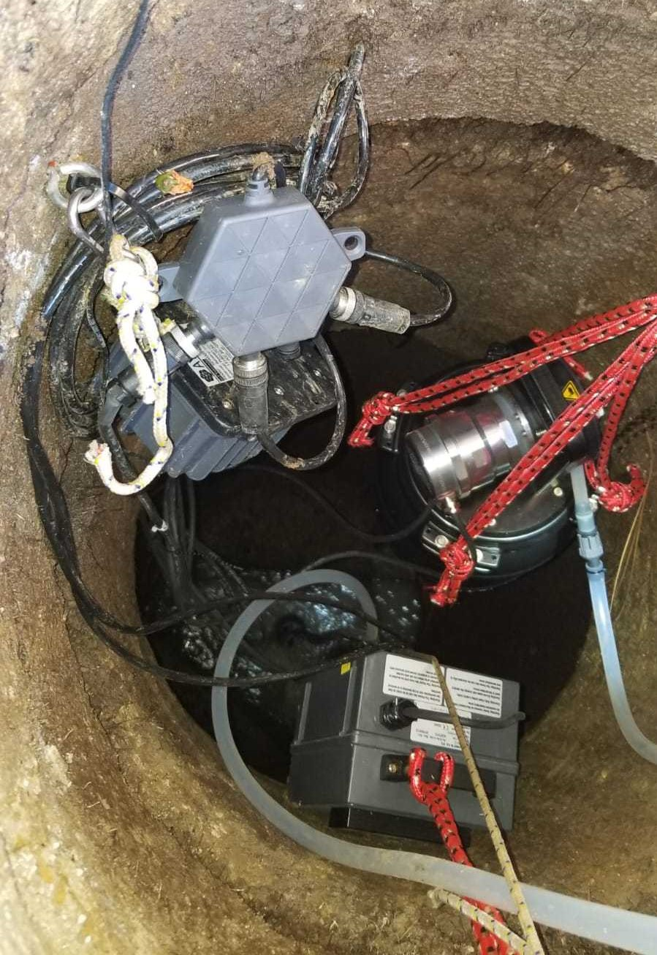

Slide 26
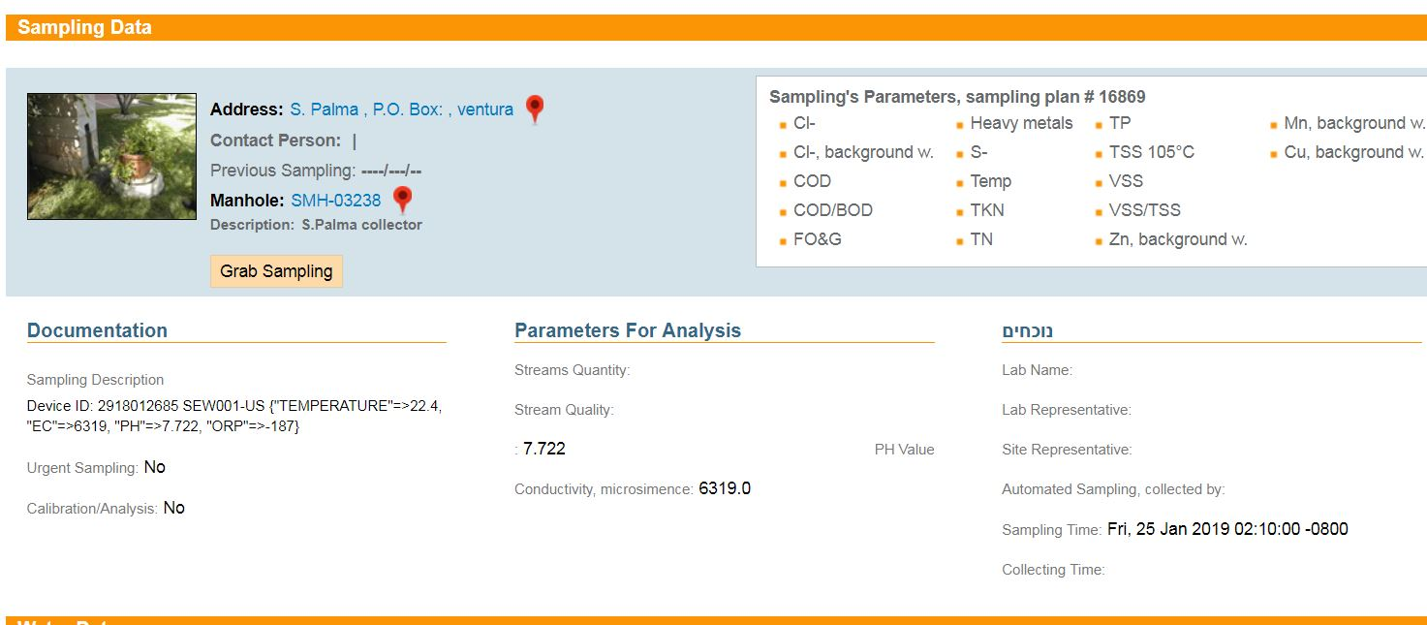
An exceedance of 6100 uS/cm triggers the autosampler to collect a sample
1/25/19 – Pollution “event” autosampler lab analysis results: TDS – 3,576 mg/L, Chloride – 1, 440 mg/L

Slide 27
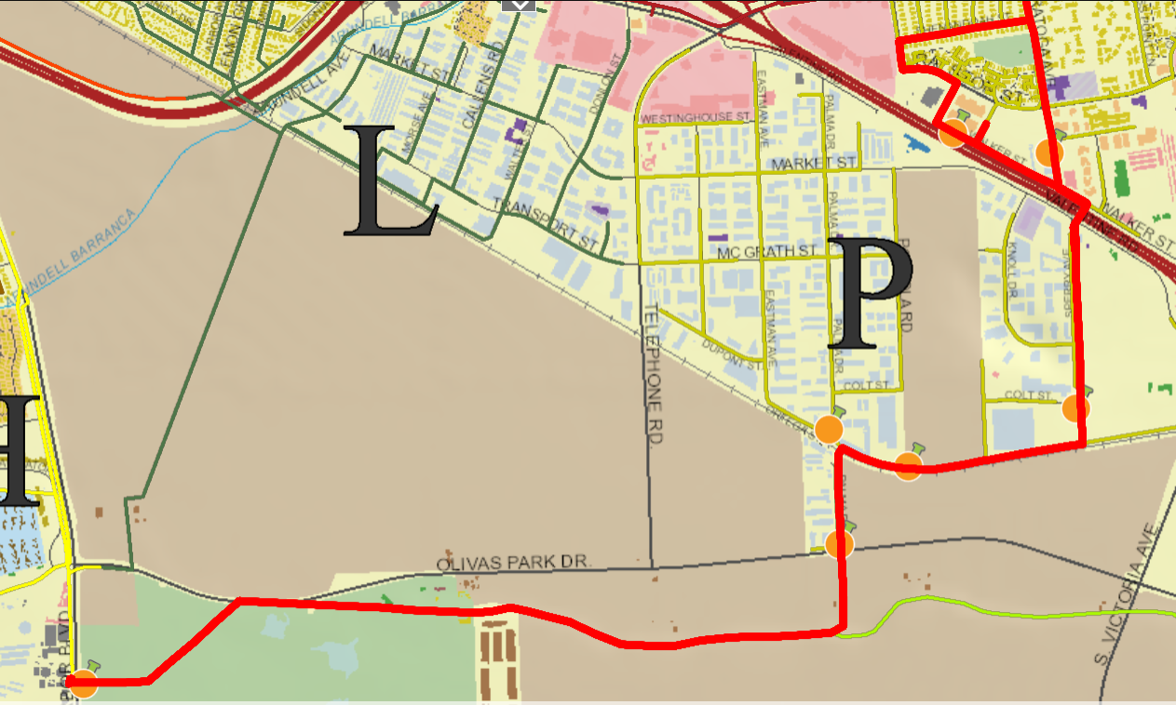
Phase I Sensor Network Locations October 8, 2019 – March 28, 2019
3rd Location 2/26/19 - 3/28/19 Sperry, Walker, Saratoga
1st location 10/8/18 - 1/29/19 Bristol, S. Palma, N. Palma
2nd location 1/29/19 - 2/26/19 S. Palma, Topa Topa, Sperry
VWRF

Slide 28
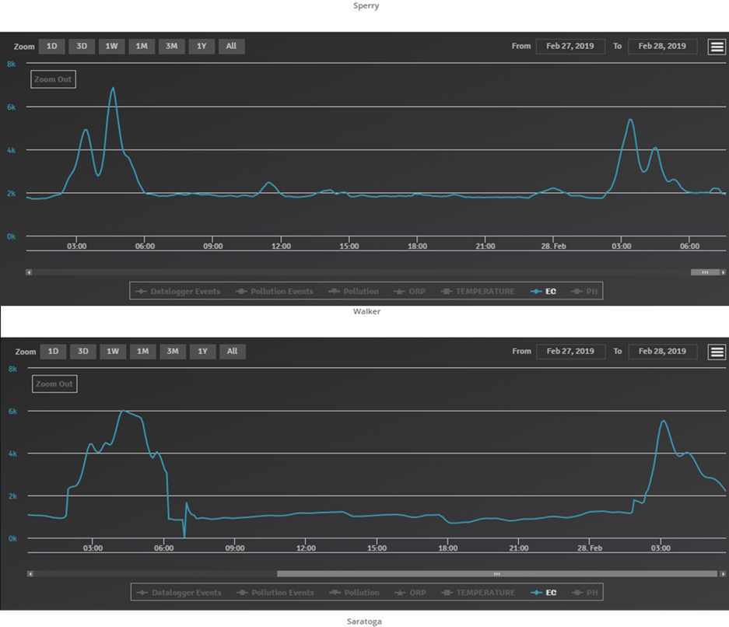
Sperry
February 27 & 28, 2019
This is what we saw after we moved the sensor stations.
EC spikes are observed at Walker and Sperry around the same time in the early morning.
Walker

Slide 29
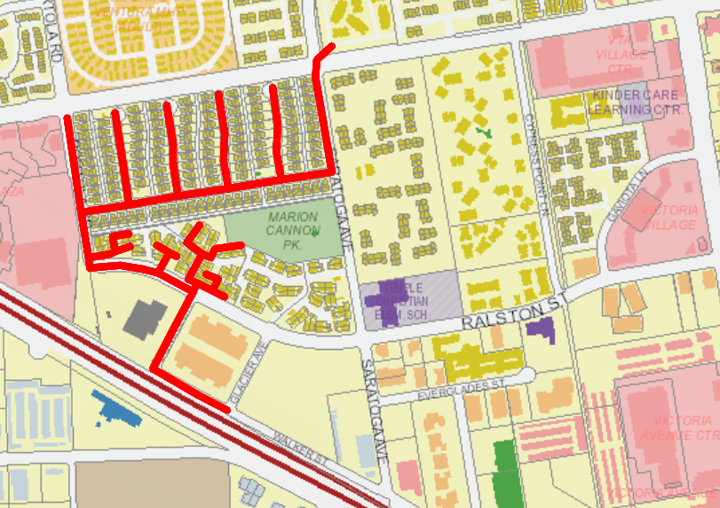
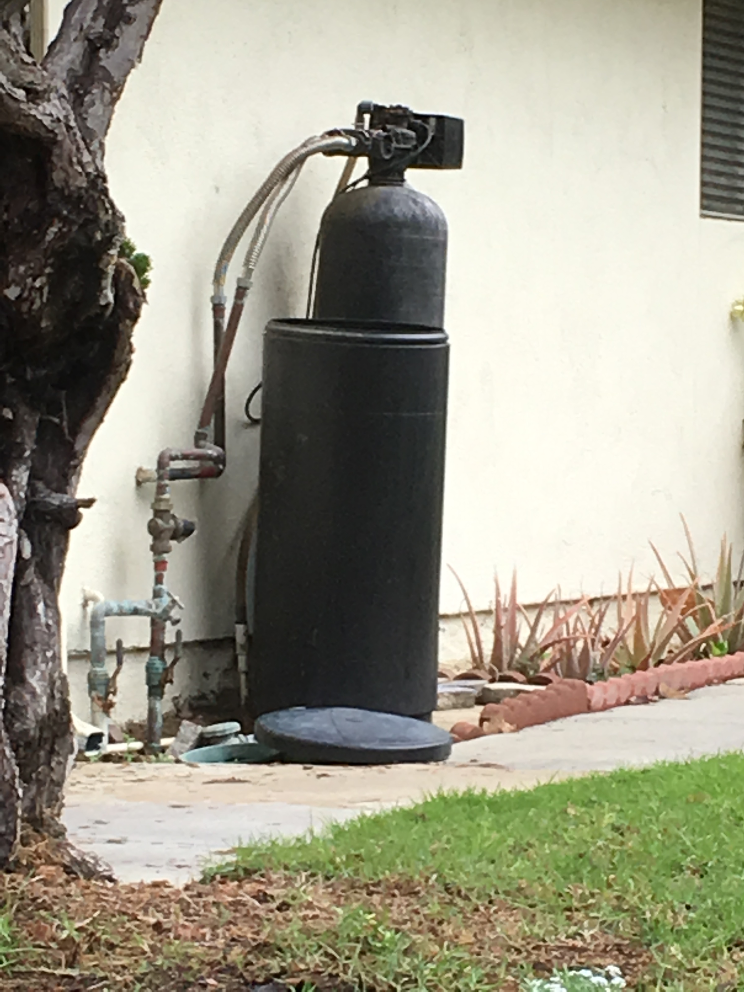
The culprit is identified!
Daily brine discharge from regeneration of water softening units from 125 triplex residential units flows downstream through the Walker sensor station.
Walker Monitoring Station

Slide 30
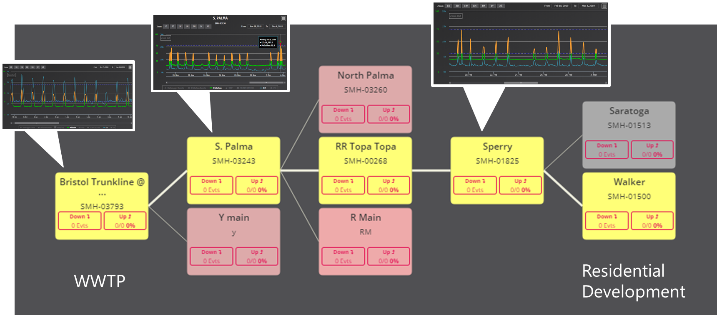
The high online EC readings were verified by collection of triggered samples. Samples collected from S. Palma that correspond to the regularly observed early-morning EC spike (1/23/2019 and 1/25/2019) deviate from the baseline samples most strikingly through high TDS (> 3,000mg/L compared to < 2,000 mg/L at baseline) and high chlorides (>1,000 mg/L compared to <200 mg/L at baseline), which is consistent with the contents of brine discharges from water softeners.

Slide 31
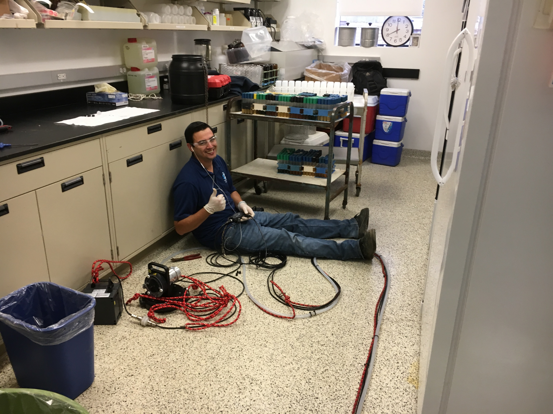
Challenges?

Slide 32
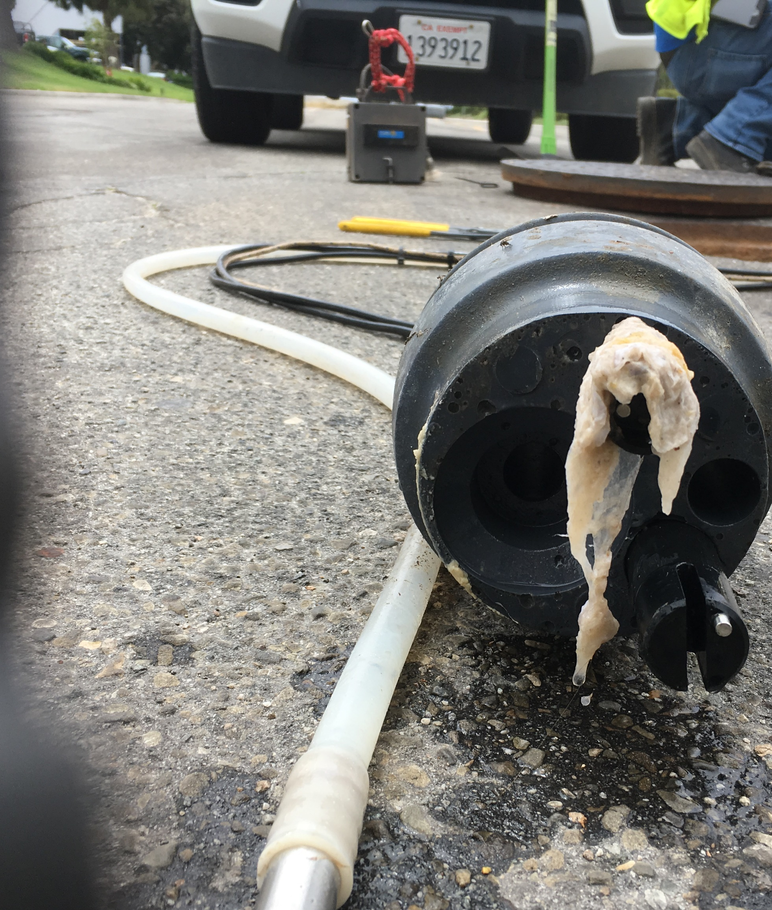
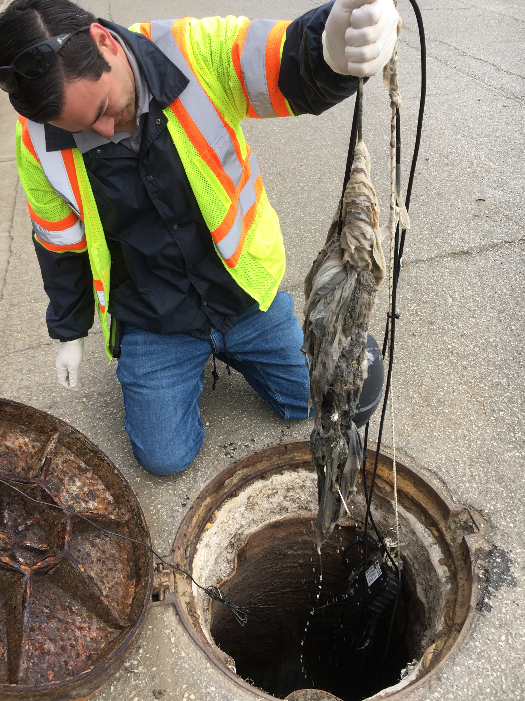
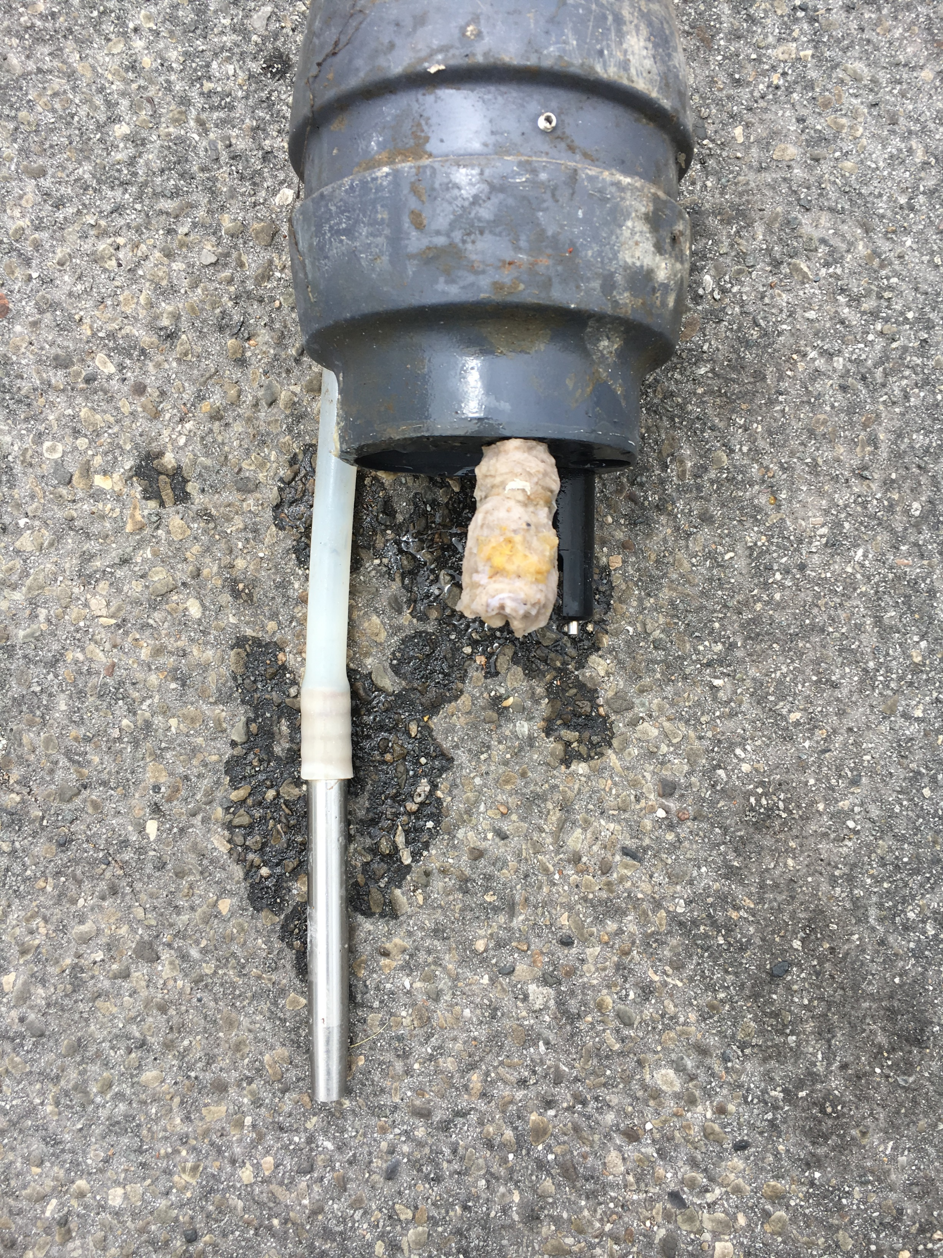
Rags were our nemesis!

Slide 33
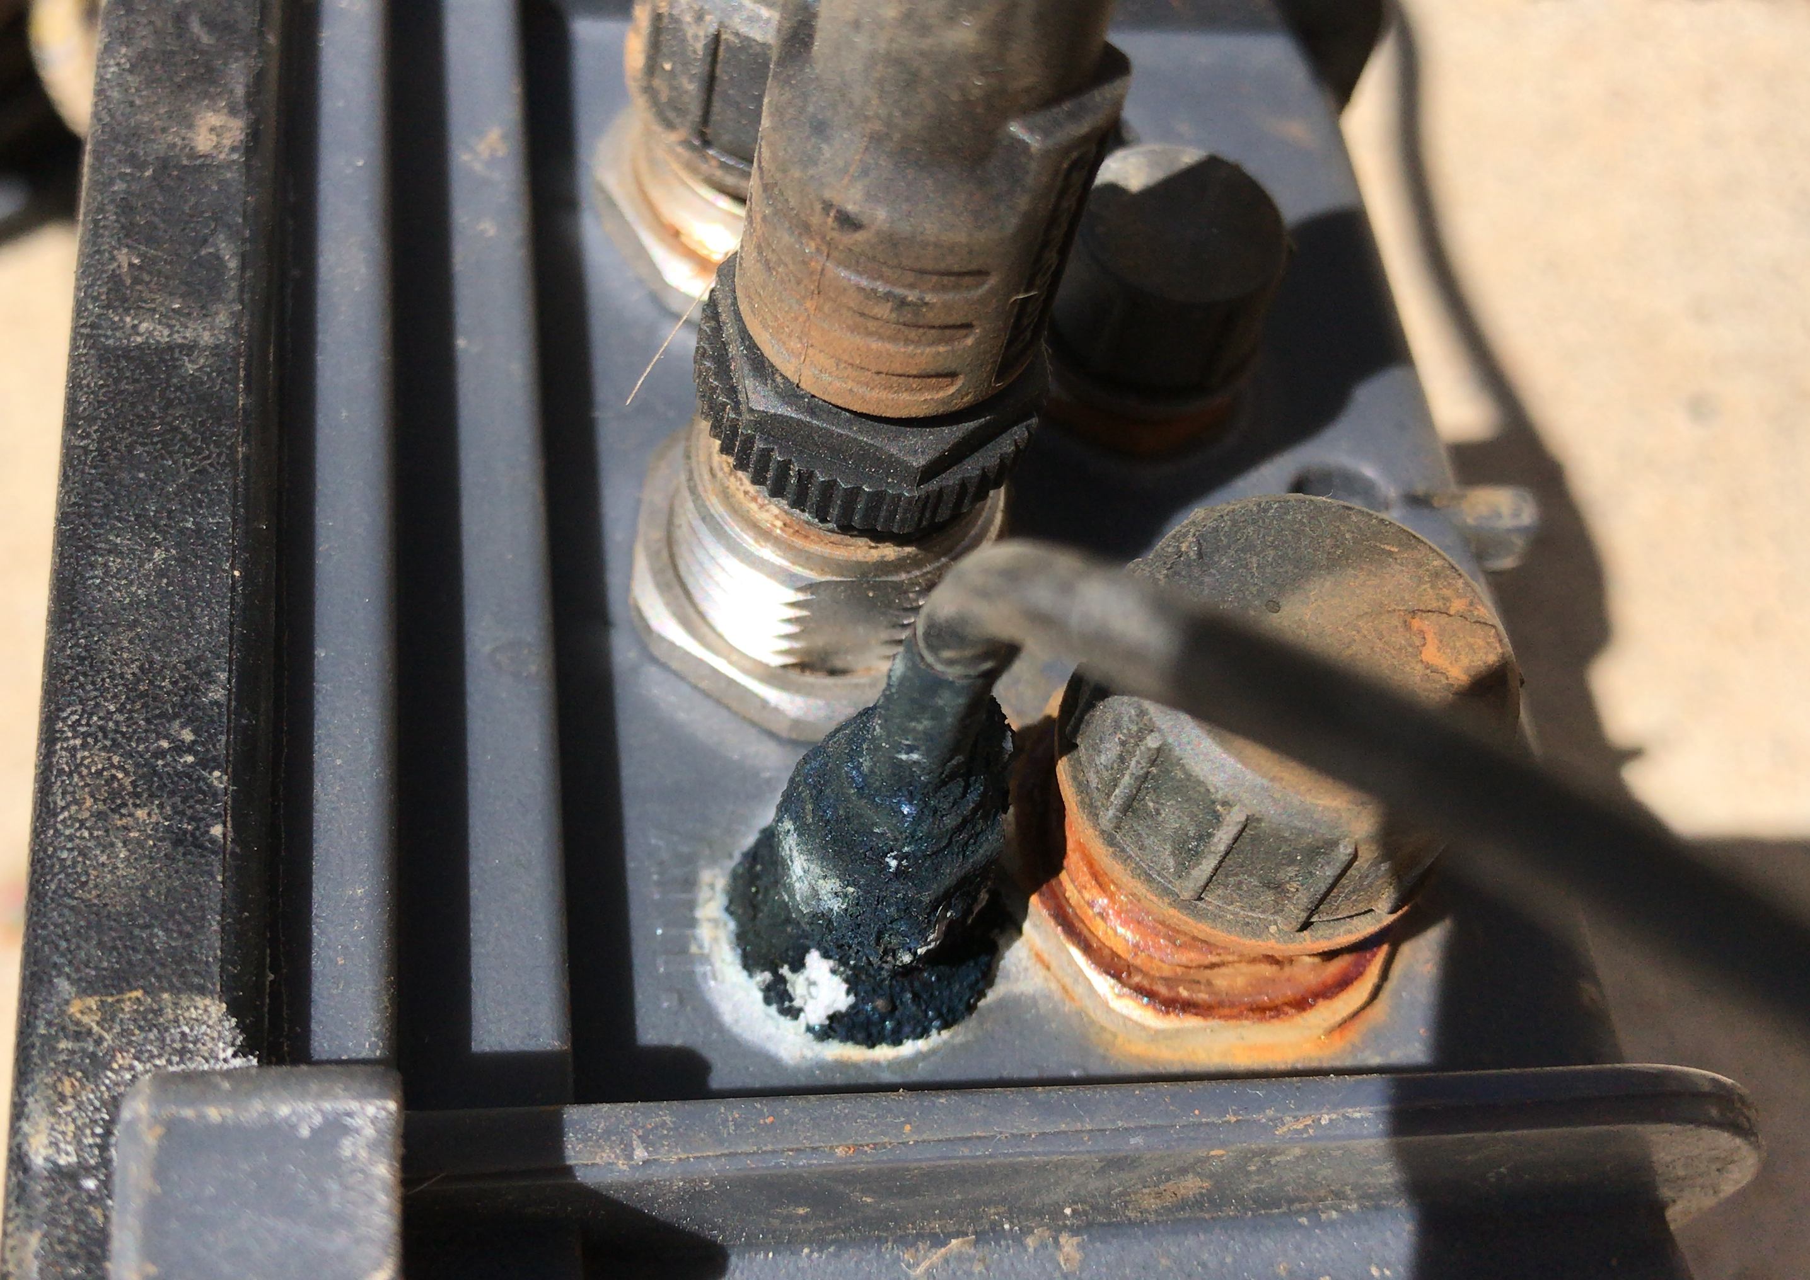
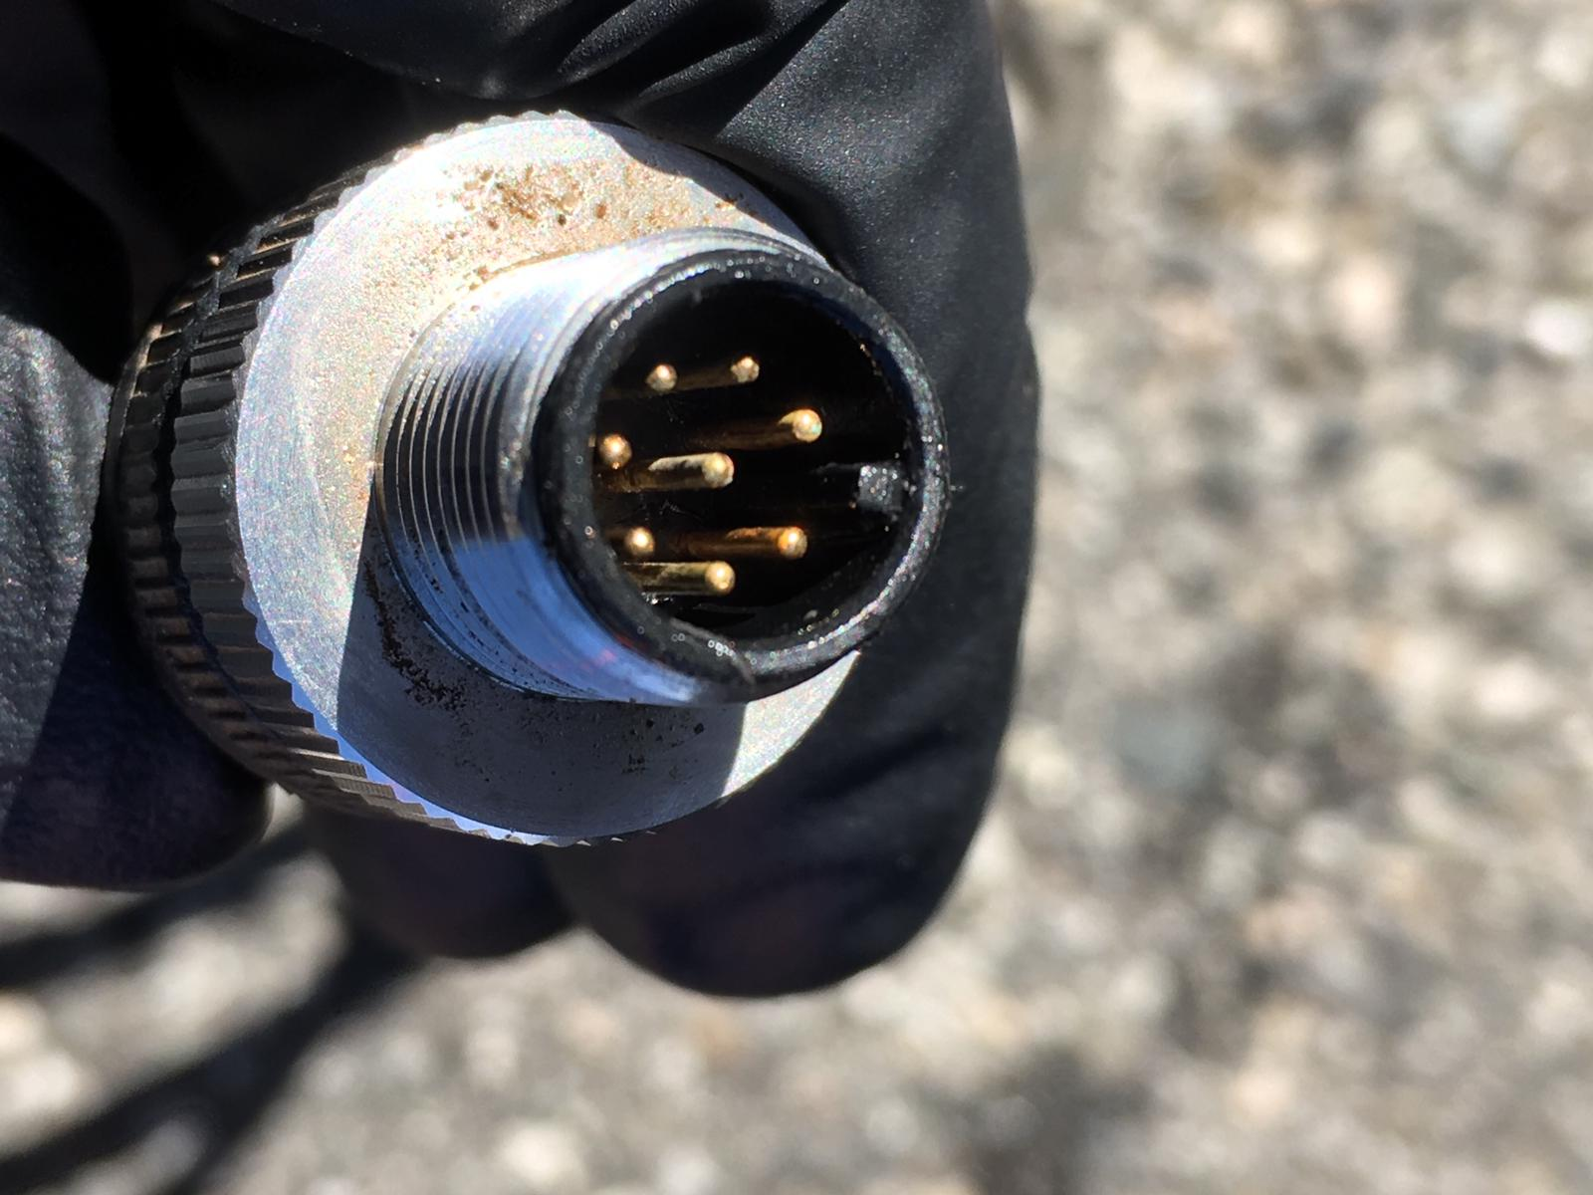
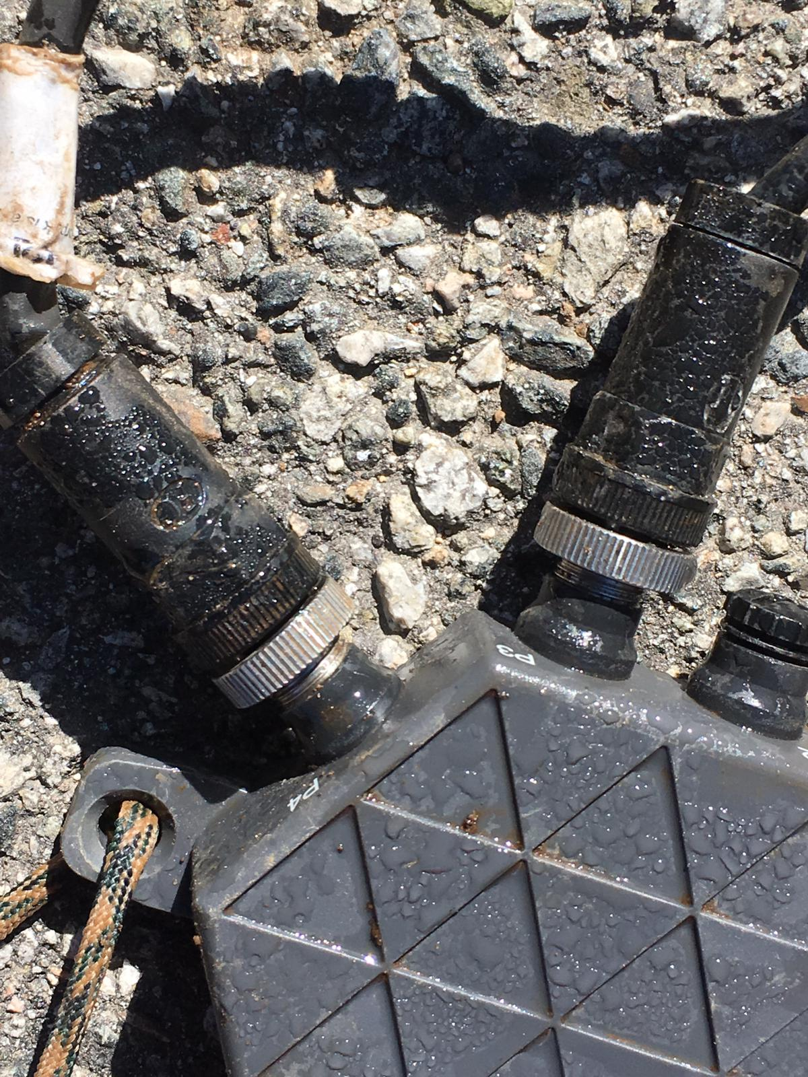
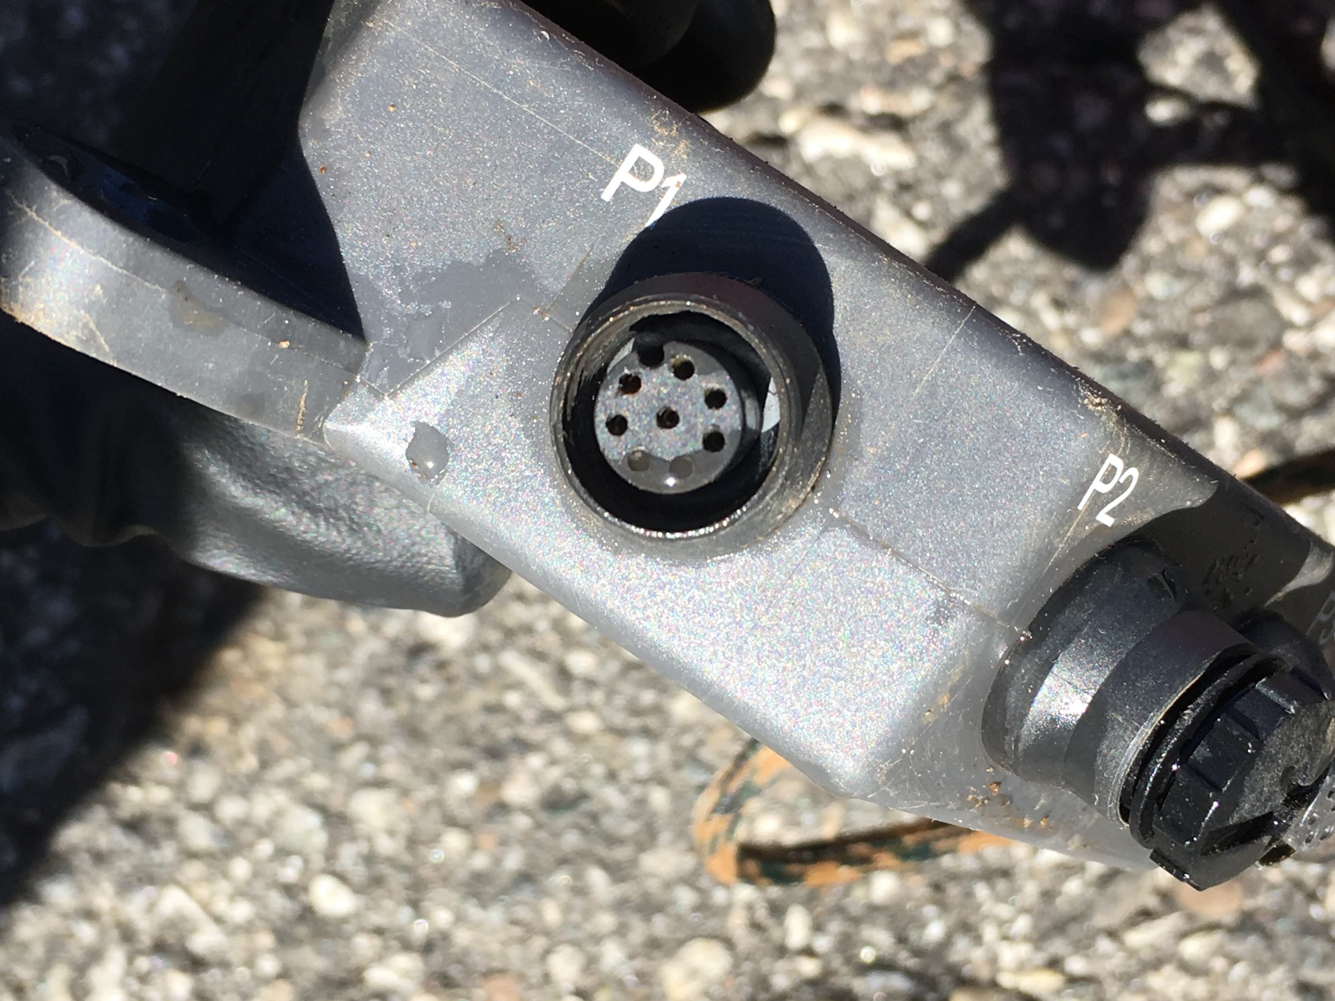
Moisture and corrosion caused improper sensor readings and malfunctions.

Slide 34
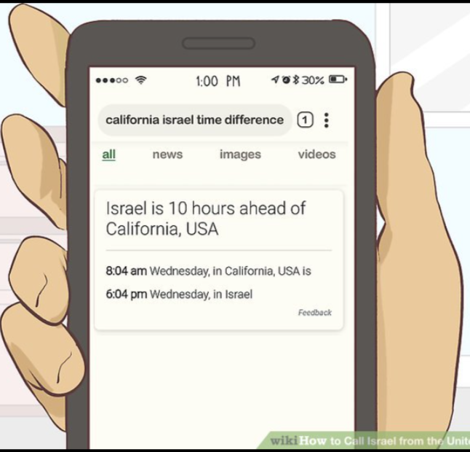

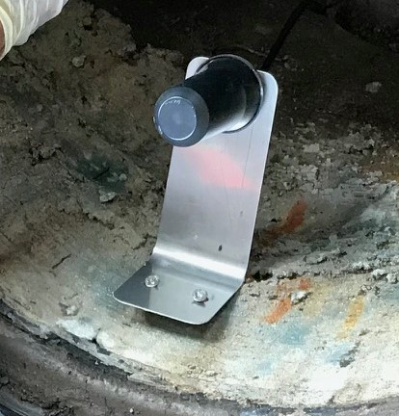

We are having technical difficulties!

Slide 35
Final Conclusions
We thoroughly enjoyed participating in this project and are very exciting to see how this technology improves in the coming years. Our overall thoughts on this technology is that additional work is needed before wide-spread implementation of real-time collection system monitoring could be used as a “Best Management Practice”.
Pros
Successful demonstration of “proof of concept”
Confirmed good compliance for phases 2 & 3
Management software and phone app were very helpful and easy to navigate
Cons
A lot more maintenance that initially intended
Sample collection was not reliable
Need to improve sensor fouling and malfunctions
Project cost were substantial, ~$10,000.00 in staff time over 9-month period, cost of hardware?
Could not use the S:can photolyser UV sensor

Slide 36

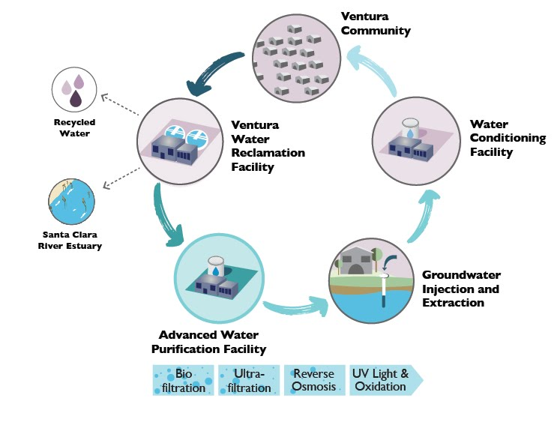
WHY IMPLEMENT ENHANCED SOURCE CONTROL PROGRAM (ESCP)?
Enhanced source control requirements triggered by Ventura Water Pure Project
Plan to create sustainable potable water supply through the construction of advanced water purification facility and groundwater injection
  Ground Water Replenishment Reuse Project (GRRP)
  Triggers Title 22 Code of Regulations ESCP requirements
  Section 60320.206 – Wastewater Source Control

Slide 37
ESCP PROGRAM REQUIREMENTS
ESCP requirements for recycled water are defined in the California Code of Regulations Section 60320.206 (DDW, 2018b)
Minimum requirements include:
1. An assessment of the fate of chemicals and contaminants that are specified by the DDW and the Regional Water Quality Control Board (RWQCB)
2. Chemical and contaminant source investigations and monitoring that focuses on DDW specified and RWQCB-specified chemicals and contaminants
3. An outreach program to industrial, commercial, and residential communities within the agency’s service area for the purpose of managing and minimizing the discharge of chemicals and contaminants at the source
4. A current inventory of chemicals and contaminants, including new chemicals and contaminants resulting from new sources or changes to existing sources
5. Is compliant with the effluent limits established in the agency’s RWQCB permit
Do you have a plan for how you will implement Enhanced Source Control for Potable Reuse?

Slide 38
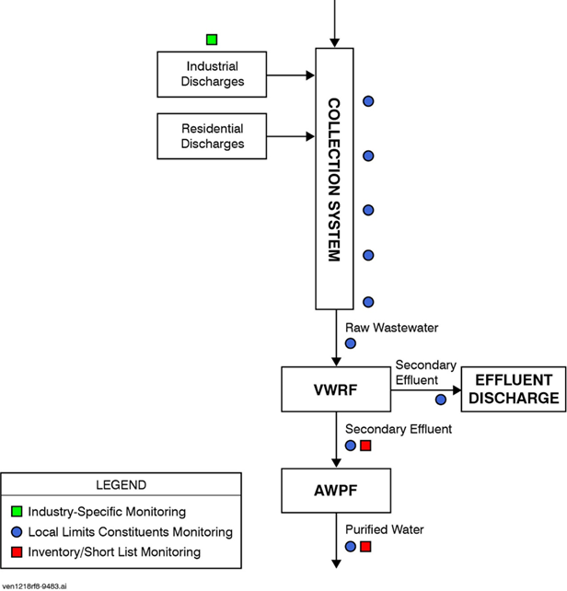
PROPOSED ESCP PLAN
Point of Responsibility: Source Control Program Manager
Expanding Upon the Existing Source Control Program, include 3 new aggressive monitoring programs:
  Purified effluent monitoring
  Secondary effluent monitoring
  Monitoring of four main trunks within the collection system.

Slide 39


SOURCE MAPPING & RESPONSE PLAN
Industrial/ Commercial Sources:
Locations are identified
Samples taken from several locations - upstream, downstream, onsite and adjacent to suspected violators.
If unacceptable concentrations of contaminants are found, action identical to current enforcement efforts by the City should be taken, Can include:
  Cease-and-Desist discharge
  NOV
  Suspension of Industrial Waste Discharge Permit
Residential Sources:
Contaminant of concerns
  Difficult to pinpoint which house is causing the violations
Heavy emphasis put on household outreach and education.
Additionally, the City provides a hazardous waste disposal program for medications, pesticides, and other hazardous waste items
This Photo by Unknown Author is licensed under CC BY-SA

Slide 40
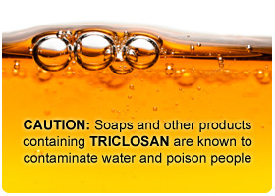
CECs are defined by SWRCB (2018, draft) as constituents in:
•Personal care products
•Pharmaceuticals
•Antimicrobials
•Industrial
•Agricultural
•Household products
•Naturally occurring hormones
•Food additives
•Transformation products
•Inorganic constituents
•Microplastics
•Nanomaterials

Slide 41
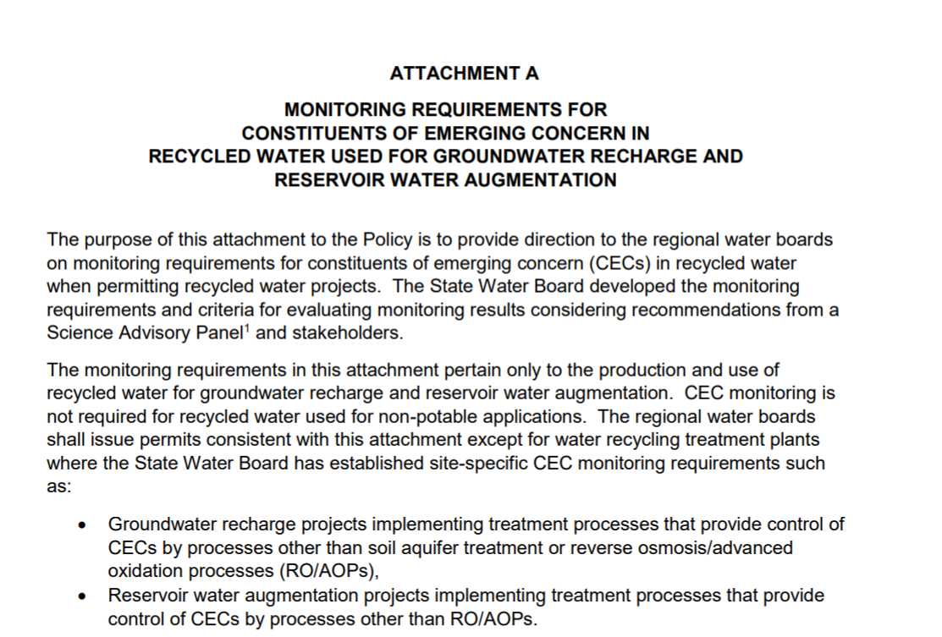
CEC MONITORING
Excerpt from SWRCB
Recycled Water Policy
Effective April 8, 2018

Slide 42

HOSPITAL DISCHARGE PROGRAM
Hospital waste discharge monitoring is not currently required by the National Pretreatment Program, however The City samples for all constituents within its sector sampling program, as well as 29 additional hospital-related CECs at one hospital sites.
City is pursuing CEC sampling at an additional hospital site.
This Photo by Unknown Author is licensed under CC BY-SA

Slide 43
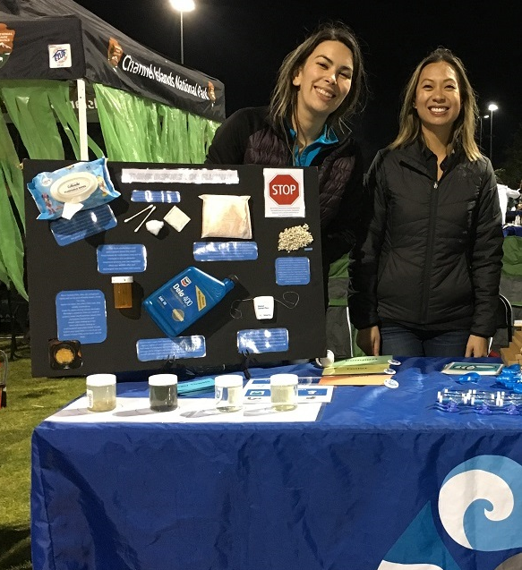
CURRENT RESIDENTIAL OUTREACH
Focused on increased awareness of current programs for proper hazardous waste, with a major focus on pharmaceuticals
Education conducted at outreach events and through partnering with Ventura Water communications team to better utilize social media to spread information
  ESCP outreach easily pairs with Ventura Water’s Water Conservation education efforts

Slide 44
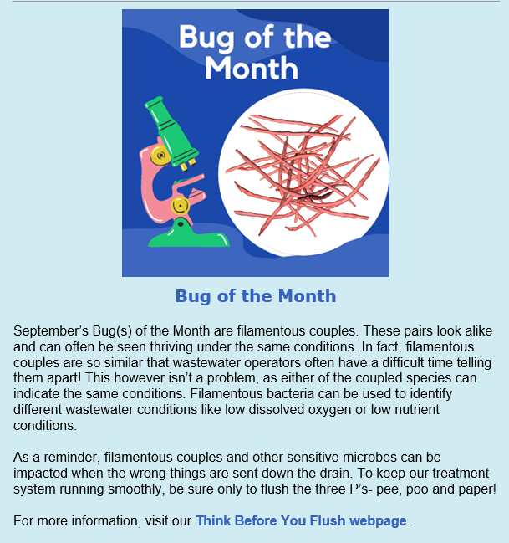

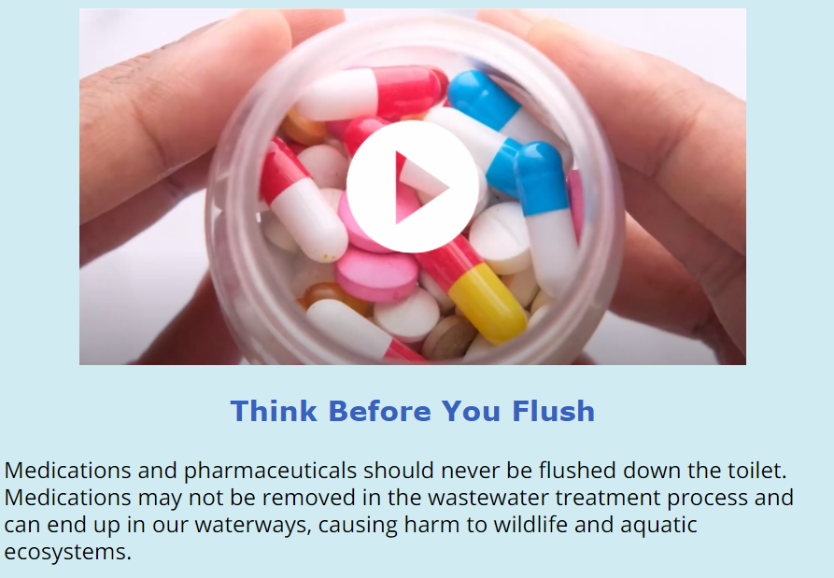

Slide 45
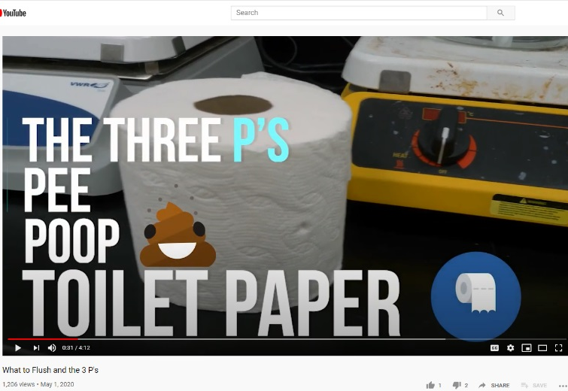
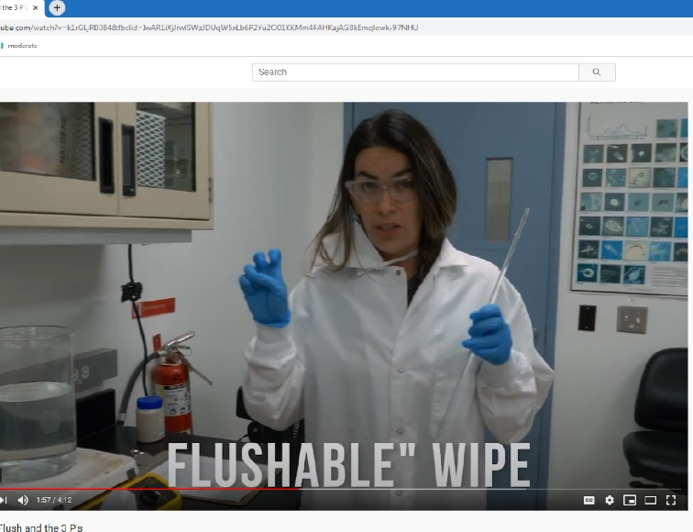
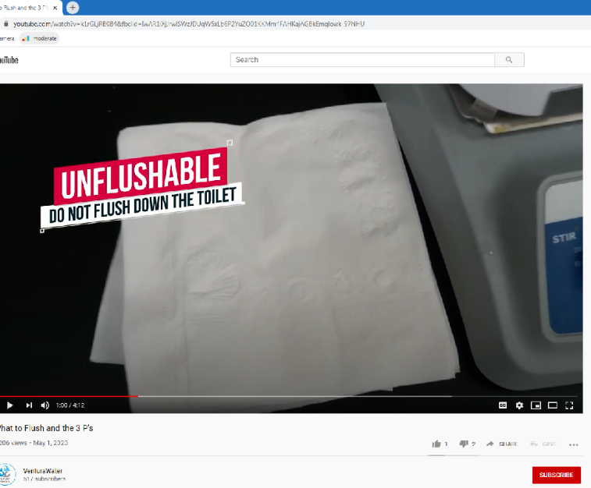
RAGS, 3 P’S AND SENSORS
Source Control staff has kept an eye out for “piggy-back” outreach opportunities throughout the city
During COVID-19 crises staff created a “3 P’s” video to educate the public about the harmful effects of rags, wipes, and other problematic products that were being sent down the drain due to a toilet paper shortage
This not only helped the city with its COVID-19 related outreach needs but also allowed staff the added benefit of spreading ESCP information
Education against rages and wipes is also beneficial for ESCP due to the ability of rags and wipes to render real-time sensors such as Kando sensors incapable of reading wastewater levels which will be an issue when real-time monitoring is put into effect for ESCP
https://www.youtube.com/watch?v=k1rGLjRB0B4&t=31s

Slide 46


Slide 47

INDUSTRIAL OUTREACH
Source control staff regularly engages with industry through its existing Industrial Pretreatment program
Cooperation from industrial users (IU’s) will be critical in the success of the ESCP
Maintaining and increasing communication and coordination with IU’s will be main focus of ESCP, along with additional discharge requirements
This Photo by Unknown Author is licensed under CC BY-NC-ND

Slide 48


Slide 49


Anne-li Steutel-Maron
US Business Development & Marketing Strategist
Kando
Notes:
Please DON’T put speakers agency logo on the slide. It will not look good.

Slide 50



CWEA
Oct. 13, 2021
kando.eco

Slide 51



We are passionate about making a positive impact on people's lives and the environment through improving wastewater quality around the world.
51

Slide 52


Change of Perception
Influent
Resource
Raw Material
52

Slide 53



The Challenge
To see the full picture
so you can take decision
53

Slide 54

Traditional Ways of Understanding Networks
Pretreatment program results
This graph shows the proportion of events* random sampling finds in key industries.
Petrochemical
4%
Food factories
8%
Metal coating
7%
Slaughterhouses
2%
Chemical & Pharmaceutical
8%
Garages
6%
Hospitality
3%
54

Slide 55

Wastewater Intelligence
Using real-time data inputs, and live analytics.
This graph shows the proportion of events* Sampling Automatically triggered by events
Petrochemical
79%
Food factories
94%
Metal coating
71%
Slaughterhouses
94%
Chemical & Pharmaceutical
76%
Garages
91%
Hospitality
90%
55

Slide 56





The Challenge
Influent
Number of events detected/week
6
Resource
ISRAEL
Events detected / week
6
4
Mean duration of events
176.3
Median duration of events
129
Raw Material
2
ITALY
TEXAS
Events detected / week
3
Events detected / week
3
Mean duration of events
103.2
Mean duration of events
2999
Median duration of events
24
Median duration of events
44
0
75
150
300
Mean Duration of detected events (min)
56

Slide 57










Industrial Event Frequency
Harmful events are more common in some industries than others.
Below are the event frequencies for some key industries.
Number of events detected/week
8
7
Metal Coating
6
Food Factories
5
Chemical & Pharmaceutical
Garage
4
3
2
Hospitality
1
Slaughterhouse
Petrochemical
0
50
100
150
200
250
Mean Duration of detected events (min)
57

Slide 58



58

Slide 59











59

Slide 60


Seeing everything that happens at the Network
60

Slide 61


Seeing the Network
Creating a language based on Data
61

Slide 62


Seeing every point of interest
62

Slide 63






Collecting the data
Controller
Automatic Sampler
IoT unit installed in a manhole
63

Slide 64





Collecting the data
Led and Detector channel #1
IP66 aluminium housing
Led and Detector channel #2
Submerged chemical condition & flow sensors
Fluoresces reflectometry
Contactless ‘A-Eye’
Organic matter sensors
64

Slide 65



Creating a language | from sensor to value
65

Slide 66


How Do We Impact
Product strategy Automated process
05
Measuring the change
04
Software Interface behavioral change
03
Planning Analytics Engine Intelligence from Data
02
Data collection
Our | Others
01
Planning
66

Slide 67


Challenges
Passive to Active
Sensors to Data
Communication
in the organization
67

Slide 68










The Customer Journey
02
On Boarding Process
Kickoff Meeting
Data review
Meet the team
Samples and Lab result
Define scope and goals, identify stakeholders and review roll-out plan Discuss timeline, touchpoints, understand expectation
Upstream detection
Track Sources
01
03
Value Creation
Adoption
Focus on detected contributors
Project Measure shows successes
Best practices for behavioral changes
Project goals positive
Expected output: reduced pollution
Business needs addressed
Client want to expand usage
04
Client want to expand usage
68

Slide 69


Impact
Empower our clients to take actions based on data and insights, so that they can fulfil their goals and vision.
56%
of monitored factories saw improved quality in terms of intensity and duration, leading to a...
49%
improvement in total wastewater quality
69

Slide 70





Water Reuse | El Paso Water
The Challenge
Unseen pollution loads were damaging WWTP’s biological treatment processes, leading to degraded wastewater outputs and permit violations costing ~$100k/year. To implement effective pollution prevention through source control, El Paso Water (EPW) had to identify the unknown illegal dischargers around their network.
Aims
Identify and trace illicit discharges across four focus areas
Value
Locating the source of unpermitted discharges enabled EPW to improve its pretreatment program and increase enforcement. Following sample analysis, EPW had the evidence to fine violators up to $10k.
Our solution enabled EPW’s team to identify discharge patterns and auto-sample events in real time, saving ~30 hours of labor.
70

Slide 71



WWTP Protection |
North Texas Municipal Water District
The Challenge
In early 2021, NTMWD experienced unexpectedly high levels of ammonia and phosphorous at its Rowlett Creek WWTP. With the pollution disrupting the plant’s treatment processes and impacting discharge quality, NTMWD needed to improve wastewater quality in its collection system.
Aims
Identify pollution events before they reached the WWTP
Take automated wastewater samples during events for lab analysis
Prioritize areas for further action based on real-world pollution levels
Value
Real-time condition reporting identified several pollution events, with automatic samplers triggered. Lab analysis confirmed high levels of phosphorus and ammonia at key locations in the network.
NTMWD estimates $25k/month OPEX savings due to Kando’s solution identifying pollution events before they arrived at Rowlett Creek WWTP.
71

Slide 72


Wastewater-based Epidemiology | Wastewater intelligence
Wastewater-Based Epidemiology (WBE) Responding to COVID-19
Kando’s solution identifies COVID-19 outbreaks up to four days before people show symptoms.
Kando’s WBE solution combines our market-leading wastewater analysis experience and our partners’ virology expertise.
Our service can detect virus outbreaks no matter the varient and pinpoint infection hotspots in the city, supporting effective public health decision-making.
72

Slide 73


Defining monitoring areas
Factors include:
Demographic information
Network information
Wastewater discharge trends
73

Slide 74


Focus areas- Zoom in
74

Slide 75




Automated sampling at optimal locations
How do we plan?
Network GIS
Upstream population
Manhole physical properties
Network trends analysis.
Data gathering units are deployed a key locations to give maximum visibility.
75

Slide 76






IoT Monitoring Units
1. Chemical condition
and flow sensors
2. Data logger
Kando’s IOT monitoring units are deployed inside client’s sewers.
3. Automatic sampler
76

Slide 77






Process
Planning
Installation
Sampling
Analysis
Monitoring
01
02
03
04
05
77

Slide 78








Upstream focus | Planning
It takes just 48 hours
to provide targeted analysis of infected areas.
Wastewater flow
Network GIS
Upstream population
Manhole physical properties
Network trends analysis.
PlaceHolder Image
Monitoring system location
78

Slide 79


Upstream focus | Results
Kando provides infection profiling for:
Whole districts
Single facilities
City blocks
Residential homes
PlaceHolder Image
Hospitals
Individual single street
Prisons
Military bases
University campuses
79

Slide 80




Ashkelon | Proof of Concept Pilot
Ashkelon Ashkelon basic information:
The ideal location:
Population: c.145,000
Area: 47.8km2
Location: Southern Israel, Mediterranean coast
No known COVID-19 cases in the community.
The city’s 200 known cases were contained in a single controlled location (a quarantine hotel).
Ashkelon Project Goals
Establish if Kando’s technology can pinpoint virus hotspots.
Improve our understanding Normalized Viral Load (NVL) patterns in wastewater.
Model the outbreak profile in the surveyed area.
80

Slide 81



Pilot design & method | Urban layout and wastewater network
01
04
Deploy IOT monitoring units at key junctions
Lab partners analyze samples
05
02
Correlate results against known wastewater profiles
Set up a focus area around the quarantine hotel
Cycle n
Disease center
03
Cycle 3
Gather wastewater samples across all the monitoring zones
Cycle 2
Cycle 1
Sewage tratment center
81

Slide 82



Pilot | Deployment overview
24 hours to install IOT monitoring units at 16 key locations:
WWTP: Reference point
E, F, G: Routine monitoring point (1/3 of the population each)
A, B, C, D: Time of flight & dilution reference points
1,2,3,4: High resolution monitoring points (One drainage basin)
Quarantine hotel: Infection pulse reference point
Hospital: Reference point
82

Slide 83



Proof of concept | Early detection in Ashkelon
Confirmed patients
per 10,000 people
(Ashkelon)
25
Ashkelon
20
17th - 26th May
15
Sewage
Monitoring and
sampling
10
5
0
03.04
05.07
83

Slide 84




Preliminary results | Early warning?
Preliminary results Pilot deployment area
Week 1: 17th May
Week 2: 26th May
84

Slide 85


Pilot | Lessons learned
It takes just 48 hours
Pilot Improved NVL profiling
Improved lab analysis
Full project cycle methodology - plan, deploy, collect, deliver
Scaling best practice
Cost breakdown and optimization
85

Slide 86


Smart WBE focus areas – Zoom in
86

Slide 87









Gali Fux
gali@kando.eco
Anne-li Maron
anne-li@kando.eco
kando.eco

Slide 88


Austa Parker
National Reuse Regulations & Policy Lead
Brown & Caldwell
Notes:
Please DON’T put speakers agency logo on the slide. It will not look good.

Slide 89




Overview of Enhanced Source Control Research and Criteria for DPR
CWEA ECI Toolbelt Training – DPR and Enhanced Source Control
Austa Parker, PhD
October 13, 2021

Slide 90
Agenda
Quick definitions
Summary of Draft criteria for enhanced source control for DPR projects
Continuing research topics for enhanced source control for DPR

Slide 91
What happens here matters here
WRRF
AWPF
Groundwater augmentation
Reservoir water augmentation
Raw water augmentation
Treated water augmentation
Collection System
Discharge to environment
Non-potable reuse

Slide 92
A few definitions
ESCP
Enhanced Source Control Program
DiPRRA
State Board-specified chemicals and contaminants
Direct potable reuse responsible agency
SB chemicals

Slide 93
DiPRRA must ensure that the municipal wastewater used to supply a DPR project is from a wastewater agency that:
In compliance with wastewater management agency’s waste discharge requirements
Administers a source control program that limits contaminants in wastewater used in DPR projects (SB chemicals)
Has legal authority to implement an industrial pretreatment and pollutant source control program
Implements and maintains a source control program that contains enhancements
Conducts a risk assessment for SB chemicals
Existing Title 22 requirements for IPR projects
New Draft DPR Criteria

Slide 94




Minimum source control program requirements for DPR
Implements and maintains a source control program that contains enhancements
Fate assessment of SB chemicals
Investigations & monitoring of SB chemicals
Outreach program limiting chemicals at source
Up-to-date inventory of chemicals identified, including new sources

Slide 95





DPR Draft Criteria for Source Control
DiPRRA work with wastewater agency to utilize local limits and other discharge control methods
Local limits designed to protect public health and water quality for potable reuse
Source control program must be audited at least every 5 years
Joint Plan (DiPRRA & partner agencies) to implement a sewershed surveillance program
Formation of a source control committee
Continuous improvement processes to address all aspects of the ESCP
Notes:
Add graphics/icons

Slide 96






Sewershed surveillance program
Joint Plan (DiPRRA & partner agencies) to implement a sewershed surveillance program
On-line monitoring instrumentation that measures surrogates that may indicate a chemical peak resulting from illicit discharge
Notification by pretreatment program to DiPRRA of any discharge that results in release of contaminants above allowable limits
Monitoring of local county public health disease surveillance programs
Other aspects of surveillance program determined by State Board

Slide 97
Research Needs Related to ESCP for DPR
Sewer Collection System
Improvement of on-line monitoring tools/sensors
Study operational reliability of in-sewer sensors
Chemical Inventory
Develop database of analytes to indicate out-of-spec discharge
Broader Applications
Development of risk assessment and management framework
Research operating conditions and software configurations for early warning systems
Establish and update register of potentially toxic chemicals removed by WWTPs

Slide 98




Helpful Resources
8-17-2021 DPR Draft Criteria
NWRI ESCP Recommendations for DPR in CA
WRF 4960 – Completion 2022
WRF 5048 – Completion 2022

Slide 99
Overview of Enhanced Source Control Research and Criteria for DPR
CWEA ECI Toolbelt Training – DPR and Enhanced Source Control
Austa Parker, PhD
October 13, 2021

Slide 100


Slide 101
Thank You!
© California Water Environment Association (CWEA)

