Slide 1
Understanding the California Statewide Toxicity Provisions
Presented to CWEA
April 29, 2021
Katie Payne & Peter Arth

Slide 2
Workshop Goals
We’ll cover
A Little About Us
Quick Bioassay Refresher
Provisions 101
Suggested Next Steps
Provide an understanding of the Provisions
Answer your toxicity testing questions

Slide 3
Katie Payne
Business Development Manager
katie.payne@enthalpy.com
858-587-7333 x14012
Peter Arth
Director, Environmental Toxicology
peter.arth@enthalpy.com
858-587-7333 x14019

Slide 4
Enthalpy Analytical
To learn more, visit the Enthalpy website:
https://enthalpy.com/
General Capabilities
Toxicity/Bioassay
Wastewater
Stormwater
Groundwater
Drinking Water
Microbiology
Hazardous Waste
Product Testing
Sediment
Soil
PFAS
Ambient & Indoor Air Quality
Soil-Gas
Stationary Source Emissions
Emergency Response
Fire Response

Slide 5
Major Toxicity Service Areas
Toxicity Support Services
Wastewater
Stormwater
Sediment
Product Support
Soil
Groundwater
Ambient Water Quality Monitoring
Bioassay Testing
Identification and Reduction
Regulatory Support
Data Validation
Site-Specific Criteria Development
Method Development, R&D
Special Studies

Slide 6
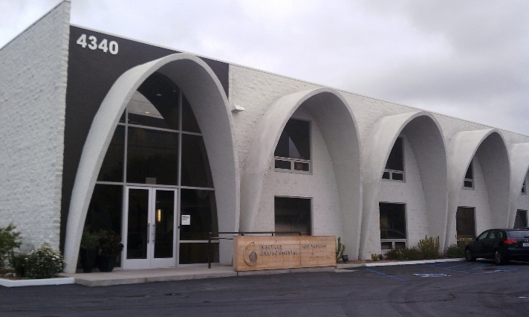
Enthalpy’s Toxicity & Consulting Group
West Coast Location: San Diego, CA
Formerly Nautilus Environmental
Responsive, applied scientists
Focused on toxicity
National, State, & Regional accreditations
Including CA ELAP and TNI
Generating high quality, legally defensible data for science-based solutions

Slide 7
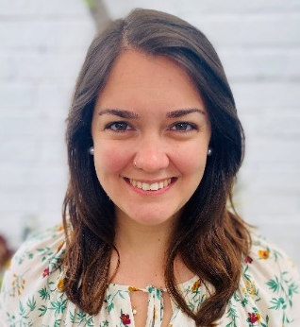
Enthalpy’s Toxicity & Consulting Group
Experts in all aspects of toxicity testing
Study design, planning, execution
Quality assurance and review
Data analysis, integration, interpretation
Regulatory support
Reliable partners
Resource to clients
We can help and educate
Core communication philosophy
Proactive approach
Ensuring questions that deliver meaningful answers, guided by data
Adrienne Cibor
Sr. Project Manager
Barbara Orelo
Project Manager
Kasey Skrivseth
Project Manager

Slide 8
Whole Effluent Toxicity Testing
A Quick Refresher

Slide 9
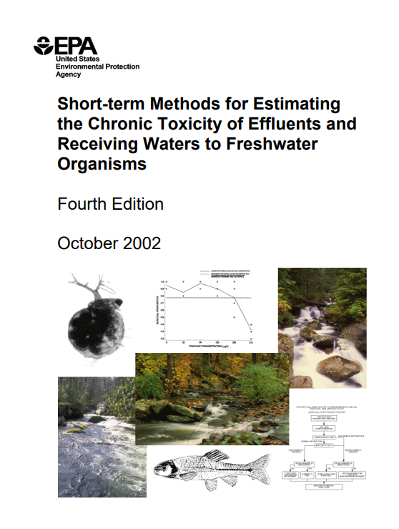
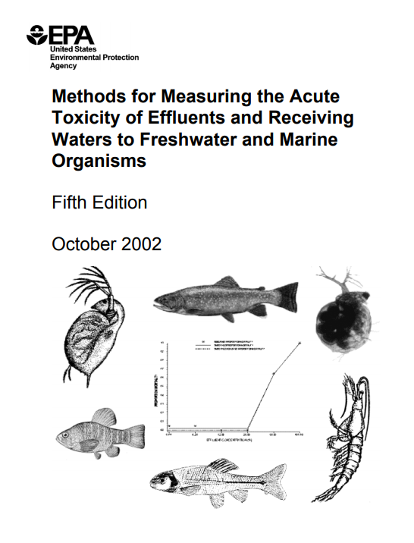
What is Bioassay?
Typically included in NPDES permits
Used to evaluate conditions and risk
Intersection of biology, chemistry, and statistics
Methods for direct biological measurement
Acute and chronic effects to organisms over time
Measures the toxic effect of a sample

Slide 10
Why Use Bioassays?
Integrate effects due to multiple contaminants
Environmental parameters affect toxicity
e.g. pH, hardness, particulates
Analytical chemistry is only part of the story
Chemical form may affect toxicity
Constituents may be toxic below MDL
Additive, synergistic, deleterious responses
Not all chemicals are measured (or known!)

Slide 11
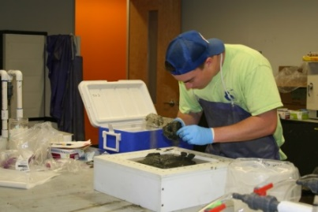
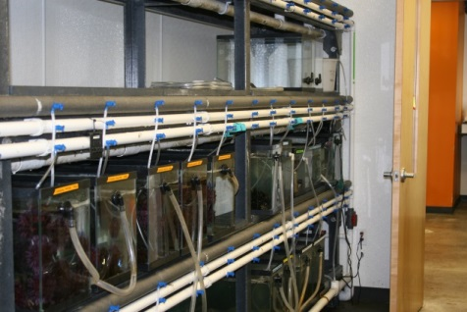
Challenges of Bioassay Testing
Live organisms can have different sensitivities
Success requires precise variable control
Pre-test organism care
Feeding
Water Quality
Data analysis/interpretation
Lab exposures aren’t always the same as environmental conditions

Slide 12
Important Factors for Successful Testing
Properly handling, acclimating, and caring for test organisms
Understanding test design and asking the right question
Observing and documenting
Good laboratory practices, clean techniques
Reference toxicant testing
Continued method development
Innovative approaches to problem solving
Knowledge of relationship between biology and chemistry

Slide 13
Common Considerations When Planning for a Bioassay Program
Define questions to be answered and study goal
Confirm context - compliance objectives, legal and regulatory
Budget - Discuss constraints and determine most cost-effective approach
Timeline – constraints, logistics, contingencies
Sampling and QA Plans – sample volumes, handling, transport, custody chain
Form of Deliverables – how data will be used and best communicated

Slide 14
California Statewide Toxicity Provisions
What do I Need to Know?

Slide 15
CA State Toxicity Provisions
A Quick Recap of Current Status
Process began more than a decade ago!
On December 1, 2020, State Board unanimously voted to adopt
Final Resolution and Provisions language still pending
Expected to take effect mid-2021

Slide 16
Scope of Applicability
Inland Surface Waters, Enclosed Bays, Estuaries and Coastal Lagoons
Does not apply to ocean waters (yet)
Provisions generally supersede other Regional Water Quality Control Plans
Regional Boards given discretion over several items

Slide 17
The Test of Significant Toxicity (TST)
Does it help me or hurt me?
Toxicity data will now be analyzed with a single statistical test
In-stream waste concentration (IWC) compared to control
Results reported as Pass or Fail
Challenges with test variability
Additional replicates may be added to increase statistical power and confidence
Utility depends on test type
Control
Sample IWC
Single Concentration Approach

Slide 18
The Test of Significant Toxicity (TST)
Does it help me or hurt me?
Can still be beneficial to conduct a multi-concentration series, in some instances
If toxicity is observed
Consider magnitude of effect
Evaluate dose response
Control 1 2 3 4 5
Multiple Concentration Approach

Slide 19
Reasonable Potential (RP)
How do I know if I need this?
If required, shall be conducted prior to every permit issuance
Evaluation of all toxicity data generated within 5 years
Must be conducted at IWC, analyzed with TST
If not, data must be reanalyzed with TST at higher concentration than IWC, if available
Otherwise, conduct a minimum of 4 tests at the IWC and analyze with TST
If >5 MGD Discharge and Pretreatment Program
RP not required
If <5 MGD Discharge
Conduct RP for chronic toxicity
Regional Board discretion for acute toxicity
Effluent limitation included

Slide 20
Reasonable Potential (RP)
Determination
Discharge has RP if:
Any of the chronic toxicity tests Fail at the IWC or have >10% effect at the IWC
Any of the acute toxicity tests Fail at the IWC or have >10% effect at the IWC

Slide 21
Monitoring Frequency & Testing Timelines
Authorized Discharge Amount
Chronic Toxicity Test Frequency
≥ 5 MGD
At least 1 per month
< 5 but > 1 MGD
At least 1 per quarter
≤ 1 MGD
Non-routine Discharge
At least 2 per year
At least 2 per year

Slide 22
Monitoring Frequency & Testing Timelines
MDEL – effluent limitation based on TST outcome and percent effect at IWC
If survival endpoint, MDEL violated with sublethal fail and 50% mortality effect
MMEL – effluent limitation based on a maximum of 3 independent tests
Fail at any endpoint is a violation (regardless of percent effect)
If no survival endpoint, MDEL violated with 50% effect to sublethal endpoint
Acute Testing
50% survival for MDEL, any fail for MMEL
Replacement Tests
Defining the Calendar Month
Regional Board discretion to decide with discharger how the month is defined
Talk to the lab about capacity and timing
Initiate as soon as possible when required test not completed
New test replaces routine monitoring, MMET, or MMEL tests for the calendar month where required test was not completed

Slide 23
Monitoring Frequency & Testing Timelines
Regional Board discretion for reduced routine monitoring upon reissuance
If the permit includes MDEL and MMEL:
MDEL and MMEL have not been violated
Applicable permit toxicity requirements have been followed
If the permit does not include MDEL and MMEL:
When during 5 prior consecutive years
Complied with applicable permit toxicity requirements
Minimum of 10 chronic tests conducted at IWC (or higher effluent concentration)
Test data are analyzed or reanalyzed using TST
No chronic tests resulted in a Fail at the IWC

Slide 24
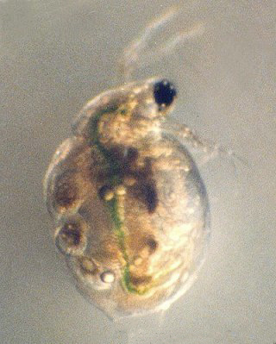
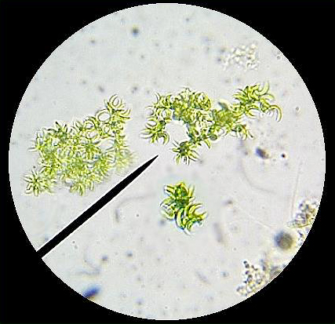
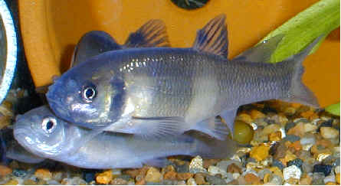
Species Sensitivity Screening
Initial Screening
Shall conduct “prior to, or within 18 months after, the first issuance, reissuance, renewal, or reopening”
May allow use of data generated within 10 years
Subsequent Screening
After Provisions effective date, required every 15 years
Or more frequently, at Regional Board discretion
Caveats
If the data are “representative of the effluent”
Data are analyzed using TST
Chronic toxicity includes vertebrate, invertebrate, and plant

Slide 25
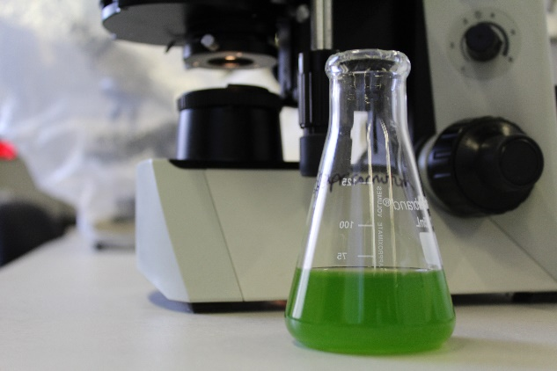
Toxicity Reduction Evaluation & Toxicity Identification Evaluation (TRE/TIE)
TRE required when
Any combo of 2 or more MDEL or MMEL violations within single calendar month or 2 successive calendar months
No more “accelerated” monitoring
Lack of definition around a pathway to routine monitoring
Many permits used to define passing the accelerated monitoring program as the pathway back to routine monitoring
This return to compliance pathway should be defined in the permit and/or the TRE plan
Have a good TRE plan ready to go before you need it!
Work with the lab for effective, efficient use of resources during TIE

Slide 26
Chronic C. dubia (Water Flea)
Freshwater invertebrate
6 to 8-day Chronic Test
1 organism per replicate, 10 replicates per concentration
Daily renewals – organism transferred
Organisms cultured in-house
Endpoints are survival and reproduction
Photo credit: SETAC SciCon2

Slide 27
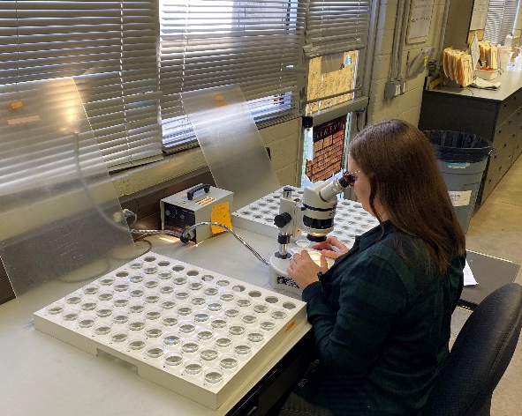
Chronic C. dubia Study
Public concern expressed about
Test variability
Lab comparability
Ultimately reliability
Appendix J released January 2020, lab/test performance eval
State Board engaged SCCWRP to facilitate stakeholder and laboratory collaboration
Stakeholder Advisory Committee
Expert Science Panel
Goal
Develop quality assurance recommendations
Reduce within-test variability and improve interlaboratory agreement
Target completion December 2023

Slide 28
C. dubia Study Implications
For permits issued after Provisions effective date but prior to study completion:
Scenario | Numeric Limit | Most Sensitive | Permit Option
1 | No | C. dubia | Permit shall include MDEL and MMET MMET exceedance would not result in violation, could result in TRE
2 | No | another species | Permit shall include MDEL and MMEL using the most sensitive species
3 | Yes | C. dubia | Either a MDEL and MMEL using C. dubia as most sensitive species OR MDEL and MMET using C. dubia as most sensitive and MMEL using next applicable species as most sensitive
4 | Yes | another species | Permit shall include MDEL and MMEL using the most sensitive species

Slide 29
What to do Now to be Ready
Financial
Revisit budget planning and approval cycles
Consider RFP language changes to ensure apples = apples*
Regulatory
Consider provisions context and additional reviewers for permit renewal
Review your TRE Workplan (we can help!)
Talk to your stakeholder representative for C. dubia study
Engage with Regional Boards for understanding of discretionary decision implementation (there are lots!)
Operational
Be proactive, understand your position – changes are coming
Discuss your proposed testing schedule with the lab
*We have questions for you on how to help

Slide 30
Financial
C. dubia Example
Variables to consider
Routine monitoring
MMEL exceedance (historical data review)
Writing RFPs that allow for alternate cost strategies
Replication
IWC vs. full dilution series
How can we help procurement process?
 | 10 replicates | 20 replicates
Unit Test Cost (x 4 quarters) | $100 x 4 = $400 | $130 x 4 = $520
One MMEL Event Test Cost | $100 x 2 = $200 | N/A
Total Annual Cost | $600 | $520
No, the test cost isn’t really $100, we just wanted to keep the math easy for this example!

Slide 31
Regulatory
Have your draft permit reviewed by
An engineer
A laboratory
A lawyer
Talk to other dischargers about their own process hiccups
Check TRE workplan requirements and review the plan meets current conditions.

Slide 32
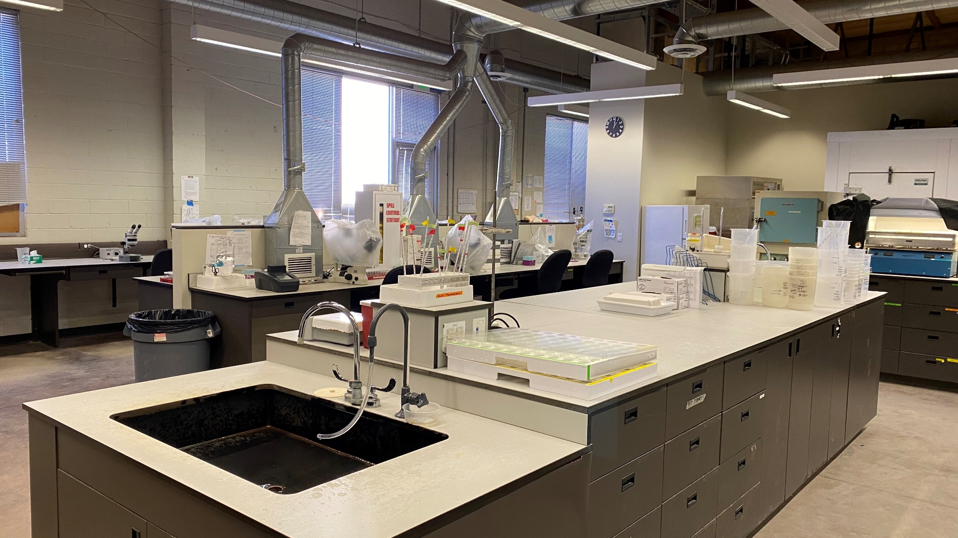
Operational
Scenario planning for individual situation
Communicate with the lab
Permit review prior to testing
Goals and constraints
Expected schedules, holding time, transportation arrangements
Changes and challenges
Progress and results
Regulatory engagement

Slide 33
Katie Payne
Business Development Manager
katie.payne@enthalpy.com
858-587-7333 x14012
Enthalpy Analytical
4340 Vandever Avenue
San Diego, CA 92120
858-587-7333
www.enthalpy.com
Peter Arth
Director, Environmental Toxicology
peter.arth@enthalpy.com
858-587-7333 x14019

