Slide 1
Drought in Context: A Systems Approach to Weather Whiplash
December 1, 2022, 12:00 pm – 1:00 pm

Slide 2
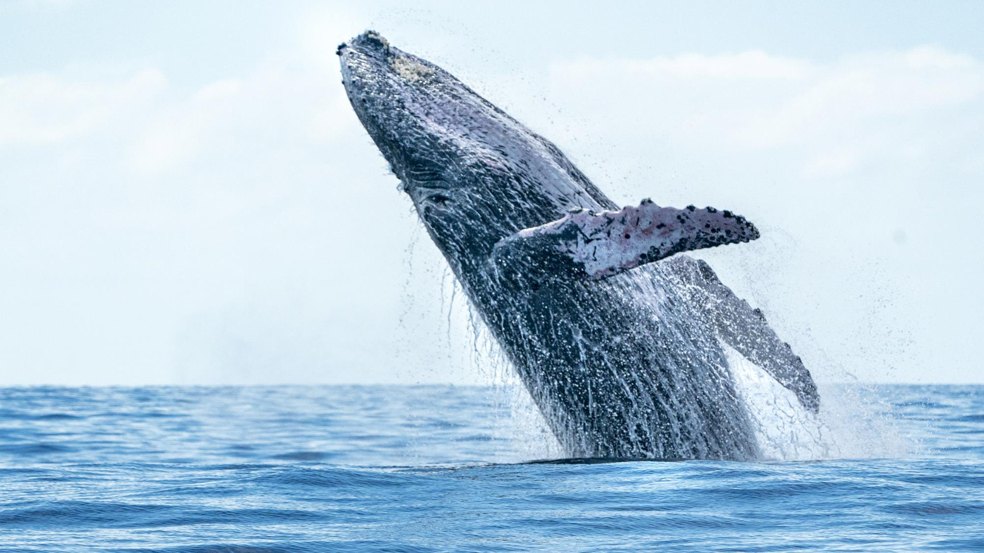
CWEA, its Board members and
volunteers are not responsible for the
actions of speakers or the content of their
sessions. No endorsement is implied or
given of any persons or their philosophies,
ideas or statements; nor of any products
or processes; nor of any organizations
or companies who volunteer to serve as
speakers in educational programs.
For reporters: all speakers today are off the record.

Slide 3
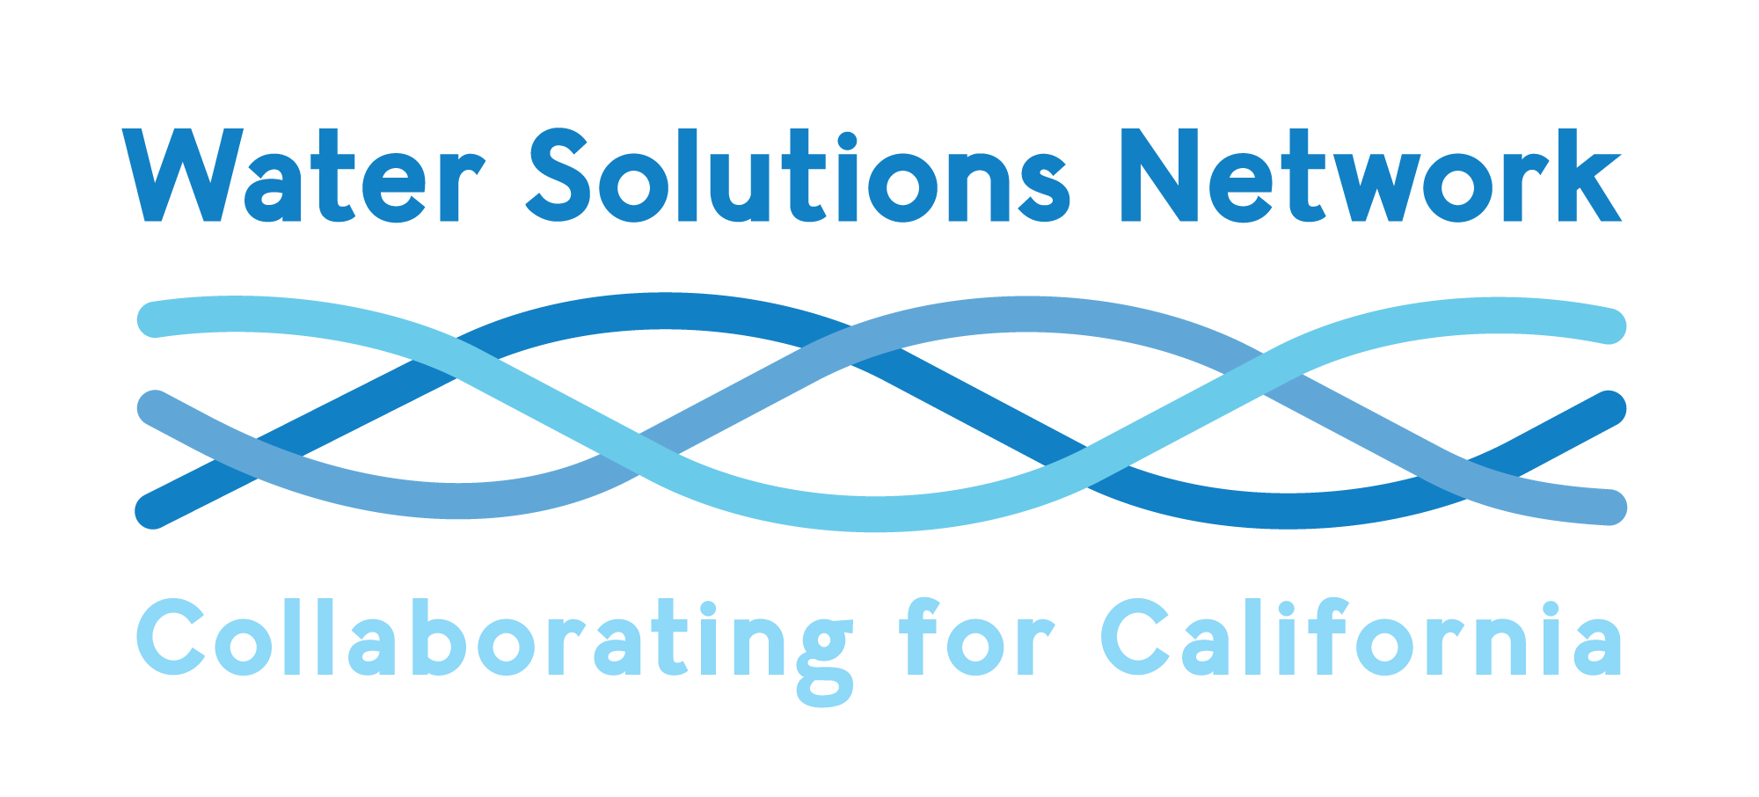
CWAC Presentation
November 2, 2022
Debbie Franco
Managing Director

Slide 4
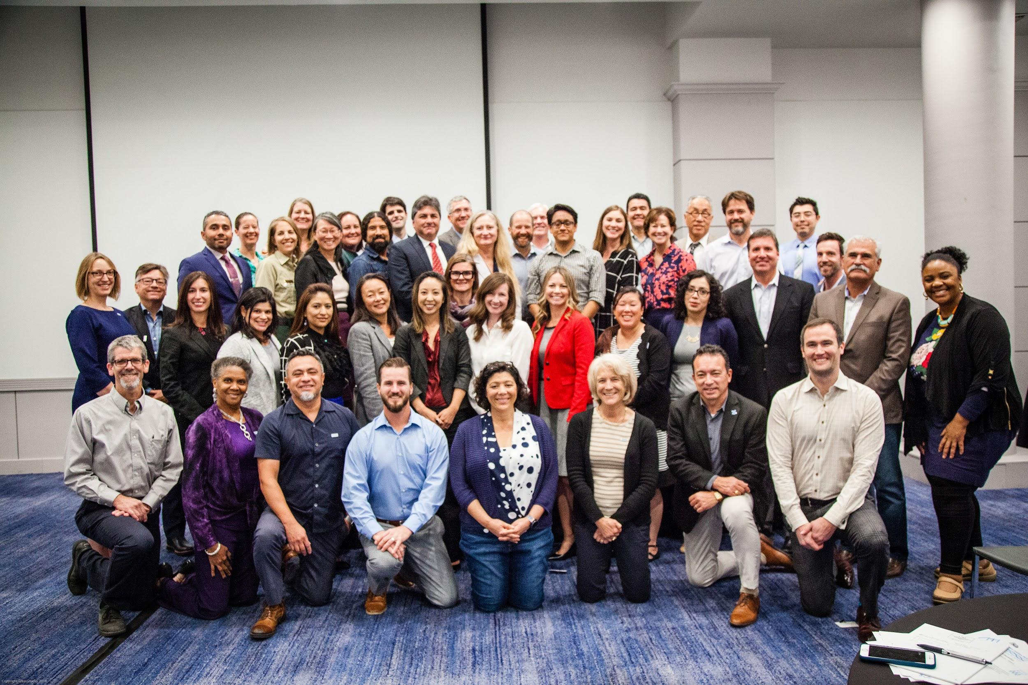
The Water Solutions Network
Cross Boundaries
Connect Resources
Choose Bold Action

Slide 5
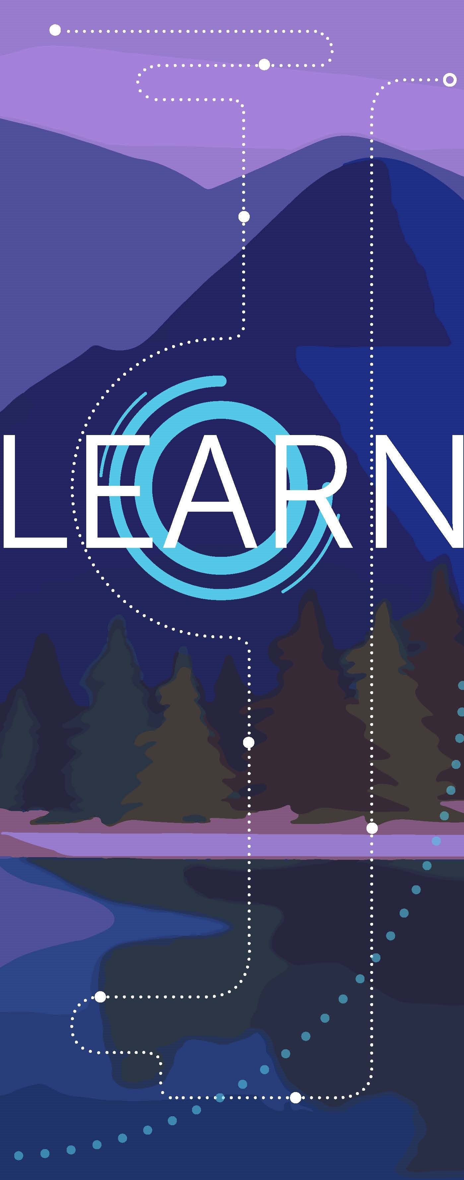
“The illiterate of the 21st Century will not be those
who cannot read and write,
but those who cannot learn, unlearn, and relearn.”
Alvin Toffler, American philosopher and futurist

Slide 6
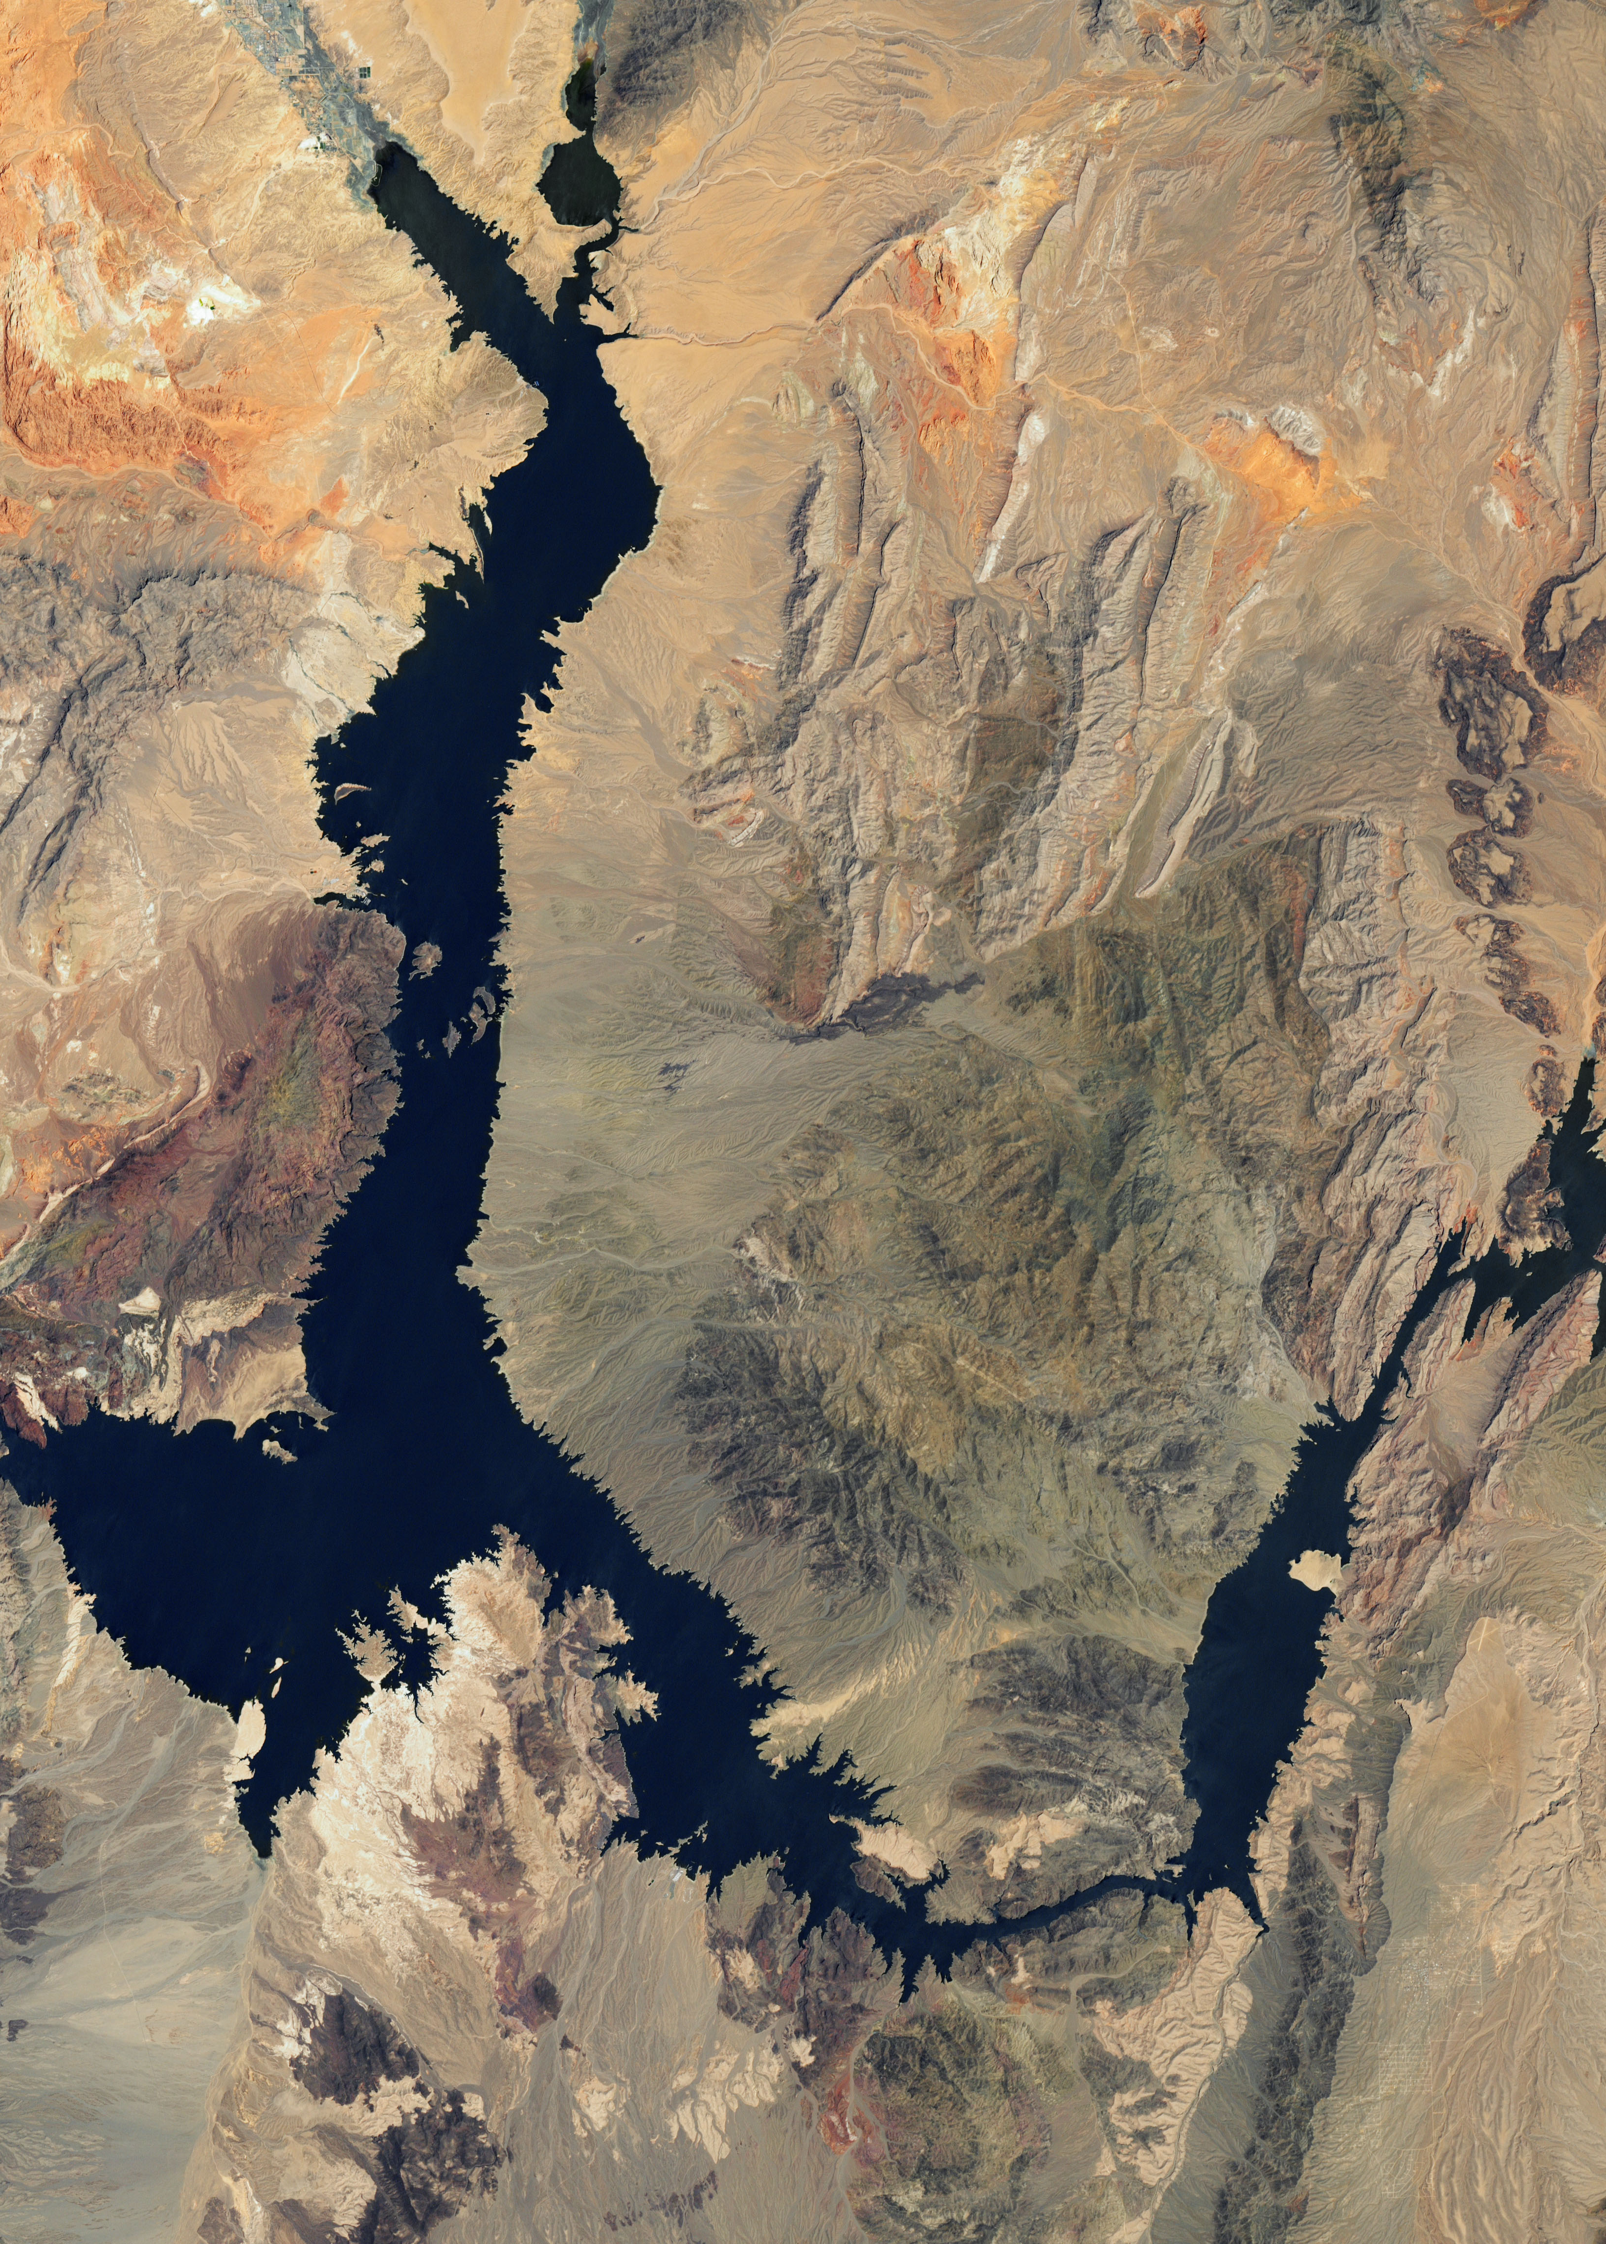
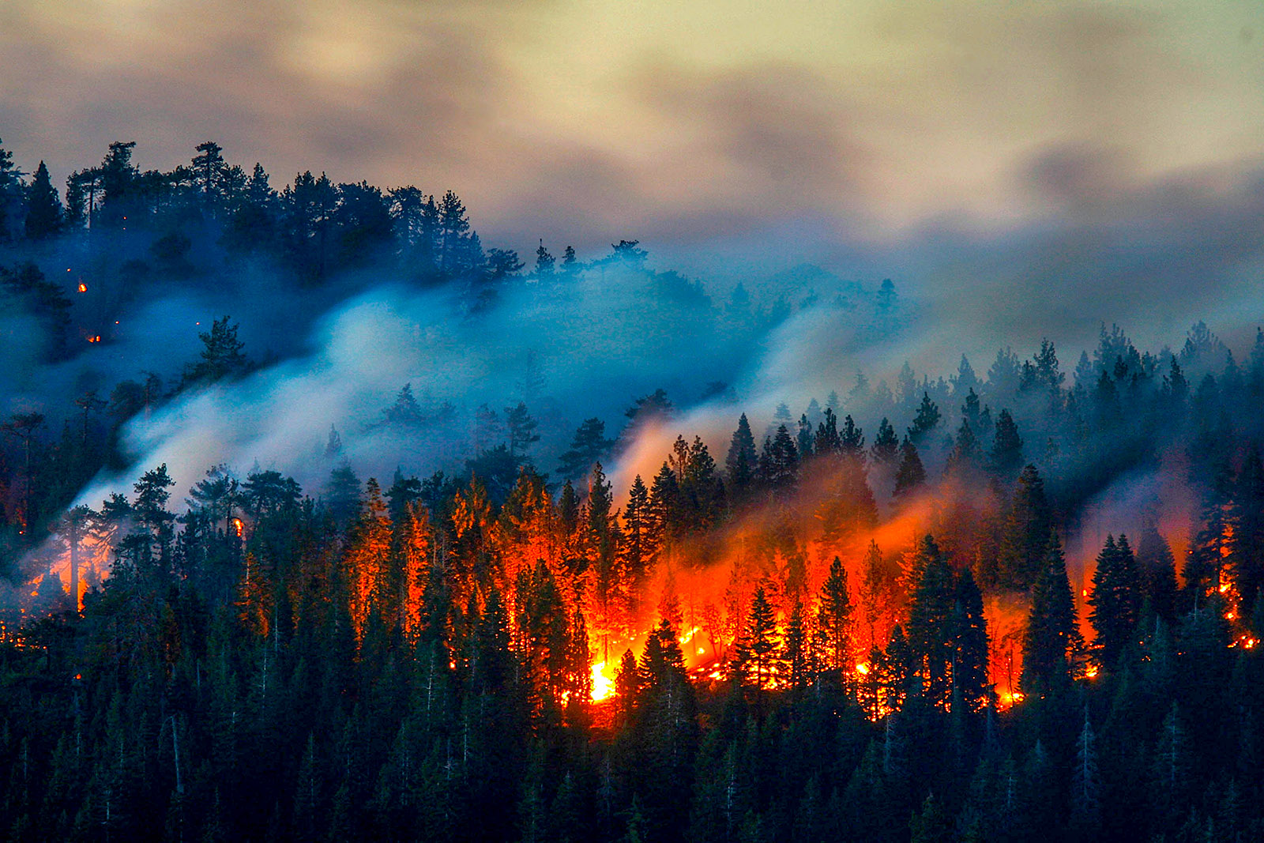
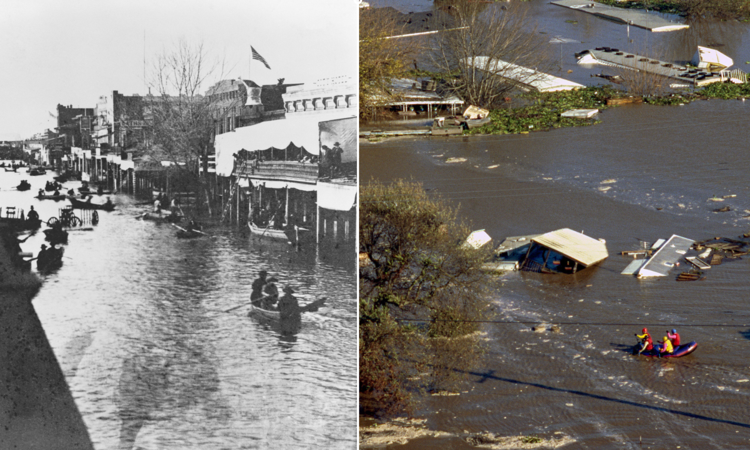
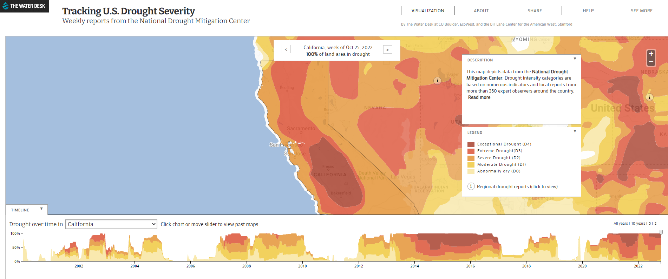
Climate Change is Here
Catastrophic Fire is Destroying Upper Watersheds
Climate Change and Changes in Land
Worst Mega Drought in 1000 Years

Slide 7
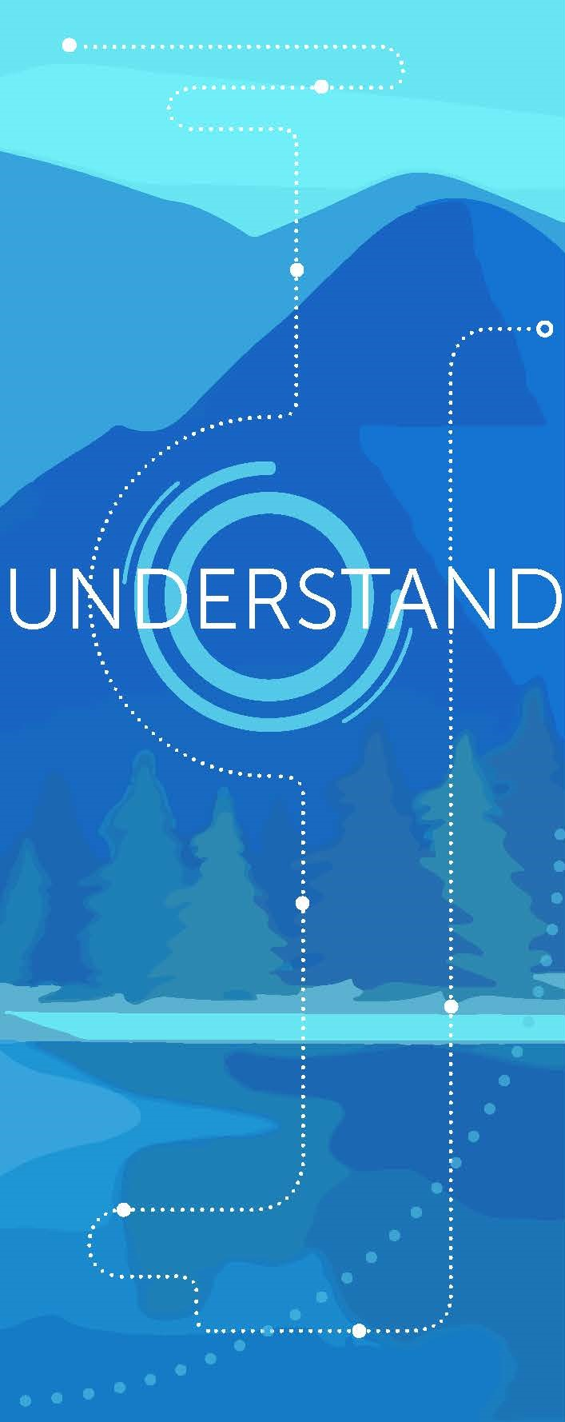
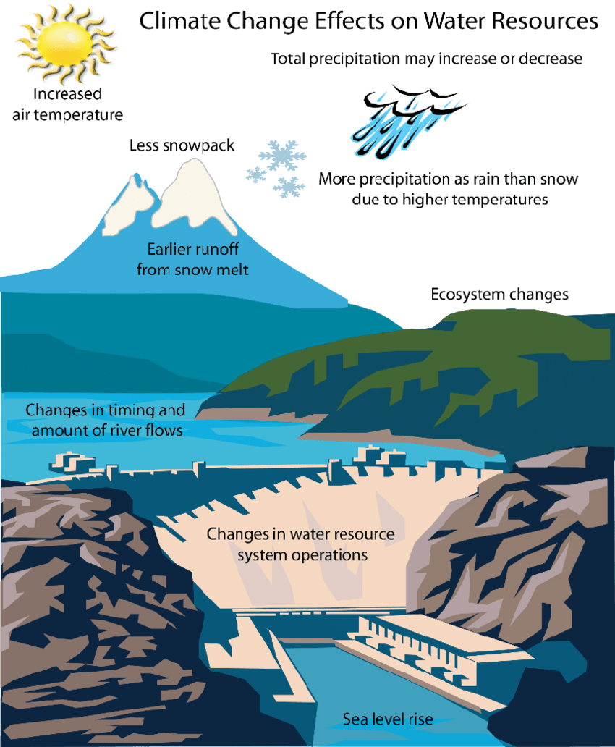
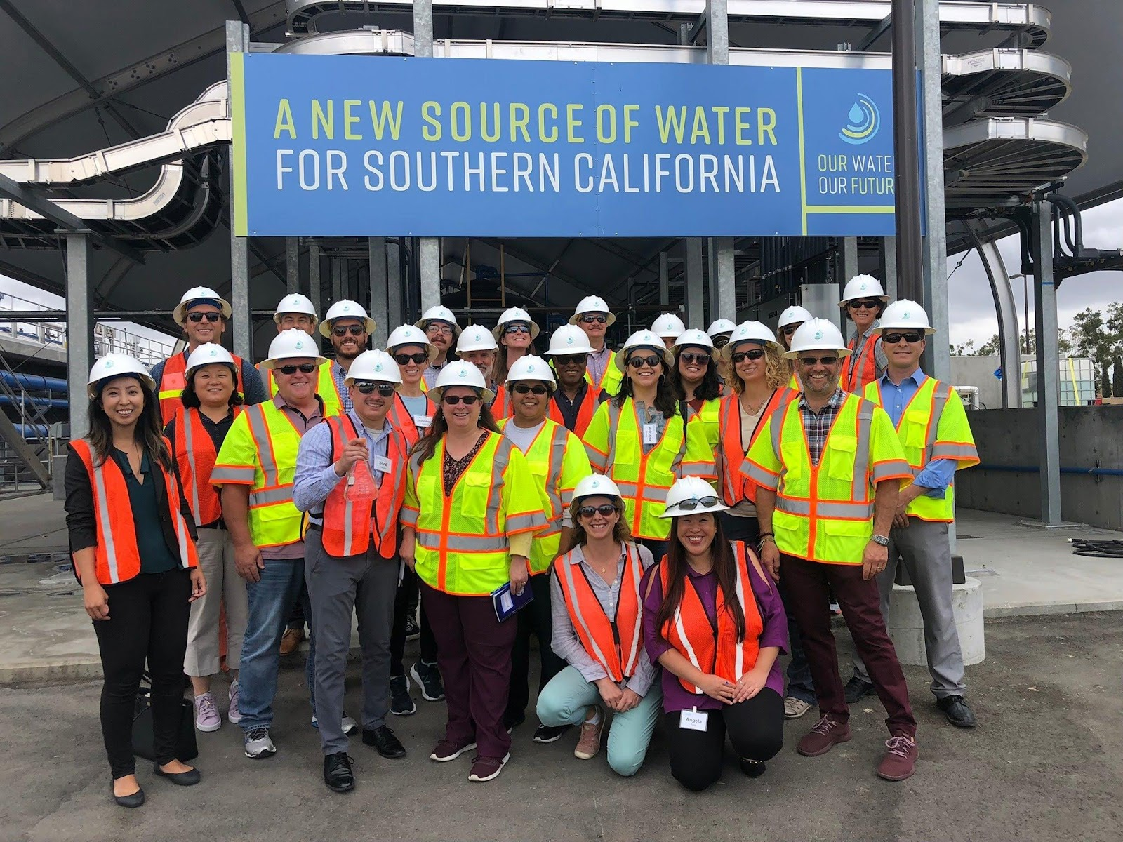
Climate Change Impacts
How do our plans stack up?

Slide 8
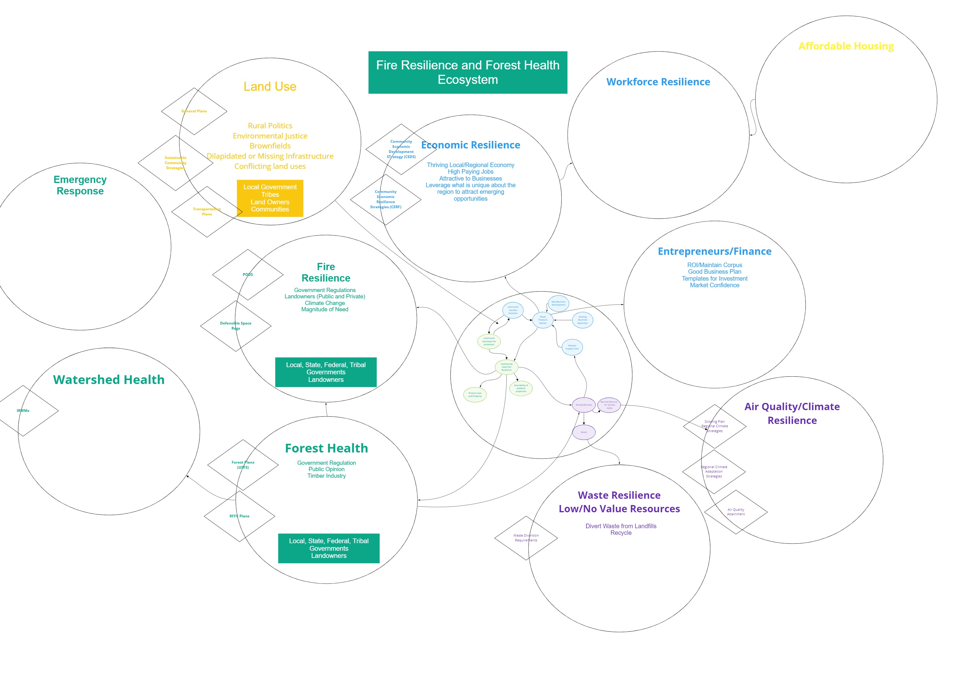
Fragmentation
More money than brains – not enough people or capacity to do all of this well in silos
Risk redundancy and cross-purposes
Miss larger impact systemic interventions
Fighting natural systems

Slide 9
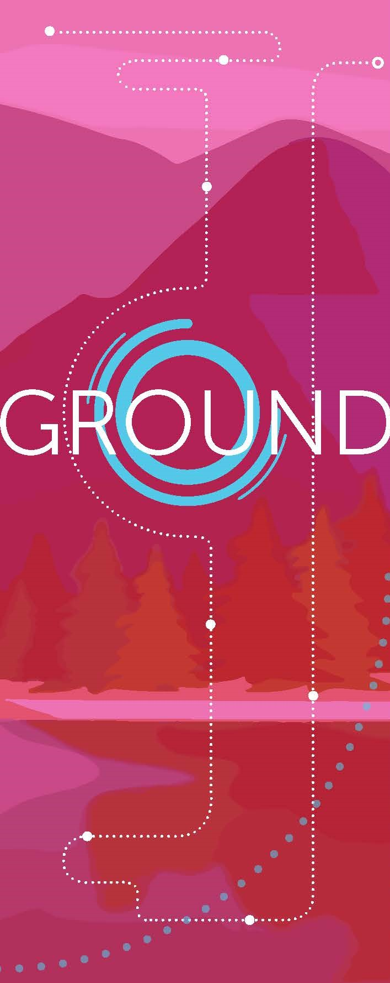

Slide 10
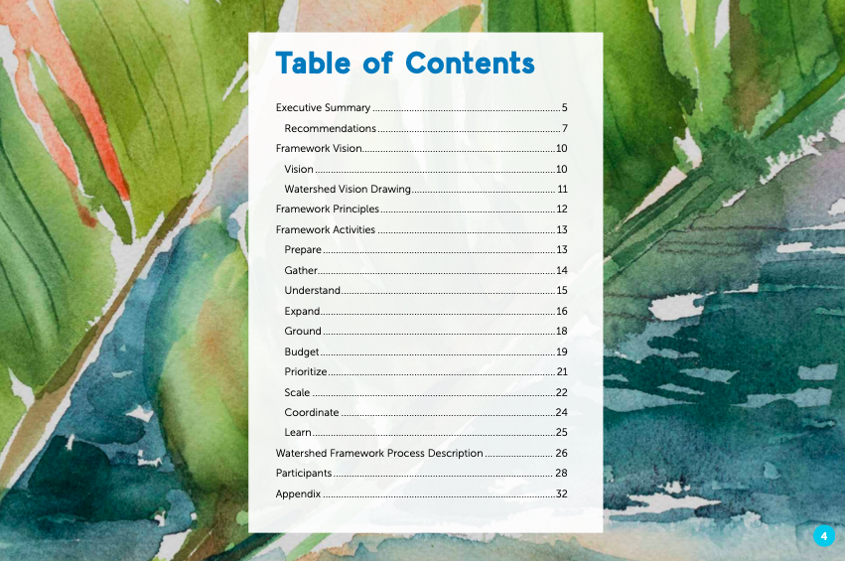
WSN Framework Innovations
Equity
Process centered on equity at the outset
Watershed Scale
Headwaters to groundwater to outflow, including engineered systems
Coordinate at watershed scale and act at manageable scale
Cross-Sector/Cross-Jurisdictional
Convened by a cross-sector and cross-jurisdictional group from across the watershed
Systems Thinking
Eliminate redundancies and amplify the impact of cross-sector, cross-jurisdictional collaborative action.

Slide 11
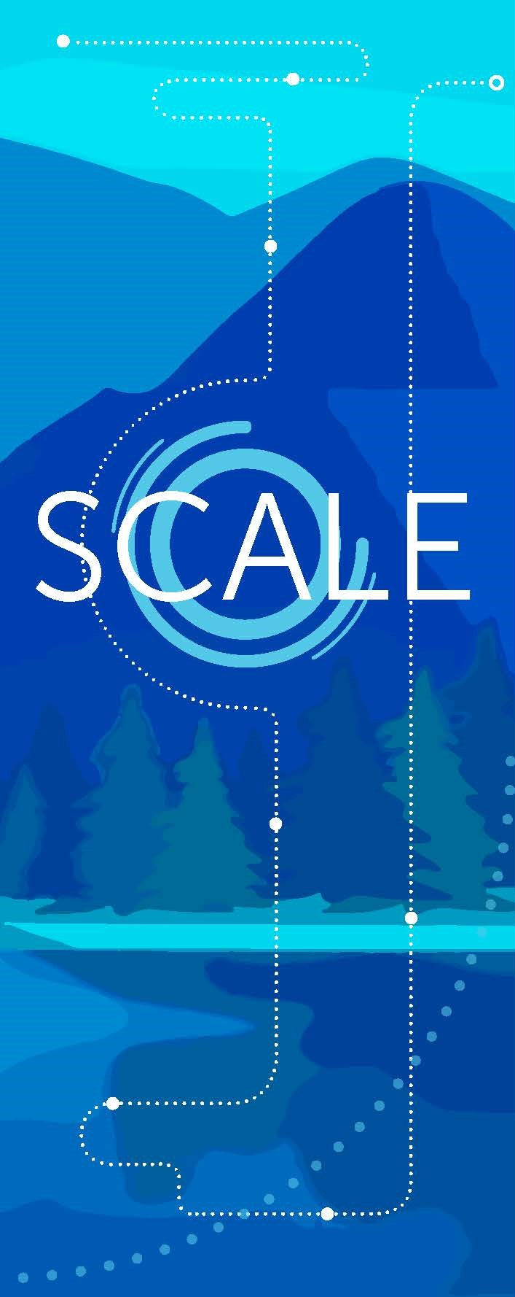
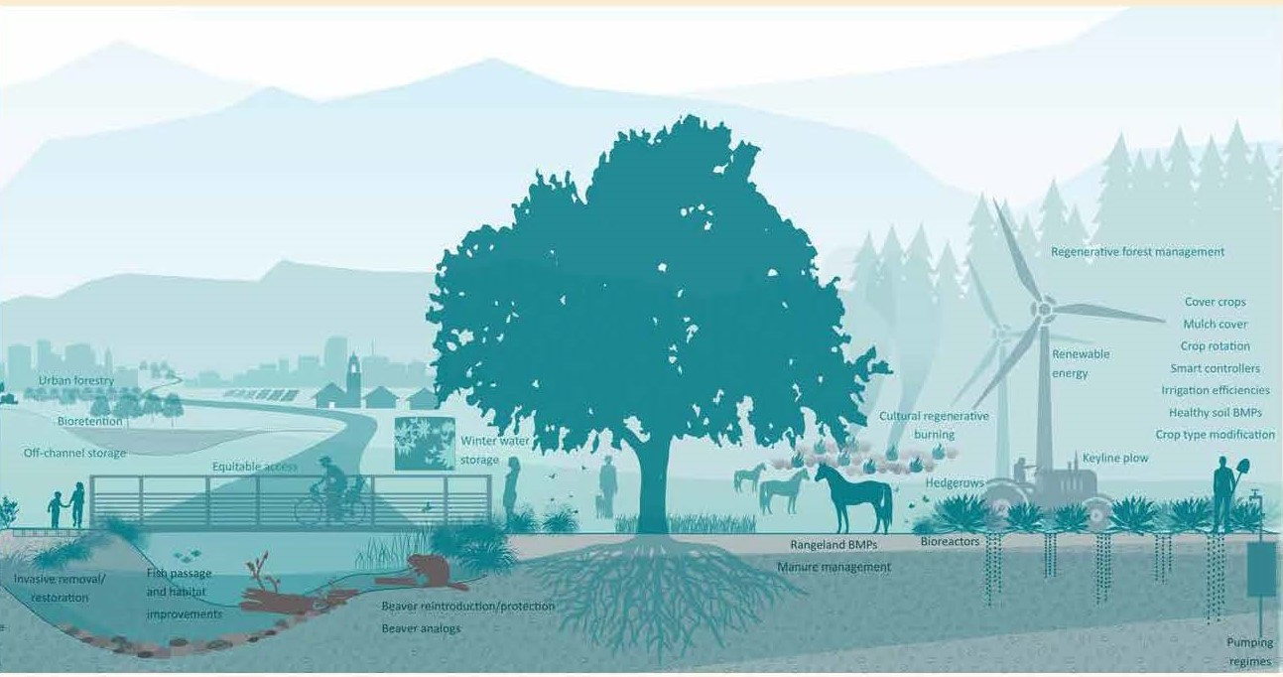
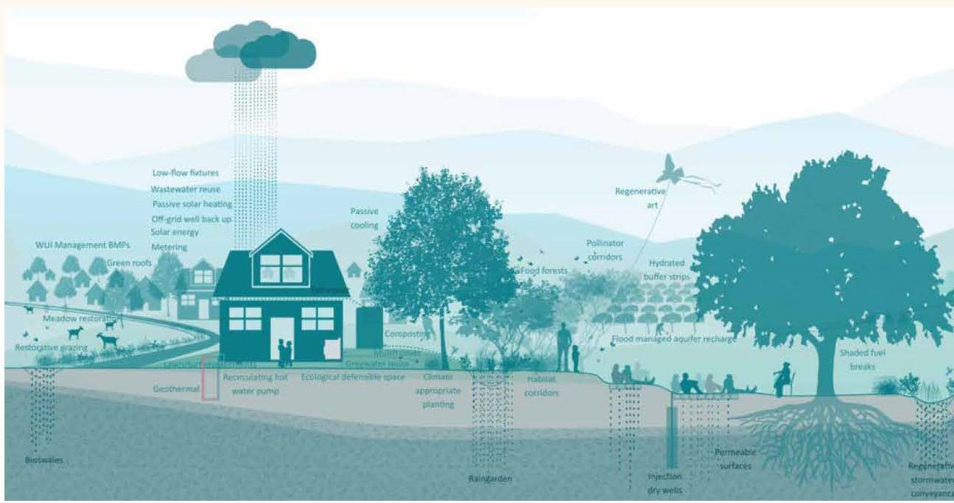
Expanding the Vantage Point
Parcel Scale:
The Power of Small
Watershed Progressive
Educated Public = Better stewards and better at surviving
Coordinated parcel scale action overcomes fragmentation
Land Resilience Partnership

Slide 12
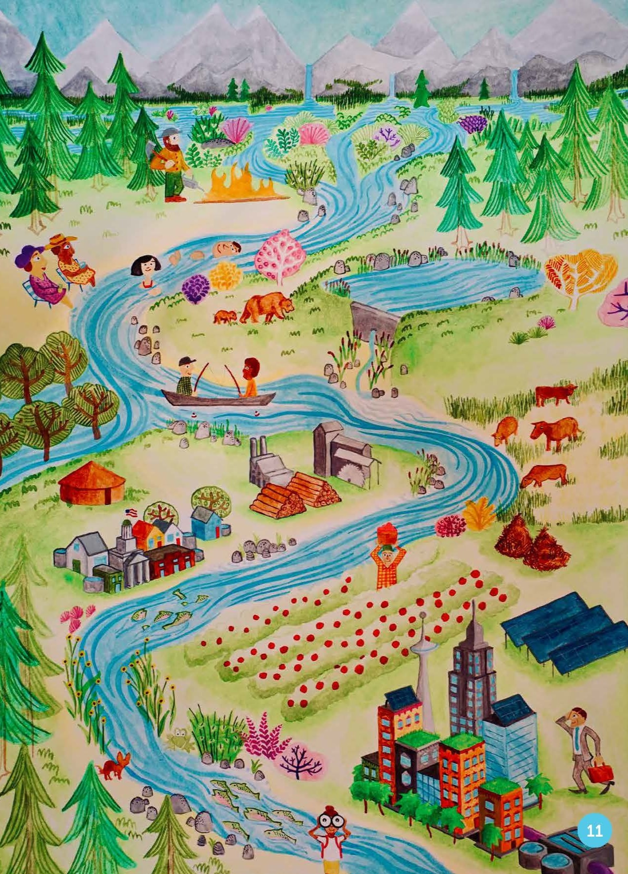
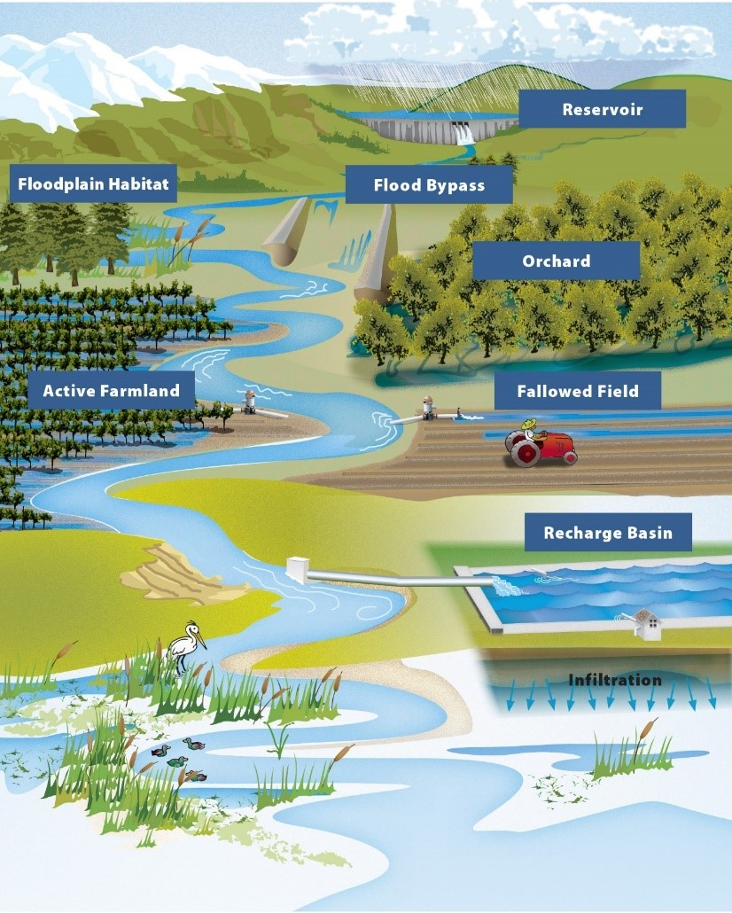
Expanding the Vantage Point
Works with the natural system = more resilient to extreme events
Illuminates landscape scale opportunities that may be more efficient and resilient like Flood-MAR, Upper Watershed Restoration, etc.
Watershed Approach
Flood Managed Aquifer Recharge
https://water.ca.gov/programs/all-programs/flood-mar

Slide 13
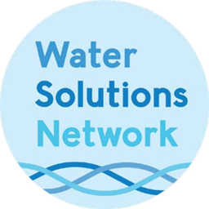
Next Steps
LEARN and ACT WITH OPTIMISM
Debbie Franco
Managing Director
debbie@watersolutionsnetwork.org
https://watersolutionsnetwork.org

Slide 14
© 2022 California Water Environment Association (CWEA)

