Slide 1
CWEA Fundamentals of Water Math - Grade 1 - 3 Certification Training
March 22, 2022, 11:00 am – 1:00 pm

Slide 2
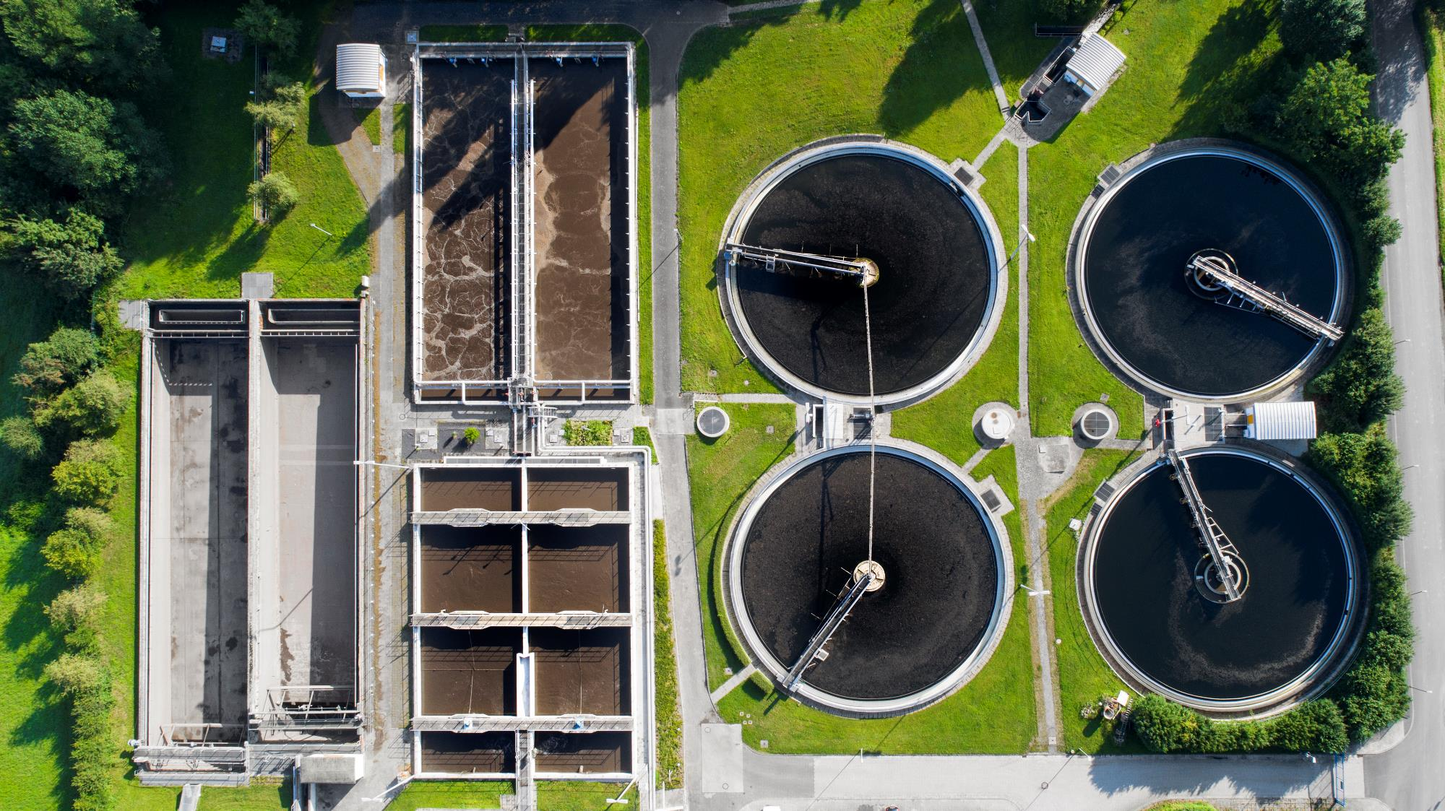
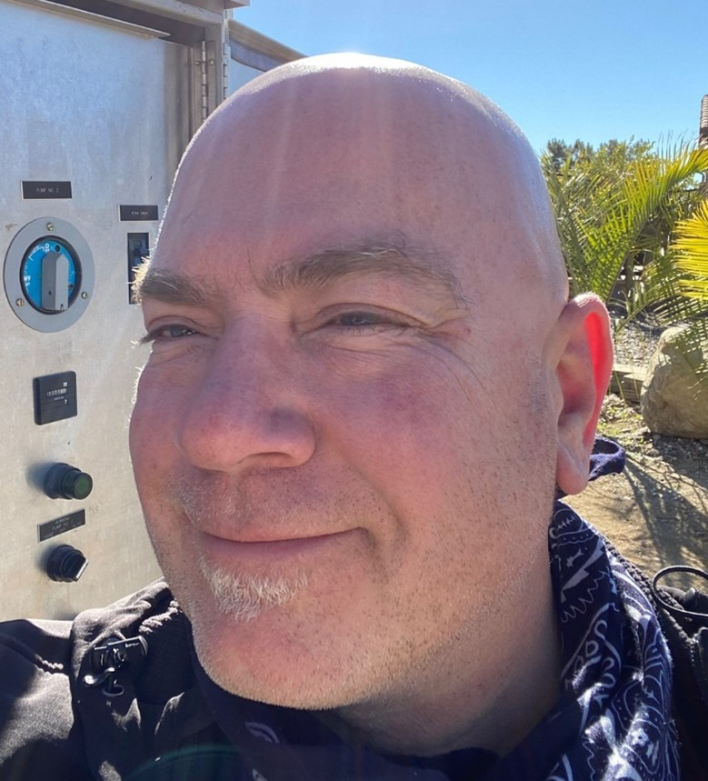
Shawn Spromberg Moderator
Wastewater Utility Supervisor
Cucamonga Valley WD
Notes:
Please DON’T put speakers agency logo on the slide. It will not look good.

Slide 3
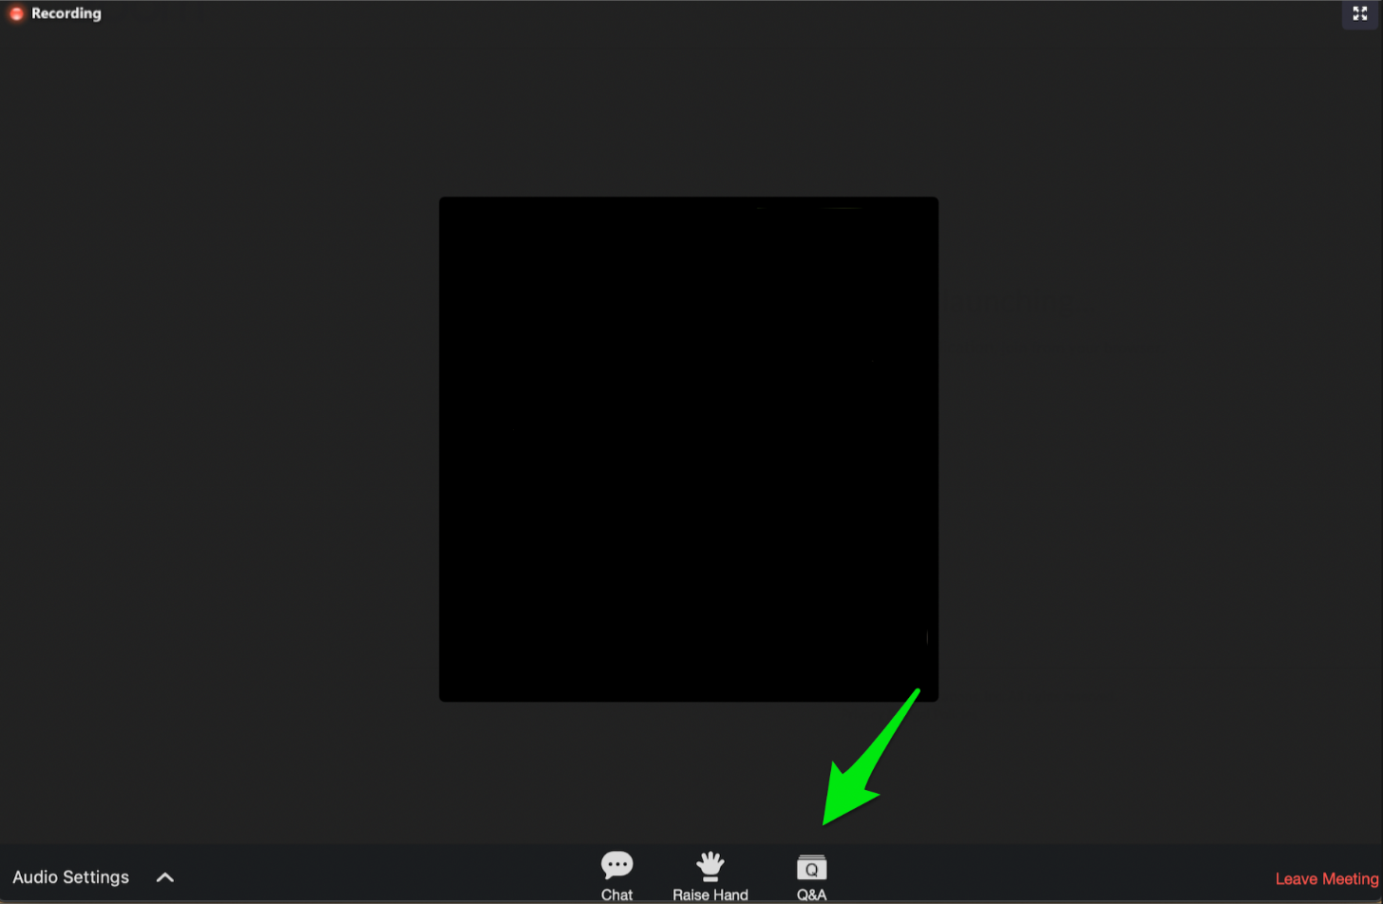
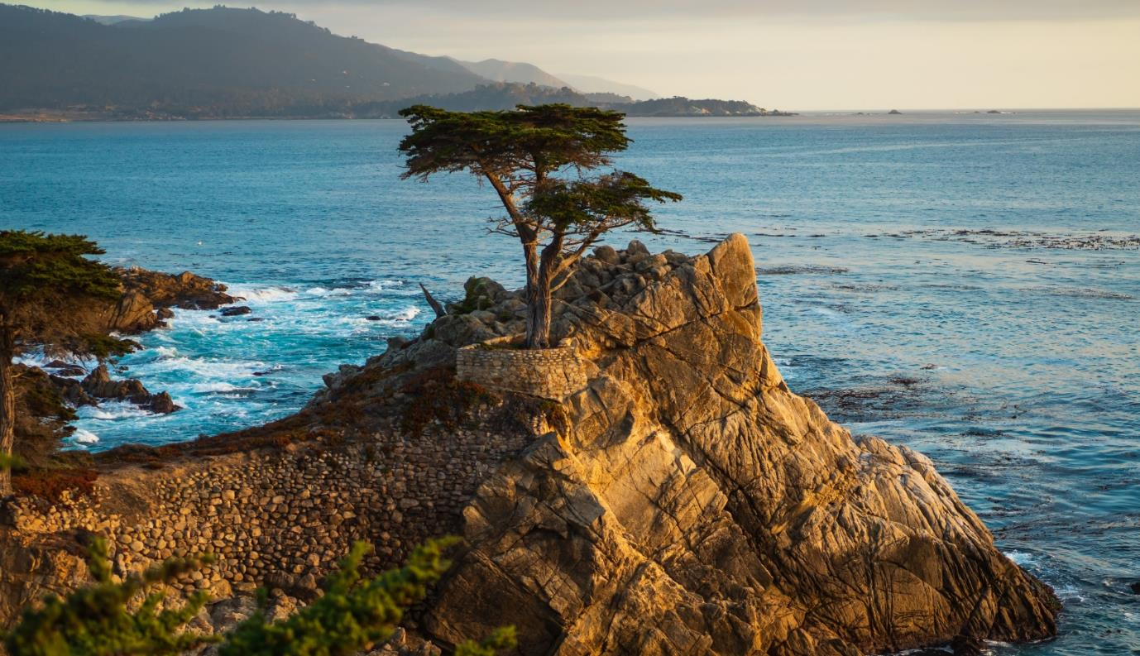
Zoom Controls: Chat for Comments

Slide 4
Zoom Controls: Q&A for Questions

Slide 5
Zoom Controls: Raise Hand Feature Not Used in Today’s Webinar

Slide 6
Attention Check Code
####
Watch for The Attention Check Code in Top LEFT Corner of Screen

Slide 7
Process for Claiming Contact Hours for
this Webinar
Note the different attention check code(s) that will appear for 60-90 seconds in the top left or right corner of the presentation.
Log in to https://owen.cwea.org/ the Online Wastewater Education Network (OWEN) with your mycwea.org account info and find this program in “Your Dashboard”.
Under the "Contents" tab, enter the correct attention check codes in the “Attention Check Code” component within 48 hours of the live webinar.
Your contact hours will be reflected in your mycwea.org account within 2-3 weeks following completion.

Slide 8
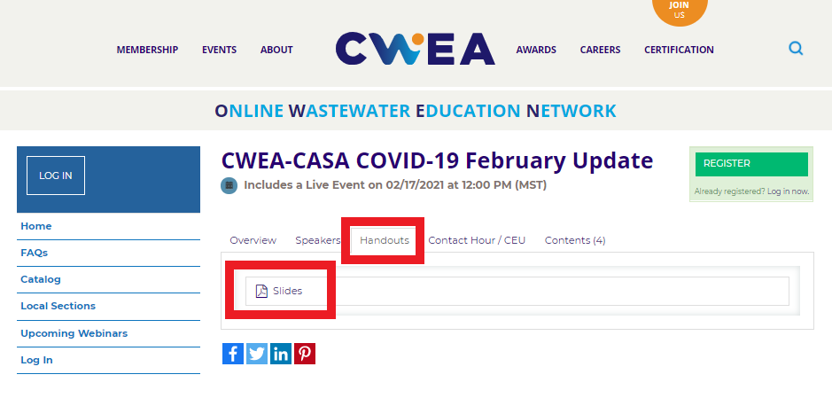
Slides/Handouts Can Be Found on OWEN under the Handouts Tab

Slide 9
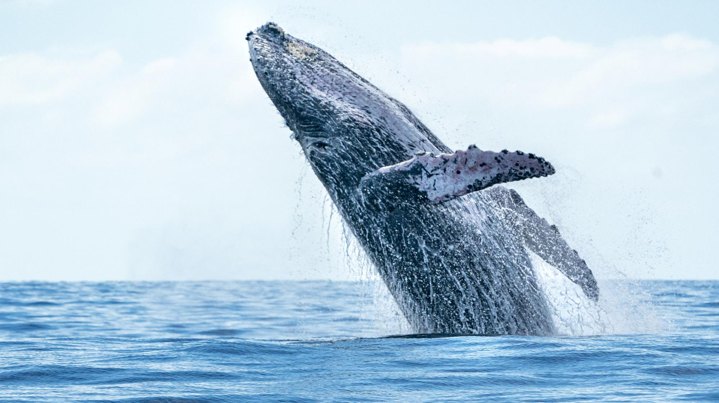
CWEA, its Board members and
volunteers are not responsible for the
actions of speakers or the content of their
sessions. No endorsement is implied or
given of any persons or their philosophies,
ideas or statements; nor of any products
or processes; nor of any organizations
or companies who volunteer to serve as
speakers in educational programs.
For reporters: all speakers today are off the record.

Slide 10
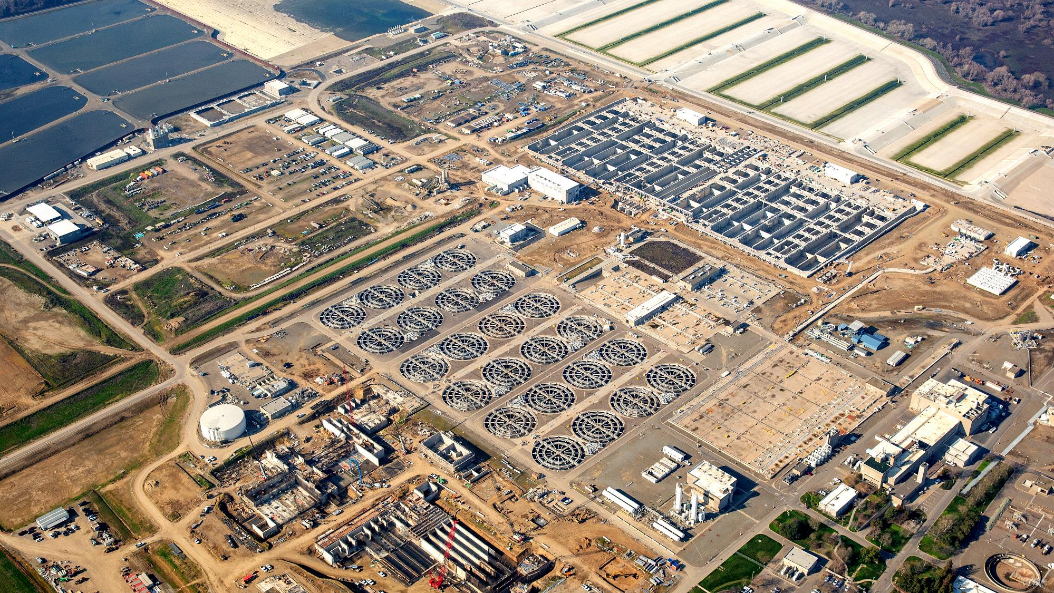
Roy Reynolds Speaker
Mechanical maintenance supervisor
Orange county Sanitation district
Notes:
Please DON’T put speakers agency logo on the slide. It will not look good.

Slide 11
CWEA Water Math Fundamentals
For Collections and Mechanical Grades, I - III

Slide 12
Expectations From this Course
Understanding of the Order of Operation
Formula Review
Basic Area and Perimeter Calculations
Area and Volume Calculations for Circles, Cylinders and Spheres
Area and Volume Calculations for Basins Channels
Pully / Gear Ratios
Water / Brake Horsepower

Slide 13
Order of Operation
Order of Operations Steps
The steps we use to solve any mathematical expression are:
Simplify all the parentheses. This includes all forms of grouping symbols, such as brackets and braces, in addition to parentheses.
Simplify all exponents.
Simplify all multiplication and division from left to right. When simplifying the multiplication and division, work from left to right.
Simplify all addition and subtraction from left to right. Again, when simplifying the addition and subtraction, work from left to right.
By following this order, we can all solve the problem and get the same solution.

Slide 14
Let's show Aunt Sally how the order of operations helps us to solve problems. I want to show Aunt Sally a problem from my homework tonight. The problem is 3 + [6 (11 + 1 - 4)] ÷ 8 x 2. Remember, to work this problem, we will follow the order of operations.
The first step to solve this problem is to work the P (parentheses). In this problem, they used both parentheses and brackets. We will need to start inside the parentheses and work out until we complete all the grouping symbols. Also, when working inside the grouping symbols, we must follow the remaining order. To begin, we will need to add the 11 + 1 and then subtract 4, which is 8. We still must now work inside the bracket, 6 times 8 is 48.
The next letter in our acronym is E for exponents. Since there are no exponents, we continue on. The next step is to simplify the M and the D (multiplication and division) from left to right. Since division actually comes first, we work it from left to right. We'll first divide 48 ÷ 8, which is 6. There is still multiplication in our problem, so next we will need to multiply 6 times 2, which equals 12. The only step remaining is AS (addition and subtraction). There is only one thing left in this problem, which is 3 plus 12, which equals 15. So, as you can see Aunt Sally, the answer to this problem would be 15.

Slide 15
Order of Operation Example
3 +[6(11 + 1 – 4)] / 8 X 2 =
3 +[6(8)] / 8 X 2 =
3 +[48] / 8 X 2 =
3 + 48 / 8 X 2 =
3 + 6 X 2 =
3 + 12 =
15

Slide 16
Order of Operation Example
120 – 5 (7 + 5) X 6 / 4 =
120 – 5 (7 + 5) X 6 / 4 =
120 – 5 (12) X 6 / 4 =
120 – 60 X 6 / 4 =
120 – 360 / 4 =
120 – 90 =
30

Slide 17
Formula Review

Slide 18
Perimeter – Square or Rectangle
Formula – 2(Length + Width)
A rectangular field must have a fence built to enclose it. If the length is 120 feet and the width is 80 feet, how much fencing is needed?
120 feet
80 feet

Slide 19
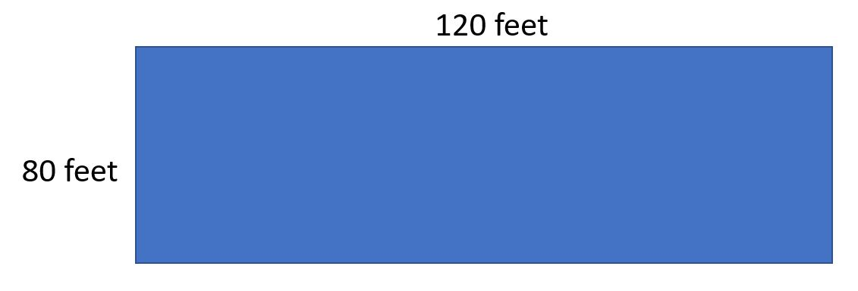
Perimeter – Square or Rectangle
Formula – 2(Length + Width)
Length = 120 feet
Width = 80 feet
2(120’ + 80’) =
2(200’) =
400 feet

Slide 20
Perimeter – Square or Rectangle
A pump station is 300 feet long and 300 feet wide. How much chain link fence is needed to enclose the pump station?
300 feet
300 feet

Slide 21
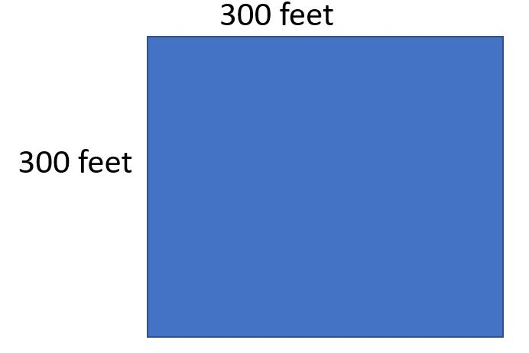
Perimeter – Square or Rectangle
Formula – 2(Length + Width)
Length = 300 feet
Width = 300 feet
2(300’ + 300’) =
2(600’) =
1200 feet

Slide 22
Perimeter – Square or Rectangle
How much fencing is needed for the drawing provided below?
130 feet (L)
40 feet
70 feet (L)
80 feet
40 feet
200 feet (L)

Slide 23
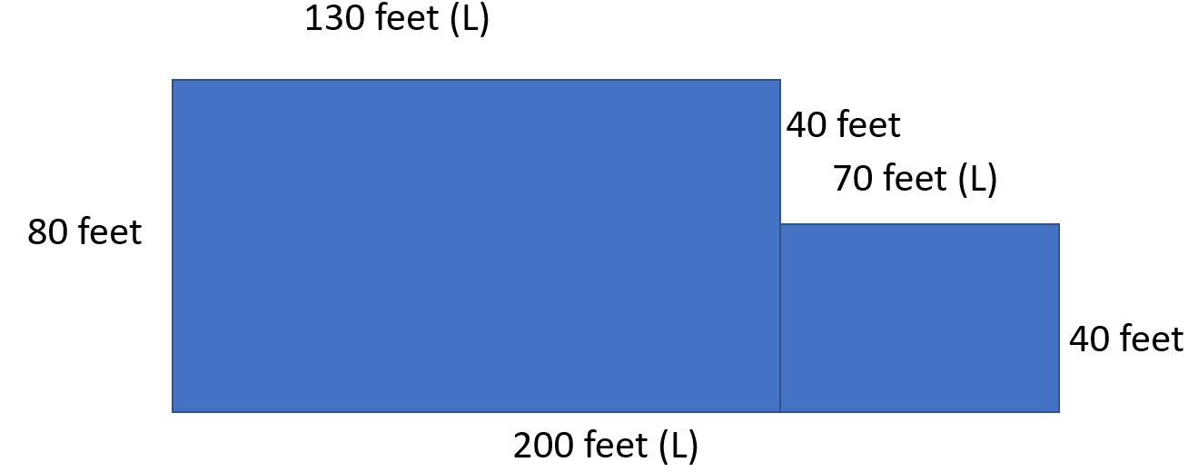
Perimeter – Square or Rectangle
Formula – 2(Length + Width)
Length = 200 feet
Width = 80 feet
2(200’ + 80’) =
2(280’) =
560 feet

Slide 24
Questions

Slide 25
Area – Square or Rectangle
Formula – (Base X Height) or (Length X Width)
The base of the wall is a 100 feet and the height of the wall is 12 feet.
What is the total area of the wall?
100 feet
12 feet

Slide 26
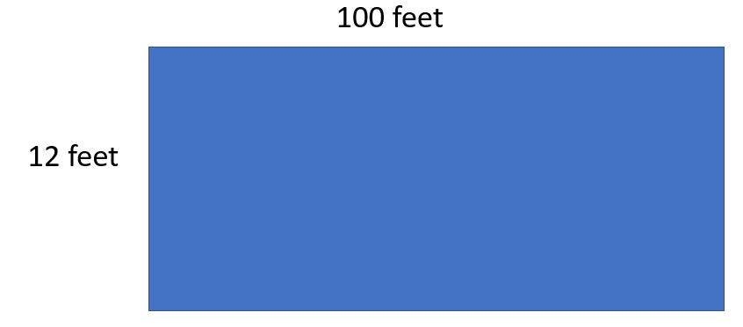
Area – Square or Rectangle
Formula – (Base X Height) or (Length X Width)
Base = 100 feet
Height = 12 feet
(100’ X 12’) =
1200 square feet
Feet / ft. Square / sq.

Slide 27
Area – Square or Rectangle
Formula – (Base X Height) or (Length X Width)
A lot has a length of 400 ft. and a width of 400 ft. How many square feet of asphalt is needed to cover the area?
400 ft.
400 ft.
Feet / ft. Square / sq.

Slide 28
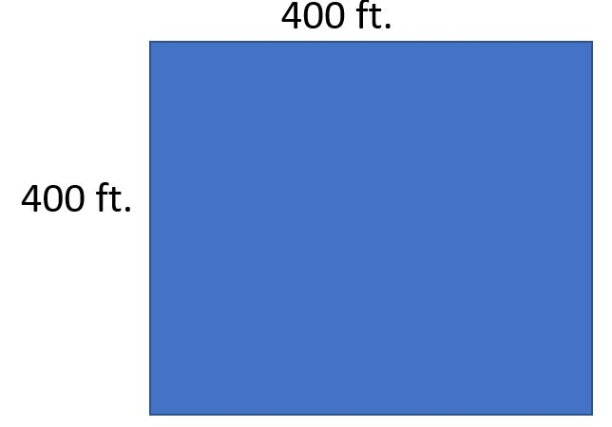
Area – Square or Rectangle
Formula – (Base X Height) or (Length X Width)
Length = 400 ft.
Width = 400 ft.
2(400’ X 400’) =
2(1600’) =
1600 sq. ft.
Feet / ft. Square / sq.

Slide 29
Area – Square or Rectangle
Formula – (Base X Height) or (Length X Width)
How many square yards of asphalt is needed to pave the lot shown?
130 feet (L)
40 feet
70 feet
80 feet
40 feet
200 feet
Feet / ft. Square / sq. Yards / yds.

Slide 30
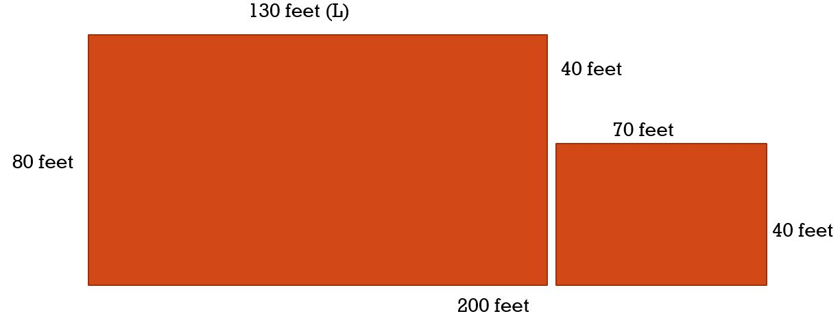
Area – Square or Rectangle
Formula – (Length X Width)
Length = 130’
Width = 80’
(130’ X 80’) =
10,400 ft. sq.
Length = 70’
Width = 40’
(70’ X 40’) =
2,800 ft. sq.
10,400 + 2,800 = 13,200 ft. sq.
13,200 = ft. sq.
9 ft. sq = 1 yds. sq.
13,200 ft. sq / 9 ft. sq. = 1466.6 or 1467 yds. sq.
Feet / ft. Square / sq. Yards / yds.

Slide 31
Questions

Slide 32
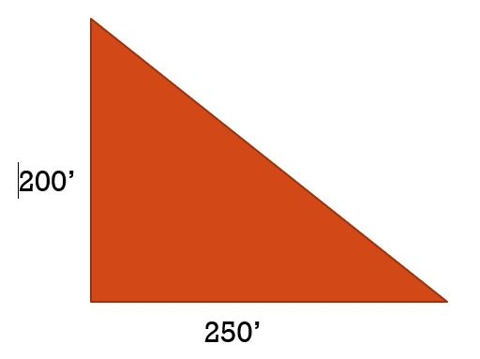
Area - Triangle
Formula – 1/2 (Base X Height) or (Base X Height) /2
Find the area of a triangular lot.

Slide 33
Area - Triangle
Formula – 1/2 (Base X Height) or (Base X Height) /2
Find the area of a triangular lot.
½(200’X 250’)
½(500’)
250 ft. sq.
Or
(200’ X 500’)/2
(500’)/2
250 ft. sq.

Slide 34
Area - Triangle
Formula – 1/2 (Base X Height) or (Base X Height)/2
Find the square footage of a triangular lot.
312”
156”
312”

Slide 35
Area - Triangle
Formula – 1/2 (Base X Height) or (Base X Height)/2
Find the square footage of a triangular lot.
½(312” X 156”) or (312” X 156”)/2
½(48,672”) or (312” X 156”)/2
24,336 inches squared
24,336” / 12”
2,028 ft. sq.
312”
156”
312”

Slide 36
Questions

Slide 37
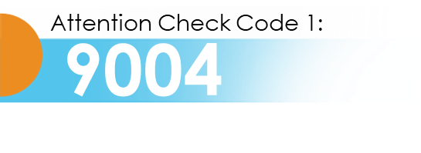
Circumference - Circle
$$π=3.14159$$
Formula - Or
What is the circumference of a circular clarifier?
C $=2 x π x$ radius
C $=π x diameter$
Radius = 26’
Diameter =52’

Slide 38
Circumference - Circle
Attention Check Code 1:
9004
Formula - Or
What is the circumference of a circular clarifier?
C $=2 x π x$ radius
C $=π x diameter$
$$π=3.14159$$
C $=π x diameter$
C $=π x 52′$
C $=3.14159 x 52′$
Radius = 26’
C $=163.36′$
Diameter =52’

Slide 39
Area - Circle
Attention Check Code 1:
9004
Formula - $A=πr^{2}$
Find the surface area of a clarifier
Diameter 130’
Radius 65’

Slide 40
Area - Circle
Formula - $A=πr^{2}$ $π=3.14159$
Find the surface area of a clarifier
$$A=π{ x 65′}^{2}$$
$$A=π{ x 4225′}^{sq }$$
$$A=3.14159{ x 4225′}^{sq}$$
Radius 65’
$$A=13,273.22 sq.ft.$$
Diameter 130’

Slide 41
Area - Circle
Attention Check Code 1:
9004
$$A= .7854{ x diameter}^{2}$$
Formula -
Find the surface area of a clarifier
$$A= .7854{ x 130′}^{2}$$
$$A= .7854{ x 16,900′}^{2}$$
$$A= {13,273.26 }^{sqft}$$
Radius 65’
Diameter 130’

Slide 42
Questions

Slide 43
Volume – Rectangular Object
Formula – Volume = Length X Width X Height
Find the volume of a rectangular tank
40’ = W
60’ = H
120’ = L

Slide 44
Volume – Rectangular Object
Formula – Volume = Length X Width X Height
Find the volume of a rectangular tank. How many gallons are in the tank if filled to the top?
V = L x W x H
V = 120’ x 40’ x 60’
V = 288,000 cubic ft
1 cubic foot = 7.48 gallons
288,000 cft x 7.48 gal.
2,154,240 gallons
40’ = W
60’ = H
120’ = L

Slide 45
Volume – Rectangular Object
Formula – Volume = Length X Width X Height
Find the volume in gallons of a rectangular tank that is filled to 75% capacity.
80’ W
160’ H
300’ L

Slide 46
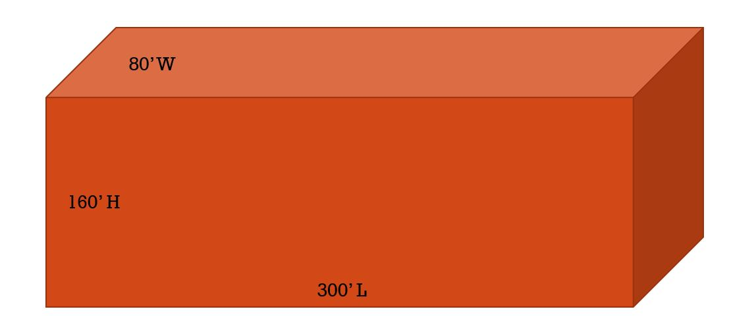
Volume – Rectangular Object
Formula – Volume = Length X Width X Height
Find the volume in gallons of a rectangular tank that is filled to 75% capacity.
V = L x W x H
V = 300’ x 80’ x 120’
120’ = 75% capacity
V = 2,880,000 cft
1 cft = 7.48 gallons
V = 2,880,000cft x 7.48 gal.
V = 21,542,400 gallons

Slide 47
Questions

Slide 48
Volume of a cylinder
Formula - $A=π x{ r}^{2}$ x height or V = .7854 x diameter x height
Find the volume of a tank that is filled to the top.
80’ = D
40’ = R
160’ = H

Slide 49
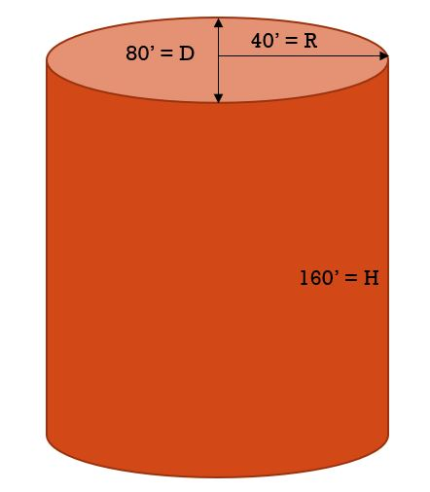
Volume of a cylinder
Formula – V $=π x{ r}^{2}$ x height or V = V $=.7854 x{ diamter}^{2}$ x height
Find the volume of a tank that is filled to the top.
Formula – V $=π x{ r}^{2}$ x height
$V=π x{ 40′}^{2}$ x 160’
$V=π x{ {1600}^{′}ft}^{2}$ x 160’
$V=π x 256,000 cft$
$V=3.14159 x 256,000 cft$
$V=804,247.04 cft$
V = 804,247.04cft x 7.48 gal.
V = 6,015,767.8 gallons

Slide 50
Volume of a cylinder
Formula – V $=π x{ r}^{2}$ x height or V $=.7854 x{ diamter}^{2}$ x height
Find the volume of a tank that is filled to the top.
Formula - V $=.7854 x{ diamter}^{2}$ x height
V $=.7854 x{ 80′}^{2}$ x 160
V $=.7854 x{ 6,400 ft}^{2}$ x 160’
V $=.7854 x{ 1,024,000 ft}^{3}$
V =${ 804,249.6 ft}^{3}$ x 7.48 gal.
V = 6,015,787.01 gals.

Slide 51
Questions

Slide 52
Velocity
Formulas – Q = A x V A = Q/V V = Q/A
Q = Cubic feet per second / cfs
A = Area, square feet / sq. ft.
V = Feet per second / fps
A 42” diameter pipe transfers 35 cubic feet of water per second. Find the velocity in fps? V = Q/A
First find the area of the pipe. $A= .7854{ x diameter}^{2}$
A = .7854 x (42” x 42”)
A = .7854 x 1,764 sq. in.
A = 1385.45 sq. in. _convert to feet_ 9.6 sq. ft.
V = 35 cfs / 9.6 sq. ft.
V = 3.65 fps

Slide 53
Velocity
Formulas – Q = A x V A = Q/V V = Q/A
Q = Cubic feet per second / cfs
A = Area, square feet / sq. ft.
V = Feet per second / fps
A plastic float is dropped into a channel and is found to travel 10 feet in 4.2 seconds. The channel is 2.4 feet wide and 1.8 feet deep. Calculate the flow rate of the water in cfs. Q = A x V
First find the area of the channel and feet per second. A = L x W
A = 2.4 ft x 1.8 ft = 4.32 sq. ft. Fps = 4.2 sec. /10 feet _ 1ft = .42 sec.
Q = 4.32 sq. ft x .42 fps
Q = 1.81 cfs

Slide 54
Sheave or Gear ratio
Formula – Big/Little = Fast/Slow
What size sheave is needed to turn a fan at 500 rpms when the motor sheave is 12” and turns at 1800 rpms?
Slow
Fast
Big
Little

Slide 55
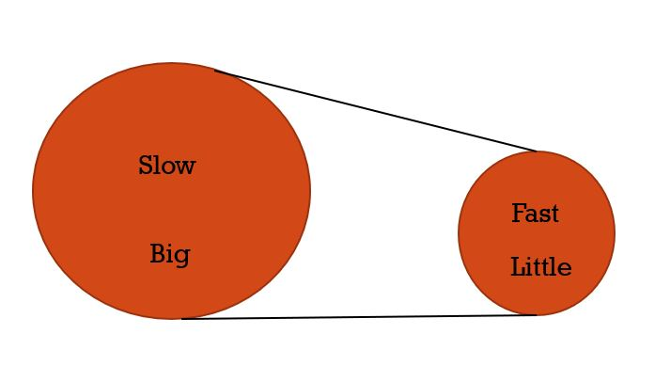
Sheave or Gear ratio
Formula – Big/Little = Fast/Slow
What size sheave is needed to turn a fan at 500 rpms when the motor sheave is 12” in diameter and turns at 1800 rpms?
Big = X
Little = 12”
Fast = 1800 rpm
Slow = 500 rpm
Big X Slow = 500 X rpm
Little X Fast = 21,600 rpm
21,600 rpm / 500 X rpm
X = 43.2” or 43”

Slide 56
Questions

Slide 57
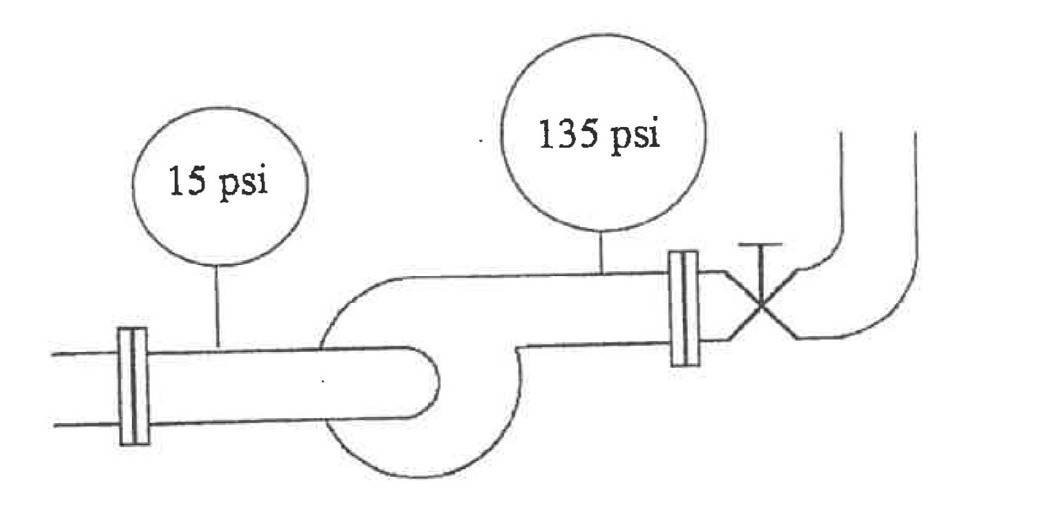
Total Dynamic Head
Attention Check Code 2:
6000
Formula – TDH = (Discharge PSI – Suction PSI) x 2.31 ft of H2O / PSI
A pump has a suction of 15 PSI and a discharge of 135 PSI. If the viscosity and bowl loss is 1.2 ft. what is the Total Dynamic Head?
Suction = 15 PSI
Discharge = 135 PSI
1 PSI = 2.31 ft of H2O

Slide 58
Total Dynamic Head
Attention Check Code 2:
6000
Formula – TDH = (Discharge PSI – Suction PSI) x 2.31 ft of H2O / PSI
A pump has a suction of 15 PSI and a discharge of 135 PSI. If the viscosity and bowl loss is 1.2 ft. what is the Total Dynamic Head?
TDH = (135 PSI – 15 Psi) X 2.31 ft of H2O/PSI
TDH = 120 PSI x 2.31 ft of H2O/PSI
TDH = 120 PSI x 2.31 ft of H2O/PSI
TDH = 120 x 2.31 ft of H2O
TDH = 277.2 ft of H2O

Slide 59
Motor Horsepower
Attention Check Code 2:
6000
Formula –MHP= (flow x total head x specific gravity) / 3960 Specific Gravity of water = 1.0
If an 85% efficient pump delivers 2,250 gpm at a total head of 100 ft, what is the water horsepower needed?
MHP = (2,250 gpm x 100 ft x 1) / 3960
MHP = (225,000) / 3960
MHP = 56.82 HP
Flow has to be in gpm.
Total head has to be in feet
Unless stated, specific gravity is always 1

Slide 60
Brake Horsepower
Attention Check Code 2:
6000
BHP= (flow x total dynamic head x specific gravity) / 3960 x pump efficiency Specific Gravity of water = 1.0
A pump is operating at 1770c rpms and supplies 6,500 gpm. The suction pressure is at 10 psi and the discharge pressure is at 75 psi. If the pump is 78% efficient and the motor is 86% efficient, what is the brake horsepower? The specific gravity of the pumped liquid is 1.12.
What is needed for the formula?
Flow = 6,500 gpm
TDH = (discharge pressure – suction pressure) x 2.31 ft of H2O / PSI
TDH = (75 psi – 10 psi) x 2.31 ft 0f H2O
TDH = (65 psi) x 2.31 ft 0f H2O
TDH = 150.15 or 150 ft
Specific Gavity = 1.12
Pump Efficiency = 78% or .78
RPM = NOT NEEDED
Motor Efficiency = NOT NEEDED

Slide 61
Brake Horsepower
Attention Check Code 2:
6000
BHP= (flow x total dynamic head x specific gravity) / 3960 x pump efficiency Specific Gravity of water = 1.0
Flow = 6,500 gpm, TDH = 150.15 or 150 ft, Specific Gavity = 1.12, PMP Efficiency = 78% or .78
BHP = (6,500 gpm x 150 ft x 1.12) / 3960 x .78
BHP = (1,092,000) / 3,089
BHP = 353.5 or 354 HP

Slide 62
Questions

Slide 63
Converting Units Of measurement
Formula – head pressure in feet = PSI x 2.31
Formula – head pressure in PSI = total feet of head / 2.31
1 PSI = 2.31 feet of head
42 PSI = X Feet of Head
42 PSI x 2.31 Feet of Head / PSI
42 PSI x 2.31 Feet of Head / PSI
42 x 2.31 Feet of Head = 97.02 or 92 Feet of Head
30 Feet of Head = X PSI
30 Feet of Head / 2.31 Feet of Head - PSI
30 Feet of Head / 2.31 Feet of Head - PSI
30 / 2.31 – PSI = 12.98 or 13 PSI

Slide 64
Converting Units Of measurement
1 Ft. = 12 inches
1 Ft Sq = 144 Inches Sq
122 Ft Sq = X In Sq
122 Ft Sq x 144 In Sq _ Ft Sq
122 Ft Sq x 144 In Sq _ Ft Sq
122 x 144 In Sq = 17,568 In Sq
18,826 In Sq = X Ft Sq
18,826 In Sq _ Ft Sq / 144 In Sq
18,826 In Sq _ Ft Sq / 144 In Sq
18,826 Ft Sq / 144 = 130.73 or 131 Ft Sq
1 Yd. = 3 Ft.
1 Yd Sq = 9 Ft Sq
300 Yd Sq = X Ft Sq
300 Yd Sq x 9 Ft Sq _ Yd Sq
300 Yd Sq x 9 Ft Sq _ Yd Sq
300 x 9 Ft Sq = 2700 Ft Sq
81,000 Ft Sq = X Yd Sq
81,000 Ft Sq / 9 Ft Sq _ Yd Sq
81,000 Ft Sq / 9 Ft Sq _ Yd Sq
81,000 / 9 Yd Sq = 9,000 Yd Sq

Slide 65
Converting Units Of measurement
1 cubic ft = 1,728 cubic inches
1 cubic yd = 27 cubic ft
1 cubic ft water = 7.48 gallons
How many gallons of water is in a tank that is 3,700 cubic yards?
3,700 cubic yd = X cubic ft
3,700 cubic yd x 27 cubic ft-yd
3,700 cubic yd x 27 cubic ft – yd
3,700 x 27 cubic ft = 99,900 cubic ft
99,900 cubic feet x 7.48 gallons – cubic ft
99,900 cubic feet x 7.48 gallons – cubic ft
99,900 x 7.48 gallons = 747,252 gallons
1 cubic ft water = 62.43 lbs.
1 gallon water = 8.34 lbs.
How much does 99,900 cubic ft of water weigh?
99,900 cubic ft = X lbs.
99,900 cubic ft x 62.43 lbs. – cubic ft
99,900 cubic ft x 62.43 lbs. – cubic ft
99,900 x 62.43 lbs. = 6,236,757 lbs.
How many gallons of water is there when it weigh 7,500,000 lbs.?
7,500,000 lbs. / 8.34 lbs. – gallons
7,500,000 lbs. / 8.34 lbs. – gallons
7,500,000 / 8.34 gallons = 899,280.5 or
899,281 gallons

Slide 66
Converting Units Of measurement
1440 minutes – day
24 hours – day
60 minutes – hour
1 MGD – 694-gal min
If a pump put out 350, 000 gallon in a day, how many gallons an hour does it pump, how many per minute?
350,000 gallons day = x gallons hours
350,000-gals day / 24 hrs. day
350,000-gals day / 24 hrs. day
350,000 gals / 24 hrs. = 14,583-gal hr.
14,583-gal hr. / 60 min – hr.
14,583-gal hr. / 60 min – hr.
14,583 gal / 60 min. = 243 gal. min.
¼ inch = decimal .25
½ inch = decimal .50
¾ inch = decimal .75
5/8 inch = decimal .625
7/8 inch = decimal .875
11/16 inch = decimal X
11 / 16 = .6875
13/16 = decimal X
13 / 16 = .8125

Slide 67
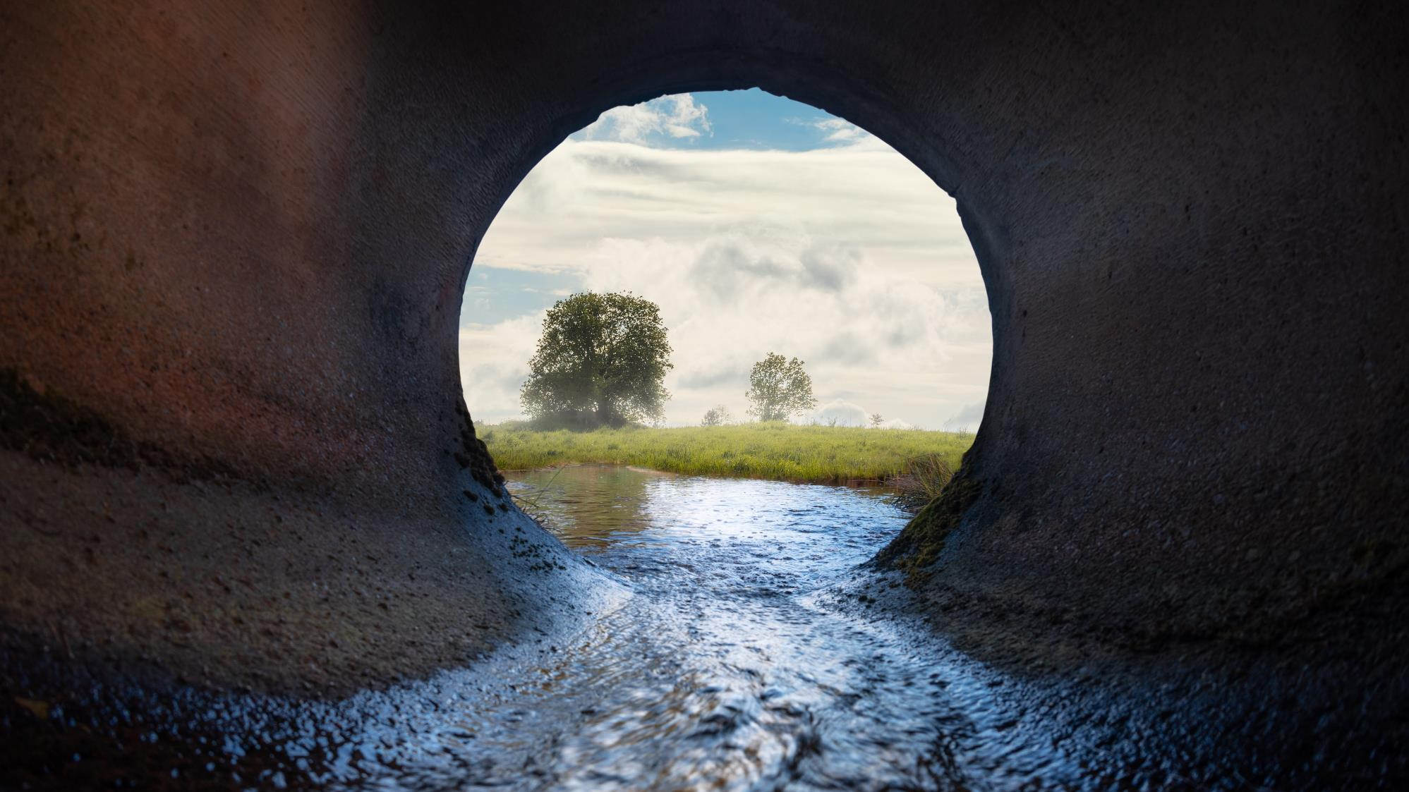
QUESTIONS & ANSWERS
Notes:
Please DON’T put speakers agency logo on the slide. It will not look good.

Slide 68
Process for Claiming Contact Hours for
this Webinar
Log in to https://owen.cwea.org/ the Online Wastewater Education Network (OWEN) with your mycwea.org account info and find this program in “Your Dashboard”.
Enter the attention codes (XXXX-XXXX) in the “Attention Check Code” component under the "Contents" tab within 48 hours of the live webinar.
Your contact hours will be reflected in your mycwea.org account within 2-3 weeks following completion.

Slide 69
Thank You!

